Slide 1
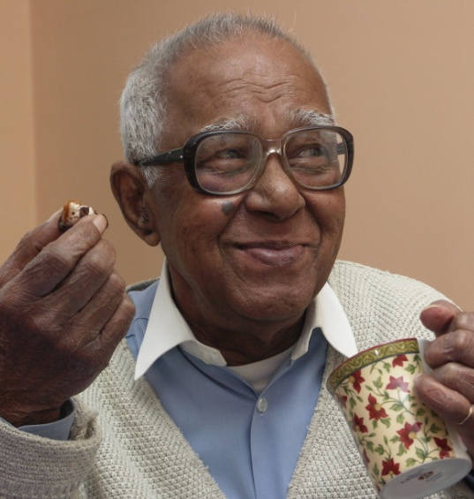
How can the social work role be supported, now and in the future, through the use of information and technology?
NCAS
3 November 2016

Slide 2
Background
Aims and methodology
To better understand how social workers are using information and technology at work and how these could be used more effectively to support practice
To help inform the development of products for social care
Literature review; 4 focus groups with social workers; interviews; survey with social workers
Social workers’ use of information and technology; Identifying the key challenges, barriers and enablers
The types of support social workers may need to utilise technology more effectively
Ideas around innovation or changes in technology and information access which would better support their role
Key lines of enquiry

Slide 3
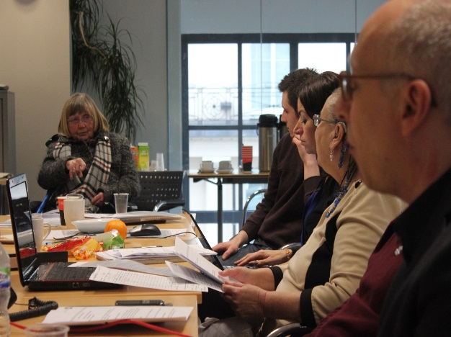
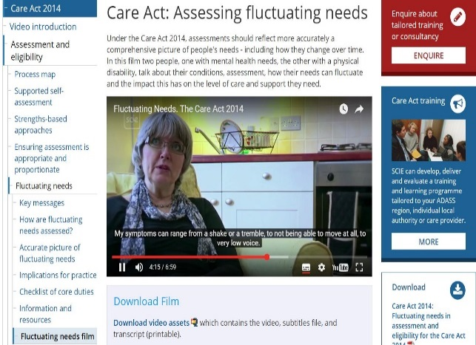
Where we are now with technology
Current use of information and technology
To support the collation and use of case specific data.
Case data is drawn from a wide range of systems.
Information needs to be drawn from a wide range of systems in other organisations
Lack of interoperability between systems.
Social workers need a wide range of information.
Technology increasingly supports communications with clients and team working
Similar issues facing children and adults.

Slide 4
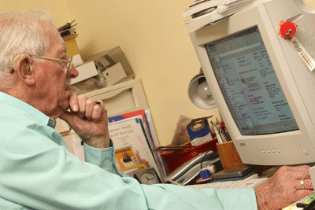
Information and knowledge sharing
Challenges of information sharing
Accessing information from other organisations in a timely and efficient manner.
‘Most agencies fall short in information sharing.’
Sector has too many different recording systems which can make information sharing difficult.
‘Everyone should have the same system. It doesn’t matter what it is’.
Social workers use a variety of sources of information, but lack time to access and read.
Organisations are reluctant to share information and use the Data Protection Act as reason not to share.

Slide 5
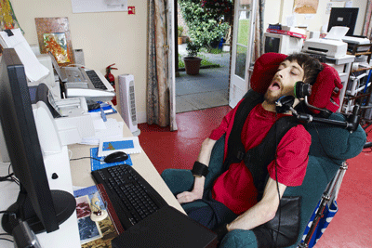
Information and knowledge sharing
Sharing information between organisations
Need to share information securely but there remains much anxiety at an organisational level about security breaches.
‘No one puts client information on a cloud. They are stored in folders on computers that have password protection.’
Need to harmonise information systems over time.
Demand for better signposting to sources of knowledge or single site.
Secure online forums are often helpful in promote peer support.
Enhance remote applications to ensure that information can be digitally recorded and remotely shared.

Slide 6
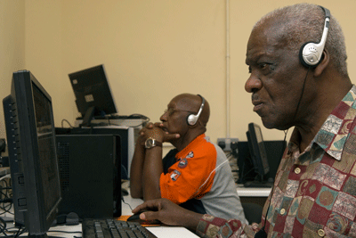
Changes in use of technology
Challenges and concerns
Systems and technology not coproduced with social workers
Lack of interoperability between different organisations’ systems.
Social workers are spending too much amount of time inputting data.
‘I spend less time with clients…in an 8 hour day I spend 4 to 7 hours inputting’.
Different electronic recording, assessment and planning systems in use; which are frequently replaced or upgraded.
Concern that technology cannot replacement with face-to-face engagement.
Increased use of digital technology in supervision was also criticised
Expansion in remote working but can result in a loss of peer support.

Slide 7
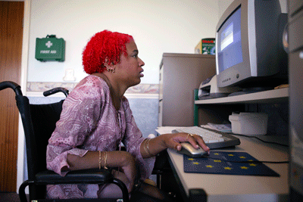
Changes in use of technology
Opportunities for improvement
Enabling social workers to work more flexibly; better laptops, smart phones and tablets
Single go-to site for information on policy, practice and resources
Access to e-learning and webinars for professional development
Online self-assessments for clients that are user friendly and agile
Assistive technology for clients delivered remotely without direct input
Technology to support work with vulnerable children, young people and those with disabilities.
‘It can make communication faster and more fluid and helps to simplify things for them’.
Increasing use of Skype to reduce the number of
home visits.

Slide 8
Supporting the sector
Drive at all levels to support social workers in using technology.
Appetite for involving social workers in co-production of new tools and support
Potential areas of support:
Sharing best practice examples on digital technology
Developing and hosting communities of practice
Providing guidance on the Data Protection Act
Ensuring software and IT systems meet social workers’ requirements.
Developing a toolkit for social workers on digital technology
Providing research updates organised in a user friendly way – brief and easy to digest
Leading change at all levels

