Slide 1

Cloud and the NHS
Cloud Technology enabling Communication
Christine Walters – Director of Informatics

Slide 2
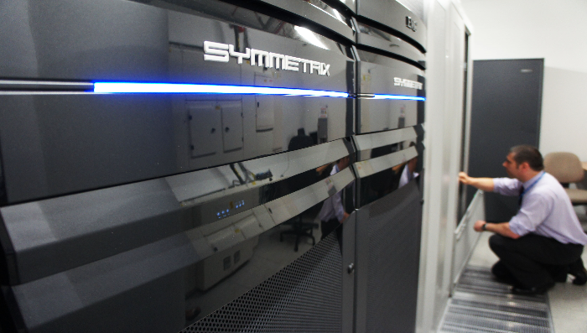
Who are St Helens and Knowsley Health Informatics?
Shared Informatics Service provider to six partner NHS organisations and GP surgeries in the locality
Service Desk, Infrastructure, Project Management, System Administration & IG Services
Responsible for clinical and non clinical system data availability and Integrity
Provide IT security
IP Telephony and Unified Communications
Library and Knowledge Services, Website Services

Slide 3

Cloud Technology
1961 - John McCarthy gives speech ,"computation may someday be organized as a public utility.” This became the underlying theory for cloud computing.
2002 - Amazon Web Services entered the market by providing storage options, computation, and other web services.
2006- Google announces their entry with the debut of Google Docs. The power of document sharing through the cloud was given to end users.
2009- Microsoft joins the party with Windows Azure. By providing platform as a service (PaaS) and infrastructure as a service (IaaS), Microsoft aimed to provide a platform for deployment through a global network of Microsoft managed datacentres.
1997 - The term cloud computing was officially used for the first time during a lecture by Professor Ramnath K. Challappa, PhD .
Two decades in, the cloud computing industry has grown from a "intergalactic fantasy" to an integral part of our lives. If you take a moment to realise how it has influenced our behaviours, you would be amazed. From streaming a movie on Netflix, to uploading your camera photos to the file sharing website, Dropbox, the growth of cloud computing has been impressive and wide-reaching.
In a relatively short amount of time, the cloud has made gigantic strides in the technology landscape. All signs seem to point up, and we are only scratching the surface on cloud computing's true capabilities.

Slide 4







Cloud and the NHS
Are benefits to be realised for St Helens & Knowsley Health Informatics Partners?
Collaborate and Integrate
Resilience
Agility
Transform working practice
Reduced Operation and Ownership costs
“Capacity on Demand”
Reduced technology refresh requirements

Slide 5
Challenges and Constraints
Information Governance
Are systems and services secure?
UK or offshore cloud datacenters & patient data
Data retention and accessibility
Shared infrastructure with other organisations
Security patching, in house or managed service?
Cyber threats & Security Management
N3/HSCN and Internet connection capacity
Secure VPN & Connectivity for data transit
N3/HSCN – Is current bandwidth availability suitable?
Consumption
Are costs based on data stored or data downloaded?
What type of data consumption affects cost?

Slide 6


Our Vision of Cloud
SERVICE
EXPERIENCE
Exceptional Service Availability >99% availability
Secure data storage
Accessibility to systems and services anywhere
Enable clinicians to be more efficient, effective and safe
Seamless working between health and social care organisations Health Information Exchange
Reduce Costs
Reduce resource skillset to manage infrastructure
Scalable solution that can be developed
A service enabling solution
Develop collaboration across the Mersey footprint
New ways of working to improve the patient experience
Facilitate remote consultations
Electronic medical record for clinician and patient

Slide 7

Enabling SERVICE
Migrate our current communications technology stack into the cloud
Telephony (VOIP)
Voicemail
Call Centre
Developing new communication technology within the cloud
Presence
Chat & messaging
Audio & Video Conferencing

Slide 8




Enabling EXPERIENCE
Telehealth
Clinician can see and hear the patient
Interaction during consultation
Unified Communications as a Service – UCaaS
Implementation of Hybrid Cloud solution
IP Telephony
Instant Messaging
Presence
Video Conferencing
“Soft Phone” technology
This needs work
Video & Audio Triage
Managed appointment for video and audio triage
Mobile consultation
Both clinician and patient can be anywhere
Removes bricks and mortar constraints

Slide 9
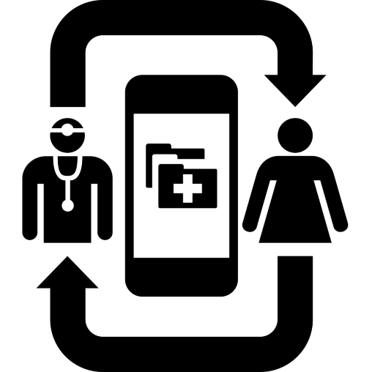
What are our cloud projects?
Video consultations for outpatient appointments for St Helens & Knowsley Teaching Hospitals NHS Trust
Stroke Service
  Telephone consultations replaced with video consultations
  Able to see the patient and visualise recovery or risks
  Reduces travel requirement to provide the holistic assessment of the patients recovery
Drains Outreach Service
  Significant travel to discharged patients to review wound drains
  Video consultation with patient vastly reduces travel time
  Able to complete consultation through video conferencing sessions
Both projects well underway with target pilot go live Q4 2017/18

Slide 10

What are our cloud projects?
Unified Communications & Call Recording for St Helens, Knowsley and Halton GP Surgeries
Unified Communication
  Telephone consultations replaced with video consultations
  Able to see the patient and improve interaction
  Provide alternative communication channels like instant messaging
  Provides foundation for telehealth projects
Call Recording
  Record telephone conversations between clinician and patient
  Record details of the call, both video and audio
  Manage call quality for service improvement and development
  Manage complaint
Both projects are in initiation phase with planned implementation for Q3/4 2018/19

Slide 11
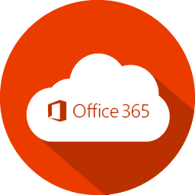
What are our cloud projects?
Collaboration with Health and Social Care organisations in St Helens – St Helens Cares – Microsoft Office 365 & Azure Tenancy
Office 365
  Enabling shared documentation between multiple organisations including Council, Citizens Advice, NHS Healthcare, Housing and Police
  Supporting the establishment of a shared citizen record within St Helens
  Initially this is sharing project documentation
  Development of shared document management that is secure within St Helens Cares organisations
Pilot is currently live for sharing project documentation between organisations

Slide 12
Questions?

