Slide 1
Digital Maturity Assessment 2017 NW ISD led Peer Validation pilot
David Sgorbati, Senior Project Manager, NHS England | John Glover, Chief Information Officer, Bay Health & Care partners Chair, of NW Informatics Skills Development Network Strategy Group
Christine Banks, NW Informatics Skills Development Manager, NW Skills Development Network | Sandra Siwiak, EPR Programme Director, St Helens & Knowsley Teaching Hospitals

Slide 2
Digital Maturity Assessment 2017
12 January 2018

Slide 3
Objectives
The Digital Maturity Assessment aims to:
Track progress made since the first round of self-assessments and the reasons behind it
Support planning, prioritisation and investment decisions within providers and STP footprints
Provide a means of baselining/benchmarking levels of digitisation nationally
Raise the profile of the digital agenda at board-level by encouraging positive discussion on opportunities and gaps

Slide 4
Key Points
Key trends emerging from the initial analysis include:
Significant variation in levels of digitisation across the country and all provider types (acute, mental health, community & ambulance)
Progress has been made over previous 24 months, but there are still big gaps areas such as ePrescribing, decision support and integration/information sharing
Not enough providers using digital tools to support inpatient prescribing & administration; recording of clinical notes & observations; identification of high-risk patients (e.g. sepsis & AKI)
Notable examples where investment over the last 12-18 months has delivered significant improvements in maturity

Slide 5
Results: High-Level Summary
The chart below shows the Readiness, Capabilities & Infrastructure results. It highlights the extent of variation across the country, with relatively few scoring highly in all three areas:
Enabling Infrastructure score:
0-39 40 - 69 70 - 100

Slide 6
Results: Section-Level
This chart shows the average score for each section of the assessment across all providers. It shows progress across all areas, but highlights continued gaps in areas such as Decision Support, Remote & Assistive Care & Medicines Optimisation:

Slide 7
Section-Level Results: 2017
Medicines Optimisation is the lowest-scoring section across all provider types. Focusing on acute providers (each bar represents one provider’s score), this chart shows a relatively small number have made good progress and most still have significant work to do.
Very high variation & low scores across the country

Slide 8
Next Steps
Over the next few months we will:
Extend the peer validation model by publishing a toolkit to support providers who wish to use the learning from the pilot
Work with high scoring and fast moving organisations to understand their achievements
Give providers and STPs access to the data to support local investment and delivery planning

Slide 9
What is the NW ISD Network?
The Informatics Skills Development Network (Est. Nov 2011) provides high quality, low cost opportunities for the professional development of health Informatics staff in the North West
Through the provision of networking opportunities and the development of learning programmes we aim to raise the professional profile of Informatics staff
By focussing on development needs beyond those of technical competence we help to position health Informatics at the heart of an organisation’s business agenda
Through Excellence in Informatics (EiL) we accredit Informatics services allowing them to showcase their professionalism and maturity

Slide 10
What is Excellence in Informatics?
Process to recognise and develop health Informatics services that measures progression against a set of evidence based professional standards (Level 1, 2 & 3)
Peer reviewed development activity that focuses on coaching, not judging
Informatics services reviewed as a whole rather than as a set of component parts
Statement to staff, that their development and professionalism is taken seriously
Demonstrates and celebrates best practice, recognising staff and their achievements

Slide 11
Objectives / Benefits
Raises importance of Informatics workforce development
Ensures good communication practices are in place across Informatics services
Encourages a culture of development, empowerment and engagement, underpinned by a competence based approach
Promotes an environment of professionalism, initiative, enterprise and innovation
Excellent way to share good practice across services and with other organisations
63 Informatics services in the North West, 22 accredited at Level 1 and 1 accredited at Level 2

Slide 12
DMA Peer Validation Pilot
Initial discussion about ISD Accreditation and the DMA in relation to measuring workforce maturity
Value of peer to peer assessment highlighted and question posed whether this might add value to DMA
NHS England invited to join an ISD Accreditation visit at Bolton NHS FT (January 2017)
Asked to develop a DMA Peer Validation Pilot proposal
6 provider organisations in the North West volunteered to participate in the DMA Peer Validation Pilot (March 2017)

Slide 13
Objectives / Benefits
Develop a consistent understanding of DMA standards and identify supporting evidence that underpins scoring
Facilitate dialogue and knowledge sharing between participating CIOs and CCIOs during validation
Detailed feedback on interpretation of DMA questions and opportunities for improvement to NHS England
Consistent peer validated DMA scoring across the six pilot organisations
Sharing of best practice amongst pilot organisations and across the wider ISD Network

Slide 14
Peer Validation Process
Distribute guidance notes, provide support to validators
Document the process and differences between self-assessed peer validated scores and share process insights and learning with NHS England
Invite pilots to self-assess their Digital Maturity and produce supporting evidence. Submit self-assessment to peer for review and validation
Schedule meetings to jointly review DMA self-assessed scores, challenge each other based on evidence to ensure consistent and accurate interpretation and scoring. ISDN to oversee processes and assessments to ensure consistency
Match pilots up to undertake peer validation. Approach will be a mutual peer validation process, where validators assess each other’s DMAs

Slide 15
Stage 1 – Peer Validation Pilot
Cohort identified:

Slide 16
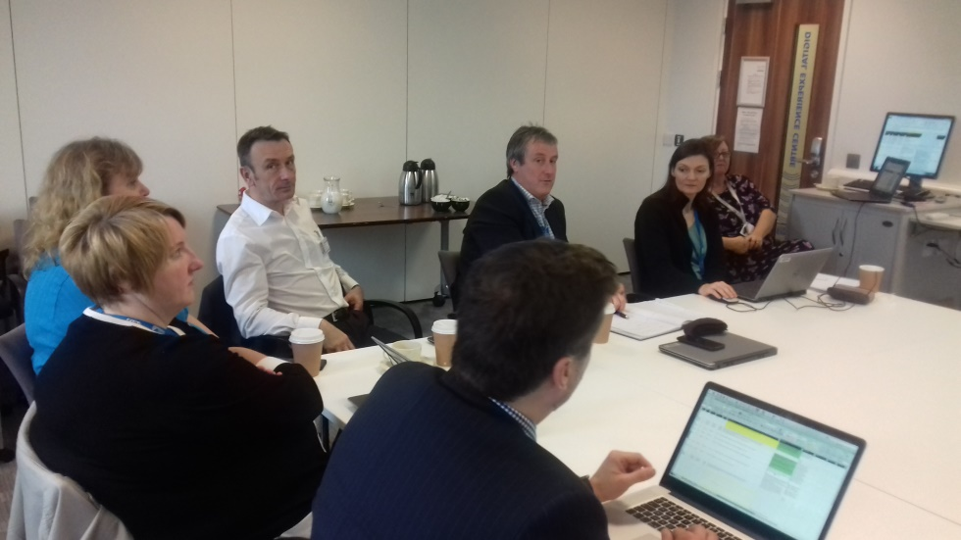
Peer Validation Visits
Various formats
Full day!

Slide 17
Overall Findings – Commitment
We had scheduled the visits to take ½ day but all meetings lasted a full day
Difference between assessment (like at ‘Excellence in Informatics’) and validation discussed; participants felt that in the first instance there should be a thorough approach
Similar to EiI the process requires a lead assessor (CIO level) who leads the meeting, challenging and supporting the receiving organisation
The role of ISD was to ensure consistency across assessments and share findings

Slide 18
Overall Findings – Outcome
Gathering of evidence and peer discussions were extremely useful
Also useful was the ability to compare how other organisations were rated
Gathering the evidence made a difference in the scoring and made for more objectives ratings
Sample evidence matrix was developed to show what evidence can be provided for each of the standards which will be useful for other organisations too
All sessions felt very supportive and were a great opportunity for sharing best practice

Slide 19
Findings – Scoring
Some ratings slightly improved following discussions with assessors who suggested further evidence
Some were marked slightly down as there was still room for improvement
A lot of questions were identified which need to be clarified / improved to make it easier for people to self-assess
It was a shame that this work didn’t take place prior to the 2017 DMA going live

Slide 20
Stage 2 – Embed DMA into EiL
Map out for overlaps and align
Add additional standards
Annual self-assessment and virtual validation
Full assessment in line with EiI every 3 years

Slide 21
Stage 3 and 4 – Embed DMA into EiL
3. Pilot joint EiI / DMA peer assessment process
4. National roll-out

Slide 22
St Helens & Knowsley Teaching Hospitals
Peer Review Experience

Slide 23
Background
Early adopter
Opportunity to inform Trust Strategy
Benchmark and inform investment decisions
Compare with peers
Ensure consistency of standards

Slide 24
Preparation
Agree Assessment Team
Agreed meeting schedule for peer review – 1 day
Update spreadsheet containing all questions with previous scores
Agreed responsible leads for each section
Meet colleagues to review and document required evidence
Recorded any assumptions made to support scoring decision for future reference
Evidence was stored electronically
The evidence was filed both by question and by section

Slide 25
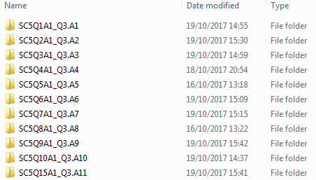
Evidence Folder

Slide 26
Peer Review
Question by question review of evidence
Challenge and review of each question
Review response and supporting evidence
Compare supporting evidence to inform score
Document discussion to enable shared learning
Online assessment completed following peer review

Slide 27
Summary
Evidence gathering helped objectivity and supports other accreditation and informs strategy development
Peer validation helpful but time is needed to plan and prepare
Some overlap with other assessments e.g. IG Toolkit
Some questions difficult to assess and required clarification
Reports available on completion of DMA need improving and extending
Suggestion to develop an evidence based portal
Opportunity to work with NHSe to suggest improvements

Slide 28
Questions?

