Slide 1
Embedding Cyber Security
Indi Singh
Head of Architecture and Cyber Security
Dec ‘17

Slide 2
Areas to cover
Wannacry and the Impact…
Key lessons learnt
What actions have we put in place
What response if it happens again
Establishing local leadership
Moving cyber to a board level agenda

Slide 3
Clinical impacts overview
This is about Business Continuity and not just a “tech issue”
Highlighted variability in readiness for cyber threats across the country and org types
Notes:
Acute Organisations where diverts were put in place: Barts Health (London), East and North Herts (Midlands & East), Lister (Midlands & East), Basingstoke (South), West Cumberland Infirmary (North).
Pharmacy impacts caused by the temporary suspension of NHSmail use during the incident unfolding, when identified no risk this was often resolved quickly.

Slide 4
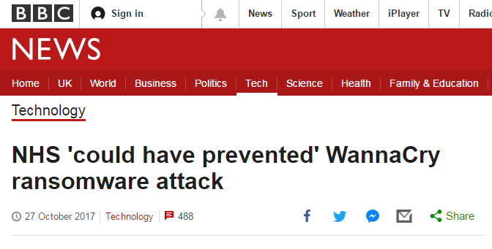

Slide 5
Will this happen again
It is a matter of WHEN as opposed to IF.
Focus on creating resilience in the system
Focus on pro-active prevention
Doing the basics right

Slide 6
Immediate lessons from the incident
Immediate lessons were identified from the recent incident, including:
the need to ensure organisations implement critical CareCERT alerts, including software patches, and keep anti-virus software up to date;
the need for organisations to identify and prioritise action to move away from or isolate unsupported systems;
ensuring that essential communications are getting through during an incident, when systems are down; and perhaps most importantly
ensuring that organisations, boards and their staff, are taking the cyber threat seriously, understand the direct risks to front line services and are working pro-actively to maximise their resilience and minimise impacts on patient care.

Slide 7
The Focus
Local implementation of Ten data security standards recommended by the National Data Guardian
Supporting local implementation with national services
Increasing the ability of the system to respond when incidents do occur

Slide 8
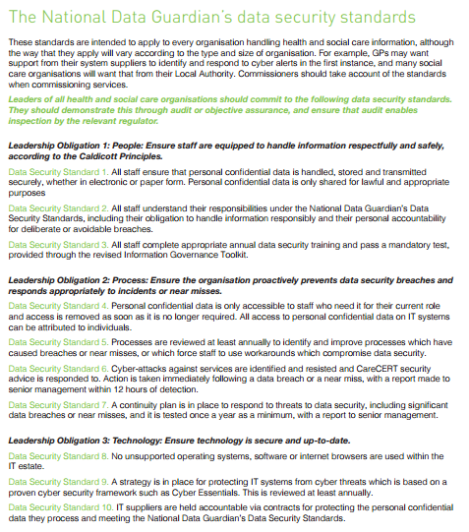
National Data Guardian
- Data Security Standards
Need for audit and objective assurance
8

Slide 9
Key Activities
Establishing a clear contractual and regulatory framework
CQC and NHS Improvement: ensuring that organisations are implementing the ten data security standards, and that this is considered in decisions to apply regulatory powers.
NHS Improvement: ‘statement of requirements' -requiring CEOs/Boards to provide written response
NHS England and NHS Improvement: following up implementation of critical CareCERT alerts within 48 hours.
CIO: £21 million being made available to address structural weaknesses in major trauma centres.
Action to remove, manage or isolate unsupported systems by April 2018, including DH/NHS Digital discussions with Microsoft .
Communications and engagement
NHS Improvement and NHS England: joint communications targeting boards, NHS Digital: staff communications campaign on data security.
NHS England: cyber champions to provide local support
Building local performance and boosting capability
NHS Digital: boosting to support system network monitoring.
NHS Digital: Redesigned Information Governance toolkit to support implementation of the data security standards.
Improve threat surveillance and incident response
draw on NCSC expertise to monitor threats to health and care system, update national and local cyber response plans, and strengthen communications.

Slide 10
What happens if we have an incident again?
To avoid future incidents:
Move from one-way broadcast of threats to now a “closed-loop” where organisations required to “actively respond” to CareCERT alerts through CareCERT Collect.
In the event of an incident:
NHS England has developed the “cyber playbook” to outline
key responsibilities in national co-ordination leading up to during an incident, including the link to the EPRR process
“Dry-Run” – test exercise of national co-ordination.

Slide 11
We are all in this together….
STP boards
CCG boards
Professional and Patient groups
Provider boards
CCIO/CIO Community
Regional Directors and teams - NHS Improvement, NHS England
Audit Chairs
NHS Digital

Slide 12
Establishing Local Leadership
CIO and CCIO Advisory
CIO network Cyber Leads
CCIO network Cyber Leads
The role of the CISO

Slide 13
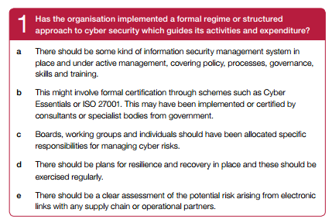
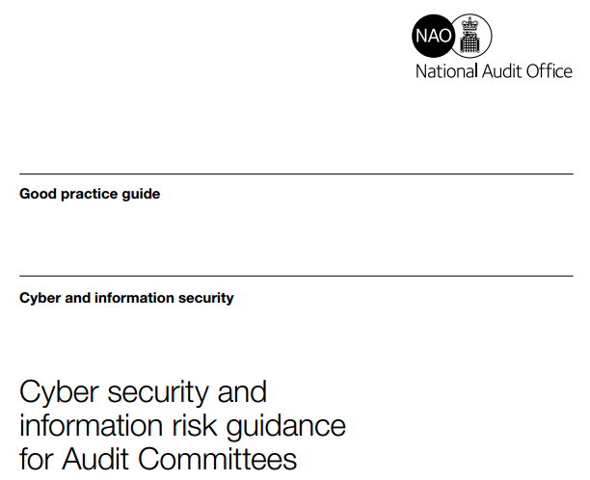
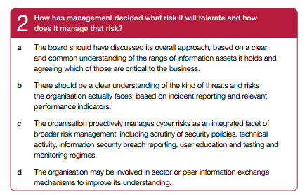
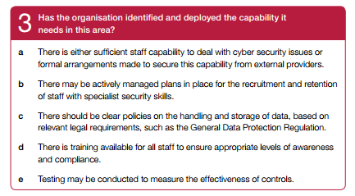
What does it mean for your board/audit committee?
https://www.nao.org.uk/wp-content/uploads/2017/09/Cyber-and-information-security-guide.pdf

Slide 14
Statement of Requirements - The “what”
Leadership Obligation One – People:
Senior Level Responsibility: There must be a named senior executive to be responsible for data and cyber security in your organisation. Ideally this person will also be your Senior Information Risk Owner (SIRO), and where applicable a member of your organisation’s board.
Completing the Information Governance Toolkit v14.1: In 2017/18, organisations are still required to achieve at least level two on the current IG Toolkit before it is replaced with a new approach from 2018/19 onwards, to measuring progress against the 10 data security standards.
Complete the General Data Protection Regulation Checklist: NHS Digital will publish a checklist to support organisations in implementing the requirements of the General Data Protection Regulation which they will be required to comply with from May 2018. Organisations must complete this checklist to ensure they will be able to meet their legal obligations from May 2018. [Link]
Training Staff: All staff must complete appropriate annual data security and protection training. This training replaces the previous Information Governance training while retaining key elements of it.

Slide 15
Statement of Requirements - The “what”
Leadership Obligation Two - Processes:
Acting on CareCERT advisories: Organisations must:
Act on CareCERT advisories in line with suggested timescales, and evidence this through CareCERT Collect;
Confirm within 48 hours that plans are in place to act on High Severity CareCERT advisories, and evidence this through CareCERT Collect; and
Identify a primary point of contact for your organisation to receive and coordinate your organisation’s response to CareCERT advisories, and provide this information through CareCERT Collect.
Note: Action might include understanding that an advisory is not relevant to your organisation’s systems and confirming that this is the case.
2. Continuity planning: A comprehensive business continuity plan must be in place to respond to data and cyber security incidents.
3. Reporting incidents: Staff across the organisation report data security incidents and near misses, and incidents are reported to CareCERT in line with reporting guidelines.

Slide 16
Statement of Requirements - The “what”
Leadership Obligation Three - Technology:
Unsupported systems:
Identify unsupported systems (including software, hardware and applications); and
Have a plan in place by April 2018 to remove, replace or actively mitigate or manage the risks associated with unsupported systems.
2. On-Site Assessments: Your organisation must:
Register to undertake an on-site data and cyber security assessment through NHS Digital’s Data Security Assessment programme;
Undertake an on-site cyber and data security assessment if you are invited to do so by NHS Digital; and
Act on the outcome of that assessment, including any recommendations, and share the outcome of the assessment with your commissioner.
3. Checking Supplier Certification:
Your organisation should ensure that any supplier of IT systems (including other heath and care organisations) and the system(s) provided have the appropriate certification. A list of certification frameworks is provided

Slide 17
Practise Practise Practise

Slide 18
Moving this to board level
This to be held as a business continuity risk – this risk should not only “sit with IT”. Business Continuity Risks and its Consequences.
Identify People, process and technology mitigations to help to “manage” the risk.
Assurance to the board that the basics are in place
1. Training. 2. Countermeasures 3. Practise and 4. Review Processes.
Role of NEDs to challenge and reference best practice from other industries
Identify CCIO and CIO Community local cyber leads, link to learn and share best practice on cyber readiness and in dealing with cyber issues. Working in conjunction with BCS.
NHS England leading on engagement with CCG Audit Chairs in their role of assurance of strategic risks. Working through NHS Improvement with Providers.
NHS England working in conjunction with Health Education England on engagement through Sustainability and Transformation Partnership boards and with BCS on active management of “cyber level board risks”

Slide 19
Questions?

