Slide 1
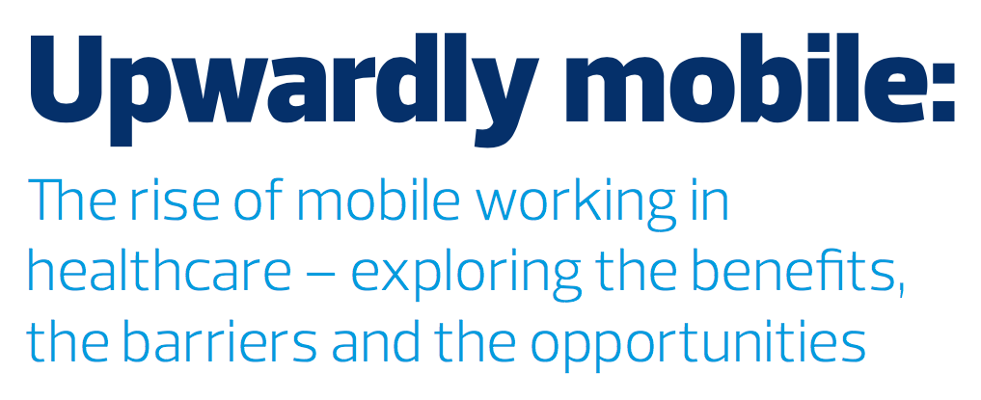
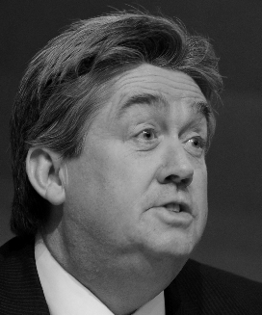
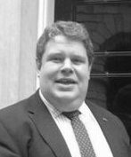
Jon Hoeksma
Editor and chief executive
Digital Health
Claire Read
Contributing editor
Digital Health
Professor Joe McDonald
CCIO
Northumberland, Tyne and Wear NHS Foundation Trust
Gregg Hardie
Head of public sector
Samsung UK

Slide 2
Claire Read
Contributing editor
Digital Health

Slide 3
The growth of technology-assisted mobile working in the NHS

Slide 4
The growth of technology-assisted mobile working in the NHS

Slide 5
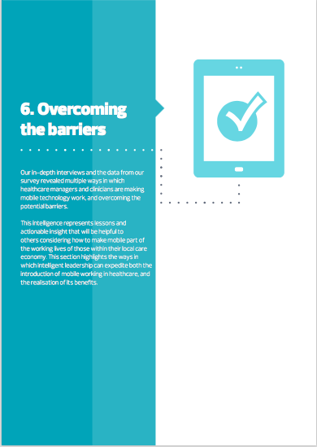
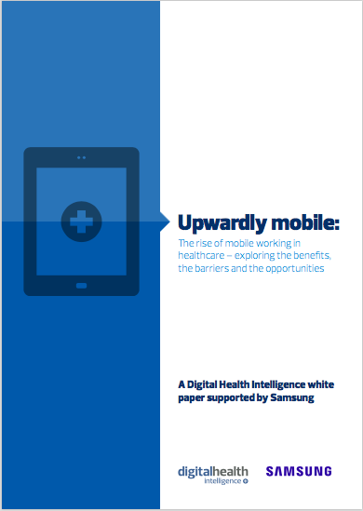
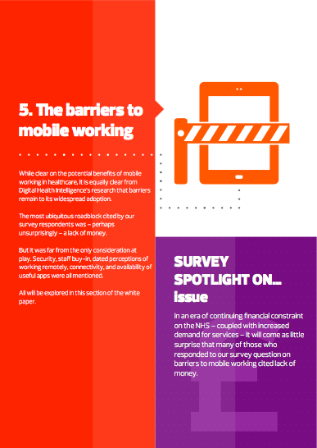
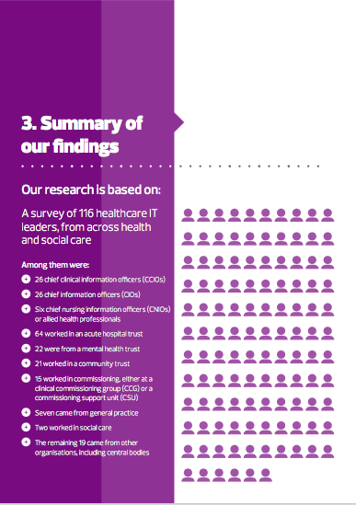
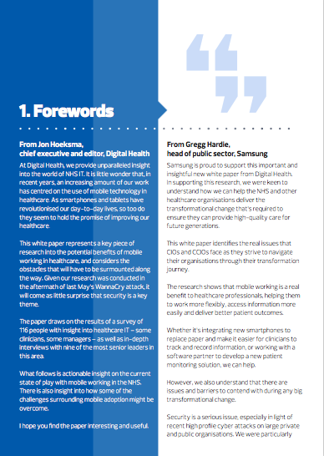
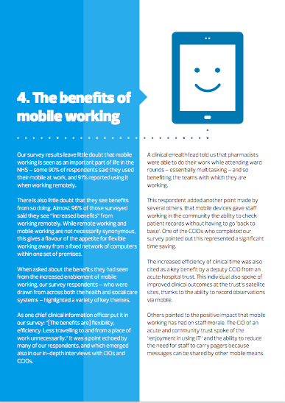
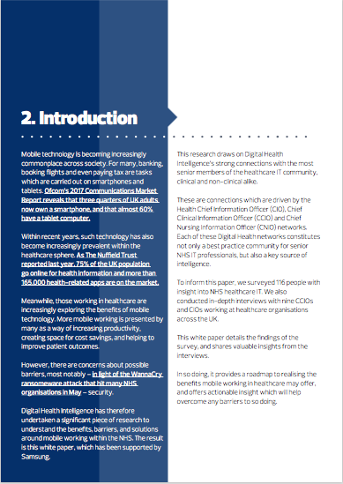
The report

Slide 6
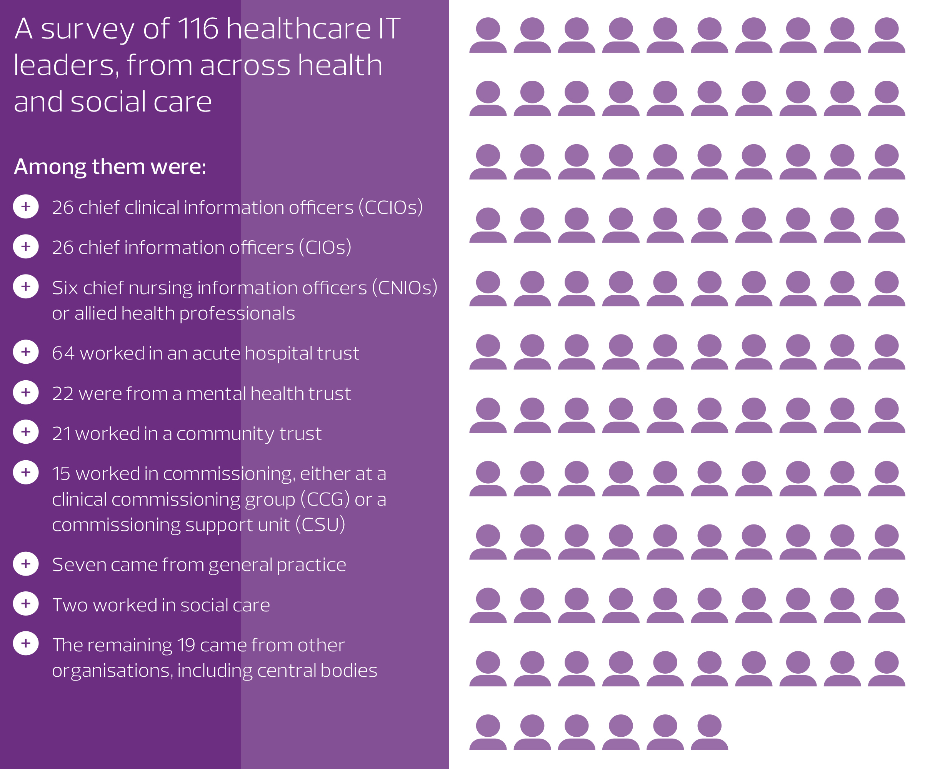
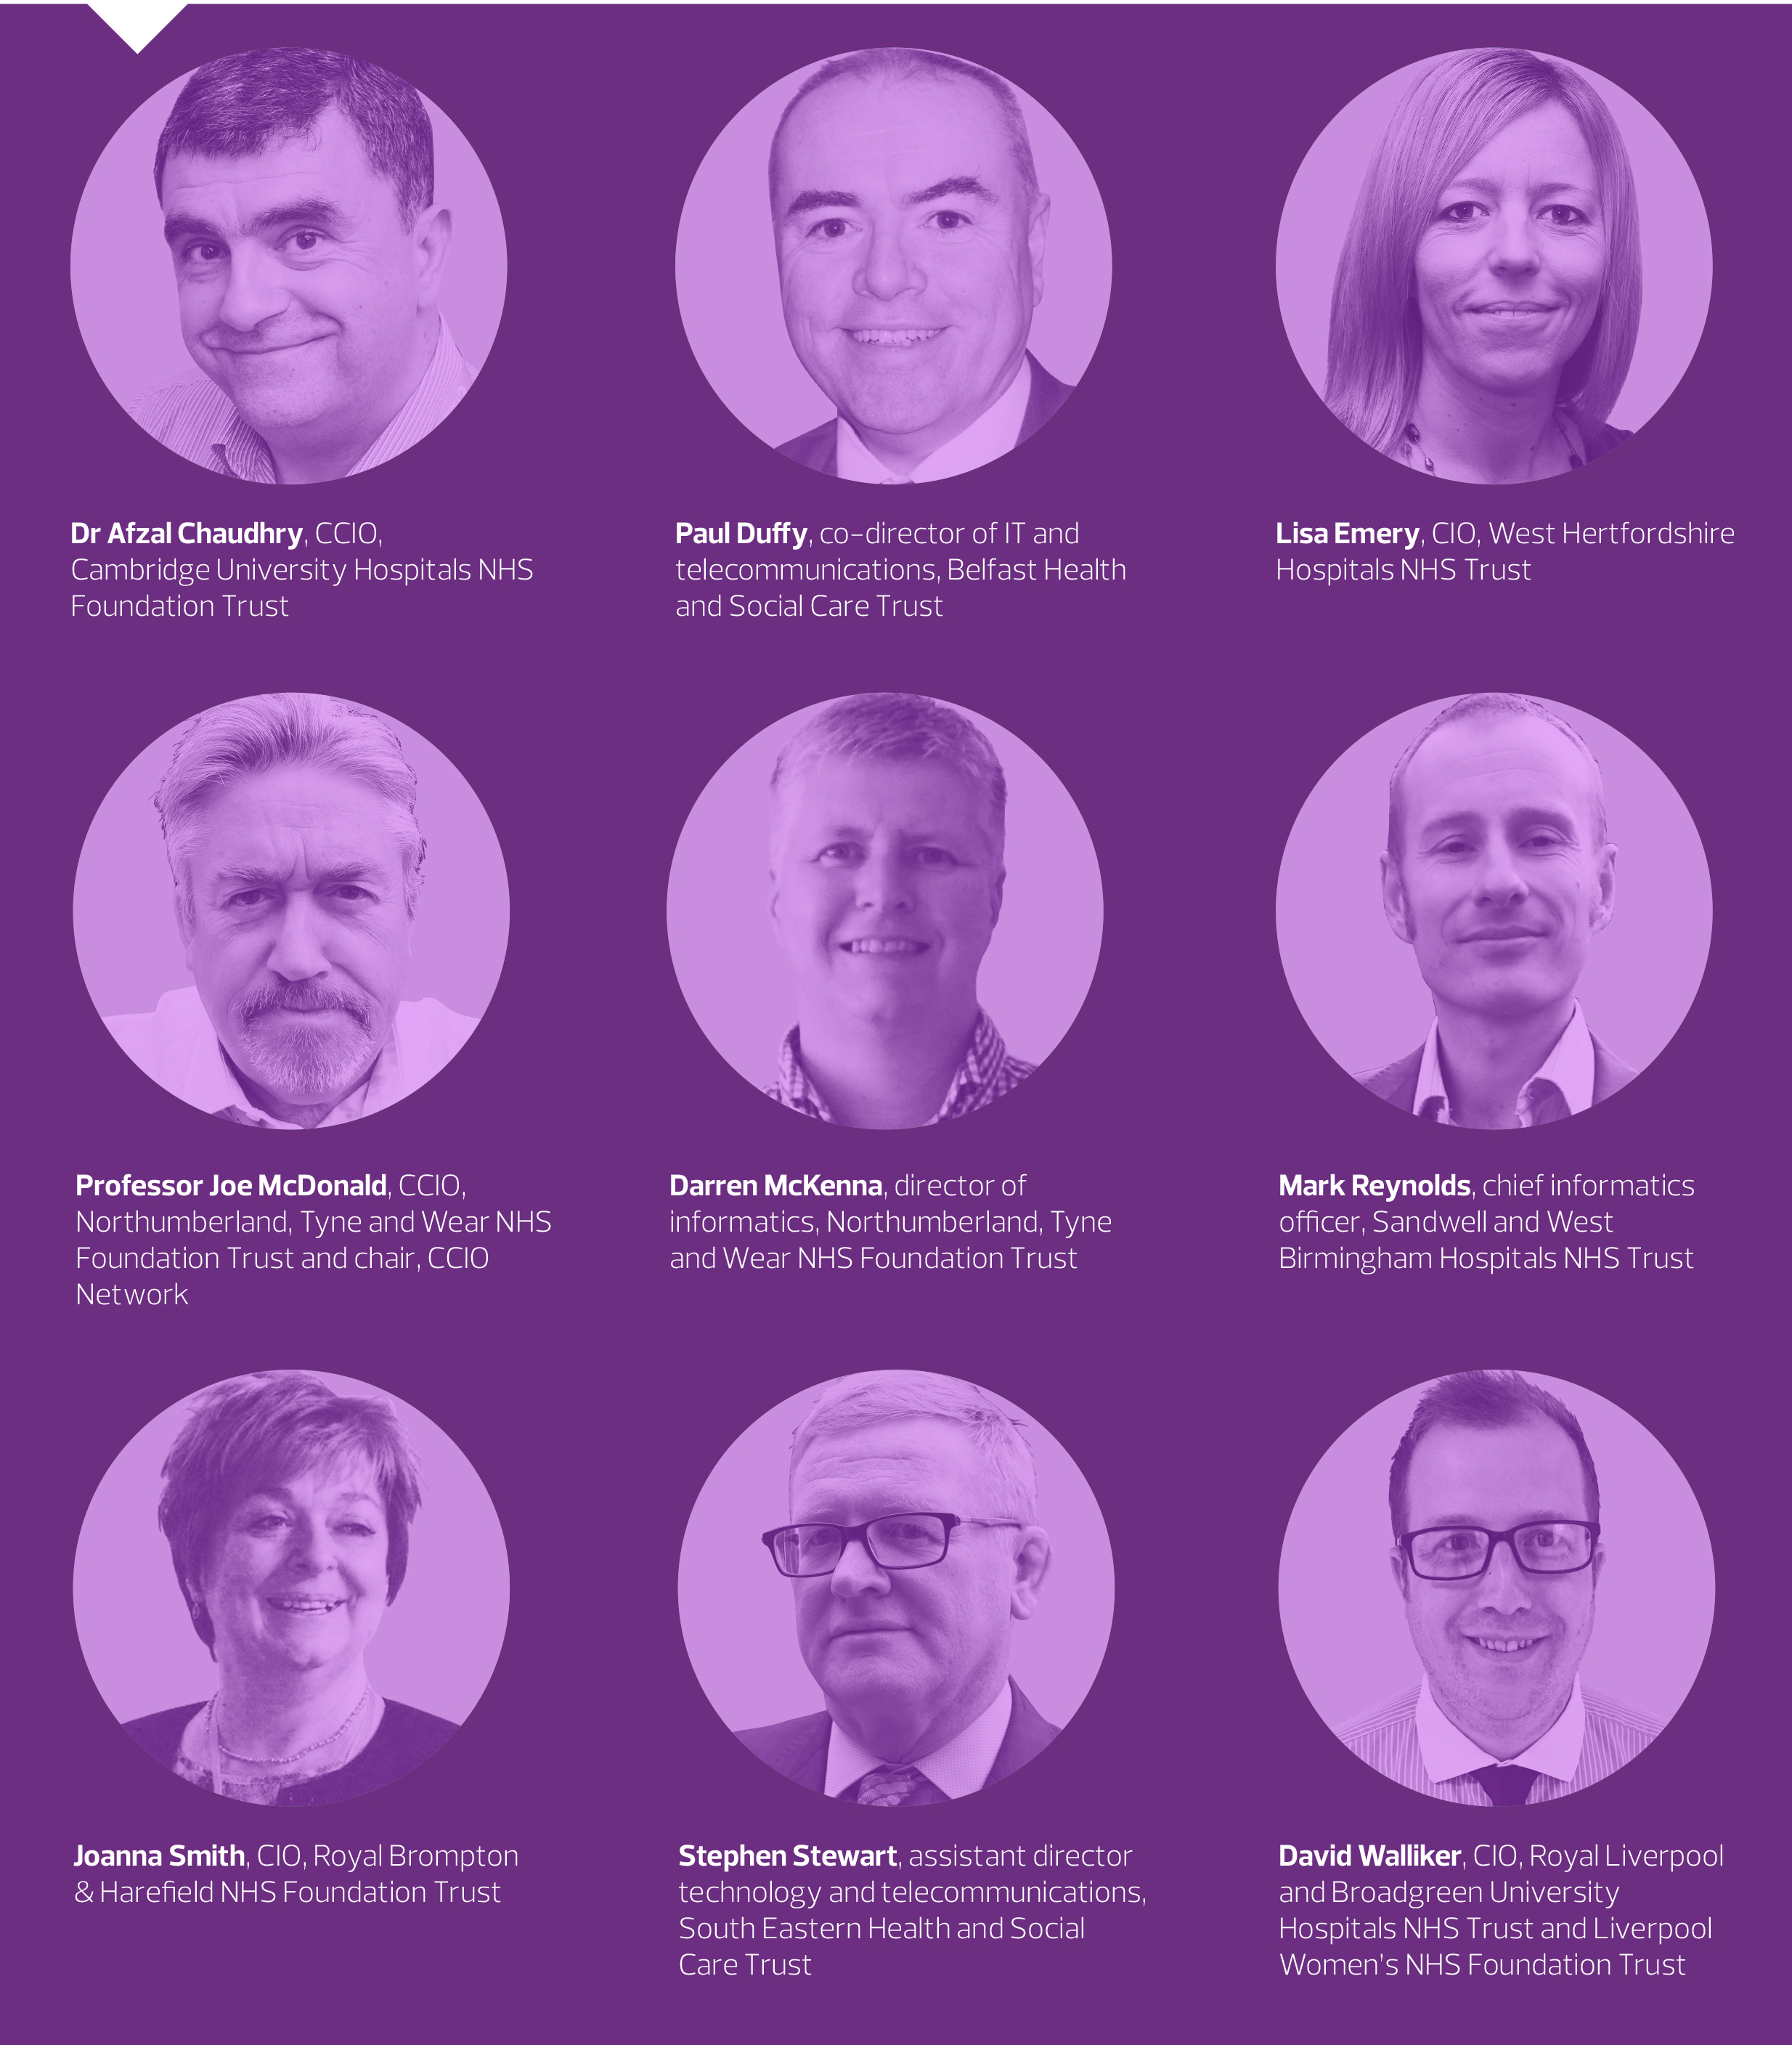
The research

Slide 7
The benefits

Slide 8
Increased productivity and greater efficiency

Slide 9
Decreased need for staff to travel, and resulting cost savings

Slide 10
Better engagement with patients

Slide 11
Increased patient safety

Slide 12
Better understanding of capacity within hospitals

Slide 13
Less disruption to staff on call

Slide 14
The barriers

Slide 15
The barriers

Slide 16
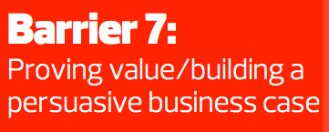
The barriers

Slide 17
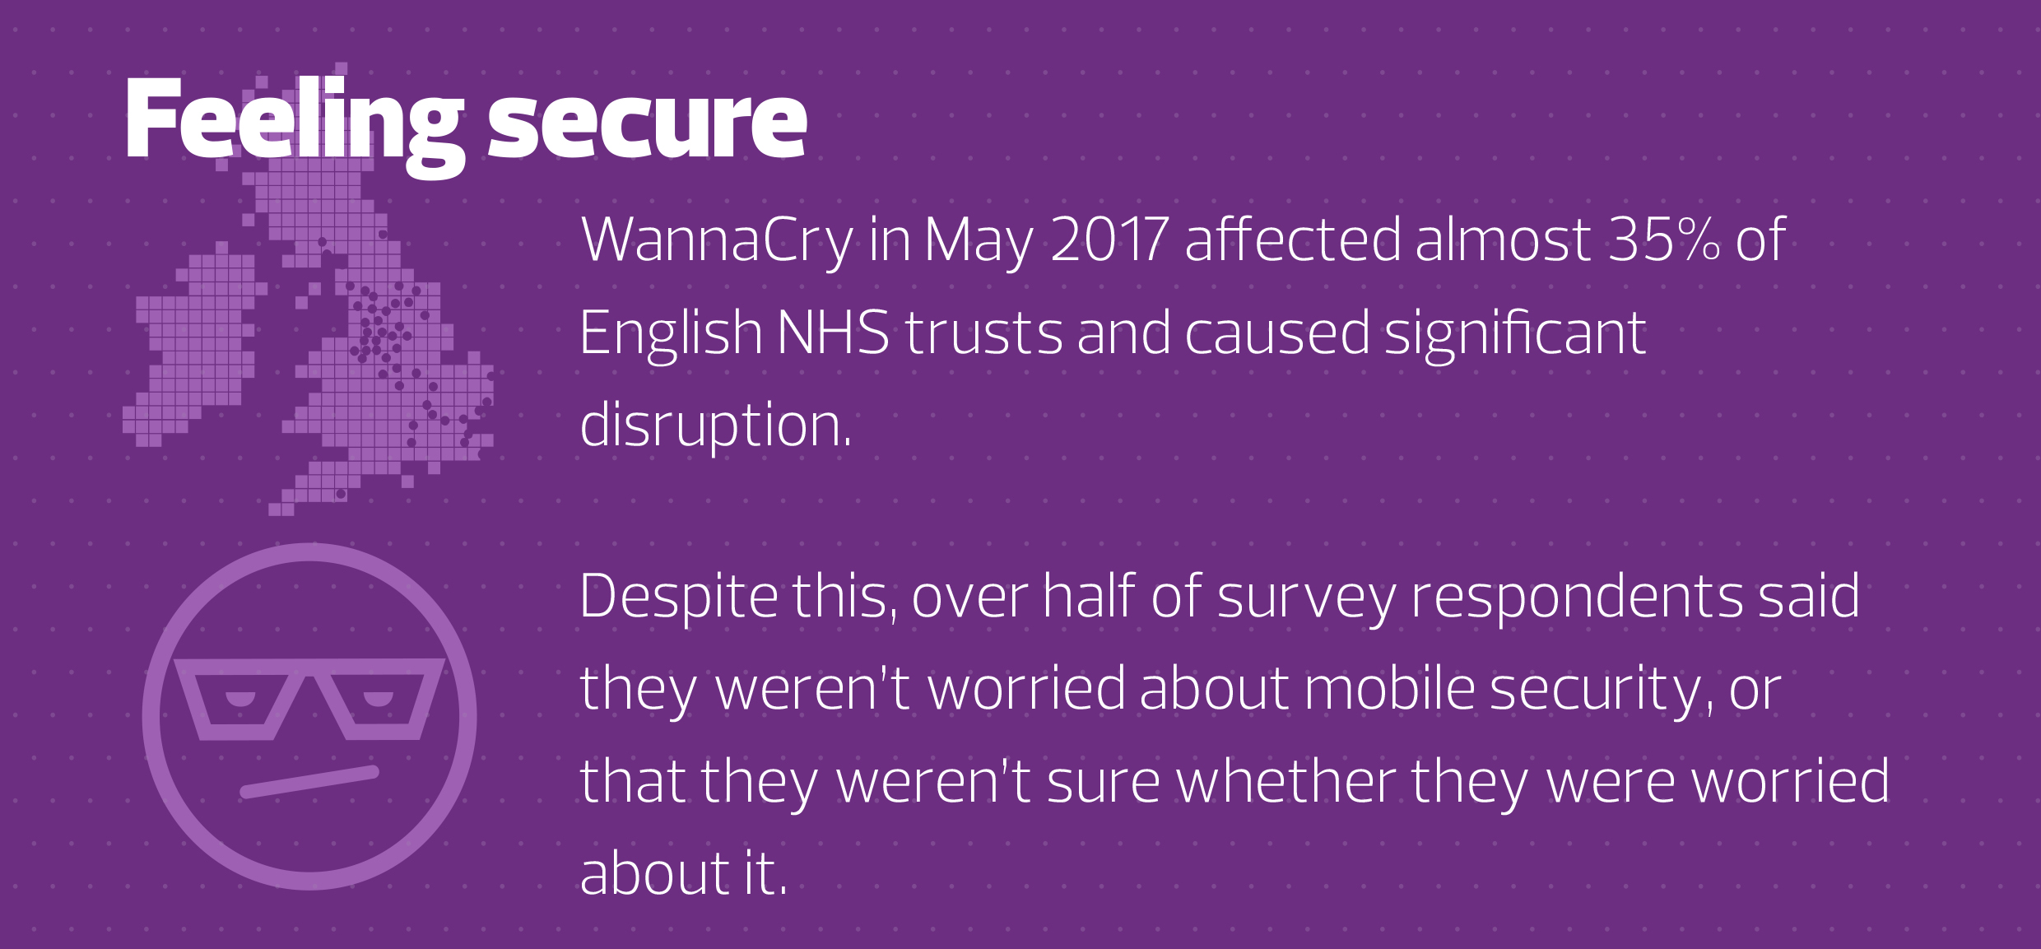
Cybersecurity

Slide 18
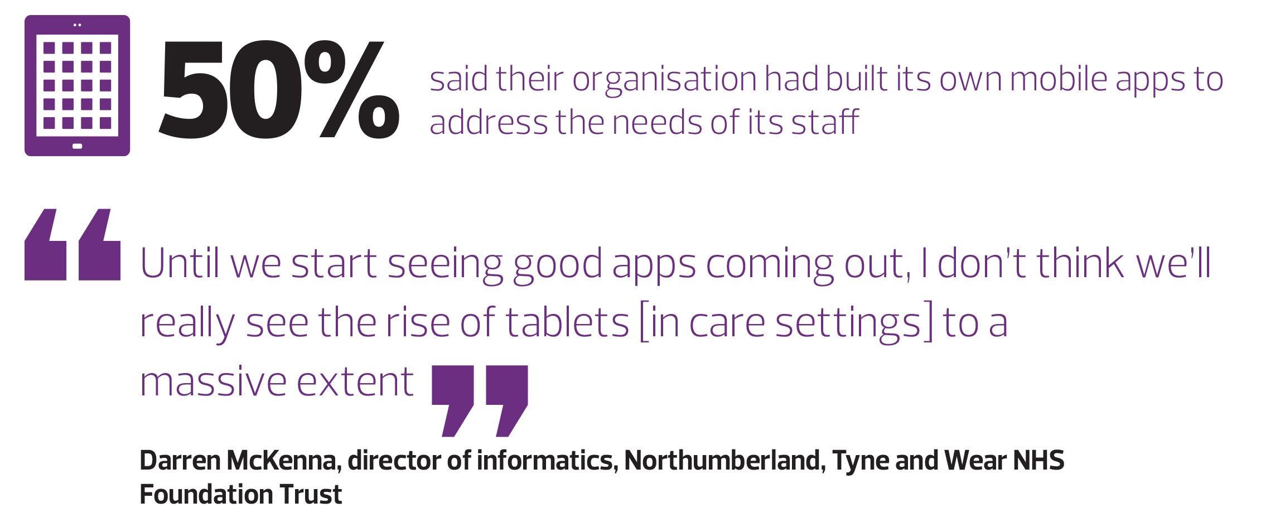
Lacking apps

Slide 19
Solutions

Slide 20
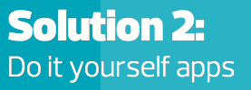
Solutions

Slide 21
The challenge

Slide 22
Digitally Equipped Trust + Mobile Enabled Clinician
=
Digitally Empowered Patient

Slide 23
NTW patient profile
320,000 patients treated by NTW since 2006
40,000 current patients at any given time but < 600 of these are inpatients
63% of current patients are long-term (> 3 years)
> 90% have never been an inpatient
Majority of patients are seen in the community and have multiple health needs.
Staff need to ensure continuity of recording and constant access to records.
Our records, like our staff need to be mobile!

Slide 24
About NTW
Formed in 2006 following merger of 3 separate Trusts.
One of the largest mental health and disability trusts in England.
Employs over 6,500 staff.
Budget over £300m.
Serving a population of over 1.4 million.
Covering an area of 2,200 square miles

Slide 25
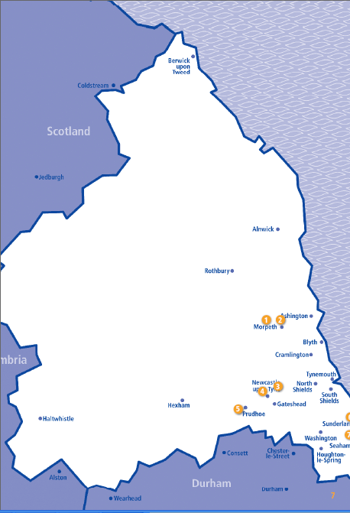
NTW Geography

Slide 26
In 2014, 38 million adults (76%) in Great Britain
accessed the Internet every day
In 2014, 74% of all adults bought goods or services online, up from 53% in 2008.
Notes:
90% of CYPS teenagers have smart phones

Slide 27
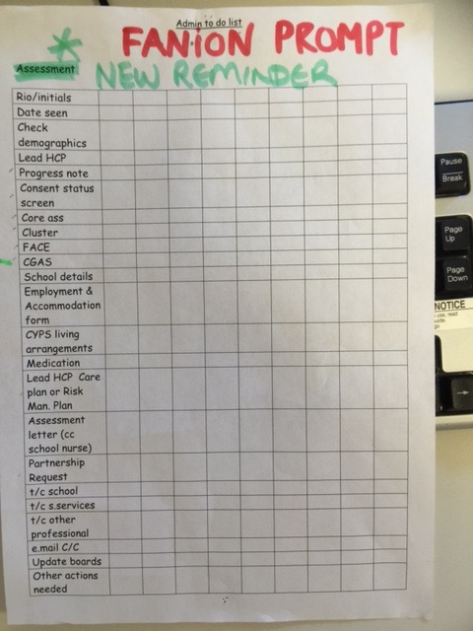
Notes:
Electronic Patient Records have significantly raised the data collection burden on clinicians.
This list was spotted on the wall of a clinic in Sunderland and is a list of all the data fields that need to be filled in by the clinician at first appointment.
All to be typed by people who can’t type, and all before you get to “What can we help you with?”
WE HAVE DIGITALLY HANDICAPPED CLINICIANS only 25% of whose time is spent in front of the patient

Slide 28
GP Refers Patient Electronically
The referral includes email address
and mobile number
Electronic System processes incoming referral, updates or creates the demographic record and referral and notifies clinician
Notes:
Other Industries get the customer to log in and do most of the admin BEFORE entering the service. E.g. Easyjet

Slide 29
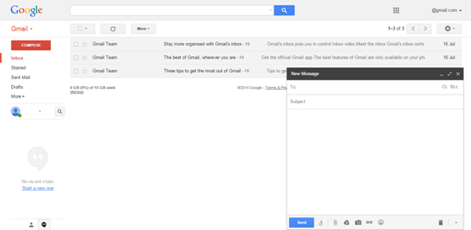
Clinician reviews referral and selects assessment forms
to be completed by the patient.
An automated welcome email is sent to the Patient with a link to complete
assessments.
Notes:
We the NHS must be the only organization in the world not collecting the customers email address.
We currently spend £14k per week on a typing pool to transcribe clinicians notes into Rio. With speech recognition and virtual robots doing the typing we can liberate clinical and admin time.
GET THE MACHINES TO DO THE WORK.

Slide 30
A View of the Primary Care Record
Mobile Access to Rio
Accurate real time dictation into Rio from smartphone using inbuilt voice rec
Video call Enabled
Notes:
A HAPPIER WORKFORCE WHO CAN WORK SECURELY FROM ANYWHERE

Slide 31
Choice of real or virtual clinic
Choice of communication mode inc email
Self check in and assessment
Repeat Prescriptions
Peer Support
Access to self treatment (Mood Gym, Big White Wall etc)
Automated customer feedback
Notes:
BECAUSE WE HAVE THE PATIENTS EMAIL ADRESS WE CAN GET INDUSTRIAL LEVELS OF FEEDBACK

Slide 32
Less reliance on expensive real estate
More working from home
Less time and money lost to travelling
Reduced admin by clinicians
Physical health targets hit with info from GP
Recruitment out of area
Treat patients out of area
Postage
Notes:
WE CURRENTLY SPEND £750K A YEAR POSTAGE
WE CAN DELIVER NTWS TRANSFORMATION FOR THE PRICE OF THE STAMPS!

Slide 33
The digital empowerment of the patient requires
Courage re Information Governance
Money
The system suppliers will not deliver this vision, we will have to do it ourselves. Now is time to invest in IT
Notes:
THOUGH TIMES ARE TOUGH, WE HAVE TO TAKE MENTAL HEALTH ON LINE TO EMPOWER OUR PATIENTS. NTW ARE GOING TO INVEST IN A DIGITAL FUTURE

Slide 34
Build your business on someone else’s expensive infrastructure
Notes:
Netflix built a global video streaming business by utilising Internet suppliers expensively developed infrastructure.
Blockbuster the video rental shop chain went bust because they failed to adapt and left themselves chained to expensive real estate based model.
The NHS has to adapt to survive and use the infrastructure that’s there
TAKE EXISTING CHEAP TECHNOLOGY AND APPLY IT TO MENTAL HEALTH

Slide 35
Work Securely from Anywhere – Reduce Travel
Project Knowledge to Anywhere - Increase Productivity
Build your business on someone else’s expensive infrastructure – Reduce Estate
Information available at the point of delivery.
Reduce the cost of NHS IT

Slide 36
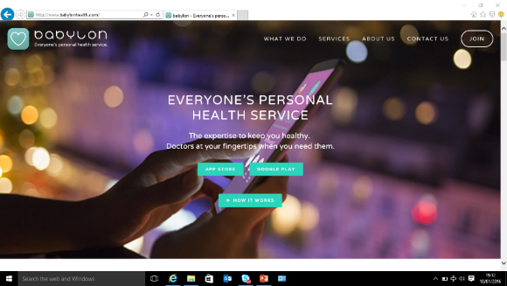
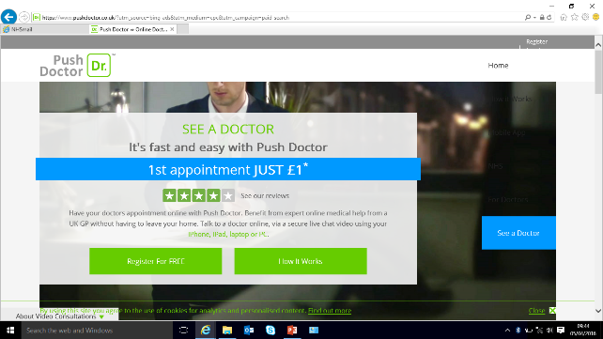
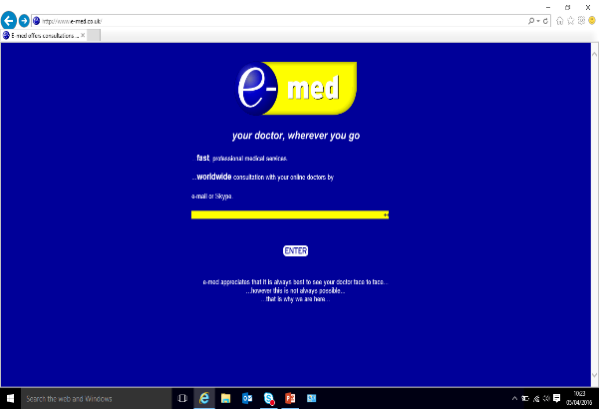
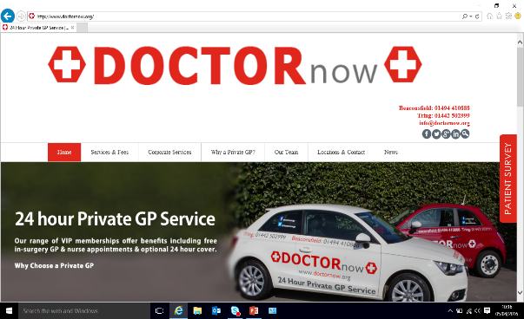
Mobile Competition is hotting up
Notes:
The NHS needs to get into this game

Slide 37
IT DOES EVERYTHING

Slide 38
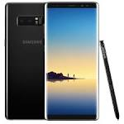
1)Is designed by the end user for the end user.
2)Includes Doctor/Patient multichannel Comms Solution
3)Automates Comms between care settings
4)Facilitates Online consultation
5)Allows patient to set privacy settings re secondary use
6)Allows recording of sessions for quality control
7)Includes speech recognition
8)One click in context access to GP record
9)Spine2 Connected
10)Can sit on top of any System Supplier
11)Cloud based
12)Will be sufficiently gorgeous that I would spend a week’s wages on it….
13)Allows me to see the presence of colleagues
14)Is paid for by the end user (not “nevergreen”)
15)Allows self care
16)Allows clinician to point patient at trusted online resources/treatment packages
17)Nav and Travel Expenses
18)Lone Worker
19)No Smart Card

Slide 39
Things you might not know about Samsung
Built three of the worlds tallest buildings Burj Khalifa, Petronas Towers, Taipei 101
Most popular car brands in South Korea
with strategic partnerships with Renault –generating over $2.5bn in revenue per year
Largest shipbuilding company globally and constructed over 600 Oil Tankers and Container Ships
If Samsung was a country it would be the 34th largest country in the world – ahead of Argentina
Invested in excess of $6bn in sports sponsorship including the Olympics and Chelsea

Slide 40
Global Leader in Technology

Slide 41
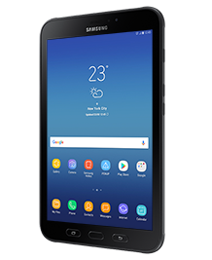
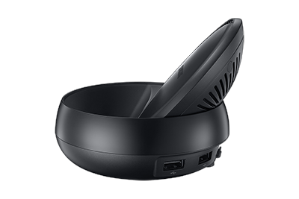
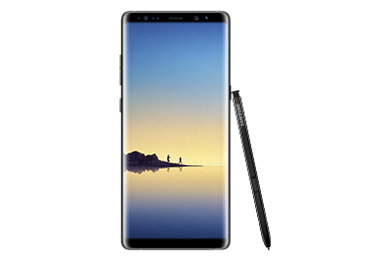
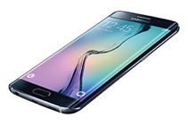
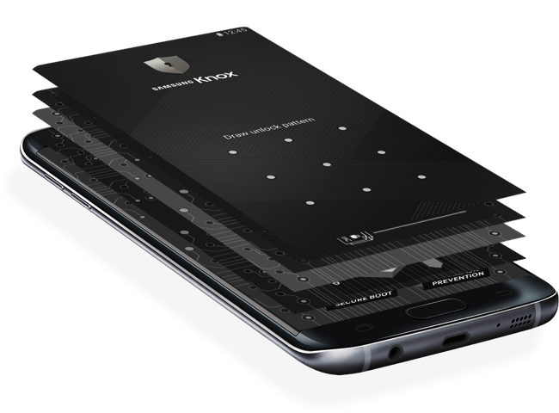
Samsung overview
Samsung’s role is to enable the NHS and other healthcare organisations to become world leaders in introducing new technology to deliver better patient outcomes and a provide a more efficient service.
Purpose of collaborating with Digital Health on this whitepaper was to better understand the real issues faced by CIOs and CCIOs as they deliver the transformational change required.
Understand there is a gap between resources and the increasing demand of patient needs.

Slide 42
Budget challenges
Samsung-as-a-service
Pre-Packaged
Services
Tailored
Services
Financing
Subscription
Services
Services
Services
Finance
Finance & Services
2. Service anywhere to manage, protect and support
3. Simple, affordable and predictable pricing
1. The technology you need
Notes:
Funding challenges will be front of mind when looking at investment for mobile working.
Help by pay per user per device
Reduces upfront costs , therefore makes technological solutions affordable
Makes technological solutions available now.
Provide a more efficient service
Enable clinicians to provide better patient outcomes

Slide 43
Multipurpose devices-DeX
Realistically laptops, mobile phones and tablets are not going to be able to do the same thing.
e.g. Clinicians looking at 6 or 7 days worth of patient observations will use a large screen as opposed to viewing them on a tablet.
Carrying a laptop, tablet and phone isn’t really in keeping with the ideal of mobile working.
Multiple devices are expensive.
Will see multipurpose devices emerging in the market.
Samsung DeX provides a desktop experience.
Notes:
DeX allows you to seamlessly turn your phone into a big screen.
Just dock your phone into the DeX Station, connect that to any screen and within seconds all the information in your phone is accessible on the big screen.
Simply un-dock and pop your mobile back in your pocket. No need to lug your heavy lap top around.

Slide 44
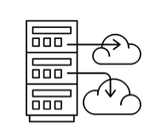
Protect your hospital
With Knox your hospital is protected and data is always secure, whatever device, app or service your people are using.
Gartner rating
Samsung Knox meets the toughest standards for mobile data security. It’s defence-grade, with the highest rating from Gartner.
Government certified
30 governments, as well as leading enterprises, have already accredited Samsung Knox platform.
Multi-layer
With a multi-layered system design, from hardware through to applications, it’s virtually impossible to gain unauthorised access to your mobile devices.
Total protection
Samsung Knox safeguards your data with its built in protection at every level, from hardware to software.

Slide 45
Knox Brings More Than Just Security
Defence-grade security
Customisation
Deployment
& Management
Multi Persona
Notes:
Customisation - With Knox, you can create new and enhanced mobile experiences for you, your teams and your business’s customers.
Deployment - With Knox you can keep users productive with new mobile devices that are switched on and ready to work straight out of the box
Managemetn - With Knox, mobile management comes easy – whether you’re looking after tens or tens of thousands of smartphones and tablets.
Multi pesonna – With Knox you can separate personal and work data to ensure your business and team’s privacy are both protected

Slide 46
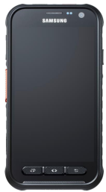
[INTERNAL]
Emergency Services Network (ESN)
Next-generation public safety communications
The UK is leading the way with the Emergency Services Mobile Comms Programme which is scheduled to finish migration to the new ESN network and devices by 2020
Who?
What?
How?
Contracting authority
Specialist device (C1)
Delivery
Specification
3GPP rel 12 + PS QCIs
IP68
Rugged
H/W keys
PTT accessories
Additional services
Knox Customisation
Knox Workspace
Services
Buying parties
Devices
44x Police forces
50x Fire services
13x Ambulance trusts
100+ Tier 2 groups
Vehicles
50k
Users
300k
Aircraft
130
Network Services
User services
TBC
Service Provider (DOF)
Milestones/ Roadmap
Actions
Samsung contract signed 21st November 2017
Home Office visit Korea 6th Feb
Trial devices April 2018
Production devices scheduled for Q3 ’18
New projects:D2D, vehicles, back office
Sales & marketing campaign
Dedicated resource
New service model
Notes:
Opportunity

Slide 47
Engage with Samsung
Helen Shaw – Head of Healthcare – based in the north
07896 873125
h.shaw@samsung
Alex Gittens – Healthcare - based in the south
07748 645927
a.gittens@samsung.com
Notes:
DeX allows you to seamlessly turn your phone into a big screen.
Just dock your phone into the DeX Station, connect that to any screen and within seconds all the information in your phone is accessible on the big screen.
Simply un-dock and pop your mobile back in your pocket. No need to lug your heavy lap top around.

