Slide 1
Securing Your Digital Transformation
Chris Moyer, CTO, Security

Slide 2
Thrive on change
  DXC Technology is the world’s leading independent, end-to-end IT services company. We guide clients on their digital transformation journeys, multiply their capabilities, and help them harness the power of innovation to thrive on change.
  CSC and HPE Enterprise Services brought innovation to clients for 60+ years
  Together, we serve nearly 6,000 private and public sector enterprises across 70 countries
  Our clients benefit from our technology independence, global talent, expertise and extensive partner network
  We are uniquely positioned to lead digital transformations, creating greater value for our people, clients and partners

Slide 3
Value of an integrated Security
Actionable Intelligence
More effectively detect and prevent threats with actionable intelligence
Security Incident Response
Quickly resolves adverse security events using a full suite of incident
response, management, and remediation services
Benefits
Leverage our extensive IT and security knowledge of clients’ environments
Gain comprehensive security visibility across the enterprise
Quickly identify and respond to incidents, especially those on managed devices
Enhance alert context with integration of multiple existing threat sources
Reduce organizational impact with rapid restoration time
Minimize incident damage with automated policy management and configuration
Control access during and after incidents
Security
Monitoring
Detects and responds to incidents and manages global risk with 24/7 security monitoring
Security Management
Optimizes operational efficiency and enhances reporting with 24/7,365 management of vital security controls
Identity
Management
Comprehensively manages user access, identity governance and administration, and privileged access accounts
Security Analytics
Proactively hunts for and prevents unknown threats using analytical
and big data tools

Slide 4



Security Operations is differentiated by 3 main areas of capability
Visibility Without Boundaries
Comprehensive Detection
Intuitive Investigation w/automated response
Massive scale log ingestion supporting both short term alerting and long term investigation
Seamless Real-time and Advanced Analytics powered monitoring and alerting built for security scale
Guided, analytics powered prioritization, investigation, entity profiling and workflow with automated orchestration and response

Slide 5
CRA Framework – Structured Approach for Advisors
Define a security strategic direction aligned with business objectives; outline a plan to achieve that direction; and ensure proper execution of that plan, including decision making based on risk management
Processes to define, evaluate, mitigate, accept, or transfer risk and ensure compliance with regulatory and industry requirements while meeting business objectives
Strategy,
Leadership
& Governance (SLG)
Translation of business strategies into effective security solutions through principles, models, capabilities and patterns
Capabilities necessary to create a security-conscious culture and manage internal security knowledge
Risk & Compliance Management (RCM)
Security monitoring, incident management and breach response
Security Resilient
Architecture (SRA)
Operational security processes, including management and measurement
Resilient Workforce (RW)
Management of identities and access controls to meet compliance, operational, and security requirements
Data classification, data security modeling and protection to prevent loss, modification, or misuse
Cyber Defense (CD)
Security Orchestration (SO)
Automated rule enforcement, threat detection, and prevention at infrastructure and endpoint
Identity & Access Management (IAM)
Development and maintenance of software to meet security requirements
Infrastructure & Endpoint Security (IES)
Applications Security (AS)
Data Protection & Privacy (DPP)
Integration of Information Technology (IT) and Operational Technology (OT) security
Protect assets from environmental, accidental or deliberate physical threats
Converged Security (CS)
Physical Security (PS)
Notes:
Background on more of the specifics on CRA if needed

Slide 6
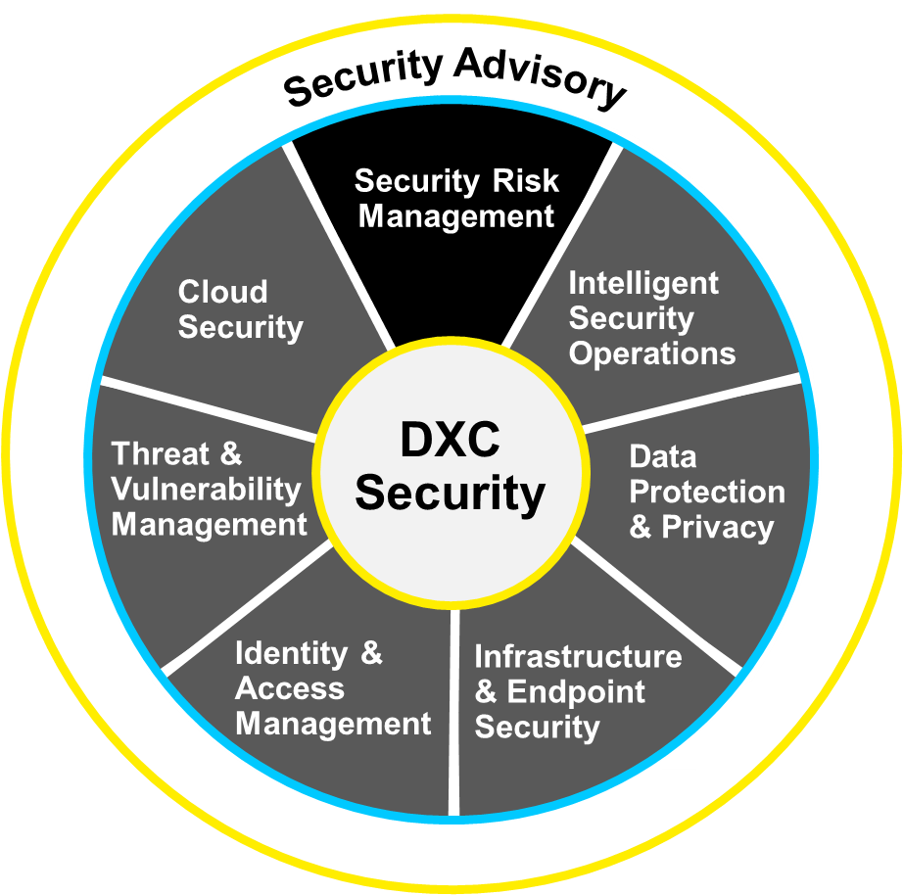
Solve security challenges with integrated set of services
Cyber Maturity Review
Privileged Account Security Diagnostic
Advanced Compromise Assessment
Cyber Attack Simulation
Ransomware Diagnostic
Security Risk Management Advisory Services
PhishEd Advisory Services
Account Security Governance
Client Security Officer
Technology Compliance
Intelligent Security Operations Advisory Services
Incident Response Advisory Services
Security Monitoring
Managed SIEM
Log Management
Deep/Dark Web Monitoring
Cloud Security Advisory Services
Cloud Security Monitoring
On-Demand Workload Protection
File Integrity Monitoring
Managed Cloud Access Security Broker
Threat and Vulnerability Management Advisory Services
Security Testing Certification Laboratories
Vulnerability Intelligence
Vulnerability Scanning
Comprehensive Applications Threat Analysis
Applications Security (within Applications Offering Family)
Data Protection and Privacy Advisory Services
Data Loss Prevention
Managed PKI
Identity and Access Management Advisory Services
Identity Management as-a-Service
Privileged Account Management
ConfidentID - Biometric Authentication
Security Access
Multifactor Authentication
Authentication Broker
Infrastructure and Endpoint Security Advisory Services
Managed Endpoint Threat Detection & Response
Managed Endpoint Protection
Managed Advanced Threat Protection
Managed Firewall
Managed Network IDS/IPS
Managed Proxy
Firewall Ruleset Assurance
Distributed Denial of Service (DDoS) Protection
Notes:
DXC Security combines our deep experience in Security Advisory with our legacy of partnering with clients to provide managed services to deliver a differentiated end-to-end security solution that fits their specific business needs and capabilities.
The DXC Security portfolio is led by a Security Advisory capability supported by thousands of advisors with regional and industry experience. These Security Advisors provide diagnostic services to quickly assess your security capabilities, uncover gaps and recommend improvements based on your position. This guidance leads to the development of a Security Improvement Plan where the DXC Security portfolio of integrated services can be utilized to deliver these improvements.
The DXC Security portfolio will provide you with the ability to simplify your security management and ongoing evolution. These integrated services bring the industry’s best security solutions into a foundational security platform that is managed by DXC’s security professionals either in partnership with your security personnel or entirely by DXC.

Slide 7
Thank you

