Slide 1

NHS e-Referral Service
Interoperability: API Integration Update
Integration Team
23rd February 2018

Slide 2


Agenda and Presenters
service overview
implementation background
technical approach
clinical referral information
current alpha developments
partnership delivery
summary
Dr Paul Denton
Programme Manager
NHS Digital, NHS e-Referral Service
paul.denton1@nhs.net
Rachel Woolfenden
Head of Elective Patient Access
Western Sussex Hospitals NHS Foundation Trust
rachel.woolfenden@wsht.nhs.uk
Hannah Van Praag
Professional Services Manager
Docman
hannahvanpraag@docman.com

Slide 3
The NHS e-Referral Service
Stephen Firman SRO
over 60,000 referrals per day
8,600 GP practices & 600 providers
62% utilisation achieved
progressive Agile delivery
full use of the e-RS required by Oct 2018
12 site completed paper switch off to date

Slide 4

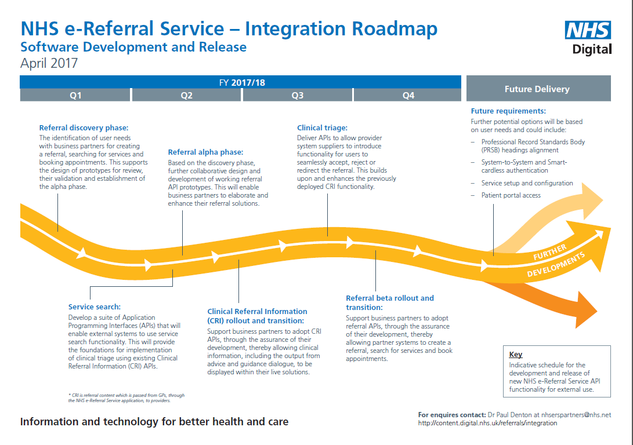
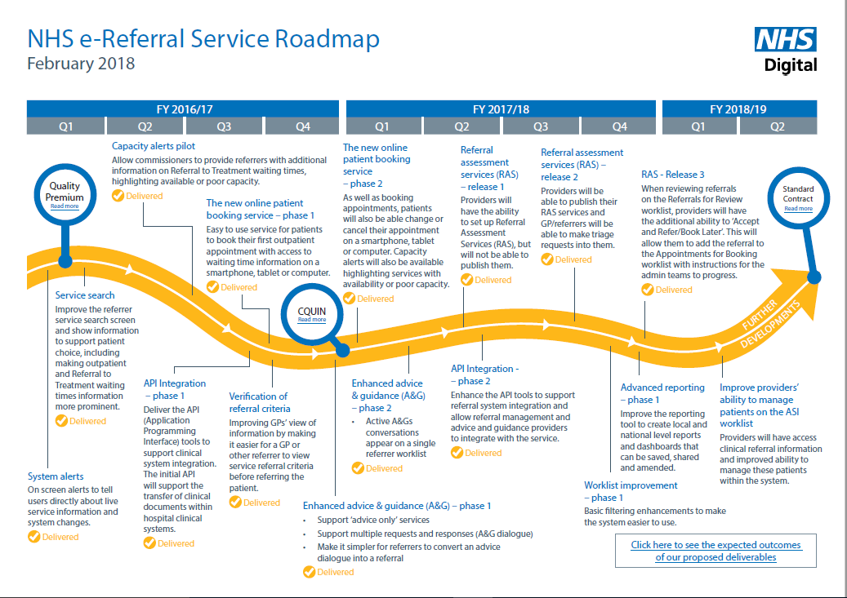
NHS e-RS Roadmaps
New for 2017-18
API Integration
Phase 1 & 2
http://content.digital.nhs.uk/referrals/integration

Slide 5

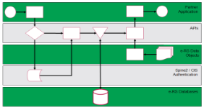


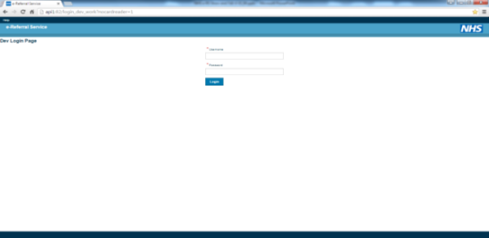
Collaborative Delivery Approach
We have an idea to improve the integration of the NHS e-Referral Service
I can use the new development and realise patient benefits
Decision Assist Limited
(Business Partner)
Dr Smith
(End User)
How do we deliver new integration and innovation opportunities in an agile, responsive and co-ordinated way?

Slide 6
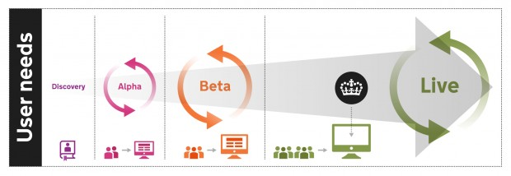
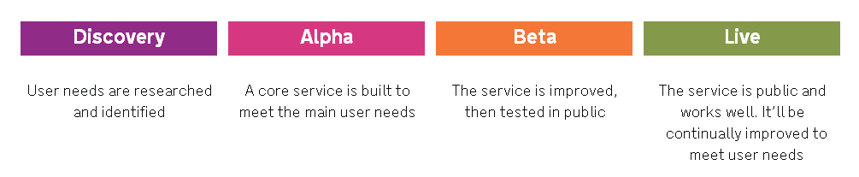
Phase 1: Initial API Release
Single Objective: To deliver a candidate suite of APIs into Live
Target Beta Delivery:
Transition and Rollout:
2017 - Onwards
2016

Slide 7
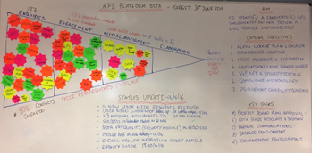
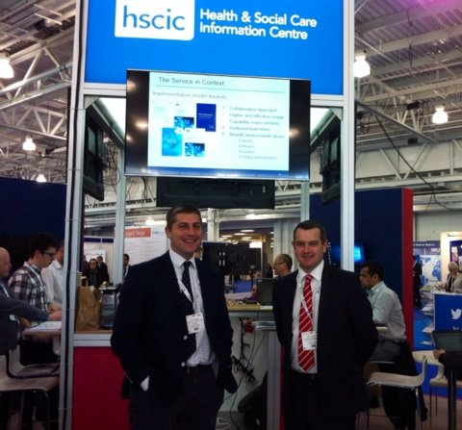
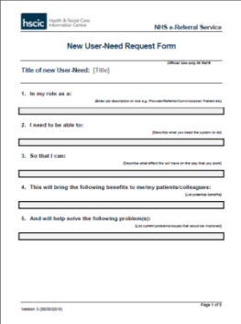
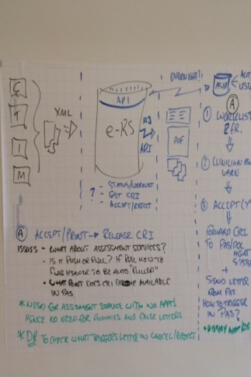

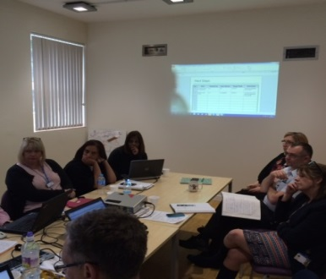

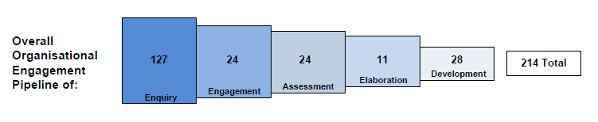
Stakeholder Engagement
January 2018 Figures

Slide 8
Clinical Referral Information (CRI) APIs
Problem:
limitation of current HL7/XML messaging that the GP clinical content added into the application cannot be easily retrieved by clinical systems
Current workarounds:
this led to a number of users undertaking manual administration through printing, scanning and uploading, together with unsupported technical solutions
Solution:
provision of APIs to allow third-party solution providers to develop compliant systems, which can search worklists to download CRI (referral header, attachments and PDF)
Outcome:
reduction in manual administration, through real-time or automated access

Slide 9
Benefits Insights
over 3.5 million referral documents were printed in 2016 (Table 1)
provider clinicians see Accept, Reject, Re-direct as a burden
current referral integration is only available to GP solution partners using limited messaging functionality
long held desire to integrate ‘Referral Letter’
Date | Requests Created | CRI Attached | CRI Printed
Jan-16 | 885023 | 775397 | 279428
Feb-16 | 959222 | 847133 | 288613
Mar-16 | 967027 | 849722 | 284097
Apr-16 | 993751 | 873573 | 293559
May-16 | 966926 | 852505 | 289851
Jun-16 | 1017834 | 900761 | 308941
Jul-16 | 934822 | 831255 | 283098
Aug-16 | 957488 | 848310 | 301808
Sep-16 | 988009 | 875617 | 302428
Oct-16 | 972335 | 860945 | 302418
Nov-16 | 1016259 | 897974 | 310677
Dec-16 | 830569 | 740747 | 260297
Table 1: Clinical Referral Information (CRI) Statistics 2016

Slide 10
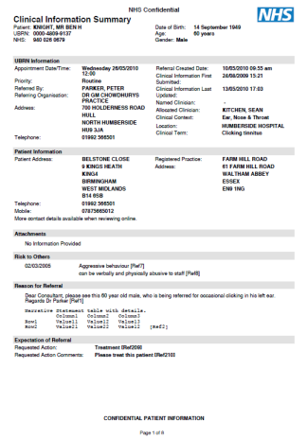
API Beta Project Objective
Delivery of a suite of Authentication and Clinical Referral Information (CRI) APIs
log onto N3 using Smartcards, Orgs and Roles
access Referral Status Information & Attributes
retrieve CRI in a single PDF with attachments
provide a pilot compliance approach and management console, with live support
advice on business and deployment benefits
* CRI denotes the breath of referral content which is passed from GPs through the NHS e-Referral Service application, to providers

Slide 11
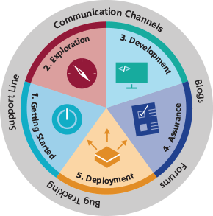
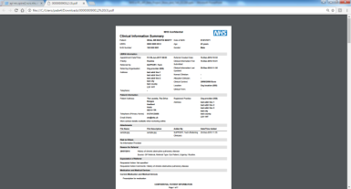

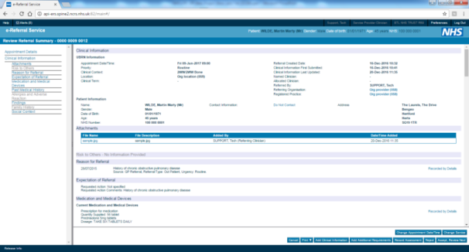

CRI Solution Architecture
Security module
SWAGGER CONSOLE
External Facing APIs
(Auth & CRI)
PDF WITH STATUS
& ROUTING ATTRIBUTES
Internal services
DEVELOPER
ECOSYSYSTEM
Business rules
ORGANISATIONS
ROLES
TESTDATA

Slide 12
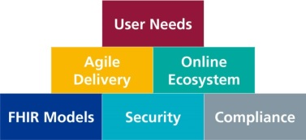
Phase 1: Development Summary
API Beta APIs completed in 2016
delivery of 8 Security and Clinical Referral Information (CRI) API Endpoints (N3/Smartcard)
ability for providers to consume CRI in an initial PDF format (Worklist, Referral Header, PDF and Attachments)
early adopter prototyping and elaboration
business case and benefits modelling
assurance approach approved

Slide 13
Phase 2 Implementation
Release | Target Date
R7.1 | 19th Jan 2018
R7.2 | 16th Feb 2018
R7.3 | 16th Mar 2018
Released | Coming Next | Planned | Prioritised EPIC Backlog
Authorisation & Authentication | Service Search | Referral Management (Target Q3 Delivery) | NHS England Strategic Analysis Strategic Review System-to-System Authentication Product Team GP IT Futures Requirements GP System Research Alerts and Notifications Advice & Guidance Suite Integration Delivery Team Develop MVP for Clinical Triage CRI FHIR V2 to V3 Upgrade Service Search Beta Transition Referral Beta Transition Clinical Triage Beta Transition Unattended API Call Discovery Professional Records Standards Body (PRSB) Information Model Gap Analysis Non-Roadmap Committed Backlog PAS/PDS Patient Registration Referral Assessment Service (RAS) APIs Smartcard-less Mobile Access Dentistry Service Setup and Configuration Patient Portal Access
Create Professional Session Update Professional Session Delete Professional Session | DoS Search (Phase1): R6.6 Patient Booking Search (Phase1): R6.6 DoS Search (Phase2): R7.1 Patient Booking Search (Phase2): R7.1 | Retrieve Appointment Slots: R7.3 Book Appointment: R7.3 Defer to Provider: R7.3 Appointment Request Letter Cancel Request Appointment Letter Update Appointment Cancel Booking
Clinical Referral Information | Referral Request Alpha | Clinical Triage (Target Q4 Delivery)
Retrieve Worklist Retrieve Referral Request Retrieve Attachments Retrieve Clinical Information | Retrieve Referral Status: R6.6 Create Referral Request: R6.9 Add Attachments: R6.9 Add Clinical Information: PRSB Tbc | Change Appointment Change Service Record Assessment (Tbc)
ValueSet | Clinical Triage | Service Search (Pending Research)
Retrieve Specialties | Accept Referral: R6.8 Reject Referral: R7.0 | DoS Search (Phase3) Patient Booking Search (Phase3)

Slide 14

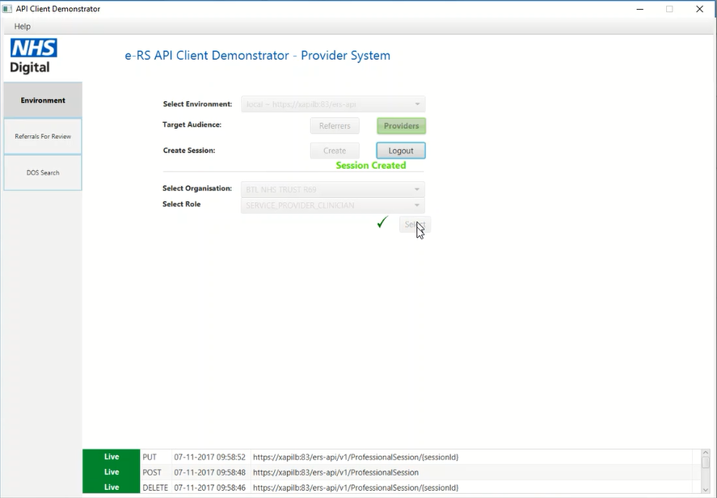
API Demonstrator

Slide 15
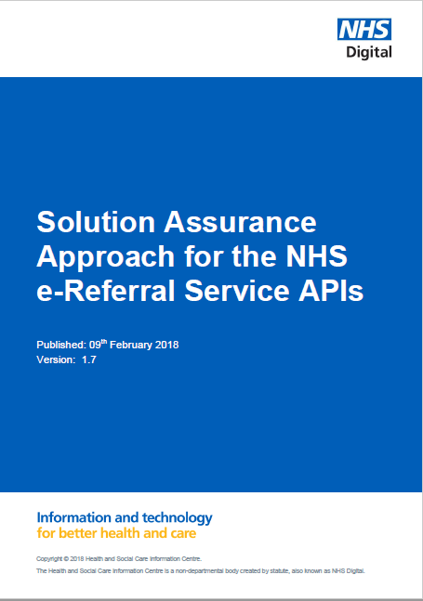
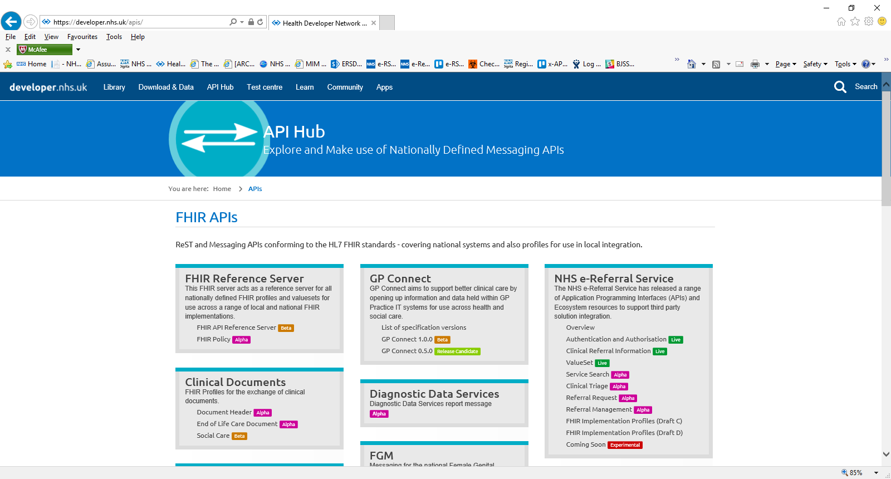
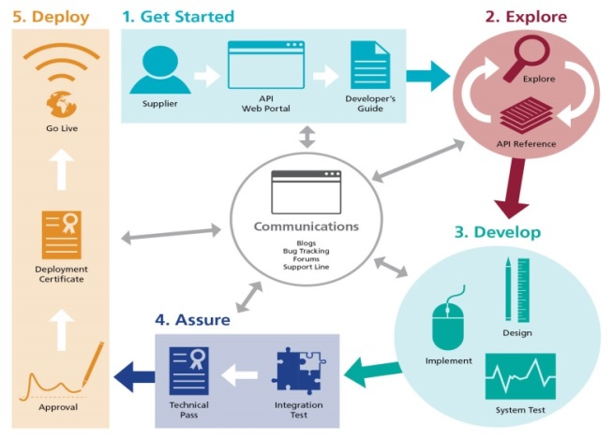
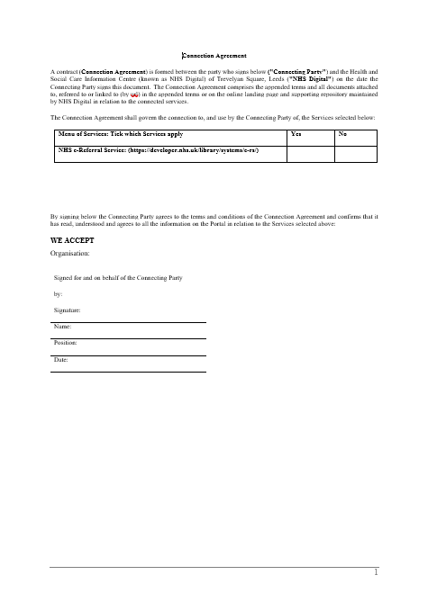
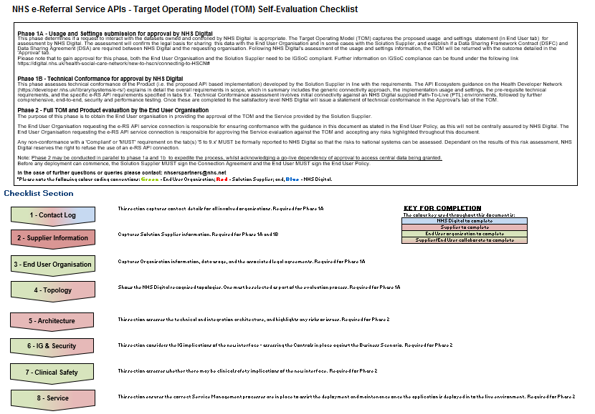
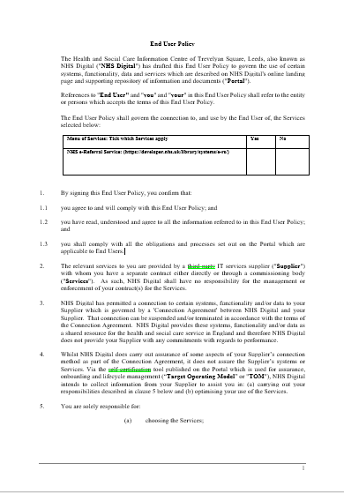
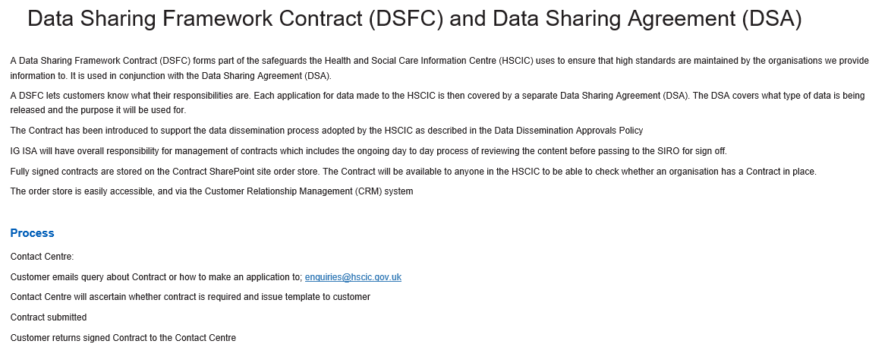
Development and Assurance Process
developer.nhs.uk

Slide 16


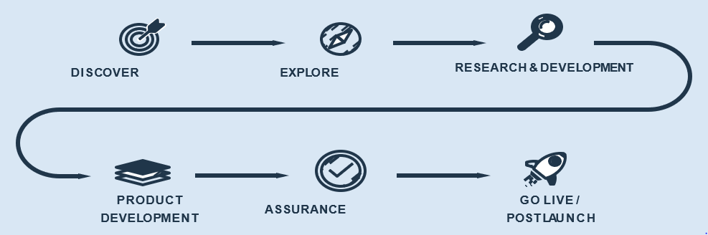

Case Study: Pilot Implementation
pilot project to deliver CRI into triage workflow
remove referral paper from process
provide foundation for integration of triage outcome
collaborative team approach
business benefit modelling
initial semi-automated smartcard authentication

Slide 17
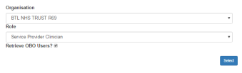
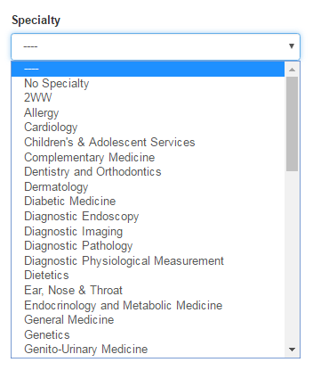


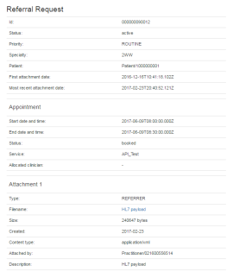
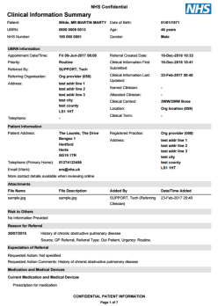

Target API Workflows
Create Professional Session
Update Professional Session
Get Worklist
Get ValueSet Specialty
Delete Professional Session
External System
Get Referral Request
Get Attachments
New APIs allow 3rd party solutions to search and download Clinical Referral Information:
- Request
- Attachments
- Clinical Contents PDF
Get Clinical Information
Care Identify Service (CIS) & Spine
NHS e-Referral Service

Slide 18
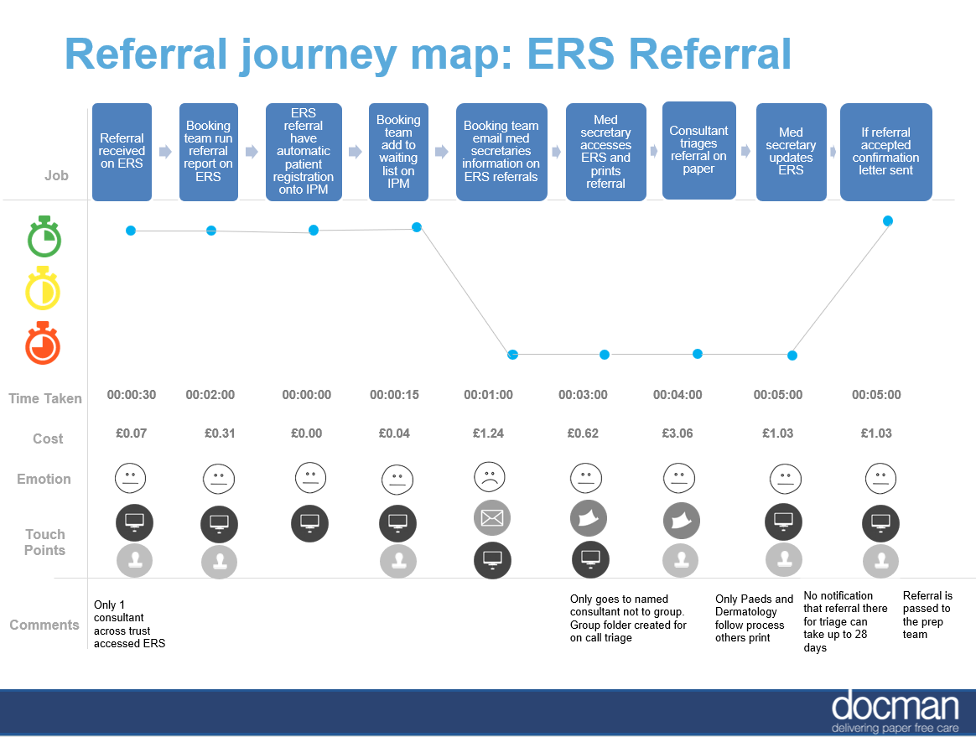
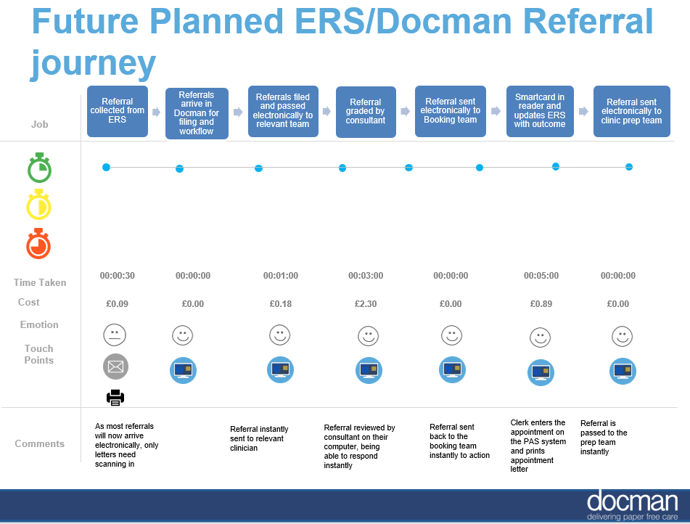
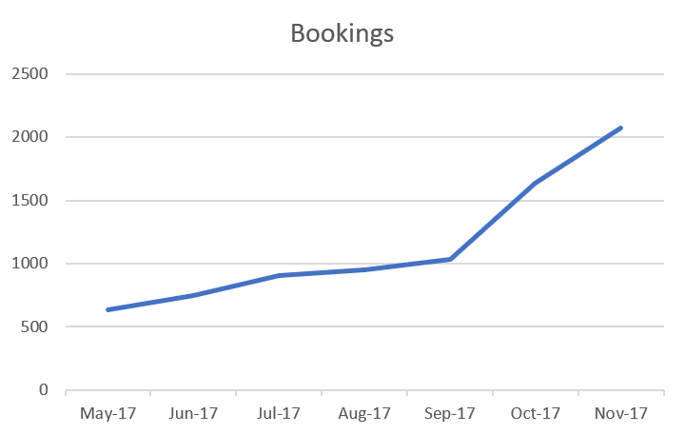
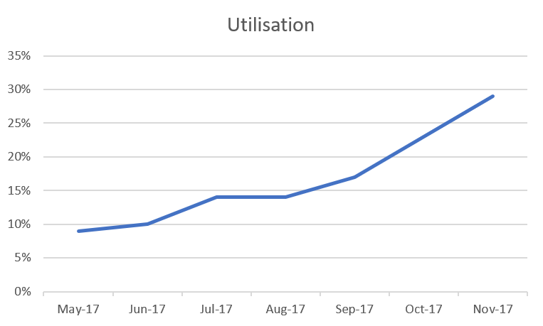
NHS Business Benefits

Slide 19
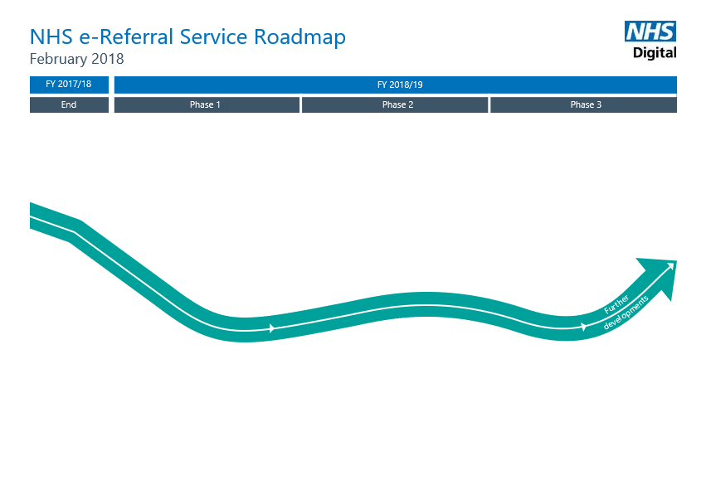
Vision Concepts for 2018-19
1. Enhance Professional Experience | Decrease effort required to use the service - Make it intuitive and more usable (fewer clicks – e.g. service searching) Improve integration – only do it once Improve professional communications Consistent approach to Clinical Dialogue, Review and refine work lists, Design and introduce professional alerts
2. Enhance Patient Experience | Improve written materials for patients Improve accessibility and ease of using Manage Your Referral (MYR) Introduce patient electronic communications
3. Improve Integration | Continue provider API Integration work – including auto register patients from RAS/A&G Research and design an improved Integrated GP Referral System (IGPRS) Identify needs of users, Create necessary APIs & Work with GPSoC suppliers to implement
4. Improve Health Service Efficiency | Further develop reporting capability e.g. early warning of demand and capacity problems (Forward order book). Activity reporting Enhance Directory of Services Enhance user base (continue Any-to-Any expansion) Assess and progress Follow-Up Appointments (based on user/stakeholder needs)
5. Enhance & Rationalise System Infrastructure and Development | Introduce analytics Introduce Beta Testing capability & test new functionality with ‘model communities Introduce support for federated models and new Accountable Care Organisations Support changes to NHS Organisation Structure Review changes for cancer 2WW Services

Slide 20

Next Steps
enhanced implementation support & information sharing
refine support tooling and resources
complete pilot assurance model
understand requirements for automation and
system-to-system or ‘unattended calls’
2018-19 roadmap approval and dissemination
work with PRSB to develop standard referral models
https://theprsb.org/projects/clinical-referral-information
For more information contact: nhserspartners@nhs.net

Slide 21

Questions?

Slide 23
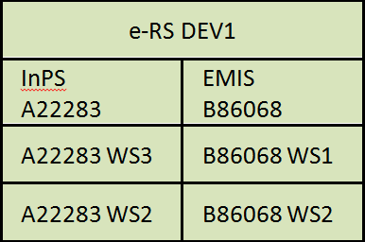

e-RS/DEV1 Path-To-Live Environment
ProApp: https://nww.dev1.ers.ncrs.nhs.uk/#/
DEV
Spine
Core & CIS
Apache httpd
EMIS
Professional
App: 80
155.231.120.150
Horizon
Client VM
eRS-API-Test1.itblab.nic.cfh.nhs.uk
Party Key:
YEU-1808939
ASID:
753468248012
DEV Spine/CIS:
Certificate & Hierarchy
Party Key:
02T-820227
ASID:
200000000138
FQDN:
eRS-API-Test1.itblab.nic.cfh.nhs.uk
Organisation:
NHST_X1 / O2T
Patient
App: 81
155.231.120.151
e-RS/DEV1
Messaging
& API: 82
https://api.dev1.ers.ncrs.nhs.uk/ers-api
10.210.162.206
NHS e-RS API Testbed
e-RS_API_Test1
155.231.129.152
PDS
TMS
10.97.89.162
InPS

