Slide 1
Building a digital NHS:
Which empowers people to manage their health and care
Welcome and introduction
Jon Hoeksma, CEO
Digital Health Network

Slide 2



Juliet Bauer
Chief Digital Officer
NHS England
Adam Lewis
Citizen ID Programme Lead
NHS Digital
Marc Heasman
NHS.UK Head of Product
NHS Digital

Slide 3
Building a digital NHS:
Which empowers people to manage their health and care
Juliet Bauer, Chief Digital Officer
NHS England

Slide 4

The challenge
We’re getting healthier, but we’re using the NHS more…
…the need for modern NHS care continues to grow
Five Year Forward View Next Steps

Slide 5

Deliver better health outcomes for patients
Reduce costs
Improve patient knowledge and control

Slide 6

Digital transformation
Empower people
Support clinicians
Integrate services
Manage the
system
Create the future

Slide 7






Empowering people – A growing family
40M people have access to free NHS WiFi
49 apps for managing healthcare
Improved content
Widening Digital Participation
GP Online Services
NHS 111 Online
WiFi
NHS.UK
Apps and Wearables
14M patients registered for GP online services
Digital Inclusion guide published
33% coverage across England
NHS APP
PHR
CITIZEN ID
DIGITAL MATERNITY
DIGITAL CHILD HEALTH

Slide 8

Integrating services into the NHS App
Empower the Person roadmap
DRAFT

Slide 9





Empower the Person priorities
A digital first NHS
From command and control to empowerment and choice
An integrated digital / physical strategy and service
Agreed and meaningful evaluation / success metrics
A fit for purpose digital funding model

Slide 10
We are getting the foundations right

Slide 11
The NHS website
Presented by Marc Heasman
NHS.UK Head of Product

Slide 12
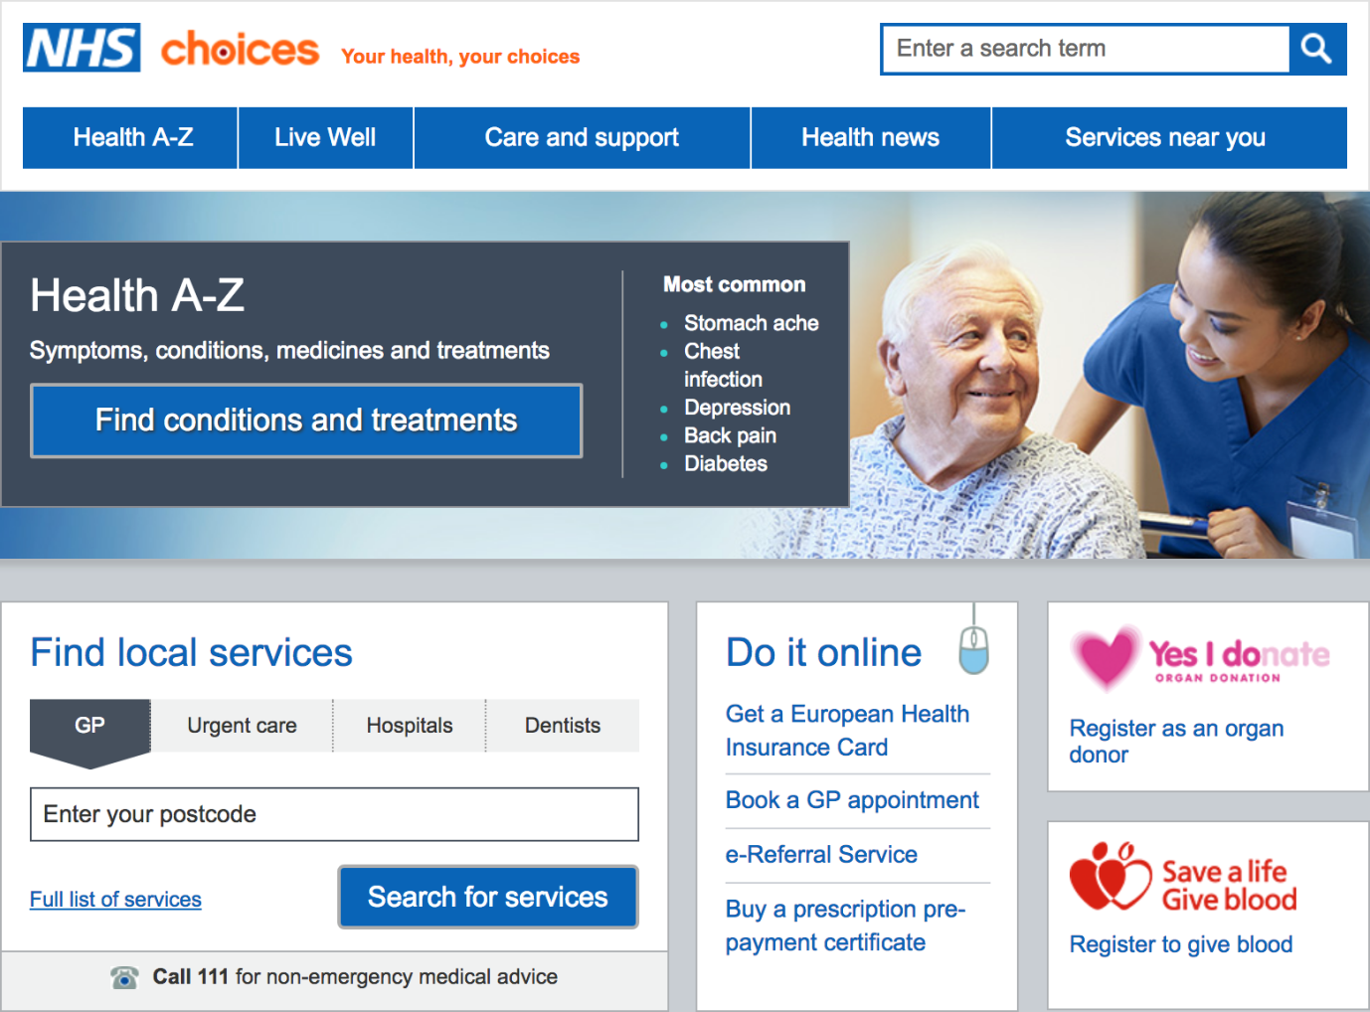
Transforming
NHS Choices
Transform from a library of content to an empowering multi-channel, digital platform
Support channel shift to digital that delivers clear benefits to patients and frontline services

Slide 13
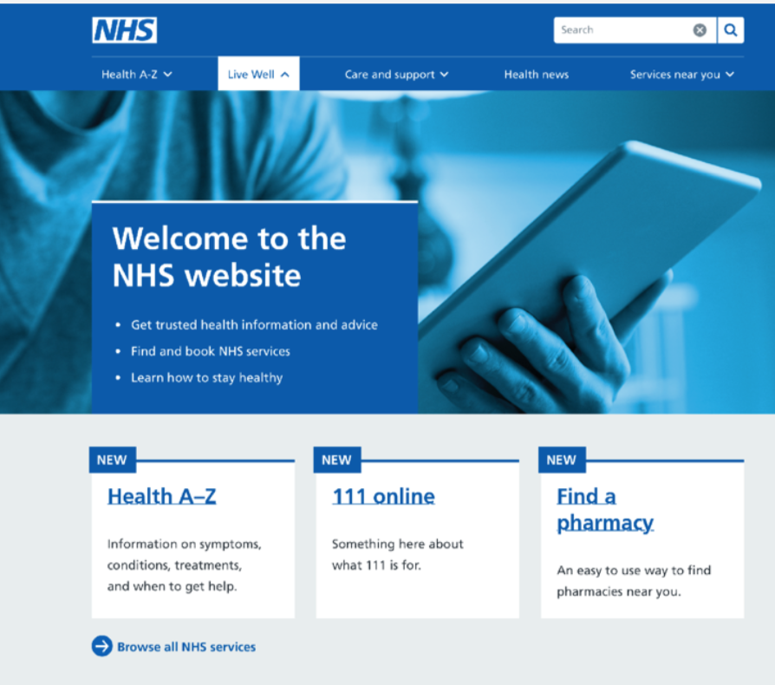
The NHS website
In September NHS Choices will become the NHS website offering better health and service information
Mobile first
More accessible
Better content
Easier to navigate

Slide 14
Creating Better Experiences: Service Pattern
NHS Website
(Contextualisation)
NHS App
(Personalisation)
Search
Content
Service
Transaction
User
journey
begins
Information
Apps, Finders, Campaigns,
Tools, Link to partners
Central or market services
CID & data access dependencies
14

Slide 15
Integrating services into the NHS App
Priority content areas – delivering impact
DRAFT
Medicines: accessible information to support prescription compliance
Diabetes: practical, educational and emotional tools for newly diagnosed adults
Mental health: improving data and digital access to services
Social care: helping people to understand their options and access services
Maternity: engaging, informing and signposting expectant parents

Slide 16
Syndication
The service which allows third party organisations to integrate our content and service information through the implementation of
APIs or widgets

Slide 17
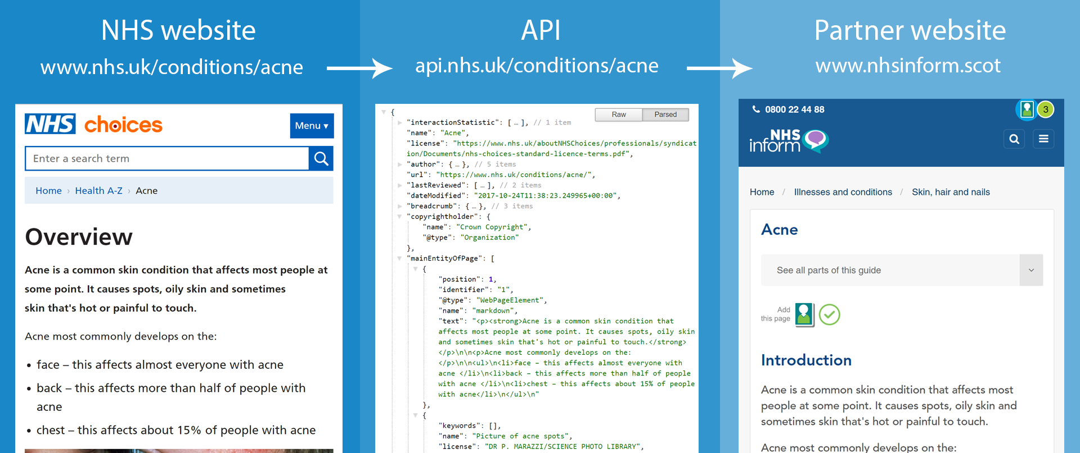
New content API

Slide 18
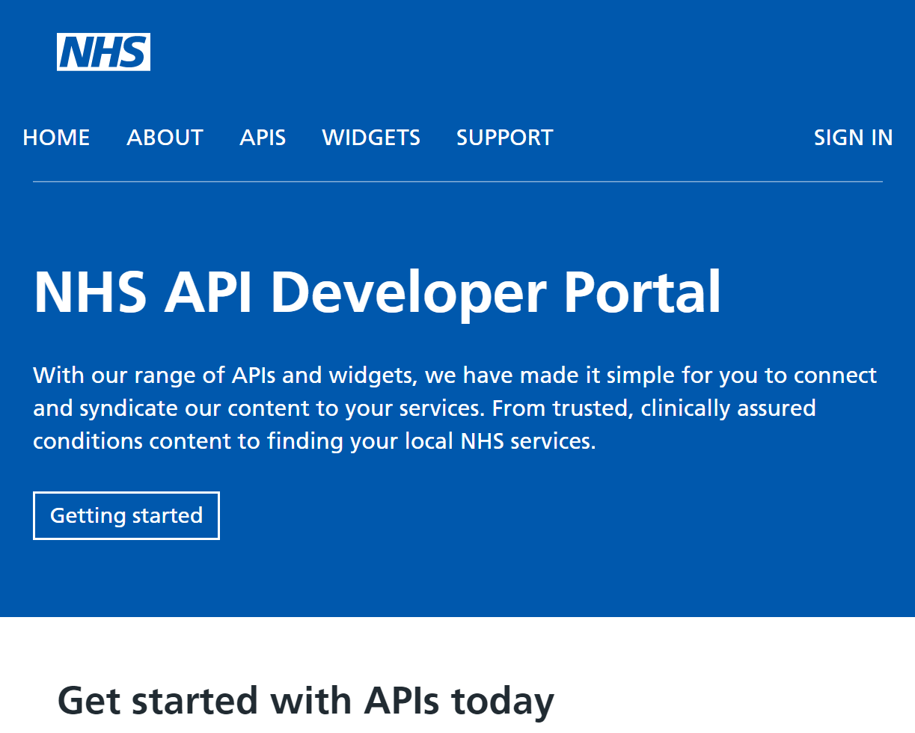
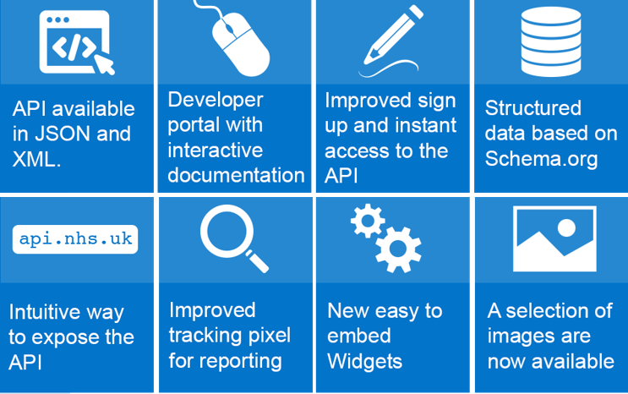
New API developer portal

Slide 19
API usage
Sign ups
Usage
Reach
500+
(Sept 17 - Jun 18)
5m+
(monthly views
excluding app usage)

Slide 20
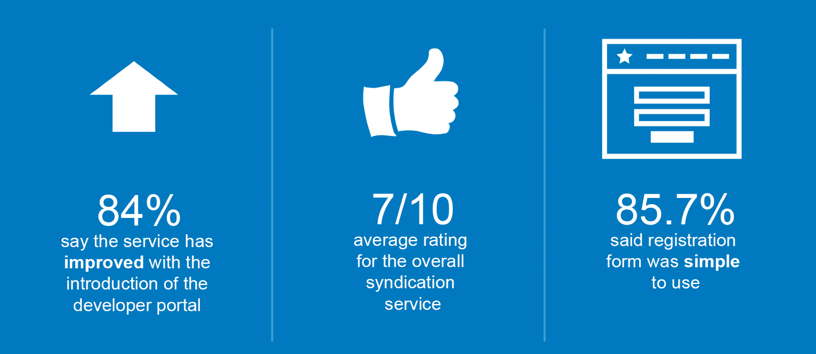
Feedback
“”
“much improved on the previous system - clean and easy to follow”
“This is honestly, the first time in 5 years of development (yep, that’s how long it’s taken to integrate through with GPs) that I can say it’s been a pleasure dealing with an NHS Organisation.”
“It’s great that we’ll be able to maintain the consistency and quality of information patients receive, providing a personalised app that incorporates the validity and reliability that NHS Choices content contains.”

Slide 21
NHS website – what it means for you
Integrate
Promote
Direct
Explore

Slide 22
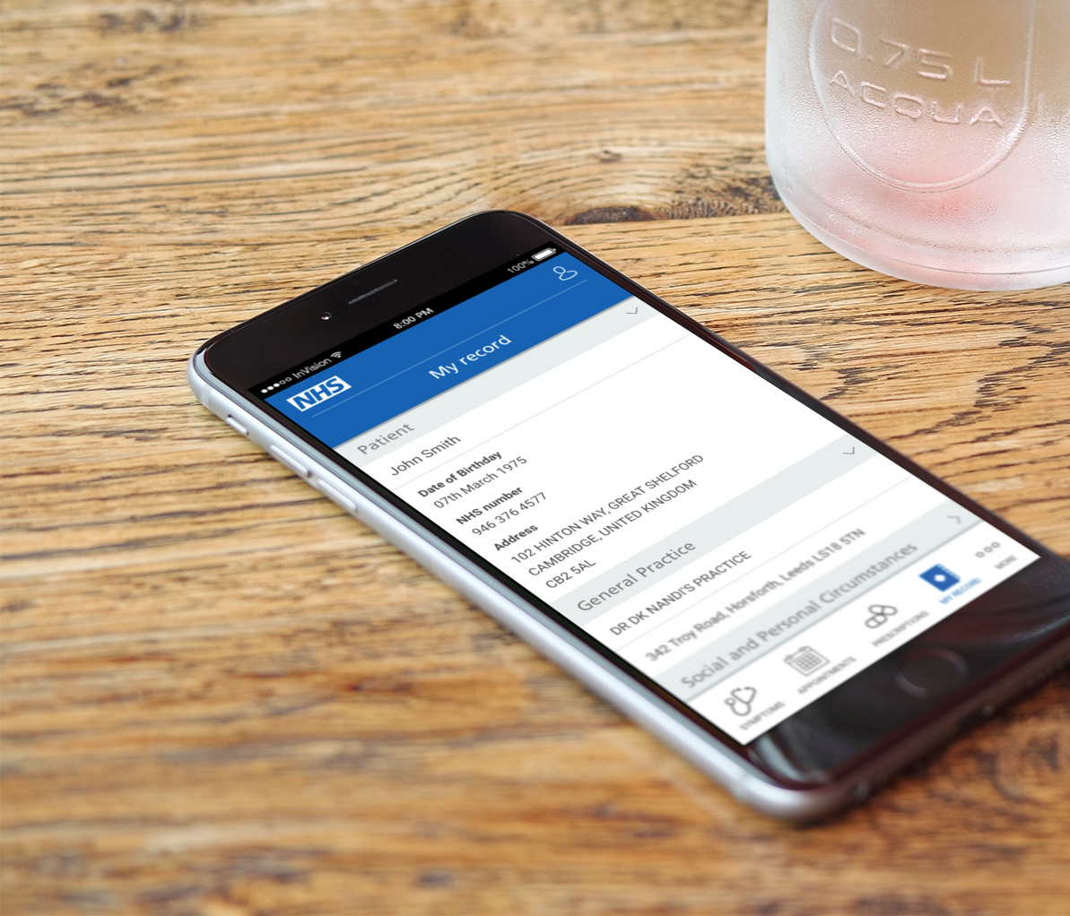
The NHS App
Provides a single point of access to:
Appointment booking, health records, NHS 111 Online and repeat prescriptions
Local digital NHS services
The NHS App

Slide 23
NHS App private beta features
Citizen ID
Symptom checking and triage
Patient record access
GP appointment booking
Integration of the service for all authentication
111 Online webpage
NHS.UK Health A-Z web page
Integration with four GP systems
Patient can view GP record
Find, book, view and cancel appointments,
Integration with four GP systems
Repeat prescriptions
National data opt out
End of life care
Organ donation preferences
View medications and order prescriptions
Integration with four GP systems
National Data Opt-out service web page, currently in private beta, in the app
Organ Donation Registration web page surfaced
Set wishes for place of care, death, religion
Details sent to GP practice

Slide 24
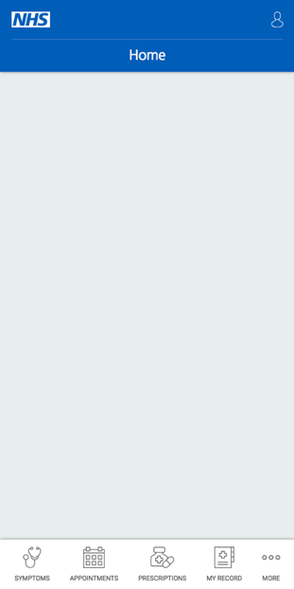
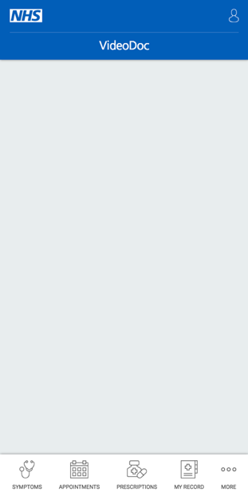
Integrating services into the NHS App
Enabling and promoting other services from the app
DRAFT
NHS App will act as a platform for other web-based services:
Creating a single point of access for mobile NHS services commissioned locally and regionally
Stimulating the open market enabling organisations to surface apps
Quick links
Appointments
Prescriptions
Other services for you
In your area
VideoDoc Leeds
Medicine Direct

Slide 25
Citizen identity
Presented by Adam Lewis
Programme Director

Slide 26
It’s time to engage
Are you delivering patient facing digital tools and services?
Do they…
contain sensitive data?
require sign on?
Then contact us – cid.phr@nhs.net
join our reference group
begin the onboarding process to access service capabilities
Our service will be available to suppliers in late 2018 - currently ~30 services at some stage in the process

Slide 27

We need to recreate this level of security, privacy and safety, online →
Trust is implicit, because it’s face to face
Clinical safety is built in as Care workers can make decisions as part of the process
The problem is it’s expensive to work this way & capacity is an issue

Slide 28
What are we delivering?
A common process for people to “sign in” to a large range of services
  This will be a completely new service, but we are working on migration path for existing Patient Online users
Where people need to prove their identity we will provide:
  An online process allowing people to get access quickly
  Supporting offline journeys with options for people who cannot complete online
In future: support for carers / power of attorney

Slide 29
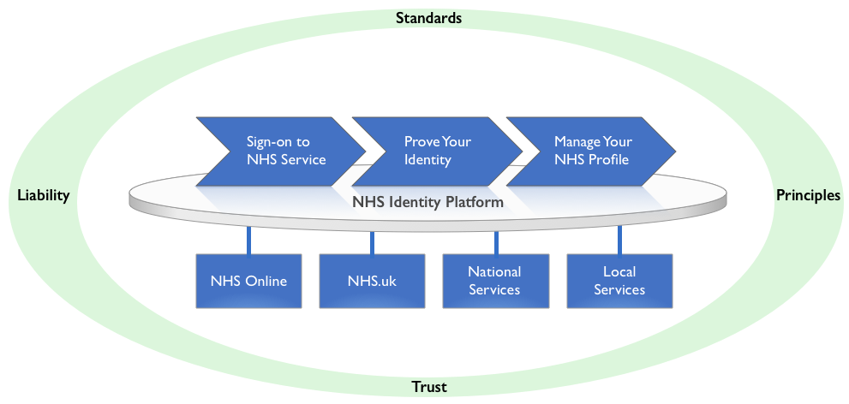
Delivery Scope
Single Identity Managed Online for the NHS

Slide 30
Key concepts
Service is consent based – we are not forcing people to use it
  people without photo ID will have to use offline journeys
NHS number used for matching patients to their records
Free at point of use for patients and NHS organisations
Authentication will be adaptive
We support working with cross government Identity – with some caveats

Slide 31
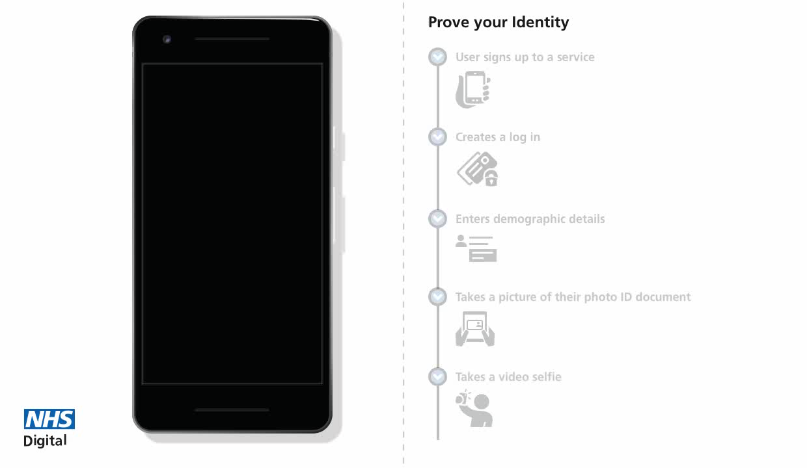
New prototype video

Slide 32
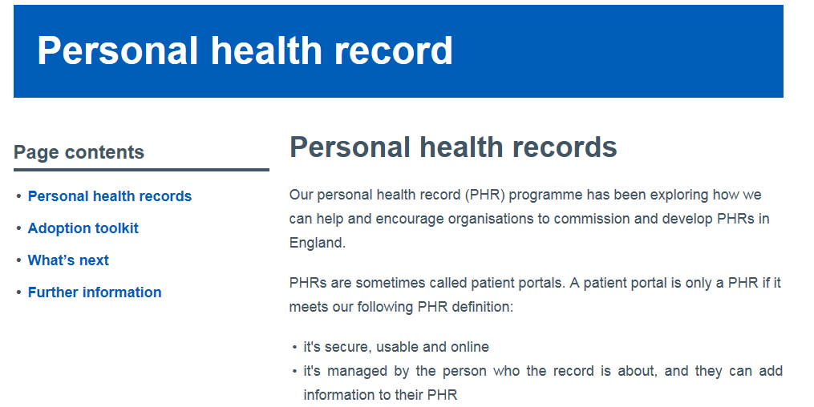
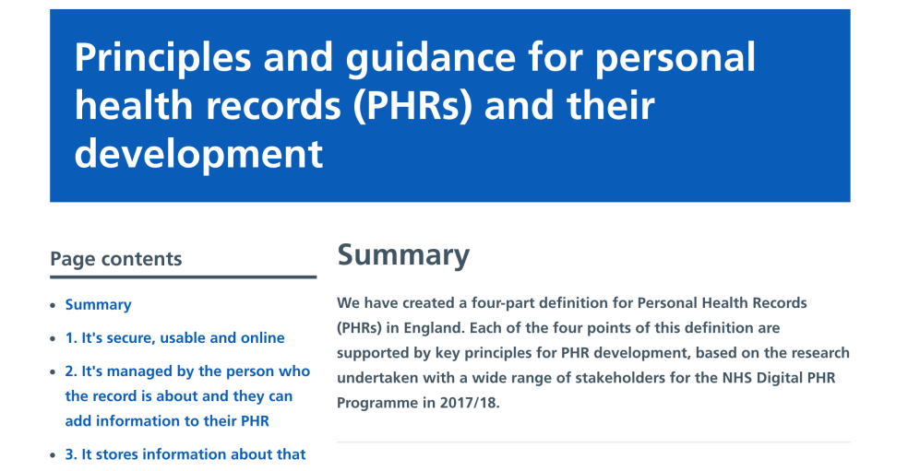
Integrating services into the NHS App
Personal Health Record
DRAFT
Principles and guidance
Standards
Adoption toolkit
Welcome feedback!
Now working with LHCRE program to enable adoption

Slide 33
Maternity Personal Health Records
Juliet Bauer, Chief Digital Officer
NHS England

Slide 34







Integrating services into the NHS App
Digital Maternity – Key projects
DRAFT
Interoperable records
Point-of-care accessible electronic maternity records, enabling consistent capture and movement of maternity information
Digital toolset
Access to unbiased, evidence based and locally specific circumstance, care plan and options information
  Digital maturity
  Create a supportive framework for growing digital maturity and capability in Maternity Services
Personal Health Records
An interface with the woman’s electronic maternity record, so that she can access her information

Slide 35
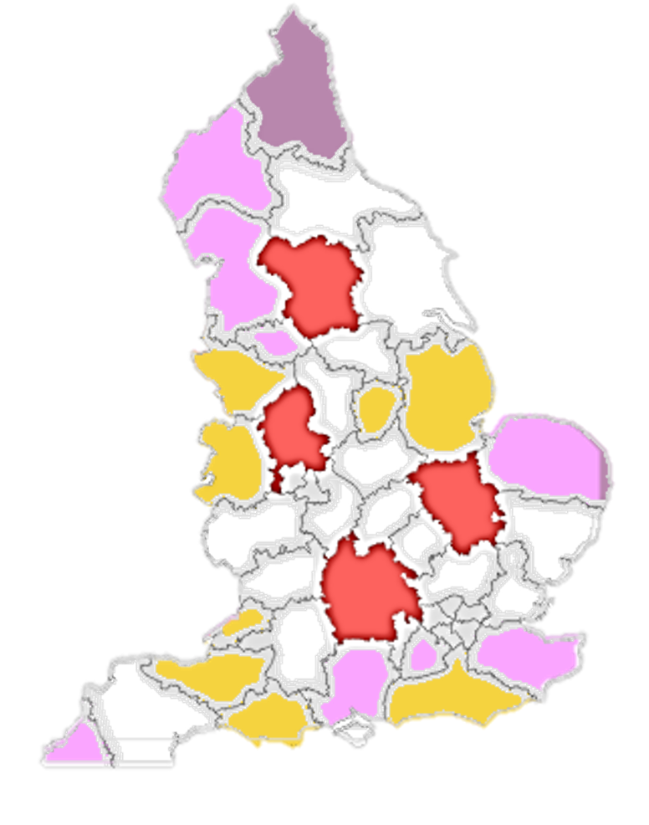
What’s next?
Personal Health Records for maternity
Maternity records that are validated by the woman and consistent across care settings
19 adoption areas
Covering up to 171,000 women
Usage risen from 0.1% to 25% of women in England who give birth

Slide 36

Getting it right
We’re working closely with users to solve real problems
We are opening up to outside expertise and developers
We’re ensuring we have excellent standards and core systems
We’re working in an open and agile way, trialling and adapting

Slide 37
Keep in touch with us
Email: england.digitalhealth@nhs.net
Online: england.nhs.uk/empoweringpeople
Blog: transformation.blog.nhs.uk

