Slide 1
Global Digital Exemplars
Blueprints for the future: how will the knowledge of GDEs be shared?
29 June 2018 12.30 – 13.30

Slide 2
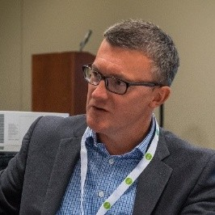

Presenters
Dr Gareth Thomas
Group Chief Clinical Information Officer, Salford Royal NHS Trust.
Consultant Intensive Care Medicine and Anaesthesia, Salford Royal NHS Trust
Paul Charnley
Director of IT and Information
NHS Wirral University Teaching Hospital

Slide 3
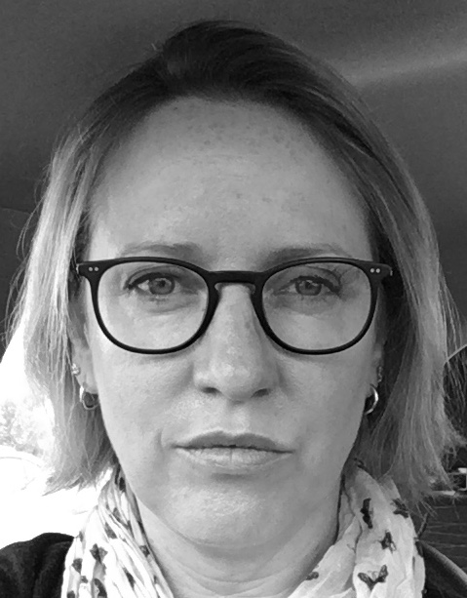
Presenters
Matthew Gardner
Senior Programme Manager
Royal Liverpool and Broadgreen University Hospitals NHS Trust
Dr Emmanuel Nsutebu
Consultant Infectious Diseases
National Clinical Advisor for Sepsis (NHS England)
Carolyn Crooks
Head of Information Management
Cambridge University Hospitals NHS FT

Slide 4
GDE Blueprinting Background & Overview
Paul Charnley & Gareth Thomas

Slide 5

Blueprinting - background
GDE blueprints are expected to help other NHS Trusts deliver digital capabilities more quickly and cost effectively than has been possible in the past
Blueprints will be live documents that drive people wanting to benefit from GDE experiences to seek further information
Each GDE will produce a number of blueprints
Blueprints will be populated over a number of years, however, they will be published as they are completed so followers benefit more quickly and do not have to wait for GDEs to finish their journeys.

Slide 6

Blueprinting - background
Blueprint methodology and framework will be publically available. Blueprint uptake is key to the spread strategy for GDEs and so they need to be compelling and high value
Blueprints will be assured by users to ensure relevance, completeness and quality
Blueprinting will be carried out over two phases – a pilot stage between Dec 2017 – April 2018 and implementation stage, which will last until the end of the programme

Slide 7

Blueprinting – Rapid access to insight
Infrastructure
Capability
Readiness
Board – Fully tech agnostic
Care setting
CCIO / CIO – Mainly tech agnostic
Care pathway
Implementation and clinical frontline teams – tech specific
Digital capability
The idea is that the final products can be viewed through a range of lenses and will offer something to different audiences.

Slide 8
Blueprinting pilots – Testing the concept
In Dec 2017 Health Catalyst and partners (PWC &Freshwater) appointed to develop a methodology and framework for developing Blueprints
In Jan 2018 Blueprinting and Learning Network Steering Group selected four GDEs as pilots to test different aspects:
  Cambridge – Bar Coded Medicines Admin (capability)
  Royal Liverpool & Broadgreen – e-Sepsis (pathway)
  Luton and Dunstable – Digital transformation in A&E (setting)
  Birmingham – Patient portals (capability, in conjunction with MH trusts)
A number of deliverables including
  Blueprint Design Strategy
  Blueprint pilot deliverables

Slide 9
Blueprinting pre-implementation plans
Week Of:
30th Apr
7th May
14th May
21st May
28th May
4th Jun
11th Jun
18th Jun
25th Jun
2nd Jul
9th Jul
16th Jul
Blueprint Pilots
CUH & RLBUH Incorporate Reviewer Feedback
UHB: Blueprint Development
UHB: Solicit and Incorporate Reviewer Input
L&D: Blueprint Development
L&D: Solicit and Incorporate Reviewer Input
Scaled Tool
Development
GDE Orientation Kick-Off Presentation & Exercises
Updated Blueprinting Framework, Collection Forms, Quality Checklist
Publication Import Design
Supplemental Project Team Training Materials
Workshops &
Stakeholder Interviews*
Identify, Schedule & Prep Stakeholder Meetings
Conduct Stakeholder Meetings
Summary of Stakeholder Findings
CIO Summer School
SG & MH Agenda Prep
SG & MH Dry Run
SG & MH Workshops
e-Health Week Prep
General Workshop
Summary of Workshop Feedback
Blueprint Identification &
Prioritisation
Develop and Test Prioritisation Survey
GDEs Complete Prioritisation Survey
Aggregate Results
Draft Prioritised Blueprint Portfolio & Schedule
Finalize Portfolio
Pre-Implementation
Planning
Strategy Documents: Incorporate SG Feedback
Strategy Documents: Incorporate Workshop Feedback
Draft Team Structure, Year 1 (Detailed) and Multi-Year (High Level) Project Plan
Finalize Team Structure, Year 1 (Detailed) and Multi-Year (High Level) Project Plan
*EHR vendor workshop TBD based on discussions with NHS leadership and EHR vendors

Slide 10
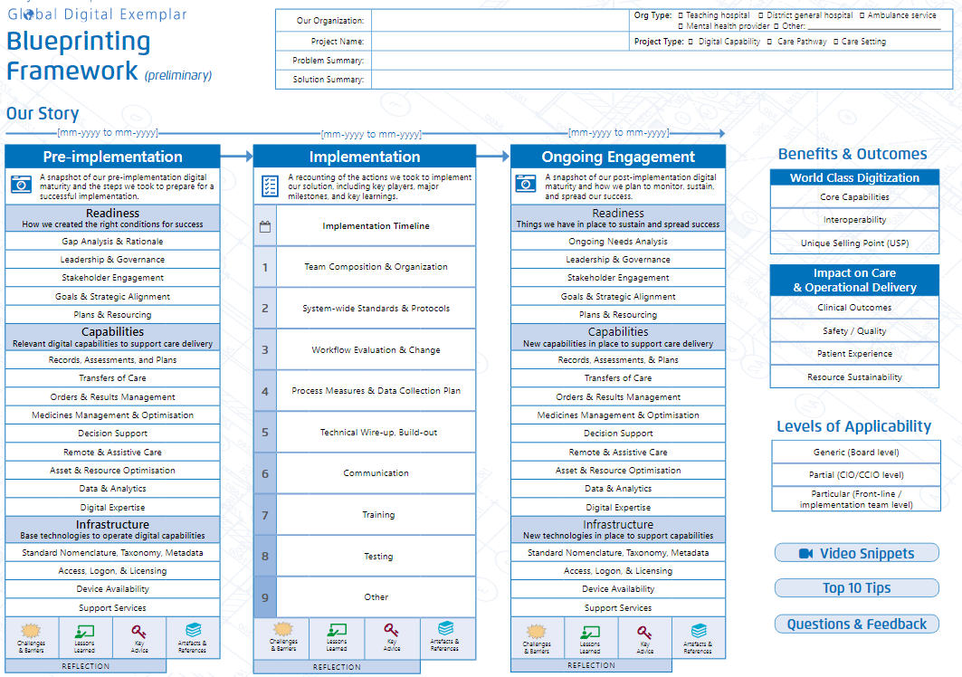
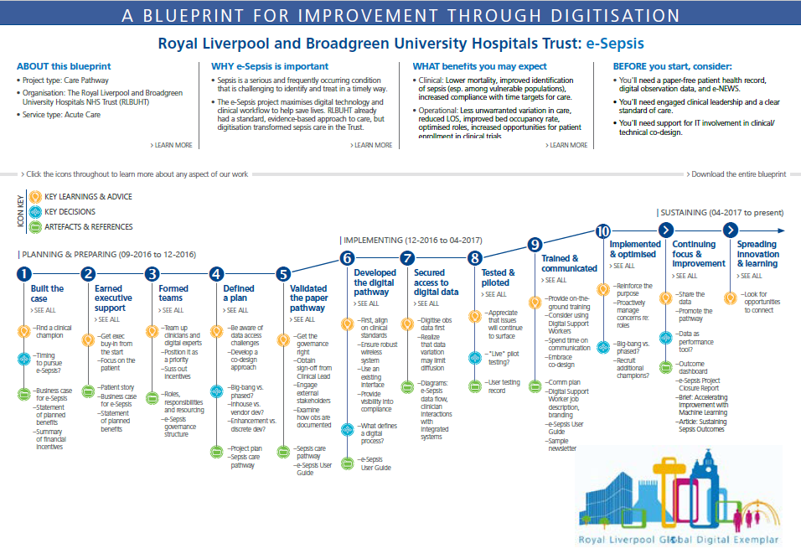
What is a Blueprint?
Key elements
Categorical information
Chronological story
Type of project
Benefits & Outcomes
Digital Capabilities, Infrastructure, Readiness

Key Decisions
Key Learnings & Advice
Artefacts
Notes:
Messages:

Slide 11
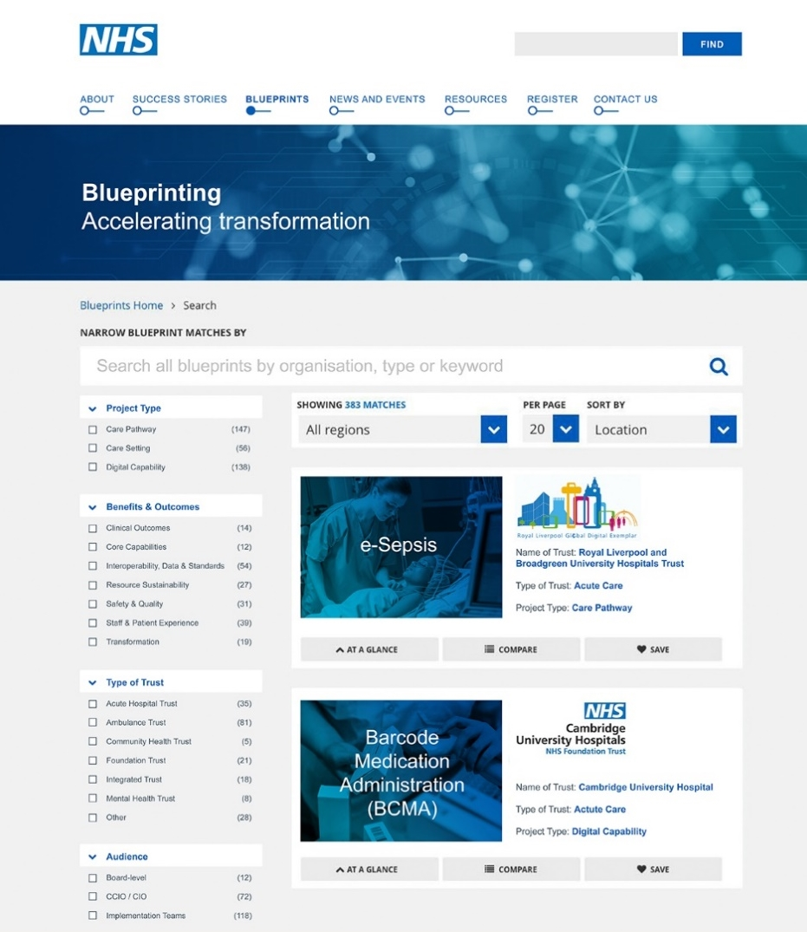
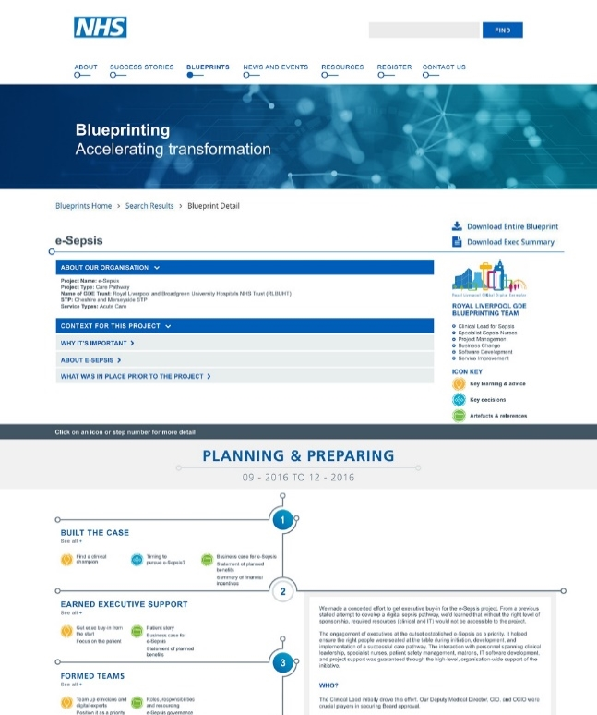
Publication portal: Potential look and feel
Filter and search for blueprints
Click to explore blueprint content

Slide 12
Determinants in prioritising Blueprints
– early thinking
Customer demand
Key stakeholders / influencers
National policy / clinical priorities
As part of this need to consider factors such as: outcomes, impact and GDE preparedness. Also work already started, mix and division of labour
Priority content
Notes:
* In the early period of Blueprint development and dissemination, it is probable that there will be limited supply for Fast Followers and aspiring trusts to choose from. However, as the BP process gathers momentum we anticipate that customer demand will dictate the most popular and ‘downloaded’ BP solutions. This, in turn, is likely to generate more content in those most popular and accessed BP areas. Alternatively, some trusts are likely to identify gaps in the market and will be keen to Blueprint and share their own solutions.
** Ensuring improved clinical outcomes and patient experience – addressing the health gap, quality gap and financial sustainability gap (FYFV). Link into key national policy areas (mental health, cancer, etc); operational and financial requirements (Planning Guidance) and major programmes (GIRFT, Rightcare, etc).
** Ensuring maximum buy in and support from very senior key stakeholders and influencers such as Sec of State, Matthew Swindells, Will Smart, Simon Eccles, etc.

Slide 13
BP Prioritization categories, weighting & responses

Slide 14
Relevance | What percentage (estimated) of patients at your trust does this blueprint relate to? | Select Option
 |  | > 90%
 |  | 75-90%
 |  | 50-74%
 |  | 25-49%
 |  | 10-24%
 |  | < 10%
 | Is the blueprint related to a current or previous national / regional priority? | Select Option
 |  | Yes
 |  | No

Slide 15
Readiness | When did the implementation on this capability occur? | Select Option
 |  | Still in process of being implemented
 |  | Implemented within last 1 year
 |  | Implemented within last 2-3 years
 |  | Implemented over 3 years ago
 | To what degree is documentation (project artefacts, charters, process flow diagrams, etc.) currently available? | Select Option
 |  | Highly available
 |  | Somewhat available
 |  | Limited available
 |  | Not available
 | To what extent are subject matter experts that supported the implementation available to help develop this blueprint? | Select Option
 |  | Highly available
 |  | Somewhat available
 |  | Limited available
 |  | Not available
 | Are GDE blueprinting team leads (overall project, business/clinical owners, etc.) already identified for this blueprint? | Select Option
 |  | Yes
 |  | Yes, but not all
 |  | No

Slide 16
Blueprinting Portfolio - Monitoring
Align & Select
Execute
Measure
Do the right things
(Suite of Capability, Setting, pathway Blueprints)
Do things right
(Build to the defined standard)
Exploit what we did
(Monitor blueprint uptake)

Slide 17
Post-pilot – next steps / prioritisation process
Potential process for Blueprint production
1
2
Prioritise Blueprint development and agree delivery plan with GDE/FF
3
5
6
7
Editorial sign off and publishing
Promoting and marketing, stakeholder engagement
Periodic refresh of Blueprints
Trusts create content with implementation support
User feedback and quality assurance
Identify desired Blueprint Portfolio
4
8
Adoption and Blueprints benefits tracking
Centre & BP SG
BP SG, ELs & Trusts
Trusts & Partner
Centre & Trusts
Centre
Centre & Trusts
Trusts
Centre & Trusts

Slide 18
Thank you.

Slide 19
Thank you.
Any questions?

Slide 20

Blueprinting
Closed Loop Barcode
Medication
Administration
@my_eHospital

Slide 21
Carolyn Crooks
Head of Information Management

Slide 22
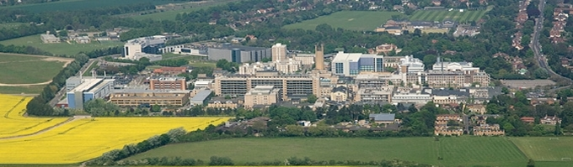
The Trust
Two hospitals – Addenbrooke’s & the Rosie
5 clinical divisions – women’s healthcare fully integrated

Slide 23
Blueprinting BCMA
December 2017: CUH agreed to be part of the GDE blueprinting pilot project.
Aim: to define the framework, methodology and publication strategy for GDE blueprints.
Scope: provide insights to shape a proposed design and subsequent process for developing blueprints.
Requirement: to provide dedicated resource involving project management, collating/authoring and subject matter expert input.
Vendor neutral, process based and not discussing the technical elements of the implementation

Slide 24







e-Prescribing including clinical decision support & medication administration chart
Patients don’t stay in hospital for longer than necessary
50% reduction in the time taken to prepare discharge medications as the EPR now integrates directly with the pharmacy robot
Computerised Physician Order Entry
96% of all medication and
instruction orders now
completed electronically
in our Epic EPR
Improved antibiotic stewardship
100% recording of the indication for antibiotic prescribing within our Epic EPR
Financial savings
£1.2 million average annual reduction in the financial gap between high-cost drug expenditure and income.
Clinical decision support
16% of allergy-related prescribing
alerts lead to a change in prescription
= 850+ significant adverse medication reactions prevented (2,450 bed days saved)
Electronic prescribing
100% reduction in sedation-related prescribing
errors in paediatrics = 50 intensive care
beds & 100 regular beds saved / year

Slide 25
Safer Medication Processes
2. Coded electronic medication database
3. Barcode Medication Administration (BCMA) & blueprinting to support other healthcare organisations
1. Fully integrated electronic patient record system including prescribing, clinical decision support & medication administration chart

Slide 26



BCMA - scanning for safety
International best practice for improving safety of medication administration
Simultaneous scanning of a patient’s barcode wristband and medication barcode
Connected to mobile / handheld devices and electronic medication administration chart in Epic EPR
Protecting patients from prescribing, dispensing and administration errors
Supports nurses in confirming five ‘rights’ of medication administration in
real time
Implemented on 18 wards
All inpatient areas by June 2018
Working towards HIMSS Stage 7
validation
Improved safety 50% reduction in medication errors

Slide 27
Planning and timing of BCMA implementation
Not implemented as part of EPR “big bang”
  Managing the rate of staff process change
  Requirement for dedicated resources
We learnt from others
  Visits to Sunderland Royal Hospital and Radboud UMC (Netherlands)
Assess the workflows and resources
  Map the ward layouts and the workflows
  Carry our hardware assessment

Slide 28
Developing a medication barcode database
Within the UK there is no national registry of barcodes for medications at this time.
For the pilot phase CUH created our own database using the First Databank (FDB) Multilex drug database
Manual EPR codes were created and matched to medication profiles for any medications not represented.
Work with the FDB was expanded post pilot to include “Chemist and Druggist” to give greater coverage

Slide 29
Most complete drug barcode database in any NHS trust
Coded medication database
dm+d compliant
Matches all prescribed orders & dispensed medications in EPR
Built in-house within the Epic EPR
55,000 barcodes
Chemist & Druggist,
First DataBank
Reporting, inter-operability
& PEPPOL standards
NHS England are forming a new national drug registry for all NHS trusts based on our methodology

Slide 30
Training – for the pilot and beyond
We created training which reinforced the CUH patient safety vision.
For Ward Staff – scan the patient, scan the medication
For Pharmacy – verify labels and medication
Our training policy developed as the programme progressed.
Train medical staff about the importance of BCMA
Utilise respected medical peers to support training
Medication inclusion and exclusion criteria became enhanced

Slide 31
Pilot phase on a single ward
Chose to pilot the programme on a paediatrics ward;
Engagement and leadership
  The ward had a Senior Sister who was motivated to drive the project forward
Staffing
  Consistent staffing, low staff turnover and low reliance on bank staff
Prescribing patterns
  Complex ward with range of prescribers
Medications and volumes
  Medications used were consistent with low volumes of drug administration

Slide 32
Implementing the pilot phase
Go live was scheduled to cause minimum disruption on the ward
“Average” Monday morning, at 11am
Dedicated trainers on the ward to answer questions
Pharmacy support available to troubleshoot medications
Support, communications and monitoring
  Individual support
  Ward team huddles
  eHospital technical huddle
  Compliance monitoring

Slide 33
Roll out across the organisation
Roll out planned according to workflow and technical capability.
Remaining areas went live in three “big bangs”
Pilot process was repeated
  Mapping of ward layout and workflows
  Support using huddles
Nurse training was adapted based on staffing factors.
Feedback mechanism developed between nursing and pharmacy staff

Slide 34
Benefits and outcomes
Clinical Outcomes
  We have a richer view into medication-related patient safety
Operational Benefits
  BCMA is cost-neutral in terms of staff time and medication costs
  Nurses satisfaction – nurses feel “safer”
  BCMA has given increased visibility into medication compliance

Slide 35
Lessons learnt from BCMA Implementation
Start with a steering group
Keep a clinical focus
Communicate your vision for patient safety
Document learning from the huddles
Group your wards by workflow
Share your data
Understand that each roll out gets easier
Recognise the limitations

Slide 36
Lessons learnt from Blueprinting
Enables reflection.
  Did we make the right decisions?
  How were those decisions made?
Encourages good project management methods.
  Document the process
  Peer review
Requires commitment to the programme.
  Dedicated resource

Slide 37
What our nurses say…
“BCMA is helping to reduce the possibility of drug errors on our ward and it’s really simple to do. Using a handheld digital device I scan the patient’s wristband which automatically brings their medication chart in Epic up on the screen. I then scan their medication and their wristband again to double-check that I am about to give the right medication to the right patient. This provides an added patient safety check and also makes me feel safer knowing that I’ve given my patients their correct medications and dose at the right time and in the right way.”
Clare O’Riordan, Staff Nurse, Care of the Elderly Ward
“Scanning of a patient’s medication and wristband together is really helping with patient safety on our ward. Nobody likes the feeling of unintentionally making a drug error and barcode medication administration significantly reduces the risk of this occurring. If you scan the wrong medications for a patient the device will sound an alert and if you take the scanned medications to the wrong patient it will again sound a warning to alert you that you have got the wrong patient.”
Hannah Nunn, Senior Sister, Paediatric Ward D2

Slide 38
Contact details:
For any questions regarding BCMA or the GDE programme at CUH, please contact:
ehospital@addenbrookes.nhs.uk

Slide 39
Thank you.

Slide 40
e-Sepsis
A digital care pathway for the citizens of Liverpool

Slide 41
Matthew Gardner
Senior Programme Manager
Dr Emmanuel Nsutebu
Consultant Infectious Diseases
National Clinical Advisor for Sepsis (NHS England)

Slide 42


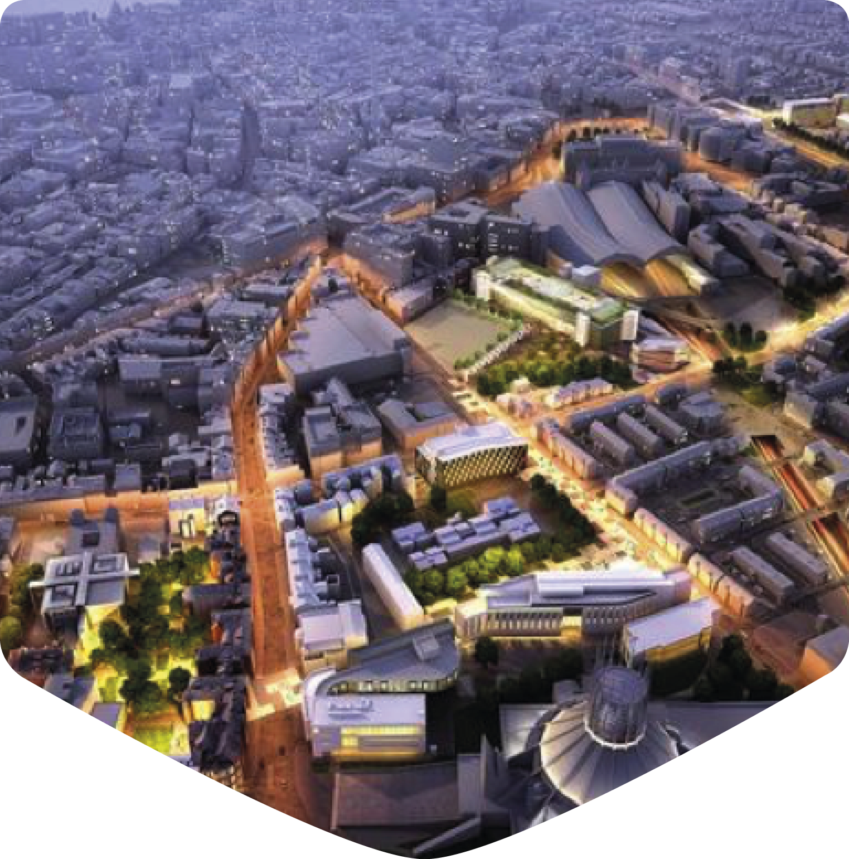




The Trust

Slide 43
e-Sepsis Blueprinting
Our journey so far
Our blueprinting journey started in December 2017 as a pilot site for the GDE Blueprinting programme.
Our focus was on the process and outcomes we followed to deliver a digital care pathway for sepsis.
Our blueprinting team was comprised of our clinical lead, specialist nurses and digital transformation experts. Co-design was key.
Digital Liverpool confirmed as pilot site for Blueprinting
Digital Liverpool Blueprinting Team Assembled
Blueprinting Data Collection
Blueprint Drafting
e-Sepsis Blueprint Peer Review
e-Sepsis Baseline
Dec
2017
Jan
2018
Feb
2018
Feb
2018
Mar
2018
Apr 2018

Slide 44
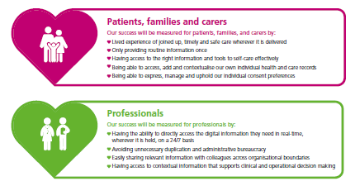
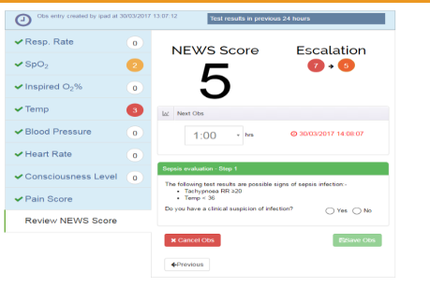
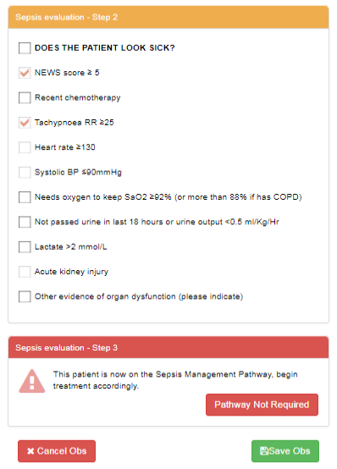
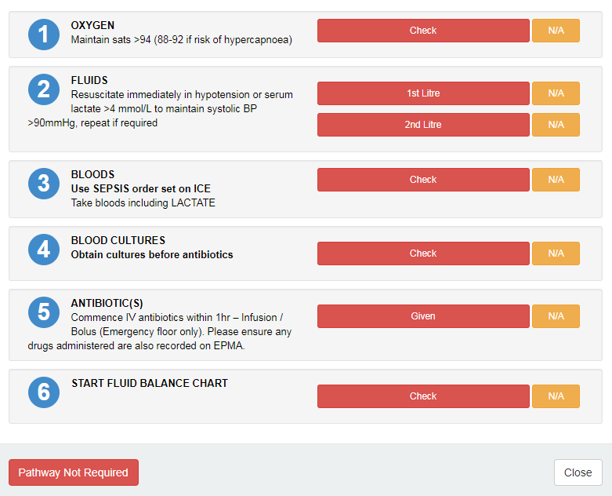
Why blueprint e-Sepsis?
Ambitions for a digital care pathway
A clinical decision support tool to increase screening for Sepsis and subsequent antibiotic administration.
An integrated digital care pathway that builds on our electronic health record.
Sepsis is a serious and frequently occurring condition but early recognition and treatment can save lives.
Our ambition was to decrease sepsis mortality rates for our patients.
The human factor: The UK Sepsis Trust estimates that 44,000 lives per year are claimed as a result of sepsis.

Slide 45


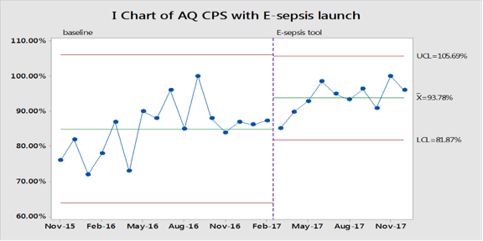
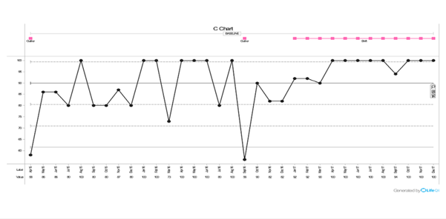
Why blueprint e-Sepsis?
Outcomes realised as a result of our digital care pathway at the point of blueprinting
2% reduction for sepsis
14% reduction for severe sepsis
11% reduction for septic shock
Delivers value:
- £300K saved through reductions in Length of Stay.
- Reductions in patient mortality (we forecast 200+ avoidable sepsis deaths)
Antibiotic prescribing <1hr in ED has increased from 65% to 85%
Reductions in patient mortality
100% of patients screened within 1 hour of hospital admittance
Since the introduction of eSepsis in 2016/17, we are seeing a reduction in mortality for severe septic shock and under 65s, a reduction in the median length of stay and increased compliance with improvement process measures (eg antibiotic administration, sepsis screening, eNEWS scores)

Slide 46
Planning and Preparing
Building the case, securing support and validating pathways
Identification of a clinical champion was key with a focus on patient outcomes. Digital care pathways like e-Sepsis are clinical not technology driven products.
Engage a diverse team of specialists at the outset – clinicians, nurses, digital SMEs, BI specialists all played an integral role in e-Sepsis system specification, design and support.
Securing executive buy-in at the start ensured focus and helped with risk mitigation for e-Sepsis (e.g. available resources to deliver and sustain change).
Ensure the conditions are “ripe” for implementation. We implemented after our electronic health record and ADT interface went live.
Engage ward managers and other senior nursing /medical staff outside the core team who can offer a different perspective.

Slide 47
Implementing
Collaborative approaches to digitisation
We identified clinical champions in each specialty carry the message (and training) to staff. We found the majority of queries were clinically rather than technology-orientated.
Devise clinical pathways and exceptions before digitisation.
Use of a pilot phase before implementation enabled us to catch and fix problems. We chose our Infectious Diseases specialty to trial e-Sepsis due to familiarity with subject-matter, digitally-receptive clinicians, and operational consistency.
Training at the point of care rather than in the class room delivered results, with 2 types of trainer – our Sepsis Nurses and Digital Support Officers (“floorwalkers”).
Reinforcing the purpose of e-Sepsis aided uptake. We branded e-Sepsis not a tool for individual compliance or corporate KPIs… but as a tool for patients.

Slide 48


Sustaining
Continuous improvement and spreading innovation
We continue to monitor e-Sepsis performance at a local and Trust-wide level. We deliver positive interventions with our central sepsis team where required.
We continue to innovate on a local level with our staff – e.g. use of text messaging to alert.
Dissemination of lessons and our experience with regional, national and international partners.
Local / Regional Roll Out
National
Sharing
International
Sharing

Slide 49

Reflective
Our reflections on the pilot blueprinting programme
^{Reflective 1}
Blueprint as you go, not only at completion.
^{Reflective 2}
Engage a multi-disciplinary team at outset. Co-design and reflection.
By July 2018
we will re-baseline the e-Sepsis blueprint
^{Reflective 3}
^{Be frank and open in a} reflective. Most found our challenges of use.
^{Reflective 4}
Engage peer reviewers earlier in the development process.

Slide 50
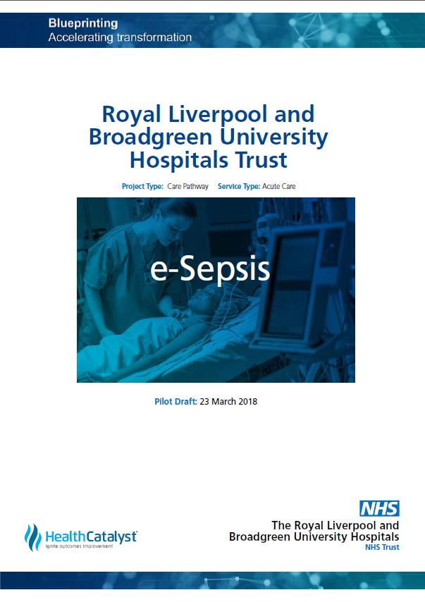
Spreading our
learning
A national blueprint for a sepsis digital care pathway…

Slide 51
Thank you.

Slide 52
Q&A SESSION
Chair: Claire Read
Contributing Editor - Digital Health

