Slide 1


Teams for NHS
COVID-19 Response
3rd April 2020

Slide 2






COVID-19
Supporting the NHS with Teams
Kate Jefferyes
Account Director, Department of Health & Social Care
Microsoft
Chris Parsons
Associate Director Solutions Assurance,
NHSmail Product Owner
NHS Digital
Chris Hawes
Digital Workplace
Intelligent Cloud & Infrastructure
Accenture
James Hornby
Senior Technical Specialist, DHSC
Microsoft
John McGhie
NHSmail Service Owner
NHS Digital
Clive Star
Chief Architect NHSmail & HSCN
NHS Digital

Slide 3

Our mission
Empower every person and every organization on the planet to achieve more
Notes:
I know it might seem like an odd place to start this webinar, but I jwanted to start with our Microsoft mission, to empower every person and every organisation on the planet to achieve more.
When we talk about empowering every person, we mean this in the broad sense. From empowering the 1 billion people on the planet with disabilities, to empowering every person that works for our NHS through collaborative, productivety and citizen developer tools. The point is that we are equally committed to helping every organisation and person through this challenging time these few slides are designed for you to take the insights we are seeing specifically rekating is Teams use and adoption and ensuring you have the right support from both your colleagues at NHS Digital as well as us at Microsoft.

Slide 4

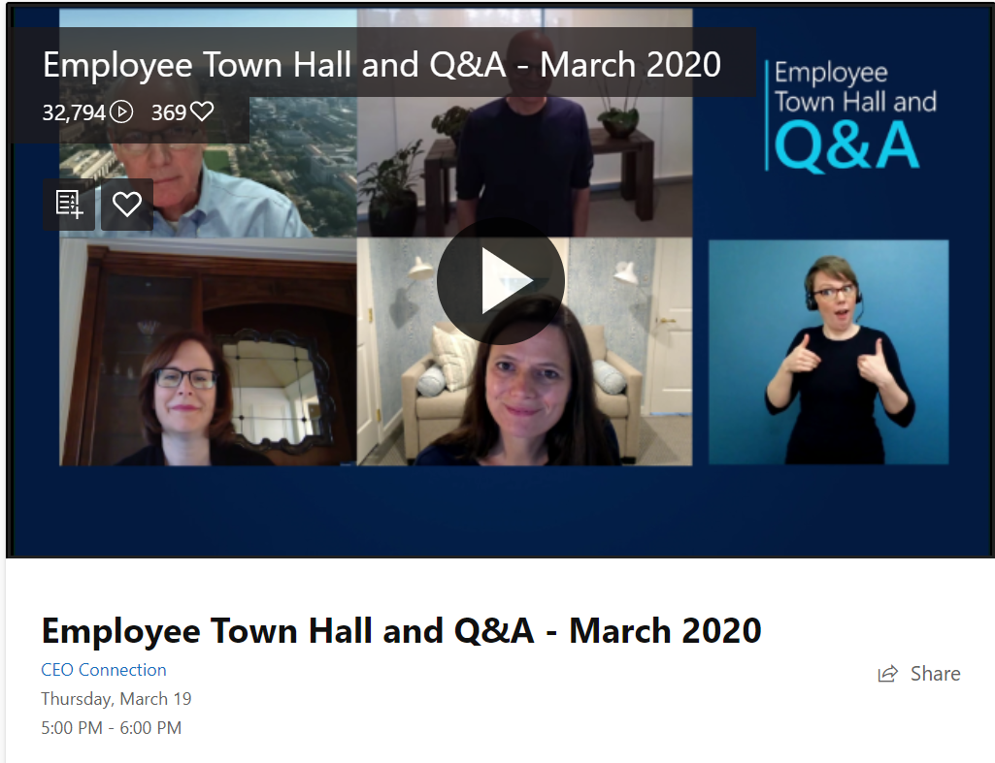
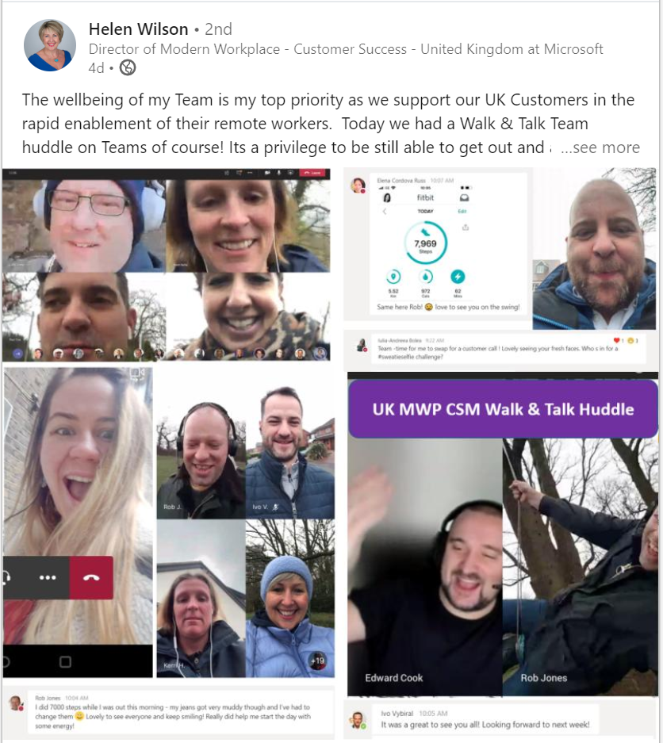
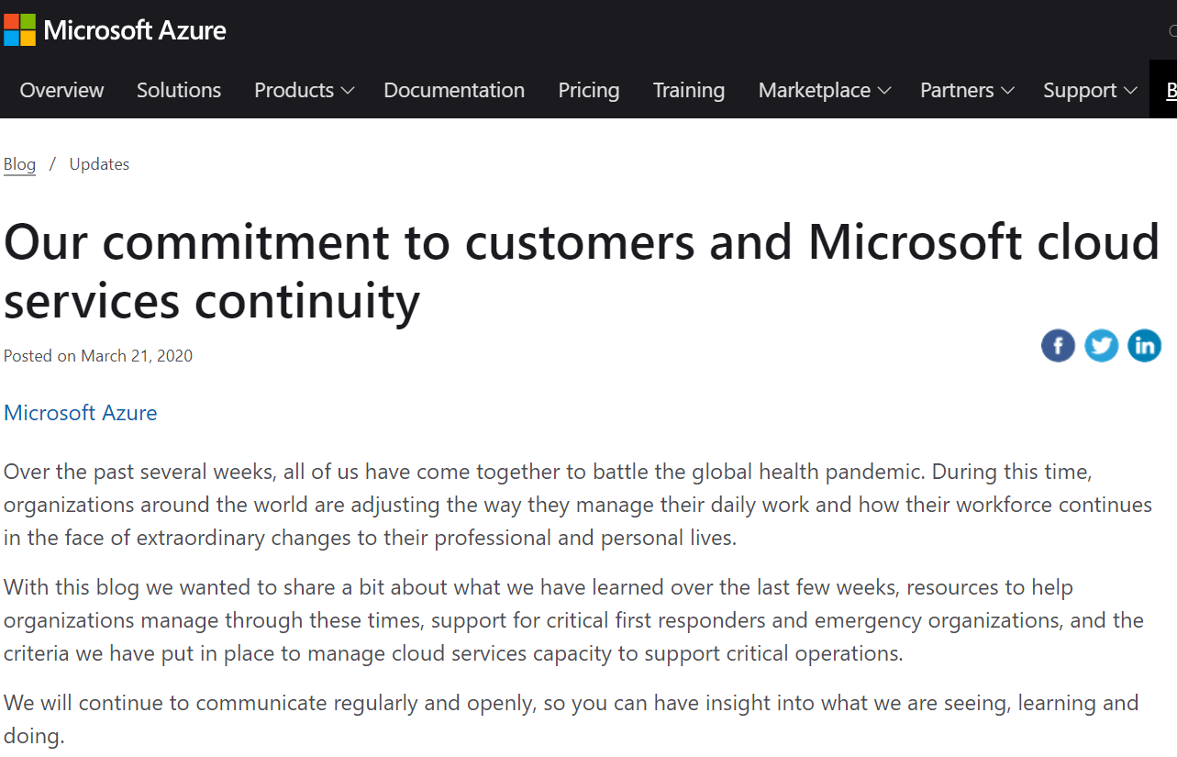
Our Mission
It is in times of great disruption and uncertainty that our ability to stay grounded in our sense of purpose and remain true to our identity is of the utmost importance.
Satya Nadella, Microsoft CEO
Notes:
If I take a step back and look at our own organisation over the past few weeks, I’ll give two reflections, Culture & Technology.
Working from home in the chaos of kids, looking after relatives and ensuring we get our work done can be a challenge. I wanted to call out a few examples of where we have seen remote/home working at it’s best:
Call out Satya’s townhall, 32k streamed in to watch. Video was on and you got to see our senior leaders in their own environment, talking frankly and openly about their own thoughts and perspectives.
Just within my own team we are running daily check-in’s, not about business – but ensuring we have human touch points – even if it is over video!
- Accessibility features in Teams, such as blur background for those who need to lip read and live transcript.
We also have a wide variety of services that MS employees can tap into about wellness and ensuring we are supporting every single person in our organisation.
The more creative ones amongst us have also dipped our tow into group personal training sessions or, my personal favourite, a virtual “Pub Quiz”.
From a TEAMS technology perspective and based on the current global situation, we have seen a massive uptake demad for all our cloud services with TEAM at the centre – just over 40 daily million users – up from 20 million daily active users in November. We’ve been working around the clock to add capacity at scale and ensure the service delivered is what our customers deserve.

Slide 5

Microsoft Global Covid-19 response - Teams
On the 5th March, Microsoft announced making Teams available to any company globally to support workers facing the global COVID-19 pandemic.
Microsoft Teams usage has increased hugely across our customer base as workers everywhere adjust to chatting, meeting, and collaborating exclusively online.
Microsoft has made a company-wide commitment to support our customers during this time.​

Slide 6
Remote consultation
Remote working
Remote Live Events
Clinical communication tools

Slide 7




CLINICAL USE
CASES
Virtual Consultations
Scheduling
Pager Replacement
VC Trolleys
Isolation Rooms
ADVANCED
MESSAGING
Read Receipts
Image Annotation
Priority Notifications
Message Delegate
Message Escalation
FRONTLINE
WORKERS
Mobile UX
Shifts
Praise
Tasks
Location
Sharing
CORE TEAMS
PLATFORM
CAPABILITIES
Meetings
Calling
Video
Chat
Apps
Extensible
Templates
Tailored Experiences
Secure and compliant Microsoft 365 (HIPAA, HITRUST, GDPR)

Slide 8





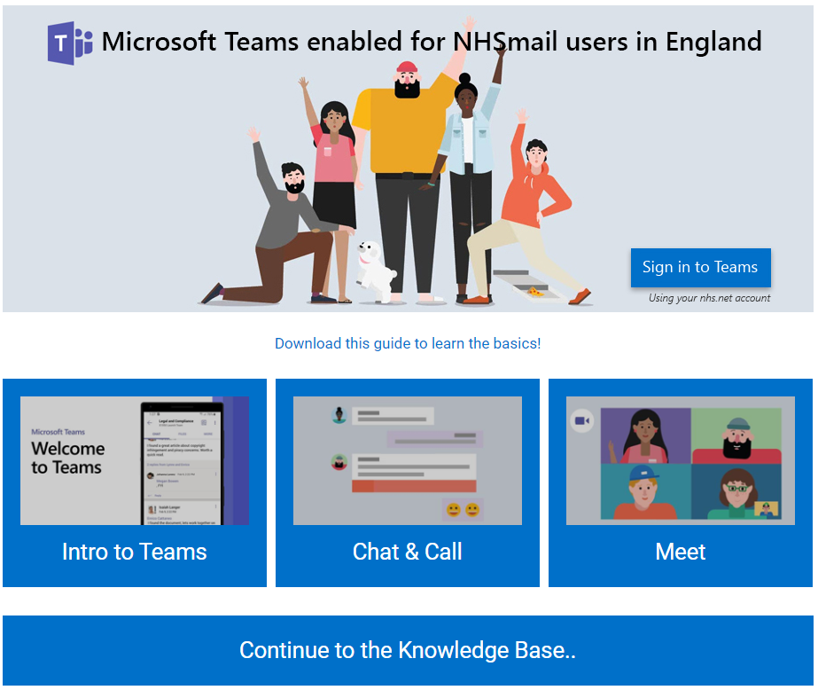
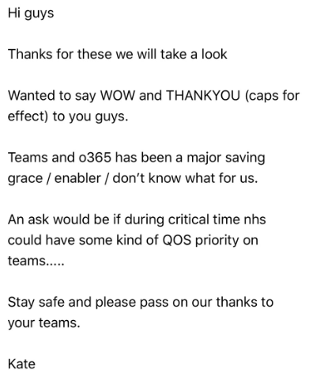
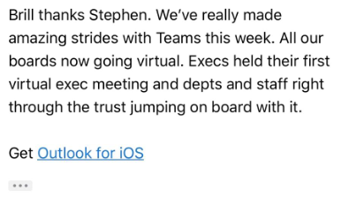
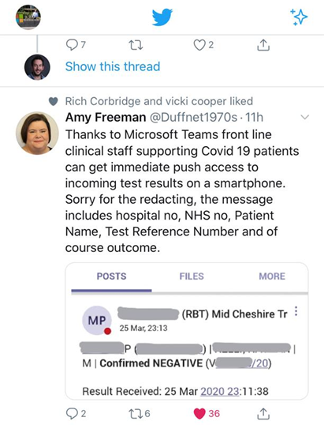
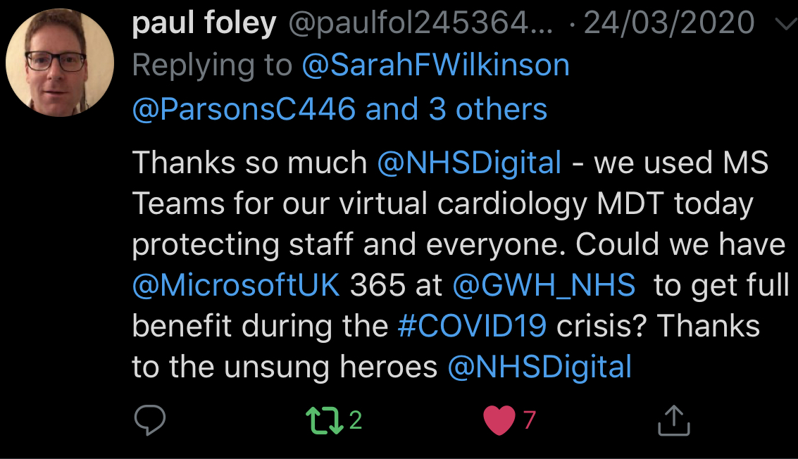


Enablement
Supporting remote
workers using Teams
Unlocking our opportunity
htts://support.nhs.net
Partner Ecosystem working together
- Regional partner training and enablement
- Working with clinicians and clinical leads at NHSX and NHSD to define clinical use cases and train accordingly
Business Applications
Modern Workplace

Slide 9
Resources – Teams and wider COVID-19
Remote working: Microsoft Teams available for free
MS Teams Success Kit has everything from IT guidance, End-user guidance, Ready-to-send Teams 101 emails and flyers, How-to guides etc.
Manage the Office 365 E1 Trial
UK Crisis Management App Webinar
Crisis Communication Power Apps Template blogpost
Practical guide for Building a Crisis Management site
Azure Bot Service: Learn more about developing intelligent, enterprise-grade bots that let you maintain control of your data.
Remote Working Advice Service: PA Consulting are offering to share expertise and assistance in adapting your processes to work with Microsoft Teams.
Helping SMBs work remotely with Teams
Staying productive while working remotely with Microsoft Teams

