Slide 1
Digital Responses to COVID-19
Ensuring safe, secure, and uninterrupted care
Wednesday, April 1st, 2020
Dr Sean Kelly MD
Chief Medical Officer, Imprivata
Daniel Johnston MRes, RN
Clinical Workflow Specialist, CSO, Imprivata

Slide 2


Customers first, especially in the time of COVID-19
Our presenters
Dr Sean Kelly MD
Chief Medical Officer, Imprivata
skelly@imprivata.com
Daniel Johnston MRes, RN
Clinical Workflow Specialist, Imprivata
djohnston@imprivata.com
@Dansjohnston
Notes:
Imprivata’s approach is Customers first, especially in the time of COVID-19
Efficiency, productivity and security are at the core of all Imprivata’s digital identity solutions, and our technology has been in the field, helping to speed care delivery for over a decade. And while Imprivata is not on the front lines, our solutions can and are being leveraged as part of the COVID-19 response.
Our foundational OneSign solution is the leading SSO technology for healthcare allowing for fast, easy and seamless access to healthcare systems. This is all about efficiency and productivity of technology that our providers need in order to be effective in dispensing healthcare. This is NO different than what Imprivata has always done, and we continue to do it.
Extended the use of our technology to our customers and market – all free of charge through end of July. This includes Confirm ID Remote Access for healthcare remote workers – all of which have been very well received by our customers. Hannah – don’t feel like you need to highlight this point as we will mention in the deck and we don’t want our presentation to some across as a special offer, this session is focused on sharing use cases and best-practices.
Further exploring more “extensions” to support our customers based on the use-cases we are seeing.
Enhancing capacity – so we can continue to serve healthcare at this time or elevated and surge need.
We are rapidly building a list of use-cases, materials and resources, that can be seen on our dedicated Covid-19 information page https://www.imprivata.co.uk/uk/covid-19 along with blogs and best-practice information.
Today we will be covering over 8 use cases from both acute and CCG settings covering single sign-on, provisioning of remote and temporary workers and telehealth and patient communications.

Slide 3
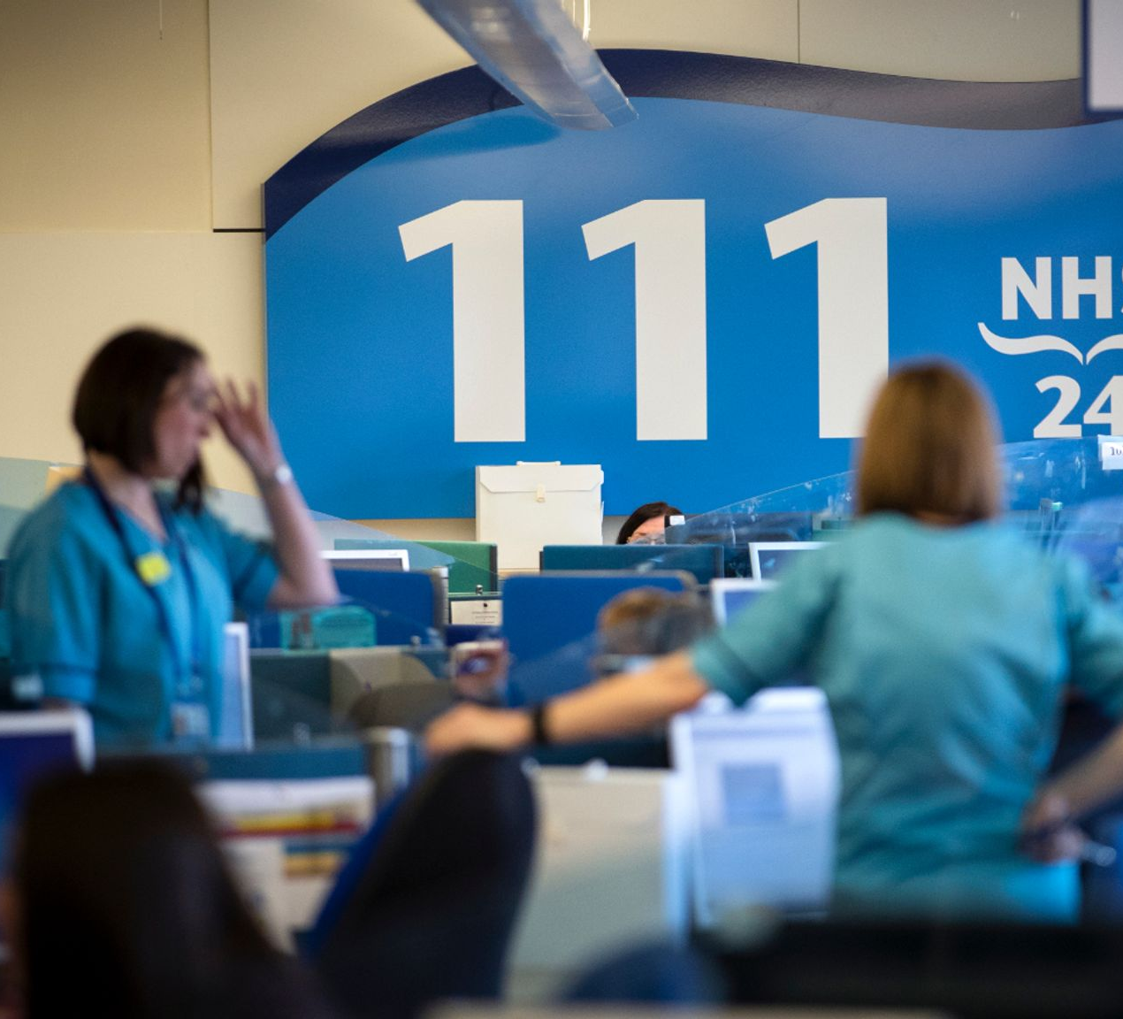
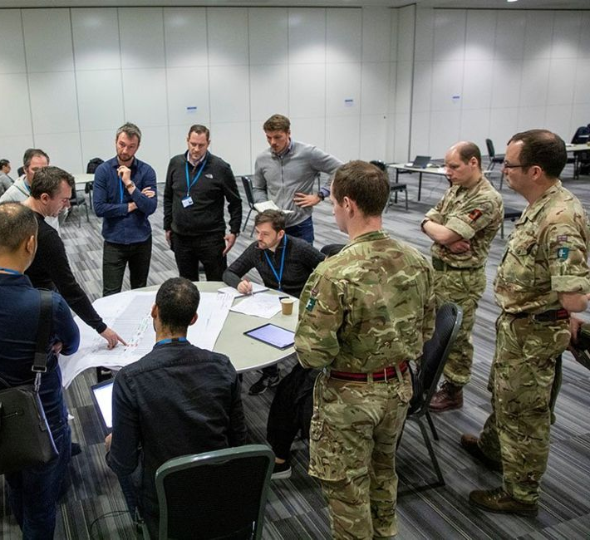
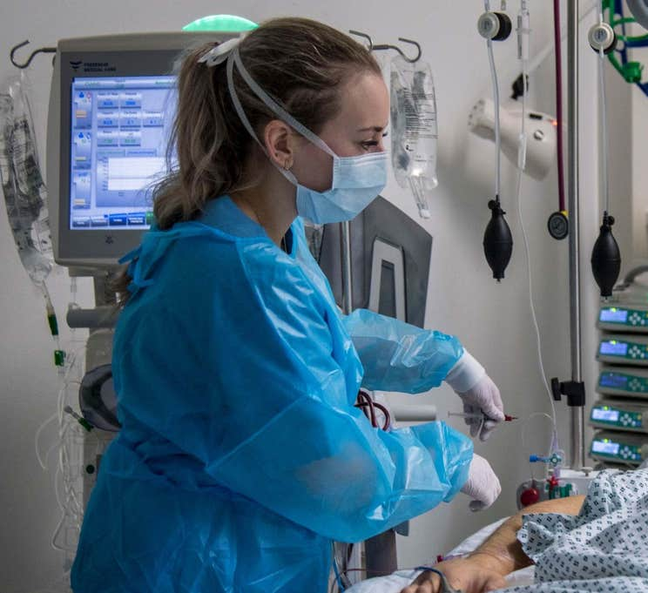
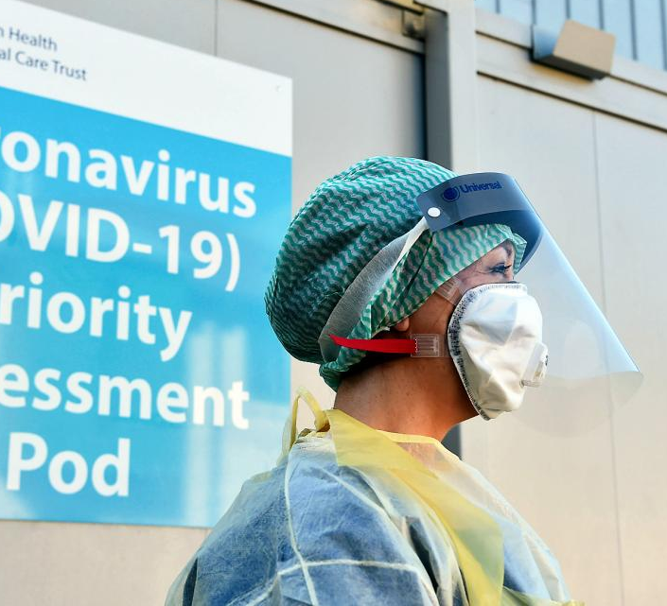

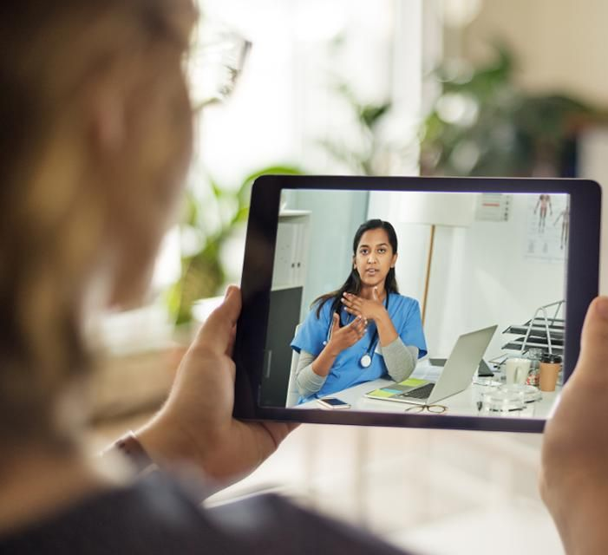
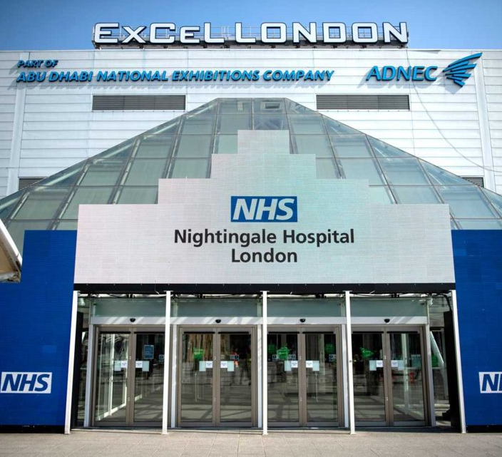
Digital Responses to COVID-19
“The NHS is mobilising like never before but the scale of this challenge has not been seen in peacetime, so we need all the support we can get.”
Ruth May
Chief Nursing Officer for England
Notes:
Acknowledge the effort and work that the NHS have been doing
Calls to the 111 service have increased by up to 400%
London Ambulance Service said it was receiving 8,000 calls a day - up 3,000 on an average "very busy" day
750,000 people sign up to join NHS volunteer army in less than a week
Letters sent to 65,000 retired doctors and nurses. More than 7500 nurses have been placed on an emergency register. About 11,000 former medics have also agreed to return to the health service and more than 24,000 final year student nurses and medics will join them
25% of NHS doctors are off work sick or in isolation
Nightingale London hospital at the excel arena will treat up to 4000 patients and was set up in a matter of days. Additional sites are being set up in Birmingham, Manchester, Cardiff & Glasgow.
Across England, hospital services have been reconfigured so that 33,000 hospital beds are available to treat further Coronavirus patients.
Pragmatic approach to tackling clinical need
Imprivata has 100+ customer we are helping with specific projects in relation to Covid-19.

Slide 4
COVID-19 response is disrupting already hypercomplex environments
Additional clinical and support staff
Clinicians with new and/or modified roles
Increased remote workforce
Remote and non-traditional treatment centers
Shared clinical mobile devices to manage dynamic nature of care
Access via personal devices to accommodate remote work
Mobile devices for patients to manage visitation restrictions
Fast-access to accommodate staff ramp-up
Temporary access to new applications and workflows based on modified roles
Introduction of new applications specifically for COVID-19
Notes:
Dan will cover the middle part
Sean to talk about the outer part (Dan to add UK colour). Talk about Covid-19 – how things are getting hyper-complex
Who is Imprivata
Imprivata identity and access management (IAM) solutions are purpose-built to meet the unique, demanding, and constantly changing security, compliance, and workflow challenges of the modern healthcare enterprise.
With Imprivata IAM solutions, healthcare organizations can strike the necessary, but often elusive, balance between security and clinical workflow efficiency across the evolving healthcare technology landscape.
Talking points about Imprivata:
75% of acute Trusts are using Imprivata solutions
Imprivata OneSign is the leading NHS enterprise single sign-on and virtual desktop access platform, enabling clinicians to spend less time with technology and more time with patients.
Over 2,200 healthcare organisations in 45 countries and over 8 million users worldwide use Imprivata solutions
In 2019, NHS customers carried out over 45 million logins using Imprivata OneSign, saving on average 45 seconds per login, that’s nearly 24,000 full days of time given back to clinicians to focus on patient care.

Slide 5
Managing and securing digital identity is as important as ever
Identity, authentication & access management is critical to onboarding, managing, and securing trusted digital identities
  Role-based access to quickly on-board clinical and support staff
  Quickly provisioning application access to accommodate staffing ramps and changing user roles
  Enabling secure access for an increasingly remote workforce
  Provisioning and securing access to shared mobile devices for clinical and patient use
  Maintaining audit trails to ensure compliance and security
Notes:
Sean to start
Dan to embellish the point and add colour

Slide 6
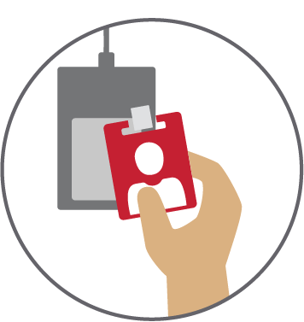

Critical Priorities
Minimise contamination
Minimise physical interaction with computers & devices
Mitigate risk
Increase Staff Efficiency
Less time on non-clinical actions
Minimise generic access for better auditing
Maximise accessibility to patient data
Reduce lengthy login times
Streamline access to applications
Notes:
Dan lead. Foundational qualities that Imp
Sean comment

Slide 7
High Impact Use Cases:
Ensuring safe, secure, and uninterrupted care

Slide 8
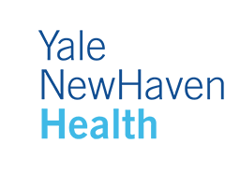
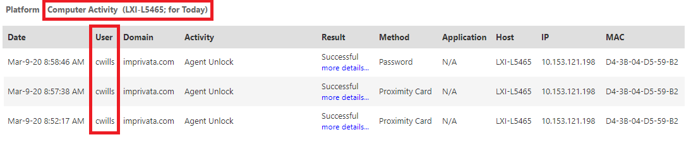
Using OneSign to help track and reduce the risk of spreading infectious disease
Login data can be analysed in real time via a Computer Activity and/or Login Activity report
Matching this data to workstation location helps Yale determine which specific users were in areas with a risk of infection (for example, did they access a workstation in a location nearby a patient with an identified infectious disease)
Yale’s clinicians tap their proximity badge to access a workstation
OneSign creates an audit record of the specific workstation, including a precise date and time
“Imprivata has been great about working with customers to use their technology to manage through the COVID-19 epidemic”
– Glynn Stanton, CISO
Details of Yale’s process are documented in an article on the Imprivata Support and Learning Center
Notes:
Sean to start, Dan to comment
Yale New Haven Health (New Haven, CT) has implemented a process for using Imprivata OneSign to help mitigate the spread of infectious disease.
Yale is using Imprivata OneSign data to identify users who had been in areas of the hospital with a potential risk of infection. They first developed this solution last year when a patient in one of their units was diagnosed with measles, and they continue to use it today.
Yale uses multiple data points (for example, staffing sheets) as a means of assessing risk, while OneSign provides the granularity to narrow down which specific users have accessed workstations in different departments. OneSign provides the precise date and time of the access, helping Yale identify users who are potentially at risk (for example, those users who accessed a workstation in a specific location of the hospital where a patient with an identified infectious disease may be).
This is accomplished by analyzing the information that OneSign collects when users tap their proximity badge to access a workstation. OneSign creates an audit record of the user’s name, the workstation they accessed, the time and date they accessed the workstation, and how long they used it for.
By matching this data to the location of the workstation, Yale is able to determine which specific users were in areas with a risk of infection, and they can take any necessary actions.
We have developed an article to document Yale’s process, which you can access through the Imprivata Support and Learning Center. We thank Yale New Haven's CISO Glynn Stanton and his team for sharing this process that we hope you find valuable in your own efforts to prevent the spread of infectious disease.

Slide 9
Using OneSign to comply with mandatory temperature checks for clinical staff
Hospital requires staff to self-check and record their temperature twice per day to monitor for potential symptoms of COVID-19
Managed through a Web application developed in-house
Working with Imprivata to enable SSO into their application via Imprivata OneSign
Allows for ease-of-use for providers and supports real-time auditing to track compliance
Notes:
Sean to start, Dan to comment
Yale New Haven Health is also using Imprivata to support a second workflow developed in response to COVID-19
Yale is requiring users to self-check and record their temperature twice each day to monitor for symptoms of COVID-19
Yale is developing a home-grown Web app to support this workflow, and they want to ensure it is as easy as possible for users
Yale is working with Imprivata to integrate OneSign to allow users to tap into a workstation then SSO into their application
The intent is to ensure the workflow is fast and easy for users
Imprivata OneSign will also provide audit data to help Yale track compliance with this policy
This workflow and policy initiated with Yale’s clinical team, who internally reached out to Yale’s IT department specifically asking if Imprivata could support the new workflow
Demonstrating confidence and trust customers have in Imprivata, Yale’s CISO Glynn Stanton connected the clinical team with Imprivata and responded with, “Imprivata has been great about working with customers to ensure their technology to manage through the COVID-19 epidemic.”

Slide 10
Using OneSign to support contained environments in COVID-19 treatment centers
Scandinavian healthcare organisation is building centres throughout its hospitals to treat patients with COVID-19
These environments will aim to reduce the risk of clinicians contracting COVID-19 when treating infected patients
Card readers were identified as a potential infection risk as cards could be left in machines in close proximity to patients and then carried off the ward with the clinician potentially spreading infection
Part of this approach is to enable proximity badge tap access via Imprivata OneSign
Imprivata worked with hospital to ensure fast-tracked shipment of additional proximity readers to support this effort
“…appreciate the time and effort Imprivata has put into this delivery.”
Notes:
Dan to lead on this slide
Region Nordjylland (Region N) in Denmark plans to use Imprivata OneSign to support a “minimal contact” environment in its newly established pandemic treatment centres throughout its hospitals
This is a newer OneSign customer that purchased 13,400 OneSign licenses, but only a few hundred proximity badge readers initially as they phase the rollout
However, the COVID-19 pandemic has accelerated the need for readers to support pandemic treatment centres that Region N is building through its hospitals
They aim to create a “minimal touch” environment to reduce risk of providers contracting COVID-19 when treating infected patients
Imprivata fast-tracked a shipment of MFR-75 card readers to the customer to help them scale quickly
Card readers were identified as a potential infection risk as cards could be left in machines in close proximity to patients and then carried off the ward with the clinician potentially spreading infection

Slide 11
High Impact Use Cases:
Secure access for an increased remote workforce

Slide 12

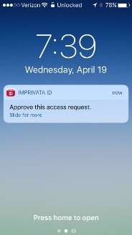
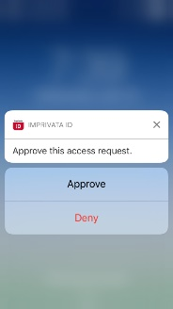

Using Confirm ID to enable secure access for an increased remote workforce
Children’s Hospital of the King’s Daughters, Virginia, USA (like many healthcare organisations) is experiencing an increase in remote workers
These users need remote network access
Imprivata Confirm ID helps CHKD and other customers secure this remote access
Multifactor authentication increases security and safeguards against unauthorised access
“Thank you for being a good partner and we appreciate this very much!”
– Deborah Barnes, CIO
Imprivata is offering Confirm ID licenses at no cost to provide secure access for increased remote workforce
Notes:
Sean to lead
Boston Medical Center, like many organizations in all industries, has experienced a rapid increase in its remote workforce to support social distancing in response to COVID-19
This requires IT to quickly deliver remote network access for a greater number of remote workers. This access still needs to be secure, particularly as hackers are taking advantage of the COVID-19 pandemic through targeted phishing attacks and similar scams (BBC article here: https://www.bbc.co.uk/news/technology-51838468)
BMC and other customer are delivering this secure remote access with Imprivata Confirm ID. Enforcing multifactor authentication increases security and secures remote network access
To support customers as they manage this rapid and unplanned increase in remote workforce, Imprivata is offering customers licenses of Confirm ID for Remote Access to all users at no cost

Slide 13

Using Confirm ID to enable secure access for an increased remote workforce
NHS Clinical Commissioning Group in the Midlands needed to increase the number of staff working remotely
These users need remote network access
Imprivata Confirm ID helps them, and other customers secure this remote access
Multifactor authentication can be enabled for users without them having to attend in person to collect a token
Imprivata is offering Confirm ID licenses at no cost to provide secure access for increased remote workforce
Notes:
Dan to lead
Dan to add talking points
----------------------------------
From Imprivata blog: Slow login times are the main frustration of NHS staff with clinicians battling as many as 15 different systems and GPs reporting as much as 17 minutes to login into their PCs – the equivalent of almost two appointments

Slide 14
High Impact Use Cases:
Rapid workforce induction

Slide 15
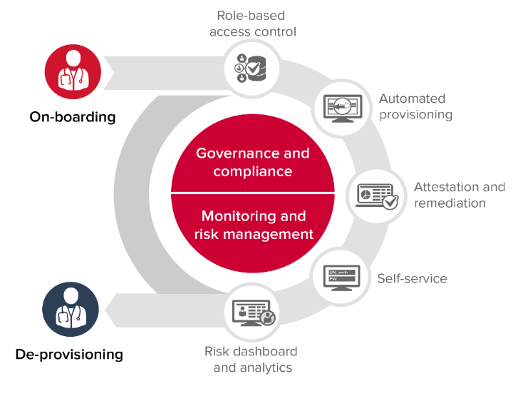
Using Identity Governance to quickly provision and de-provision access during staff ramp-up/down
Organisations are ramping up clinical and support staff to help manage COVID-19 response
These users need to be on-boarded quickly and given access to the necessary applications
Customers are using Imprivata Identity Governance to provide this access, including to enable a remote workforce
This includes using IdG's bulk feed to quickly provision access for critical apps that normally would require approval workflows, without losing audit trail
Gives users fast access without compromising security or auditing
Customers are then able to quickly de-provision remote network access for users who no longer need it
Notes:
UK specific notes:
Letters sent to 65,000 retired doctors and nurses.
More than 7500 nurses have been placed on an emergency register.
About 11,000 former medics have also agreed to return to the health service and more than 24,000 final year student nurses and medics will join them
25% of NHS doctors are off work sick or in isolation

Slide 16
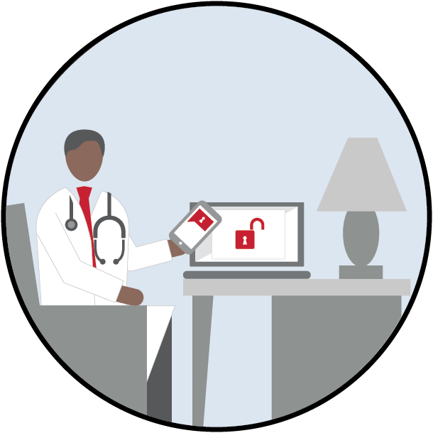

Using Identity Governance to quickly provision access to Skype for remote users
Increased remote workforce, including telehealth and non-clinical staff
Remote users need access to Skype for communication and collaboration
Identity Governance helped provision Skype access for ~400 users in less than one hour
Notes:
Using IDG to up-staff
Quickly provision to tele-health. Quickly provisioned for Skype for tele-health
Can we use Virtua?

Slide 17
High Impact Use Cases:
Enabling telehealth and patient communications

Slide 18



Using GroundControl to manage patient iPads to facilitate visitation restrictions
University of Rochester Medical Center has put in-person visitation restrictions in place to limit the risk of spreading COVID-19
URMC is planning to give iPads to patients to communicate with would-be visitors
These iPads would be shared, and therefore need to be configured and returned to a “ready state” for the next patient
URMC working with Imprivata to implement GroundControl to manage this process
“I see GroundControl as essential to an effort like this!”
– Jeremiah Green, systems management
Notes:
The University of Rochester Medical Center has put restrictions in place for hospital visitation, in an effort to reduce the risk of spreading infectious disease
URMC is considering providing iPads to patients so they can communicate with would-be visitors
These would be shared iPads, so URMC needs a way to provision, configure, wipe-clean, and reset the devices back to a “ready state” for the next patient to use
URMC asking Imprivata to work on implementing GroundControl to manage these devices
Jeremiah Green, systems management, says “I see GroundControl as essential to an effort like this.”
Also use this side to talk about the use case at CHA MSFT

Slide 19


Using GroundControl to manage in-patient iPads for telehealth in isolation wards
West Coast health care providers are restricting physical contact with Covid-19 patients to reduce exposure to the virus
Organisations are planning to give iPads to patients to communicate with clinical staff when telehealth check-ins are appropriate
These iPads would be shared, and therefore need to be configured and returned to a “ready state” for the next patient
Several organisations are working with Imprivata to implement GroundControl to manage this process
Notes:
Dan to speak to this
Shortage of PPE
CHA MSFT - Not just ios – android zebra
Also use this side to talk about the use case at CHA MSFT

Slide 20
High Impact Use Cases:
Ensuring continuity of secure and uninterrupted care in temporary locations

Slide 21
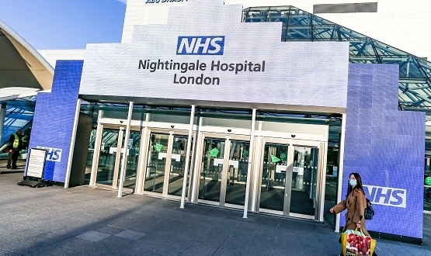
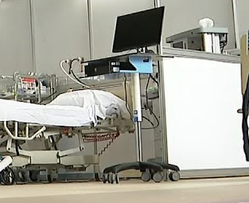
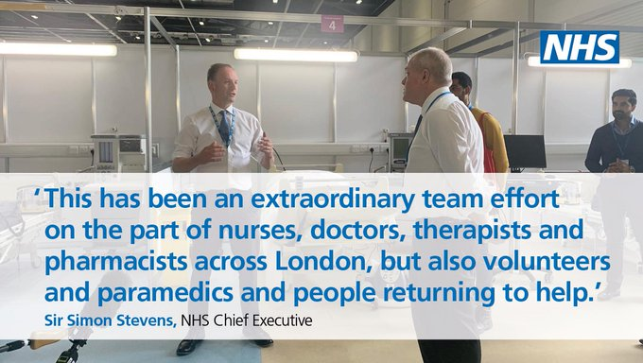
Nightingale Hospital London
Support NHS Trust mobilising Nightingale Hospital London
Update existing infrastructure to support the new 4000+ bed hospital
“Informatics team installed network, wifi, 1000’s of PCs…and Cerner e-health record. Fully integrated with 5 other Barts Health hospitals and existing patient data (+ local GPs)”
Provide VDI solution for EMR and application access at new site at ExCel
Notes:
Dan to lead
New quote on this slide is from a tweet by David van Heel, CCIO at Barts Health
https://twitter.com/dvh13?ref_src=twsrc%5Etfw%7Ctwcamp%5Etweetembed%7Ctwterm%5E1244730705235582980&ref_url=https%3A%2F%2Fwww.digitalhealth.net%2F2020%2F03%2Fbarts-extends-cerner-epr-to-nhs-nightingale-hospital%2F
Mention clinical assessment offering

Slide 22
Critical Priorities
Minimise contamination
Minimise physical interaction with computers & devices
Mitigate risk
Increase Staff Efficiency
Less time on non-clinical actions
Minimise generic access for better auditing
Maximise accessibility to patient data
Reduce lengthy login times
Streamline access to applications
Notes:
Dan lead. Foundational qualities that Imp
Sean comment

Slide 23
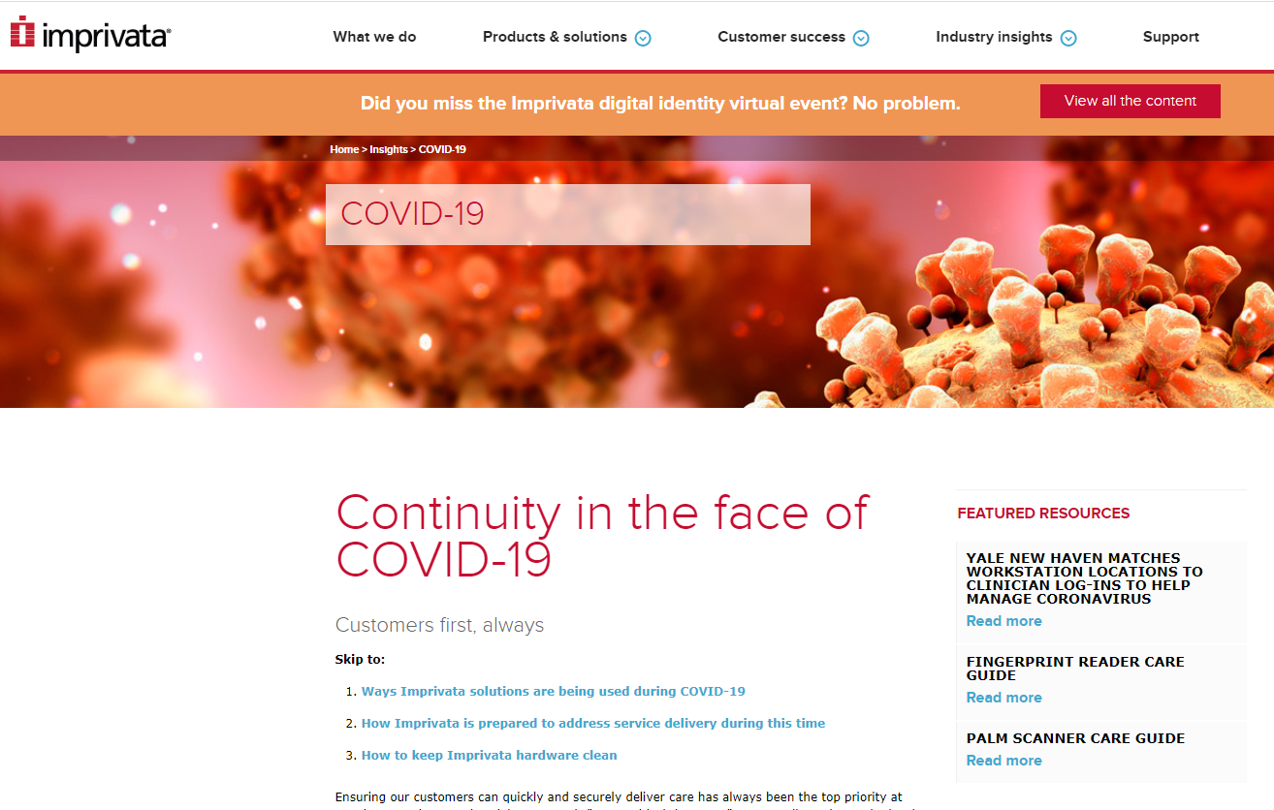
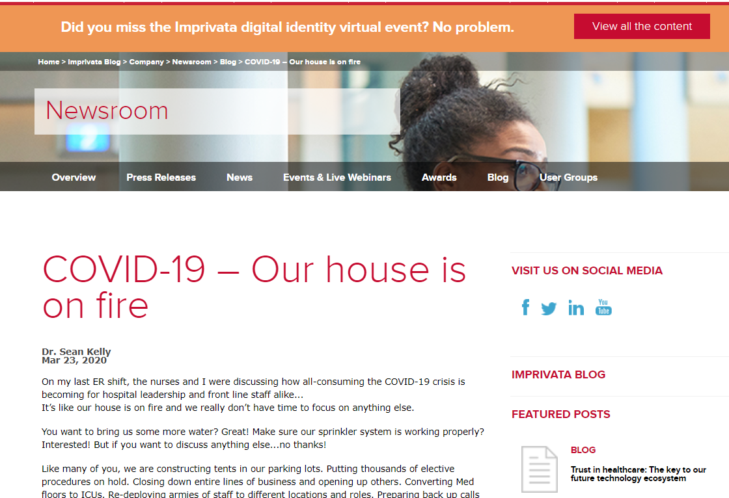
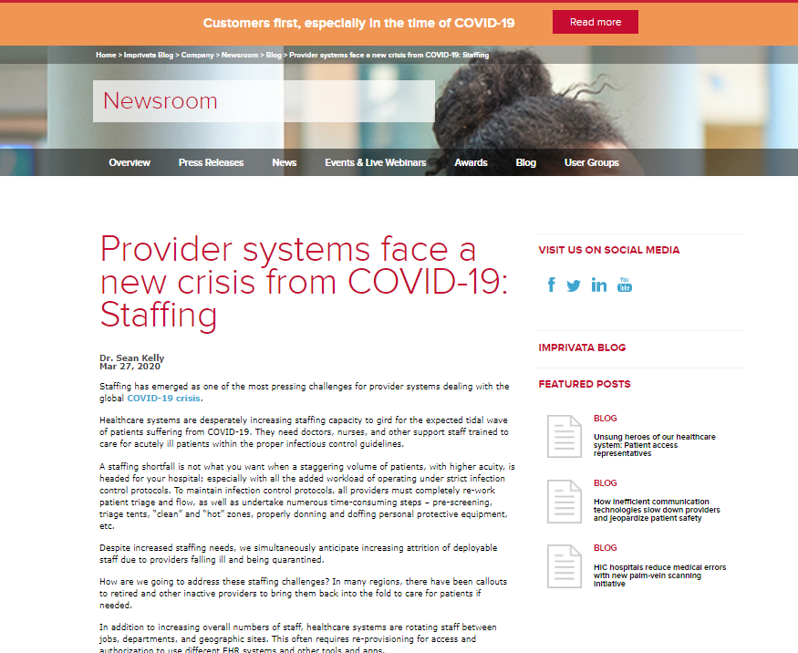
Customers first, especially in the time of COVID-19
https://www.imprivata.co.uk/uk/covid-19
Dr Sean Kelly MD
Chief Medical Officer, Imprivata
skelly@imprivata.com
Daniel Johnston Mres, RN
Clinical Workflow Specialist, Imprivata
djohnston@imprivata.com
@Dansjohnston
Notes:
Mention what they can find on the website
Use case content
Details of offerings available from Imprivata
Blogs
Further webinars
Hardware cleaning guides

