Slide 1
Simon Eclles, NHSX CCIO NHSX Briefing and Q&A: Digital Responses to Covid-19 24 March, 2020
Chair: Jon Hoeksma, Digital Health

Slide 2
Digital Health & Covid-19 www.digitalhealth.net
Daily Covid-19 News including live blog https://www.digitalhealth.net/live-covid-19/
Weekly Digital Responses to Covid-19 Webinars – each Friday @ 12.30
Weekly Networks Digital Responses to Cobid-19 Q&A and briefing – 24 March @ 12.30 with Dr Simon Eccles
Discussion and sharing on Discourse https://discourse.digitalhealth.net/

Slide 4
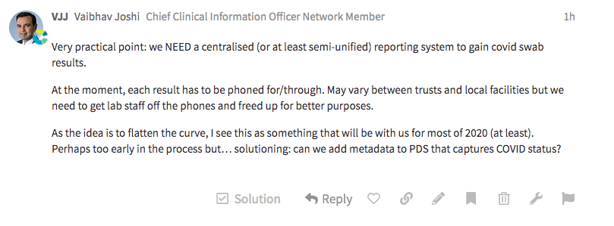
Need – need a centralised reporting system to gain Covid-19 swab results

Slide 5
Question – how are we tracking patients nationally who have Covid-19
Challenge – linking up local trackers

Slide 6
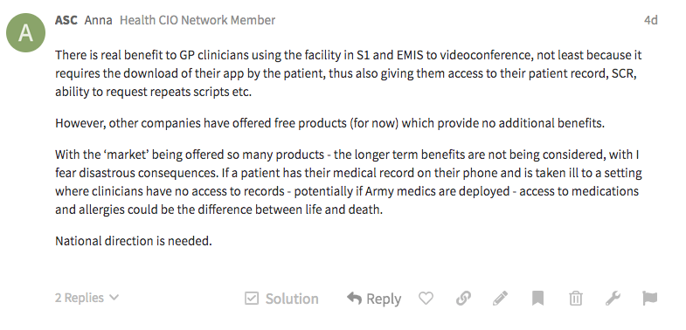
Request – national direction on VC apps and products

Slide 7
Request – national guidance on video clinical consultations
Question – is there a national clinical VC solution?
Question – are clinical modules of Teams up and running?

Slide 8
Request – national safety case for video consultations from NHSX

Slide 9
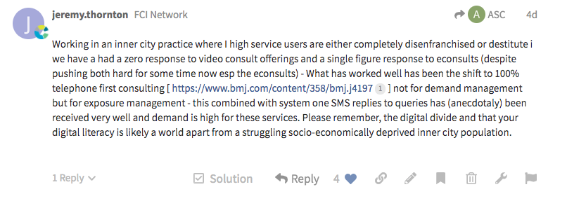
Request – remember digital divide when moving to digital primary care

Slide 10
Question – how many nhs.net accounts can a trust create in a period?

Slide 11
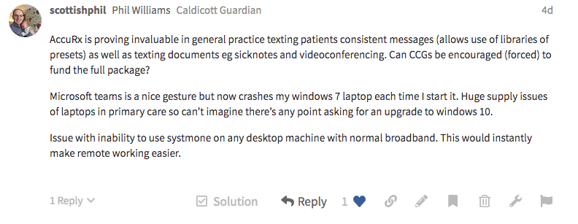
Blocker – slow CCG and ageing hardware and limited broadband preventing digital response

Slide 12
Blocker – high local IT support/provider costs to practice for laptops

Slide 13
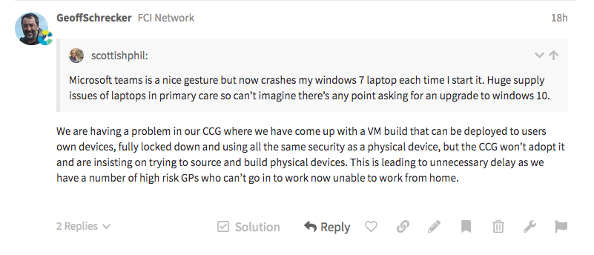
Blocker – CCG insisting build and configure hardware rather than allow VM build

Slide 14
Request – clearer guidance on working from home/remotely approaches

Slide 15
Blocker – repots of 4-day delays in delivery of SMS from some messaging solutions

Slide 16
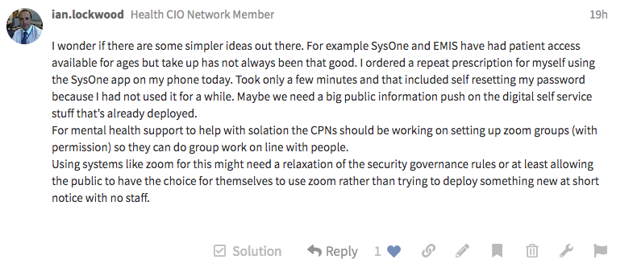
Suggestion – provide MH nurses and CPNs with Zoom Groups and relax IG rules to make possible

Slide 17
Blocker – far too slow for some going through SCR connection approvals (2.5 years for some) through middleware.

Slide 18
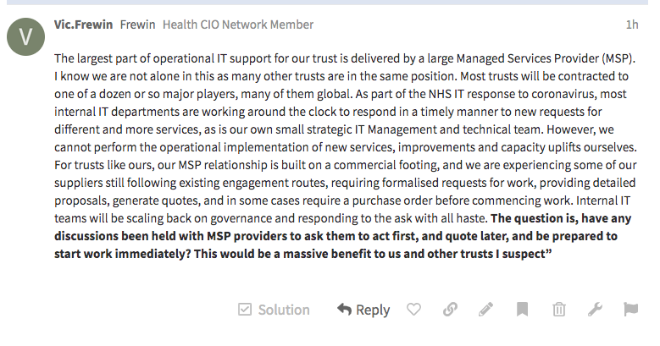
Blocker – Managed Service Providers supporting trusts key but slow to respond, behave commercially
Suggestion – Direct MSPs to act first and quote for work later

Slide 19
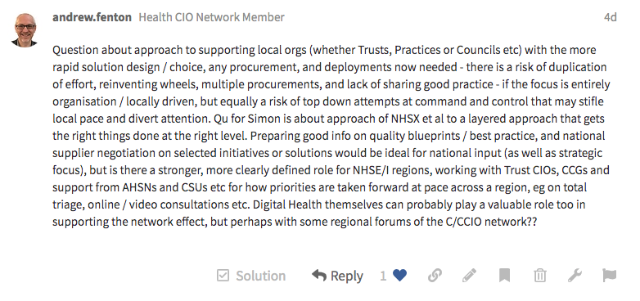
Question – how to do the right thing at right level in layered approach
Suggestion – regional forums CCIO/CIO network

Slide 20
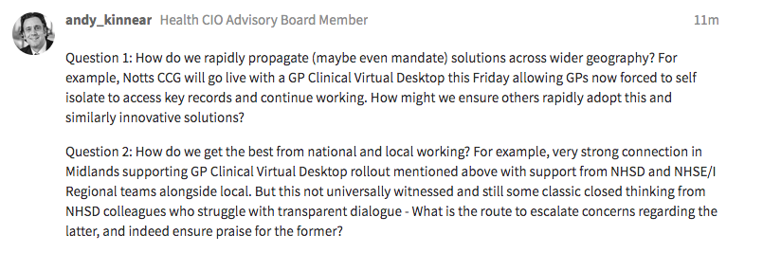
Question – how to spread solutions across wider geographies?
Question – how to get best from national and local working?

Slide 21
Digital Responses to Covid19 Digital First Primary Care + Remote Care + NHS Staff identify 27 March, 12.30 -13.30
Panel Discussion
Chair: Jon Hoeksma
Dr Shaun O’Hanlon, medical director EMIS
Dr John Parry, medical director TPP
https://www.digitalhealth.net/events/digital-responses-to-covid-19-2/

