Slide 1
Sarah Wilkinson, CEO NHS Digital
Digital Responses to Covid-19
Q&A and Briefing
14 April, 2020

Slide 2
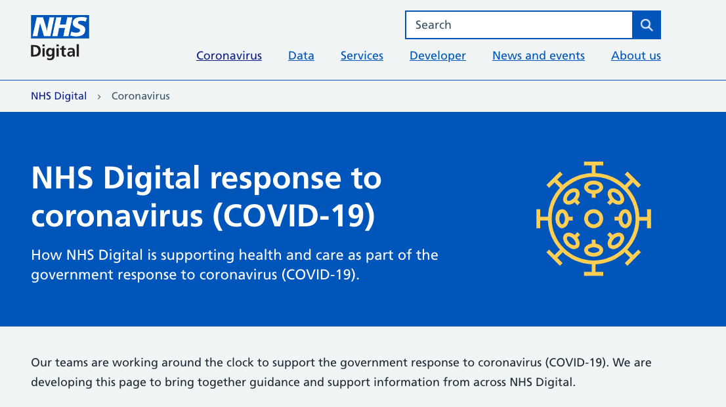

Slide 3
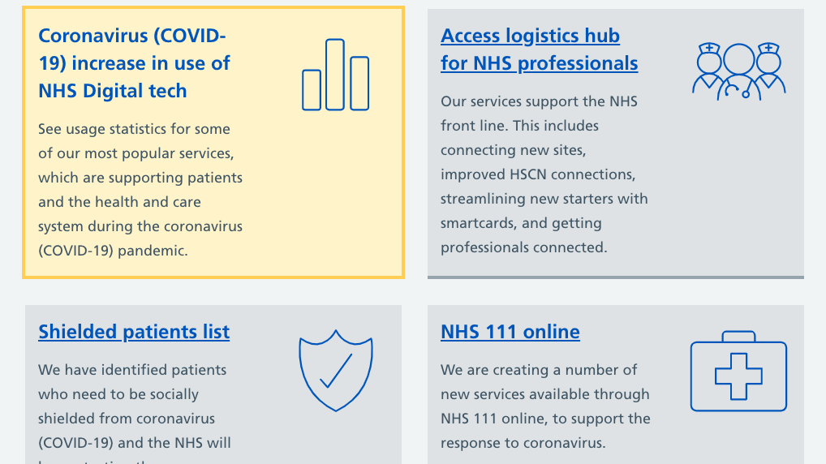

Slide 4
NHS Digital Coronavirus website
Coronavirus website at
https://digital.nhs.uk/coronavirus

Slide 5
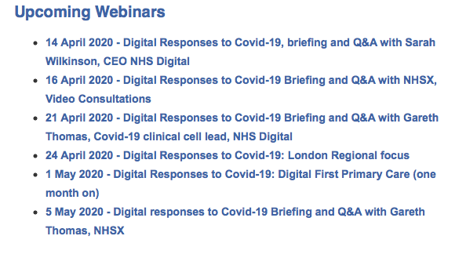

Slide 6
