Slide 1
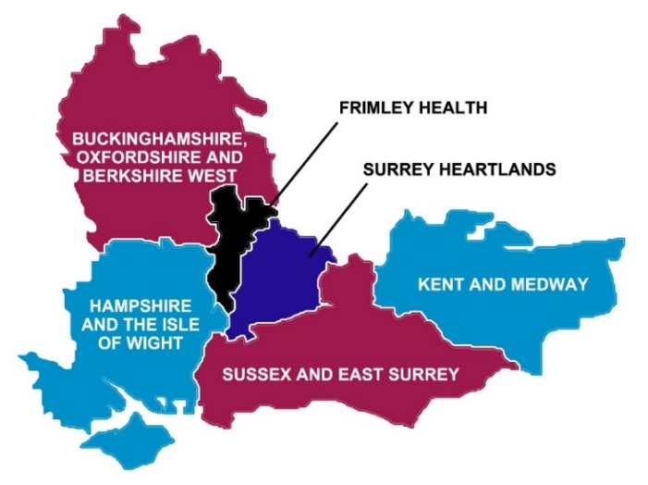
Digital Responses to COVID-19
South East Regional Focus
Chairs:
Jon Hoeksma, CEO Digital Health
Jane Barnacle, Regional Director for Digital Transformation, NHSE/I South East
15 May 2020

Slide 2
Speakers
Adrian Byrne, CIO, University Hospital Southampton NHS Foundation Trust
Jo Hillier, Digital Clinical Lead, Sussex Partnership NHS Foundation Trust
Dr David Triska, GP in Witley Surgery, Clinical Director West of Waverley Primary Care Network, Professional Director of Primary Care at The Royal Surrey NHS Foundation Trust
Katherine Church, Joint Strategic Chief Digital Officer, Surrey Heartlands Partnership
Panellists
Jane Barnacle, Regional Director for Digital Transformation
Natasha Walton, Regional Head of Digital Strategy and Transformation
James Hempsted-Kingham, Director – Digital First

Slide 3
Primary Care
Dr David Triska
Clinical Lead for Digital First
Surrey Heartlands Partnership

Slide 4
Digital Shared Care
Real time two-way supportive consultations with primary and secondary care

Slide 5
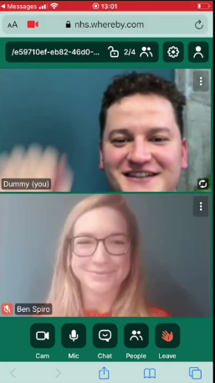
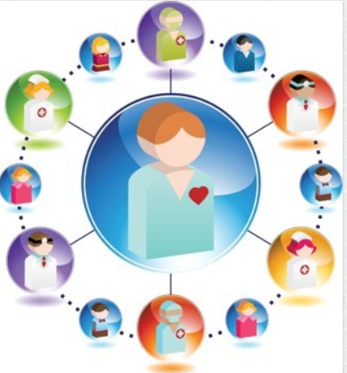
Digital Shared Care Working
Remote access to specialist input in paediatrics/cardiology/neurology
Generalist support to specialist decision making
Adaptive to patient needs with them at the centre

Slide 6
Fluid and Adaptive Care
Reactive care that will flex with population demands

Slide 7
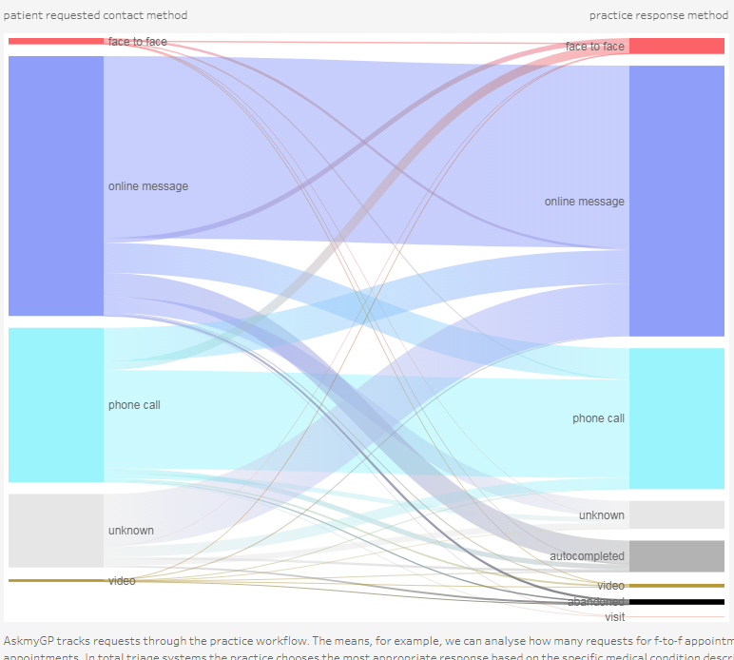
Reactive Care Redesigned
Digital Journeys post COVID
Support for cross-working in PCN/ICP
Allowing time and space for complex care in surgeries
Fluid support to surgeries to deliver care to their own patients

Slide 8
Proactive Teams
Real time supported care across the health and social care spectrums

Slide 9
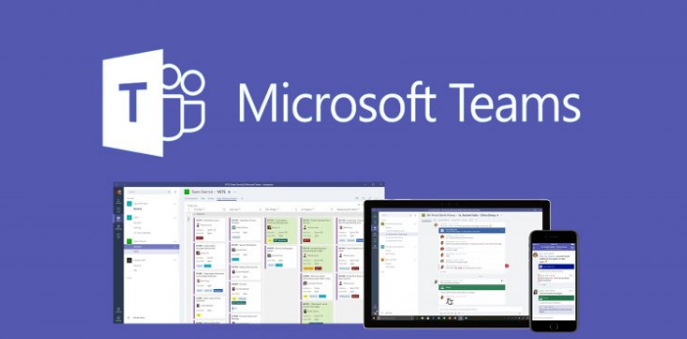
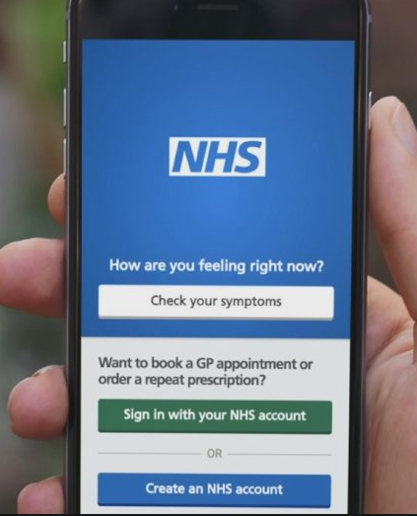
Long Term Conditions
“I used to come in 3 times for my condition reviews, doing it all at once with the doctor and the nurse made such a difference. I didn’t think I’d get the video to work but it did!”
Intelligent Monitoring
Practicing in teams for complex care appointments
Use of new technologies for clinical collaboration
Patients integrated into the care process
“Having such good access to the practice team for my diabetes is already making a difference. My HBa1C is already down a point on my libre app”

Slide 10
Engagement of GPs
Flexible working for future generations

Slide 11
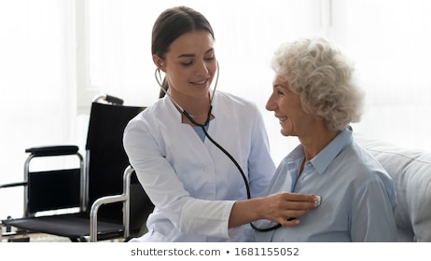
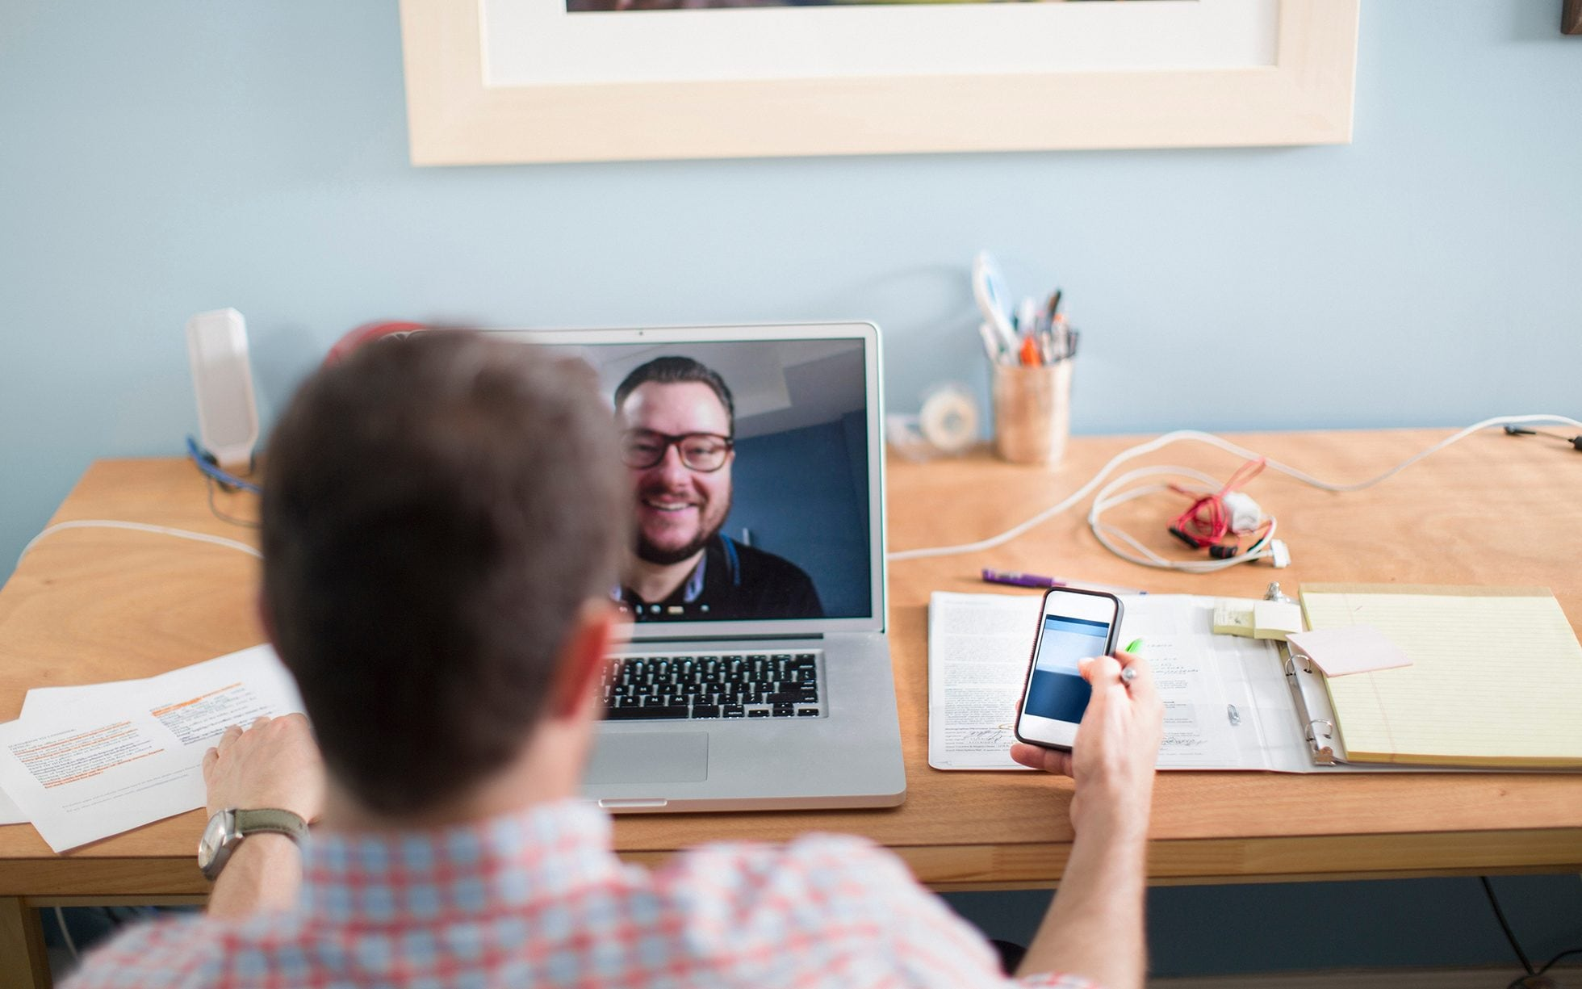
Future-GP working
“I couldn’t see a future for me in General Practice. I can now.”
Unbound by location when needed to be
Offering variety and tailored to the person
Supporting families and retention of staff
Cementing continuity of care as the cornerstone of General Practice
“The time and space I’ve got means we can tackle complex problems well- not just squeezing it all in.”
“My team feels like we are ‘proper’ family doctors again – traditional values of GP which we can deliver thanks to digital.”

Slide 12
Summary
Reimagining the structure of general practice to provide stability with the core values of primary care retained
Continuity of Care
Patient Orientated
Generalist
Adaptive and responsive

Slide 13
Care Homes and Social Isolation
Katherine Church
Joint Strategic Chief Digital Officer,
Surrey Heartlands Partnership

Slide 14
Key Themes
Working as an integrated system: Working across care and health boundaries to respond fast to Covid 19 and make sure no one fell through inter-organisational gaps
Accelerated digital solution design: rapid user centred design and development to reach out and wrap digital health and care around some of the most vulnerable people in Surrey
Digitising Care Homes: wrapping care homes into the health and care ecosystem to overcome the physical boundaries of lockdown - interpersonal and clinical.

Slide 15
Vulnerable Populations and Social Isolation
Using digital to overcome the physical barriers of lockdown and isolation

Slide 16
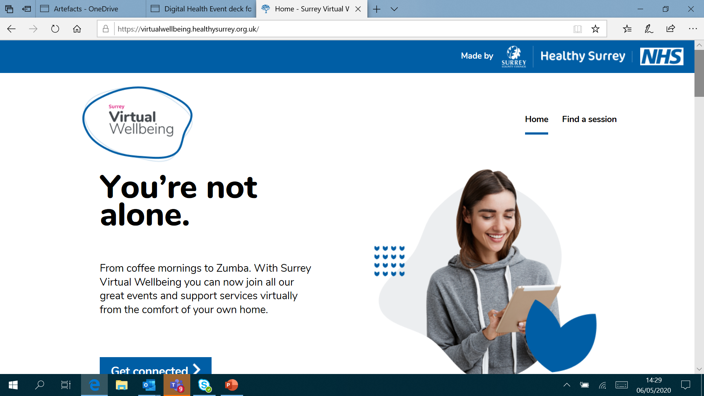
1. Digital wellbeing platform
Inter- agency collaboration to deliver an online platform for live courses
Deployed in 4 weeks

Slide 17
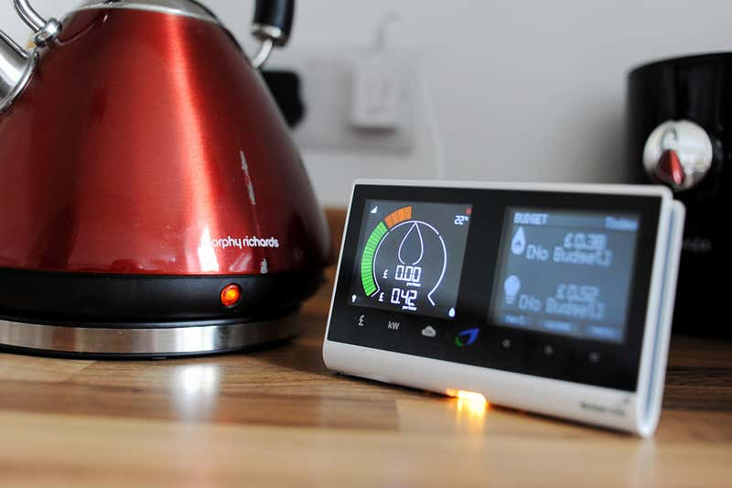
2. Remote monitoring smartmeter & AI platform
Using digital to overcome physical boundaries of lockdown
Alerts to families if their loved ones haven’t moved or used any electricity in the home

Slide 18
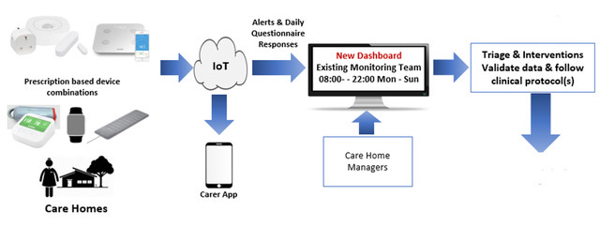
3. Integrated AI and clinical monitoring
Behind the scenes data analytics
Monitoring team receive alerts plus daily questionnaire responses in dashboard – actioning using agreed protools
Covid19 adaptation of our dementia platform
Cross system product aimed at shielded and super shielded vulnerable population
Impacts
Reduce need for GP calls and 111
environmental & physiological devices installed in care homes and used daily alongside questionnaire app
Reassurance at a glance, family can see appropriate alerts, monitor activity & review questionnaire responses
Reduce A&E and hospital admissions
Reduce ambulance
call-out and attendance
Reduction in depression, agitation and anxiety

Slide 19
Digitising Care Homes
Extending digital tools and devices to enable remote health and care

Slide 20
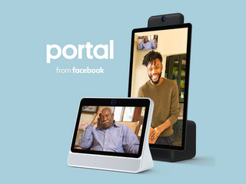
4. Facebook portal for care homes
“Our residents may not fully understand the what effect Covid-19 is having on the world but they can tell something is different and that can be unsettling. Being able to see and hear their relatives is incredibly comforting at this time
We see huge benefits in using the Facebook’s Portal, especially with residents who have dementia.
Yasheen Rajan, Director, Kindred Care
Free of charge for care homes (70 care homes)
Intuitive and easy to use for residents and families
Supports end of life conversations for patients and their loved ones

Slide 21
5. Bringing care homes into the NHS systems
Secure connectivity and communication for health professionals (75% signed up)
Rapid deployment & training for Teams to support virtual MDTs (all practices signed up)
Platform for virtual consultations (90% GPs)

Slide 22
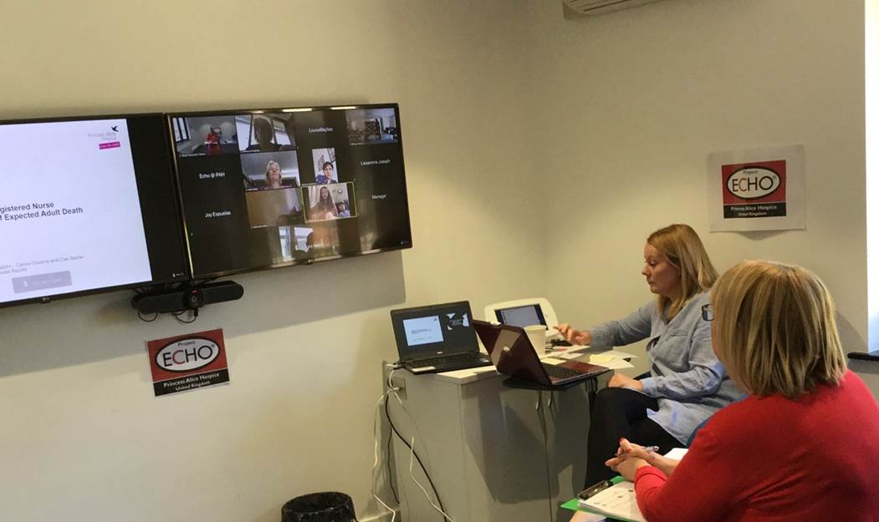
6. Online training platform for care home staff
12 different courses around difficult conversations, end of life infection control, verification of death
Over 90 homes signed up in 5 weeks – capacity for all care homes in Surrey

Slide 23
Final Thoughts
Working as an integrated system to accelerate and integrate responses
Accelerated digital solution design – Covid has made us work at pace and scale
Wrapping care homes into the health and social care system: A KEY PRIORITY

Slide 24
Virtual Consultations in Mental Health Services
Sussex Partnership NHS Foundation Trust
Jo Hillier – Digital Clinical Lead

Slide 25
Context
We provide mental health and learning difficulties services across Sussex and the South East
Prior to Covid-19 we had a handful of teams offering virtual consultations
No virtual group intervention offer
Other GDE sites had similar experiences with roll out

Slide 26
What are we using now?
Attend anywhere – for consultations with service user and/or carer
Skype for professional meetings
Gotomeeting for group interventions
Have used other app’s when the above solutions don’t fit clinical practice e.g. what’s app with unaccompanied asylum seekers

Slide 27
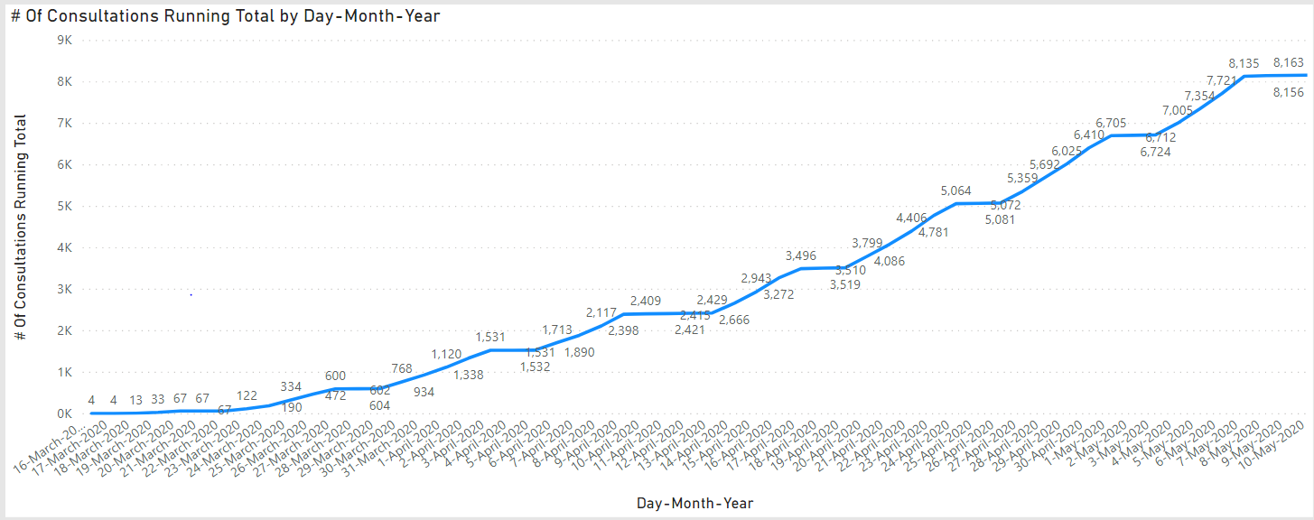
Cumulative number of consultations offered across Sussex Partnership since 16th March 2020

Slide 28
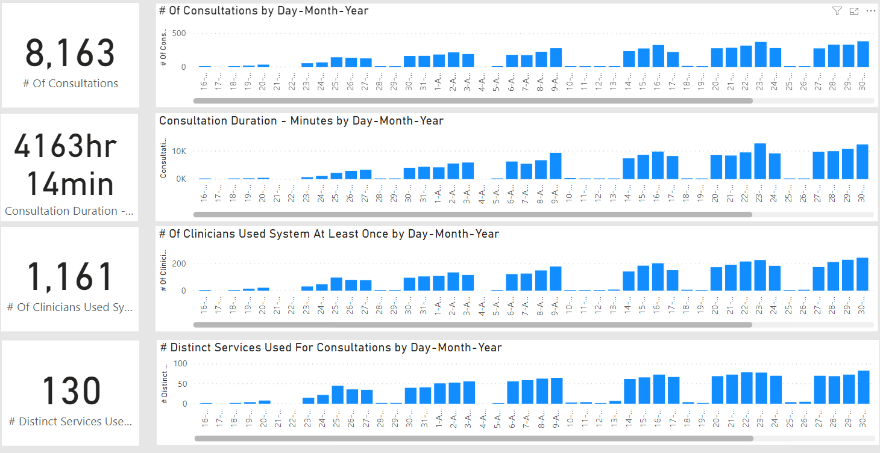
Using power Bi for adoption data – we can also look at role and specialty to
consider adoption and spread

Slide 29
Virtual Consultation Vision
Every clinician should be able to offer a virtual consultation/intervention
Every service user/carer should be able to request one

Slide 30
Recipe for success
Clinical Leadership integrated in digital team
Endorsement from Experts by Experience
Expected offer from all services
Group and one to one offer
Support to 3rd sector partners – usage across pathways
Provision of Power BI to analyse
adoption data

Slide 31
What next?
Analyse data and develop adoption
Analysis and collection of user experience
Clinical protocols and guidance
Virtual group development
Virtual front door from trust website
Recording consultations for training purposes

Slide 32
Jo Hillier
Digital Clinical Lead jo.hillier@sussexpartnership.nhs.uk

Slide 33
Secondary care. What made a difference?
Outpatient rescheduling tool
Using low code dev with Oracle Apex
Supporting MDTs
Integrating MS Teams with the EPR
Adrian Byrne
UHS CIO and Chair of Digital Health CIO Network
@uhsft; @uhsdigital @mymedrec; @adebyrne

Slide 34
Outpatient triage using rapid low code dev
Before
After
Patient list
Patient list
Triage
Cancel
Backlog
Delay
Extend the EPR
MyMR
Rebook
Admin and clinical staff work from anywhere
“there is no going back”

Slide 35
Microsoft Teams, from 100 to 5,000 users
Messaging
Integration
Out of the box
Integration with MS (Active Directory; MS Office)
Collaborative sharing space
Options for: - Organizing chat/teams - Creating chaos!
Chat-bot technology
Chatbot technology
Link to integration tools
Bring forth clinical data
Channel e.g. results data

Slide 36
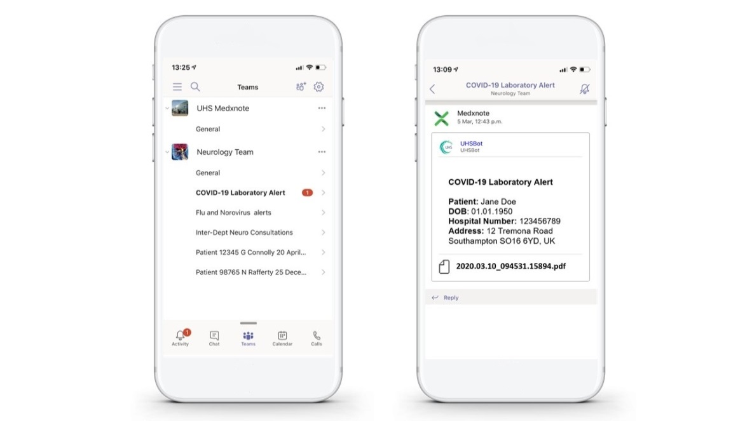
Microsoft Teams, from 100 to 5,000 users
MDTs
Results
35-40 meetings per week
12-25 staff in each
c. 1,600 cases
Chat-bot technology
Integration
Bring forth clinical data
Channel the results e.g. Covid-19
Benefits
Meetings carry on
Staff work from anywhere
Blockers-problems
Lots of information sources
If you can’t serve the information up,
you cant do it

Slide 37
Microsoft Teams, from 100 to 5,000 users
Results
Chat-bot technology
Integration
Bring forth clinical data
Channel the results e.g. Covid-19 Pathology, radiology, untrasound etc

