Slide 1
Using remote triaging and online consultations in managing COVID-19
Dr Minal Bakhai
Deputy Director and National Clinical Lead for Digital First Primary Care, NHS England and NHS Improvement
General Practitioner, Brent CCG

Slide 2
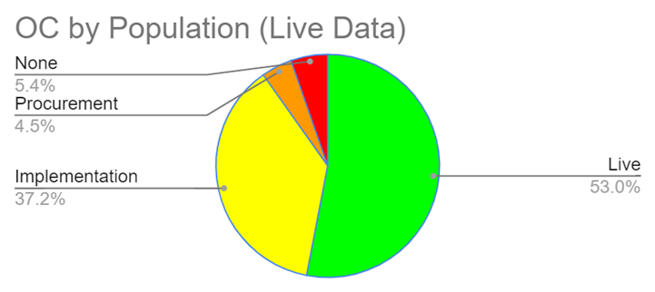
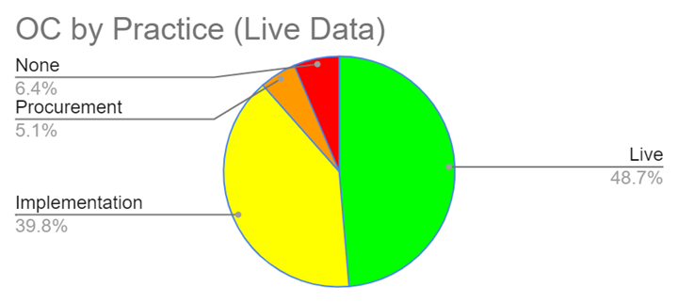
Overview of data
Data accurate as of 15 April 2020.

Slide 3
Digital/phone total triage
Online message
Patient submits an enquiry in their own time through a structured online consultation form via the practice website
Video consultation
Administrative staff filter admin requests and send clinical queries to the most appropriate clinician
flagging urgent requests
The clinical history is presented in a way that is quick and easy to assimilate. Clinician
reviews and responds through the most appropriate channel
Telephone consultation
Or, patient phones the practice and administrative staff complete an online consultation form on behalf of the patient
Face-to-face consultation

Slide 4
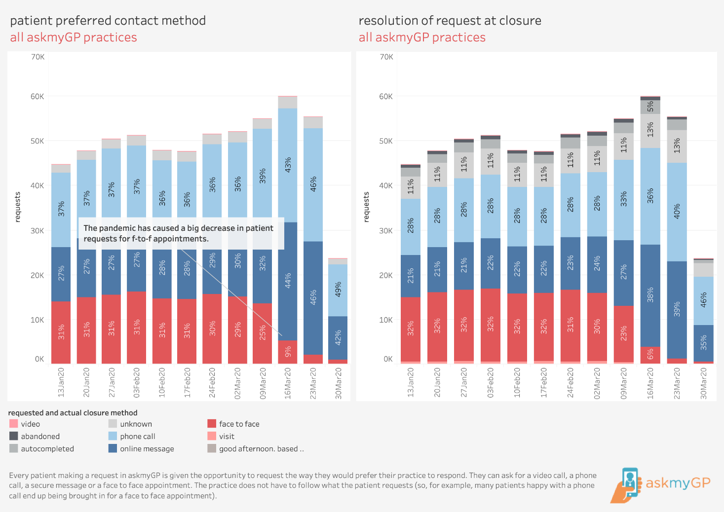

Slide 5
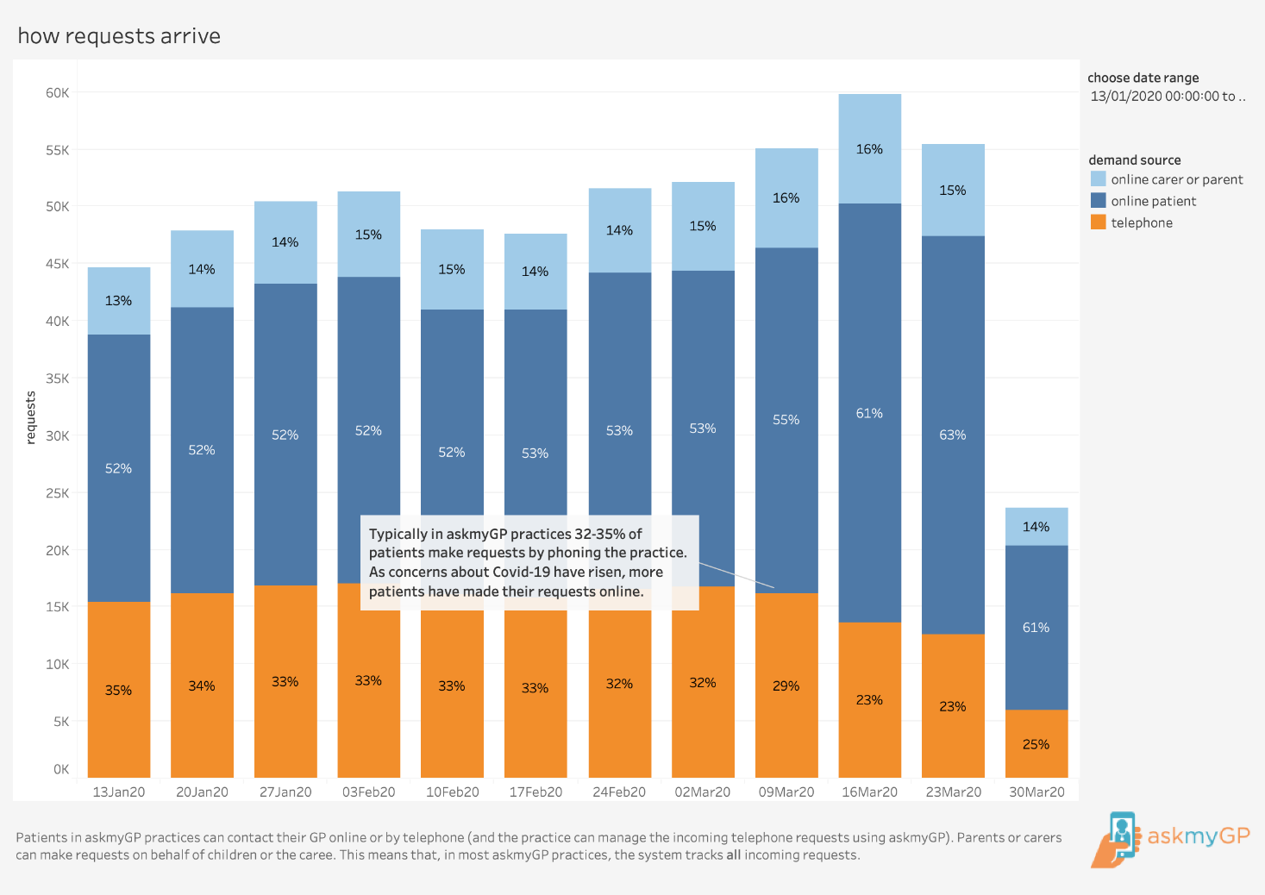

Slide 6
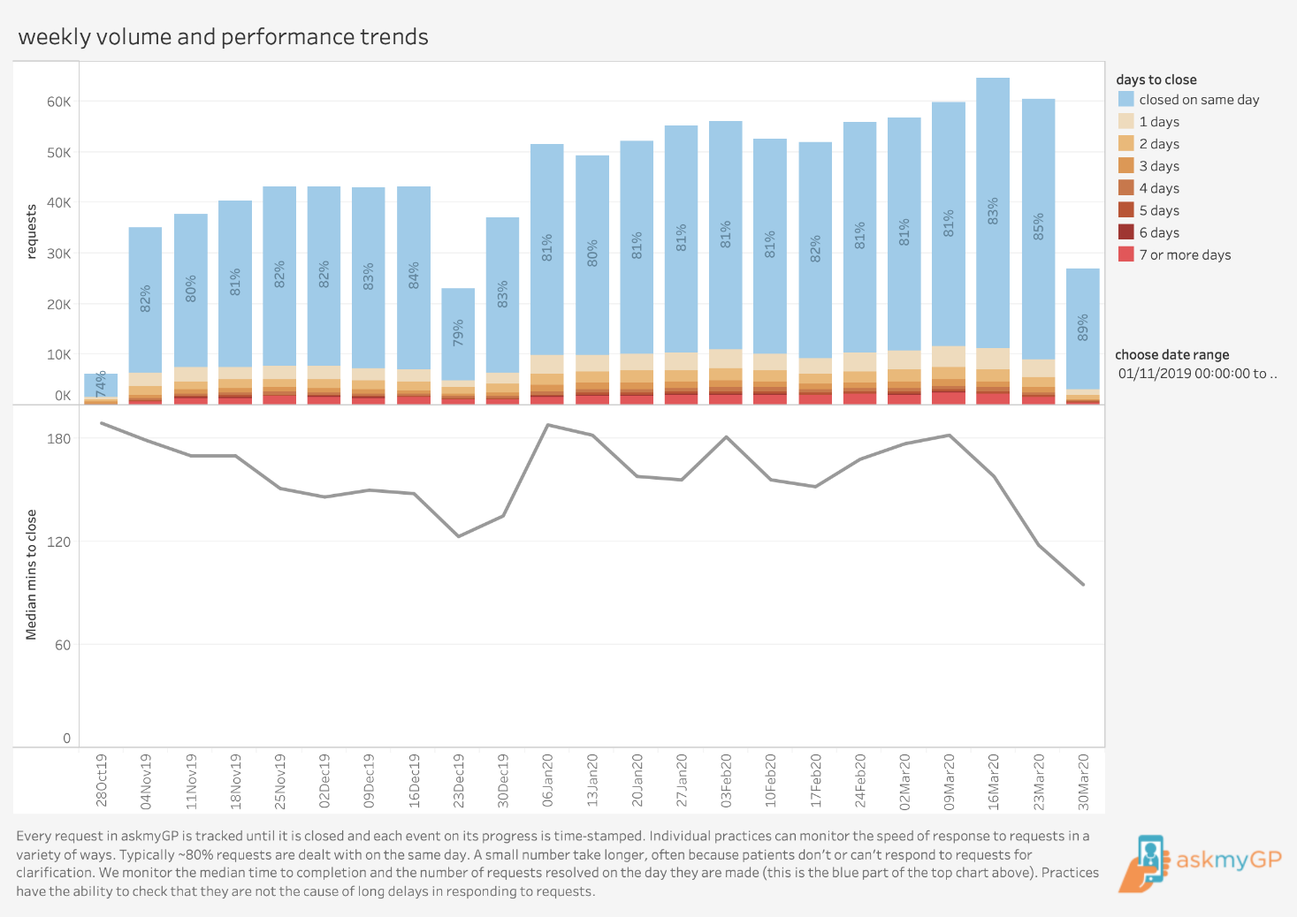

Slide 7
Online consulting tips
Trust
Resilience
Review
Safety net
Relate
Commit
Summarise
Notes:
Minal

Slide 8
Resources
Advice on how to establish a ‘total triage’ model in general practice using online consultations
Health Education England e-resource on remote total triage model in general practice
FutureNHS Digital Primary Care workspace for NHS staff
For any assistance in accessing the workspace contact england.digitalfirstprimarycare@nhs.net
Notes:
Minal

