Slide 1
Digital responses to COVID-19 Alleviating system demand by harnessing shared care records and remote patient monitoring
Bruce Horne, Product Specialist Lead, Orion Health
Pauline McLean, Clinical Consultant, Orion Health
Ben Wilson, Product Specialist Lead, Orion Health
Jocelyn Palmer, Programme Manager, Connecting Care, NHS South, Central and West CSU
7th May 2020
Notes:
Afternoon everyone, thanks for joining us. My name is Bruce Horne, a Product Specialist Lead with Orion Health in the UKI. We are joined by Jocelyn Palmer the Programme Manager from our customer Connecting Care. Also contributing today will be my colleagues Pauline McClean our Clinical Consultant, Ben Wilson, Product Specialist Lead and Nicole Allan, Product Director for our Engage – Patient Portal Product.

Slide 2
Contents
Introductions
Orion Health overview
Responses to Covid-19
Connecting Care case study – adaptations to the shared care record for Covid-19
Orion Health’s Outbreak Management Solution
Questions and answers
Notes:
We have a number of things to cover today including:
An overview of Orion Health for those if you who do not know us.
Some discussion around how, as a supplier we have been working with our customers in the UKI & globally on the response to Covid 19. This will focus on two areas:
Our ‘Outbreak Management Solution’.
And how customers have been utilising their existing shared care records in new ways.
In reference to the latter Joss will then be able to talk through examples from Connecting Care.
I will then conclude, with Pauline’s input, by going into more detail on our Outbreak Management solution before time for questions and answers.

Slide 3
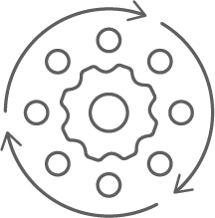
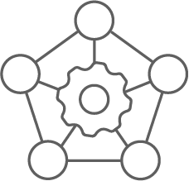
Orion Health Overview
Our customers
Established for
27 years
18 years’ experience working with the NHS
Customers and staff in 15 countries
50+ HIE/ IDCRs on the Orion Health platform
Committed to interoperability and standards – INTEROPen member
100+ million
patient records worldwide
Notes:
First a little background on Orion Health. We are a New Zealand based company established almost 30 years ago and have 18 years of experiences working with the NHS.
On the right hand side you can see some of our customers. These include award-winning customers such as Connecting Care, who we will hear from a little later on, the Northern Ireland Electronic Care Record and the Dorset Care Record.
We also part of the LHCR programme, working with the Wessex and One South West LHCRs as well as Greater Manchester Combined Authority.

Slide 4
Powering healthcare for 17m+ patients in the UK and Ireland
Notes:
We are best known as the leading supplier of clinical portals in the uki. There are over 2,200+ organisations across the UKI using our solutions, covering over 17m+ patients.
Orion Health also has a number of products that support a myriad of use cases. As it is not always possible or desirable to adopt everything in the first instance, our customers often begin their
journey with us with a shared care record, and layer on more functionality as projects become more mature:
On this slide, working from left to right:
Integrate health and care data – We are able to take datasets from multiple sources and present it to end users so that they can have a holistic view of care for an individual.
Additional functionality includes the ability to input data through pathways, forms and care coordination; medicines management and patient engagement.
The data collated and input can drive analytical outputs using our Discover product and surfaced to be used for machine learning with the help of our data science team.
Our clinical portal is currently live with over 30 customers in the UKI.

Slide 5
Responses to Covid-19 – Approach
Collaboration with existing customers
Key principles
Clinically driven use cases
Rapid deployment
Minimal change management
Measured solutions
Challenges
Fast-moving environment
Flexible, measured engagement and solutions
Notes:
As we are all aware these are unprecedented times and as a supplier we have been very mindful as to how we offer support. This has meant that we have sought to work collaboratively with our customers to understand their use cases and to see how components of our ‘Outbreak Management Solution’ or our existing capabilities can best assist.
There are have been a series of principles that have underpinned our approach:
Clinically driven use cases – We want to ensure that what we are doing brings about benefit.
Rapid deployment - Essential to meet the use case as soon as possible.
Linked to this minimal change management in the form of simple to use tools or evolutions of existing ones.
Measured solutions – We have tried to ensure, as best possible that any solutions provided has some longevity beyond this crisis.
Our approach has not come without challenges:
For us as with everyone, the situation, certainly in the early weeks was evolving rapidly making it challenging for us to settle upon the ‘right’ solutions. This is where the collaborative approach has been helpful.
We have had to be flexible both in the solutions that we can provide and also in the engagement of our customers.
I will now hand over to my colleague Ben Wilson who will talk through the solutions in a little more detail

Slide 6
Outbreak Management Solution
Building on existing shared care record platforms
Comprehensive technology stack that helps alleviate the burden that virus outbreaks can place on already stretched health services.
Combines established Orion Health products pre-packaged in a single solution to enable a response to multiple use cases
Stand-alone / cloud-based solution & rapid deployment
Key aim is to reduce hospital visits by allowing patients to be monitored and treated in their homes, using a range of virtual care tools.
Already deployed to a number of healthcare systems around the world and working with an existing customer to bring to the UK.
Three key themes:
Identify patients for remote monitoring and care
Manage patients preparing for hospital admission, and where appropriate post discharge
Engage, connecting patients and healthcare providers
Customers leveraging their existing shared care record platforms across UKI
Making shared care records available to any front-line staff who need it
Being reactive to accommodate upstream system changes
Making the shared care record quicker to use
Adapting existing functionality to assist COVID-19 response
Making more and important information available to better support and inform patient care
Notes:
Deployed in other areas around the world and looking to bring ot the UK
If we look back 6 weeks ago we could see healthcare systems globally being overwhelmed and facing exceptional challenges – seeing this first in China and then Italy
We knew that we have a comprehensive technology stack that could help and saw a flood of evolving use cases flowing in from existing customers What we wanted to do is make our healthcare technology available very quickly to help with the pressure, particularly on acute services at that point in time from the Coroanvirus Outbreak.
The intention is to reduce the inevitable burden that virus outbreaks can place on an already stretched health service. We want to alleviate spikes in demand, reduce the risk of further spread of the virus and flatten the epidemiological curve. Our comprehensive solution strongly supports the shift to a virtual care approach.
Each of these components are in production for clients globally, however the components have not been combined into a single solution before and integrated with the data points required for the COVID-19 response in the United Kingdom.
The system is split into three modules: ‘Identify’, to identify patients for remote monitoring and care; ‘Manage’, to manage patients preparing for hospital admission and, where appropriate, post-discharge; and ‘Engage’, a portal connecting patients and healthcare providers which enables results and enquiries to be messaged securely, reducing the need of hundreds of phone consults.
Orion Health’s Outbreak Management Solution helps alleviate pressure on health systems by shifting patient care from the hospital to the home. The aim is to reduce hospital visits by allowing patients to be monitored and treated in their homes, using a range of virtual care tools. This will enable hospital resources to be reserved for those with the greatest need, helping to contain the virus and prevent new cases from hospital transmission.
Way its working, patients are getting into ED departments and triaged in the emergency department and they’re saying you’re not ill enough to go into ICU. So we’re going to give you some meds and you’re going back home. Those are the patient’s we’re following with eCOVID. At most of the hospitals there is 1 Nurse or Secretary which creates patients into solution, giving goals and explaining situation. Will be followed at home and putting GP into Circle of Care plus the referring immunologist from that area. Creating alert lists and when patient becomes red then immunologist or GP get notifications and become aware of it. And can call patient do a teleconsultation or decide if patient needs to go back to emergency department. COVID is not long term disease, its very short term and now into 2 months into lock down so some patients entered system early April and after 15 days are now out of the solution.
Patient gets out when not ill anymore.
If patient not filled out goals for last 24 hours will receive an SMS asking to put goals in. Send reminders to patients (use email/SMS depending on which patient is)
Extend access to wider audiences - making the shared record accessible to more users, we very quickly enabled the licences of our systems to be extended to several more thousand users across our customer base including many of those working in community pharmacy in order for them to be able to view key information such as GP prescribing information. Also adding in new roles in some instances such as Ambulance Service, NHS 24 staff, and dentists.
Accommodating upstream changes – we adapted our call triaging process to and mobilized our team to react immediately to any COVID-19 related support request and previously changes we were previously making on weekly or monthly release cycles we were terming emergency releases.
As our shared care record platforms receive information from a number of systems what we were finding was as those systems were being adapted and re-designed to deal with the current crisis, such as new wards opening, ED departments relocating or new hospital sites (e.g. Louisa Jordan Temporary Hospital in Glasgow) being established we had to reflect a number of codeset system changes within our system.
Changes to established solutions – some of the main changes here were making the system more accessible and quicker to use. Some such things were reducing mandatory fields, customers requesting to relax some of the inbuilt IG rules such as GPs being able to search for patients on the system outside of their own GP practice cohort for example. Also a number of changes that needed to be implemented as per governmental guidance being released. British Society of Thoraic imaging guidance for example we had to add in infection status rules when users were ordering radiology imaging requests.
Repurposing existing solutions to COVID-19 response. Some of our customers looked at their existing solutions to see how they could be re-purposed. One such example is in Northern Ireland ECR where they have deployed a national diabetes pathway on our platform. In that diabetes solution a collaboration tool can be used to capture progress notes against patients who have been rolled onto that diabetes pathway. So the issue was progress notes was currently tied to the diabetes speciality. A change that was requested was to add COVID-19 as a note type and to move the note functionality into the main patient screen so it is much more accessible and a chronology of the patient story could easily be seen.
Rapid enablement of new solutions using existing deployed products – an example of this is where customers already had parts of our solution deployed that could be used to meet emerging requirements around COVID-19. For example using the same products talked about previous around the diabetes pathways but looking to use it for admission / ward rounds. These sorts of projects which would typically take months if not weeks were turned around within days. We had other customers looking at similar things around using it for Discharge Summaries as per new government guidance.
Sign posting new data – the last broad category is around brining in additional information. Being able to see laboratory results in a shared care record is one of the fundamental data items in a shared care record so the majority of our customers are alredy processing laboratory results. As testing moved from not just the key public health England labs but into the local NHS Labs the COVID-19 infection status results as these were being released by the Virology labs and being made readily available helping to inform staff and users of the shared care record. Other areas included the better sign posting key documents such as care plans to ensure patient wishes were respected and I know Joss will be talking about ResPECT.
We also have a number of customers who are in the process of loading in the shielded patient alert lists being used to identify patients who meet the high risk criteria for contracting coronavirus (COVID-19) and custoers wanting to capture and display COVID-19 alerts in the shared care record itself.
Previosuly Releasing 3-4 weeks. Calls triaged and mobilize our teams to react immediately as COVID-19 related support requests come through.
Termed emergency releases – mostly NID. Still do testing but extra resources. A lot of things small.
Building on Existing shared care record platforms
Northern Ireland Electronic Care Record (NIECR)
Greater Glasgow and Clyde
Children’s University Hospital
Extending Access – Granted several thousand licenses to enable more health and care workers access to the system. Some examples were to community pharmacists in order to be able to view GP prescriptions.
Accommodating upstream systems – shared care records are brining in data from lots of upstream systems, up to around 85 systems in some of our examples.. As Wards were being re-purposed, new sites being opened we had to accommodate a number of new codesets. Likewise where we’re sending on information to systems such as Orders changes.
Re-purposing existing solutions to COVID 19 response – as an example of this is a collaboration tool in NID where
As we are all aware these are unprecedented times and as a supplier we have been very mindful as to how we offer support. We have been careful not to try to ‘sell’ or ‘push’ offerings to customer where there have been other immediate priorities.
To this point we have tried to ensure that our customer engagements have been collaborative, this has meant that we have sought to understand our customers use cases and to see how components of our ‘Outbreak Management Solution’ or our existing capabilities can be best assist. This has also meant that the nature of the solutions discussed has varied.
There are have been a series of priniciples that have underpinned our approach:
Clinically driven use cases – We want to ensure that what we are doing brings about benefit. For example we engaged key clinicians at Dumfries and Galloway who were able to articulate how to configure a proposed solution and business process behind it within a week. We ensured that we kept use of their time to a minimum but also saw it as essential to make sure that the deployment was fit for purpose.
Rapid deployment we saw as essential to meet the use case as soon as possible.
Linked to this minimal change management in the form of simple to use tools or evolutions of existing ones. We acknowledge that wide scale training is not feasible in this climate for many.
Cost effective, we have tried to keep solution costs to a minimum as we want to support at this time and do not want price to be prohibitive.
Measured solutions – With all of the above said, we have tried to ensure, as best possible that any support provided has some longevity beyond this crisis and have tried to avoid reactive solutions as a result. For example remote monitoring of patients could be adopted beyond Covid and the patient use cases could be extended.
We wanted this presentation to be relatively honest and not paint a picture that all has been perfect in recent weeks. Out of this we have some lessons learned which we will cover later but also wanted to touch on two (albeit obvious) challenges that we have faced:
For us as with everyone, the situation, certainly in the early weeks was evolving rapidly making it challenging for us to settle upon the ‘right’ solutions. This is where the collaborative approach has been helpful.
Linked to one of the principles above, we have had to be flexible both in the solutions that we can provide and also the engagement of our customers. We have worked to be as respectful of this as possible, working to their timescales and at times carrying more risk.
I will now hand over to my colleague Ben Wilson who will talk through the solutions in a little more detail and reference some use cases.

Slide 7
Jocelyn Palmer, Programme Manager,
Connecting Care
jocelynpalmer@nhs.net
@JossPalmer1

Slide 8
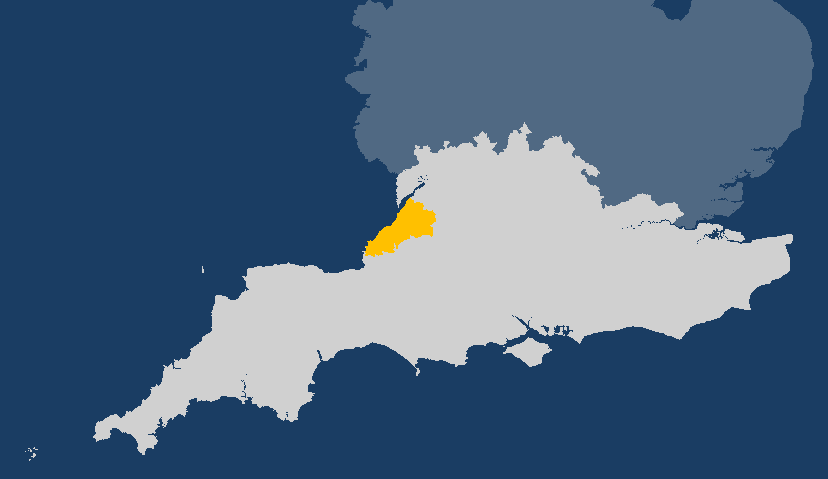
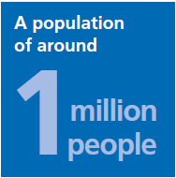
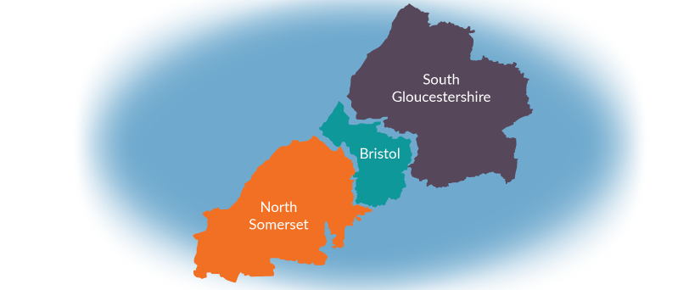
Bristol, North Somerset and South Gloucestershire - ‘Connecting Care’
As 100 people
48 live in Bristol 86 live in urban areas 17 are 0-14 years old 17 are 65+ 6 are ‘most deprived’ and 26 are ‘least deprived’…15 year gap Significant diversity across the region
Better, safer and more
joined-up care

Slide 9
Connecting Care Partnership

Slide 10
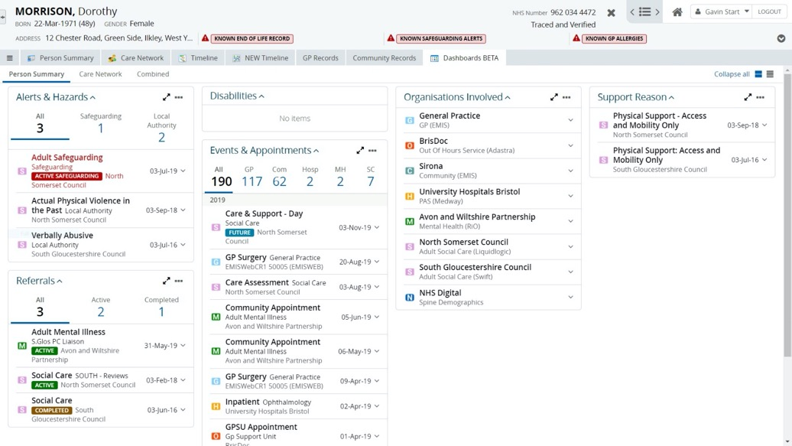
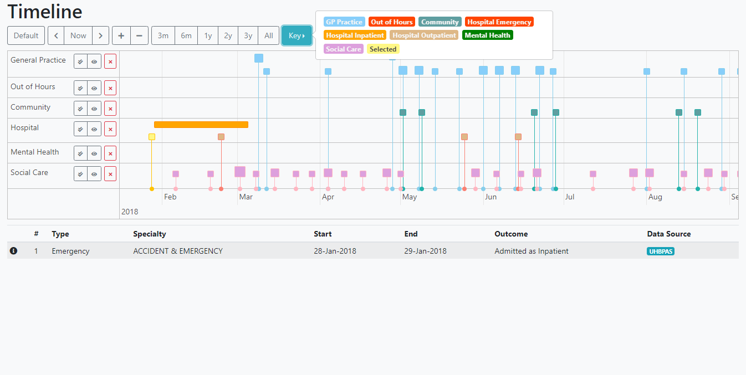

Slide 12
Orion Health Outbreak Management Solution
Notes:
Thanks Joss – that gave us a good understanding of how Connecting Care have reacted to Covid and are building upon their existing shared care record as part of this. I will now talk about the ‘Outbreak Management Solution’ highlighted earlier in the presentation.

Slide 13
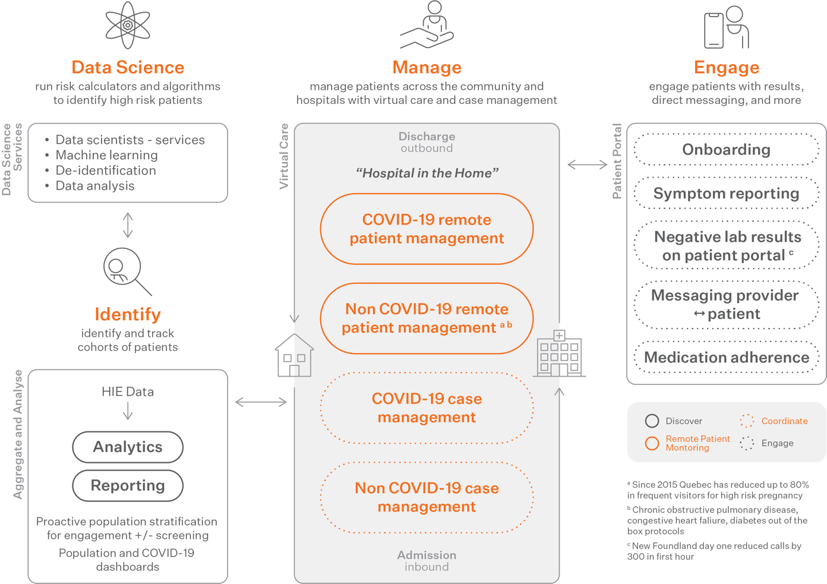
Outbreak Management Solution components
Notes:
The ‘Outbreak Management Solution’ is composed of a number of established Orion Health products. As Ben mentioned earlier it was designed to be standalone and quick to deploy.
We are finding that product components of this solution meet different customer use cases as opposed to there being a need for the entire solution.
On the right we have ‘Engage’ which articulates functions provided by our ‘Engage – Patient Portal’ product:
The product enables simple patient onboarding and symptom reporting.
The most applicable use case that we have identified in the UKI is for Engage to provide citizens with a central repository to access Covid test results.
Manage – In this section we highlight two other product components of the ‘Outbreak Management Solution’ to assist with the remote management of citizens:
Our Coordinate – Collaborative Worklists enable users to categorise citizens into different configurable lists for example ‘New patients’, ‘Suspected Covid Patients’, ‘Positive Covid Patients’ or as the use case requires.
Our Virtual Care – Remote Patient Monitoring tool enables citizens to record symptoms at home or in the community. These results will flag to a user, those of concern can prompt intervention whilst those that are ‘normal’ can be acknowledged. This tool enables earlier hospital discharge, to free up capacity, and allows safe ‘management by exception’.
The Data science strand is made up of analytics and reporting through our ‘Discover’ product and our Data science services
For the former we can provide dashboard reporting for customers to provide population level statistics related to Covid to help them identify where tested citizens and key workers are. We are in the process of discussing deployment of this with one customer in the UK.
Regarding the latter we have the capability to use data to enable predictive insights and overnight it was announced that we have received funding from the NZ government to work on a National Algorithm Management Solution for COVID-19.

Slide 14
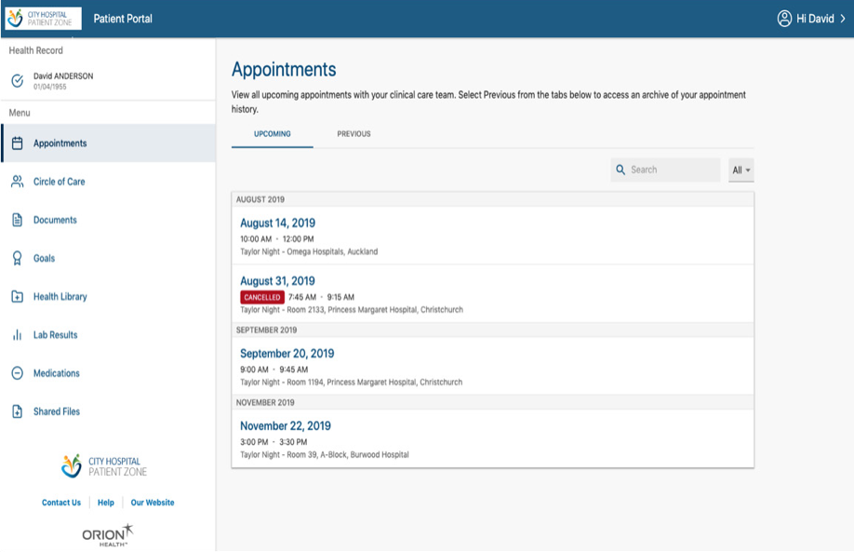
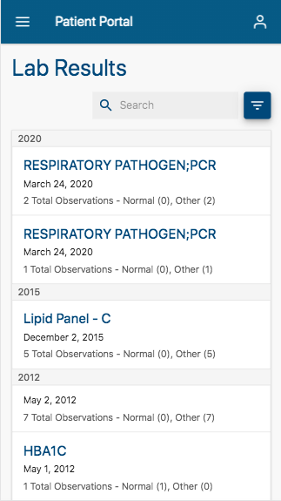
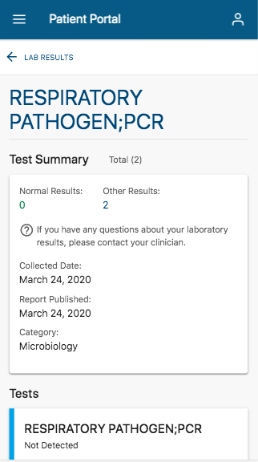
Outbreak Management Solution components – Engage Patient Portal
Reduce resource time for negative result handling
Safely send Covid-19 laboratory results to citizens
Notes:
Related to the ‘Engage’ strand of the previous slide here are some screenshots of test data from our Engage – Patient Portal. This can be made accessible to citizens to receive test results. The benefit being that this saves resource and telephone time responding to citizen test result calls or phoning through to communicate them.
I will now handover to our Clinical Consultant Pauline McClean who will talk through one of the use cases identified in the UKI related to our Outbreak Management solution.

Slide 15
Case Study 1: Free up acute hospital bed capacity by discharging COVID-19 patients who have had complications (e.g. pneumonia) earlier than normal and monitoring those patients at home
Patient referred for discharge to ‘virtual ward’
Patient setup in RPM within Outbreak Management Solution
Clinician reviews RPM Triage Dashboard
Clinician reviews and adapts monitoring plan
Provider assesses severe cases and patient presents back to hospital
Provider Actions
HOME
Future
HOSPITAL
Hospital Discharge
Patient Actions
Patient tests Outbreak Management Solution access
Patient completes assigned monitoring plan
Patient on target and removed from monitoring plan and virtual ward
Note - Patient or clinician can telephone each other directly were required
Orion Health Group of Companies
Notes:
Working with one of our customers – NHS D&G, we were able to explore how the Outbreak Management Solution can assist them using our Virtual Care tool. They already have a successful process to manage the ‘virtual ward’ of discharged patients using Orion Health’s shared worklist functionality.
Their use case was to support patients with COPD and Covid 19 at home following discharge, and potentially to allow for the early discharge of some patients.
Sending patients home with monitoring devices such as pulse oximeters and thermometers and enrolling them onto our Virtual Care monitoring platform prior to discharge, means the staff can do a run through and familiarise the patients with the devices and how to report on their health activities, such as temp and oxygen saturation values using their preferred digital technology, phone, tablet or laptop.
The clinical staff in the integrated respiratory teams can them manage by exception those patients who need closer monitoring because the overarching protocols for monitoring the COPD responses have inbuilt pre-configured alarms set around the parameters of SaO2 and temp. They are presented with a ‘triage’ list of these patients to manage. This differs from current practice of telephoning every patient every day – now the only need to call where they are concerned, however, the protocols also direct the patient to contact either their respiratory nurse or the emergency services if they are at all concerned. It is not an emergency monitoring system.
Where patients have not been compliant and aren’t completing their monitoring, again a list of patients is available for them to proactively manage and call to see if there are any issues.
The tool is part of the Orion Health product stack and is successfully implemented most notably in Canada where it has been used to monitor over 30,000 Congestive Heart failure and COPD patients since 2010 reducing hospitalisations by 27,000 and A&E visits by 46,000. In this use case the tool is intended to enable earlier hospital discharge to free up bed capacity for more critical patients and also to reduce administration of patients at home through follow up calls by allowing management by exception.

Slide 16
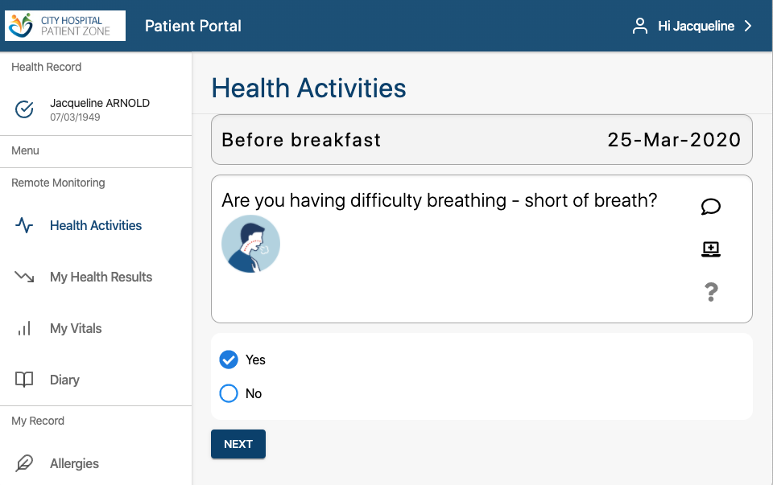
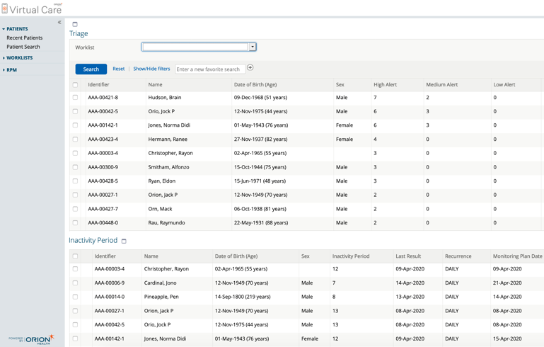
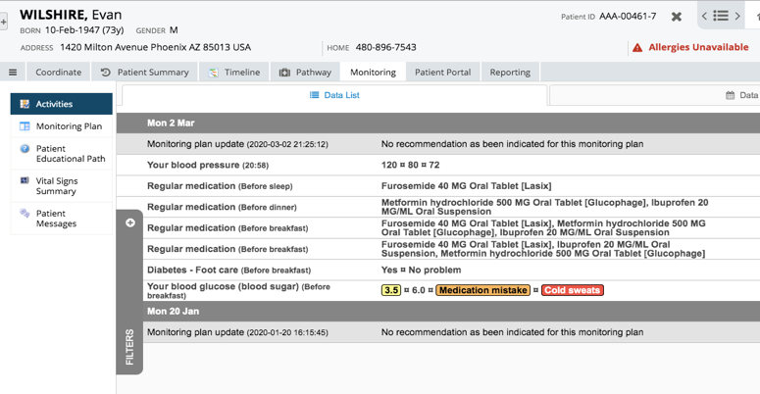
Outbreak Management Solution components – Virtual Care
Remote monitoring enables earlier discharge to free beds
Manage patients by exception to optimise resource and capacity
Access the completed health activities detail
Empower citizens to record symptoms
Structured data capture
Notes:
We wanted to ensure that we also shared some of the look and feel of our products in this presentation. Here are some screenshots from the Virtual Care – Remote Patient Monitoring tool…

Slide 17
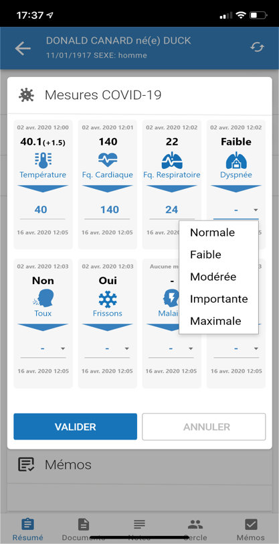
Case Study 2: Free up ICU bed capacity by monitoring less sick COVID-19 patients at home
Terr-eSanté, Paris case study:
Regional health agency for Ile-de-France
Enables remote monitoring of patients affected by the epidemic and confined to their homes
Patients inform self—monitoring criteria several times a day, in accordance with current health recommendations
Healthcare professionals can follow the progress of their patients in real time
Went live on 13 March 2020 with 70 patients
Latest update:
4,575 COVID patients currently enrolled and being tracked in solution
1,590 patients out of the solution
Notes:
The next step is to provide some patients at home with a ventilator in order to keep them out of the hospital where the beds are reserved for critical patients.
What we did with Terr-esanté was adult oriented. Now that we're getting more patients in, the Ministry of Health and hospitals are now working on different questionnaires for children and retired population.
You may not want to monitor adults, children and elderly with the same kind of questionnaires. The symptoms could be slightly different. What we did with Terr-esanté was adult oriented. Now that we're getting more patients in, the Ministry of Health and hospitals are now working on different questionnaires for children and retired population
The ‘Outbreak Management Solution’ is composed of a number of different Orion Health products, the extent to which each is applicable will vary from customer to customer. We are finding that components of this solution meet different customer needs as opposed to necessarily the overall end to end picture.
On the right we have ‘Engage’ which articulates functions provided by our ‘Engage – Patient Portal’ product:
The product enables simple patient onboarding and symptom reporting as outlined earlier in this presentation
The most applicable use case that we have identified in the UKI is for Engage to provide citizens with a central repository to access Covid results, reducing phone line burden for ‘negative’ patients.
We have referenced ‘Medication Adherence’ here as it is a capability that we offer from engage but have found that UKI use cases are still evolving and have not required the capture of this yet but we believe that it will come in future.
Manage – In this section we highlight two other product components of the ‘Outbreak Management Solution’ to assist with the remote management of citizens:
Our Coordinate – Collaborative Worklists enable users to categorise citizens into different configurable lists for example ‘New patients’, ‘Suspected Covid Patients’, ‘Positive Covid Patients’ or as the use case requires.
Our Virtual Care – Remote Patient Monitoring tool enables citizens to record symptoms at home or in the community. These results will flag to a user, those of concern can prompt intervention whilst those that are ‘normal’ can be acknowledged. This tool enables earlier hospital discharge, to free up capacity, and allows more ‘management by exception’ preventing the need to call each remote citizen each day.
The Data science strand is the most advanced offering within the solution and is made up of analytics and reporting through our ‘Discover’ product and our Data science services. For the former we can provide dashboard reporting for customers to provide population level statistics related to Covid to help them identify where tested citizens and key workers are. We are in the process of discussing deployment of this with one customer in the UK currently. Regarding the latter we hope to be able to use the vast amount of data that our solutions will generate to enable more predictive analytics for example assessment of patient risk. One key pre-requisite for this strand is that the data required is available through existing Orion Health products and others sources to ensure population of dashboards and predictive models accordingly.
I will now handover to our Clinical Consultant Pauline McClean who will talk through one of the use cases identified in the UKI related to our Outbreak Management solution.

Slide 18
Key takeaways
Collaborative approach
Identified benefits
Empower citizens
Optimise resource time
Free up capacity through earlier discharge
Shared care records available to any front-line staff who need it
Structured data to enable analytical insights
Key principles
Clinically driven use cases
Rapid deployment
Minimal change management
Measured solutions
Notes:
Thanks Ben, that almost brings us to the end of our session. Before we close for questions and answers I just wanted to step over some key takeaways:
We have worked to ensure that we take a collaborative approach with customers to ensure that any solutions are use case driven.
In the process the tools available through our ‘Outbreak Management Solution’ and extended local shared care record have defined the following benefits:
Empower citizens through letting them track symptoms and have access to results.
Optimise resource time by enabling automated result sending and remote monitoring of patients.
Remote monitoring enables earlier discharge and can free up bed capacity for those most in need.
Build upon existing care records to share key data to those front line staff that need it.
Capture of more structured data in forms to drive analytical insights
Along with the benefits we have tried to adhere to the principles listed to ensure that solutions can be effective and meet the use case but at the same time have potential longevity.

Slide 19
NHS – thank you
Notes:
That concludes our presentation. We at Orion Health would like to extend our deepest gratitude to everyone in the NHS who have worked tirelessly to support the British population over recent weeks.

Slide 20
Q&A
Contact Details
jocelynpalmer@nhs.net
bruce.horne@orionhealth.com
ben.wilson@orionhealth.com
nicole.allan@orionhealth.com
pauline.mclean@orionhealth.com
Useful Links
https://orionhealth.com/global/solutions/outbreak-management-solution/
https://orionhealth.com/nz/knowledge-hub/white-papers/how-technology-can-help-alleviate-the-covid-19-crisis
Notes:
Thanks again and here are our contact details should you wish to understand more after this call.
We would now like to turn the session over to a Q&A.

