Slide 1
Digital Staff Passport to support COVID-19

Slide 2
Panellists
Melanie Whitfield NHSE&I People Directorate | Head of Improving People Practices, People Directorate
Daniel Elkins NHSE&I People Directorate | Managing Partner, Productive People
Emma Turner NHSE&I People Directorate | Improving Employment Models Lead, People Directorate
Phil Stradling NHSX | Architect
Andrew Temple Blackpool Teaching Hospitals NHS FT | Health Informatics Project Manager
Philip Graham Blackpool Teaching Hospitals NHS FT | Digital Programme Director

Slide 3
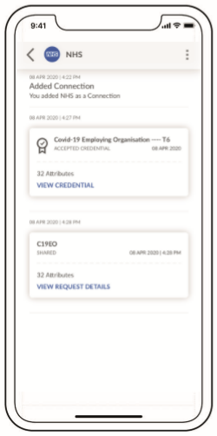
Agenda
Introduction and the Case for Digital Staff Passports | Melanie Whitfield NHSE&I People Directorate
Passporting Solutions and the Scope of the COVID Digital Staff Passport | Melanie Whitfield NHSE&I People Directorate
Technical Architecture | Phil Stradling NHSX
COVID Digital Staff Passport – How it works, sign up process and testing and beta plans | Daniel Elkins NHSE&I People Directorate
End to End User Experience | Andrew Temple Blackpool Teaching Hospitals NHS FT
Questions and Answers | Philip Graham Blackpool Teaching Hospitals NHS FT

Slide 4

Case for Digital Staff Passports
Prior to COVID, there was a strong and growing case for a Digital Staff Passport to enable and simplify the high volume of staff movements between NHS organisations. A verified employment record held on staff’s own smartphones would significantly reduce the need for duplication and provide assurance to colleagues and NHS organisations. It is estimated that up to two days are lost through duplication of employment administration and core skills training whenever staff move between NHS Trusts.
For COVID, plans have been accelerated for an interim COVID-19 Digital Staff Passport while the full product is being developed. The temporary COVID Staff Passport will enable rapid staff transfers, particularly supporting significant movements of staff to the Nightingale Hospitals.
Verification of identity and pre-employment checks
Introduction of the COVID Staff Passport will:
Replace some of the manual processes to reduce the time to on-board staff for providers and individuals
Reduce the burden on clinical and administrative staff
Provide a legal agreement and verification of key employment checks to ensure the member of staff able to be work at another location safely.
Suitable for temporary or bank staffing
Reduction in time to onboard staff

Slide 5





COVID User Scenarios
I am a community nurse employed by a community trust and I am being deployed into my local acute trust to support COVID-19 response. I need to be able to demonstrate my right to work in the acute trust.
“I am a respiratory physician at an acute trust currently. My services are now required at another trust, how do I demonstrate I have the relevant employment checks?”
I am a retired physician and have volunteered to come back to work in the NHS. I have been through checks with one provider and asked to work in another trust, I am keen to get on with quickly treating patients
I am a nurse with ICU skills and have volunteered to work in a NHS Nightingale Hospital. I need to be able to demonstrate to NHS Nightingale that employment checks have been completed by my current employer.
I am a GP trainee, currently on rotation at one trust. I was previously in A&E at neighbouring acute on rotation. I am now being deployed back to previous placement and need to demonstrate I have the appropriate employment checks in place

Slide 6




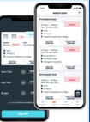
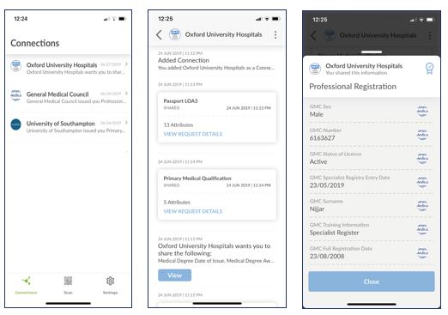
Passporting solutions
There are several ways in which staff can be moved between NHS organisations and the Digital Staff Passport builds on and is compatible with all of these.
Solution |  | When to use
Workforce Sharing Agreement (aka MOU) |  | Should be used for transferring staff from outside the NHS (e.g. Primary and Social Care) as it provides a legal agreement between parties.
NHS Smart Card |  | Provides some evidence of identity and where somebody works and enables access to some systems.
ESR Inter Authority Transfer (IAT) |  | If an application has been created on ESR then the IAT can be used to pull across information, if entered, from current NHS employer.
ESR Self service record |  | If staff member has access to ESR self service, provides evidence of training record. Employment checks are implied, without specific information being available.
Collaborative Bank Apps |  | Enables bank workers to work in neighbouring providers in scope of the collaborative bank and relies on quality of identity and employment checks process for each system.
Digital Staff Passport (COVID version) |  | Available to all NHS providers and all staff. Provides legal agreement between parties. Employers verify quality of identity and employment checks.

Slide 7


Digital Staff Passport Scope
The Digital Staff Passport being launched very soon is the COVID version that is an interim solution to support the immediate needs of NHS organisations. The roadmap to the full NHS Staff Passport continues to be developed in the background.
Scope of COVID version 1.0:
Planned Developments for Full Passport :
Nationally available to all NHS providers for substantive and bank staff. CCGs and ALBs being considered
Future potential for primary and social care.
Additional credentials i.e. professional registration, assignments, training etc.
Simple, single credential covering key employment checks information
Future integrations with ESR, erostering and other workforce system to ensure full flow of real time data.
Verified data at moment of issue - valid only for the period of COVID-19
Embedded licence to attend thereby reducing need for MOUs or workforce sharing arrangements.
Trusted frameworks for each credential to underpin.
Ability to use for improved login to clinical and workforce systems.
Out of COVID scope:
New staff joining the NHS (checks need to be completed first), Agency workers and Non-NHS e.g.: primary and social care
Trusted data issued from sources like GMC, Passport office, DBS and others

Slide 8

Technical Architecture
A Digital Staff Passport for holding and presenting professional credentials
Credentials issued by authoritative sources - professional bodies, employers, etc
Enables single sign on (SSO) using multi-factor authentication and federation
Based on Open standards for exchanging credentials and SSO:
  Verifiable Credentials - https://w3c.github.io/vc-data-model/
  Decentralised identifiers - https://w3c-ccg.github.io/did-spec/
  OpenID Connect - https://openid.net/connect/
My staff passport of professional credentials
Issuers | Credential
Medical university | Medical degree
GMC | Licence to practice Re-validation
NHS organisations NHS Identity/Post Office | Proof of identity Proof of address
Hospital Occ Health | Occupational health check
DBS | DBS Advanced Adult & Child check
Issuer
Issues
Holder
Acquires, Stores, Presents
Credentials
Verifier
Requests, Verifies
Issue
Credentials
Send
Credentials
Register
Identifier
Verify Identifier
Ownership
Verify Identifier
Ownership
Identifier Registry
Maintain Identifiers

Slide 9





How COVID Digital Staff Passport works
Staff will hold and share a verified record of their digital identity and employment checks on their own smart phone in a tamper-proof format that they can present to any other NHS organisation they are deployed to.
Employer verifies the employee identity and employment checks
Held securely on staff members own smart phone
Hospital receives digital verification of employment checks

Slide 10
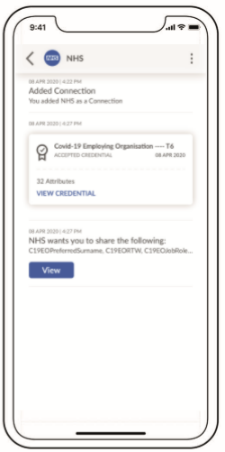
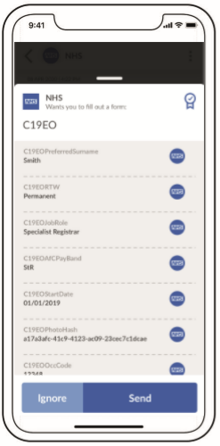

COVID Digital Staff Passport
Designed to be user friendly with the staff member having control of sharing their own verified information. Provides the staff member with the ability to take their information to any NHS trust and be onboarded in person or remotely by HR teams.
The connect.me app will soon be available for download from app stores

Slide 11
Getting your NHS Organisation Set Up
Each NHS organisation will need to sign up to some terms and conditions to issue staff passports and invitations will be sent to HR Directors as soon as the solution is ready.
HR staff will then be authorised to log in and will benefit from user guides to get started.
HR Director Check List
HR staff member checklist
Respond to invite to register your organisation to participate or email nhsi.digitalstaffpassport.nhs.net
Agree to the Terms of Use (including Licence to Attend, Data Processing Agreement)
Nominate member(s) of the HR team to issue/verify credentials
Communicate introduction of the Digital Staff Passport to relevant managers and staff and invite staff to go through the 5 step process.
Start using issuing and receiving digital staff passports
Log in via the portal when you receive joining instructions
Look at user guides and support that will be available at www.staffpassports.nhs.uk
Start issuing and receiving digital staff passports
Issue employment checks credential to existing staff when they are required to work elsewhere
Receive verified staff passports from staff you are receiving from other NHS organisations
“Don’t forget to let me know about the Digital Staff Passport as I can use it today enrol on other Trusts staff banks”

Slide 12


Simple 5 Steps for Users
Staff member
Current HR team
New HR team
Staff member
1
2
3
4
Contact your HR department to issue you with your new Digital Staff Passport with either face to face or video call to verify identity
Download the app and you will be invited to connect your app to your employer so your verified employment checks can be issued onto your Digital Staff Passport
Contact your new employer to share your Digital Staff Passport. You will be invited to connect to your new employer so they can securely receive the employment checks information.
Complete local orientation and gather equipment
5
Start Working
Overview of the solution, how it works, FAQs and guides will be made available at
www.staffpassports.nhs.uk
(under construction)

Slide 13

Test Pilots and Beta
Trusts and ICSs up and down the country have asked and offered to be involved in the testing and piloting of the Digital Staff Passports, as represented on the map.
Trusts have been carefully selected to represent different regions and a spectrum of acute, community and mental health providers and CCGs across England.
Communications will be sent across the HR and CIO communities to advise of progress and when the product will be available for all providers and CCGs.
Digital Staff Passports will supersede the need for local workforce sharing agreements (aka MOUs) and will provide greater assurance for organisations and staff.
This map will continue to be updated as the number of testing partners increases in advance of national roll out.

Slide 14
End-to-end User Experience

Slide 15
End-to-End User Experience
Setting up your NHS Organisation
Email received by HR Director
Agree Terms and Conditions (inc. Licence to Attend, Data Processing Agreement)
Nominate members of HR team to issue/verify Digital Staff Passport credentials
Employer issues digital passport to Worker at Hospital A
Support Worker to Download App
Create a connection with Worker
Issue Worker with COVID Employment Credential
Worker is onboarded with digital passport at Hospital B
Create a connection with Worker
Receive COVID Employment Credential

Slide 16
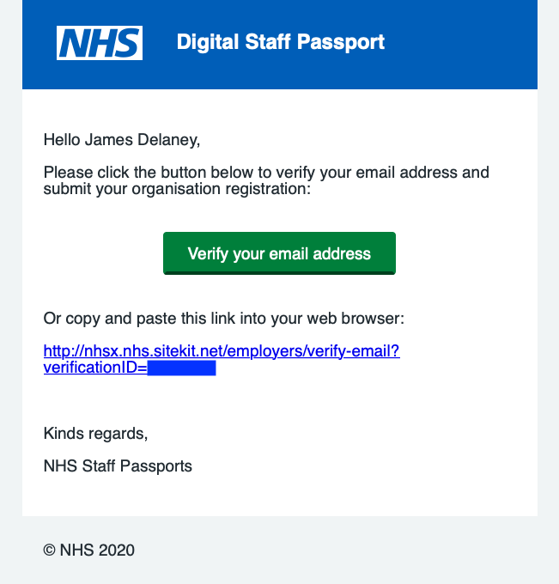
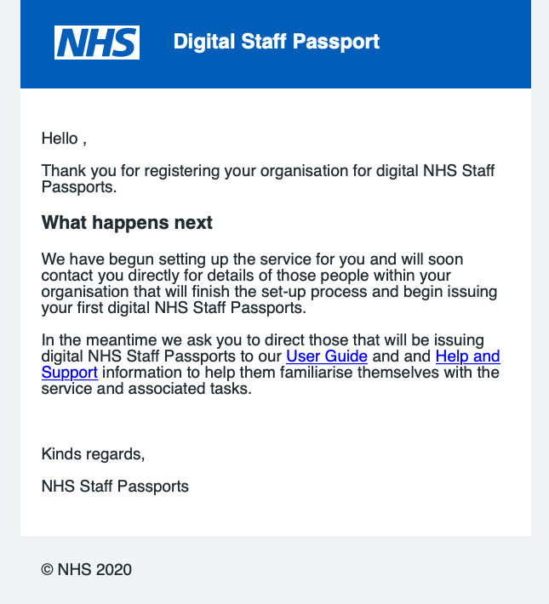
Setting up your NHS Organisation
Email 1) Request to verify email address
Email 2) Confirmation of successful registration submission

Slide 17
Employer issues digital passport to Worker at Hospital A
Important: Employer first performs Identity checks to a high Level of Assurance

Slide 18
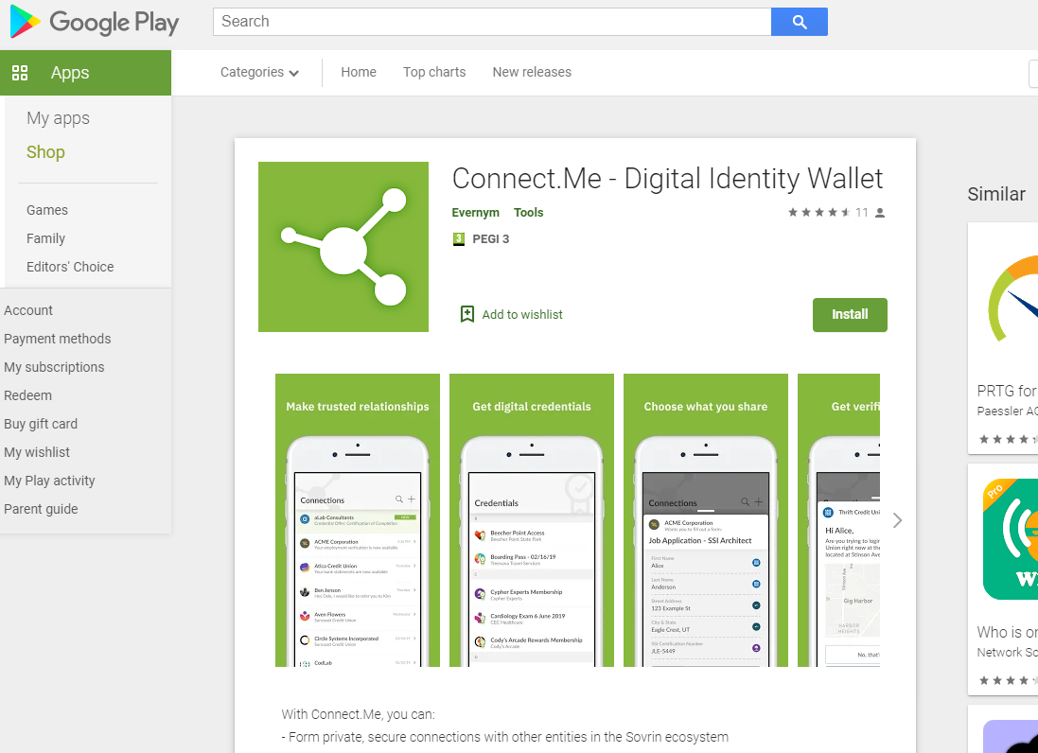
Supporting worker to download the app

Slide 19
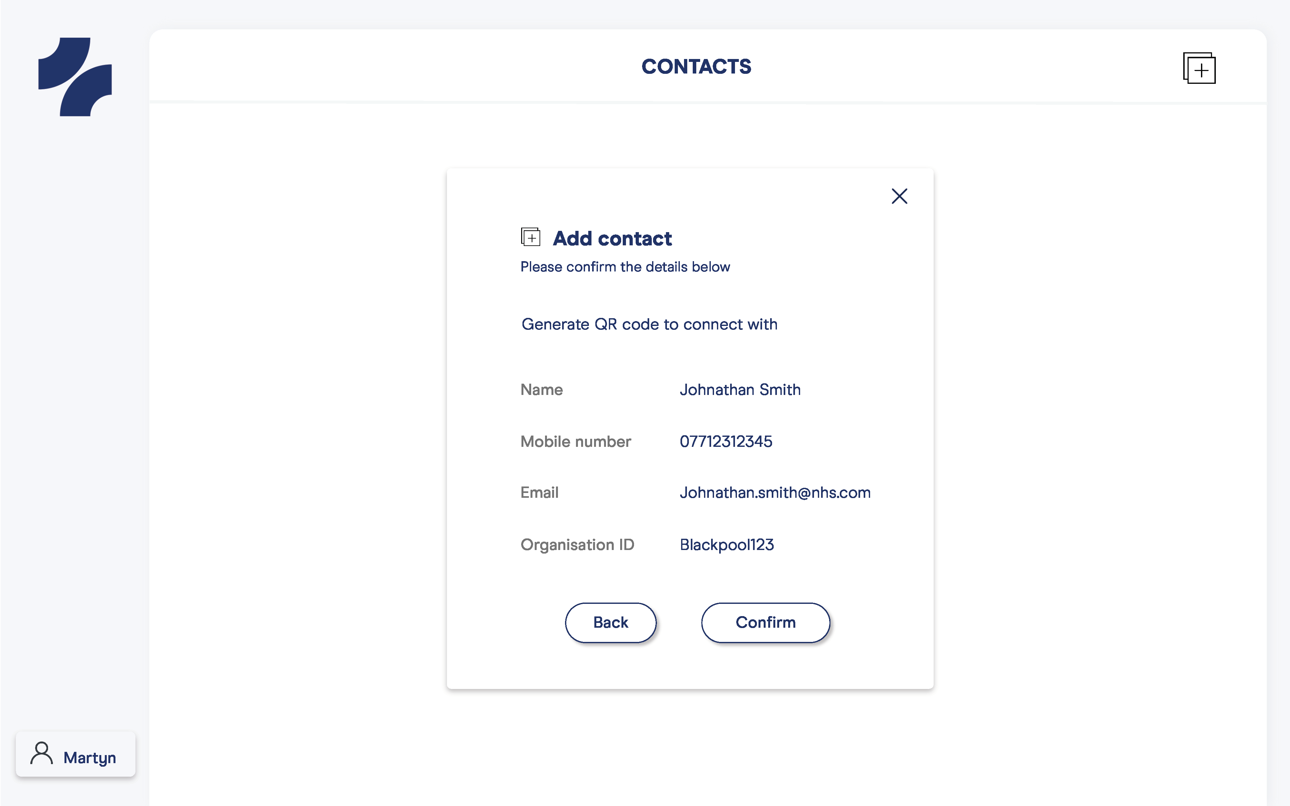
Make connection to Worker’s phone
© 2020, Truu Ltd

Slide 20
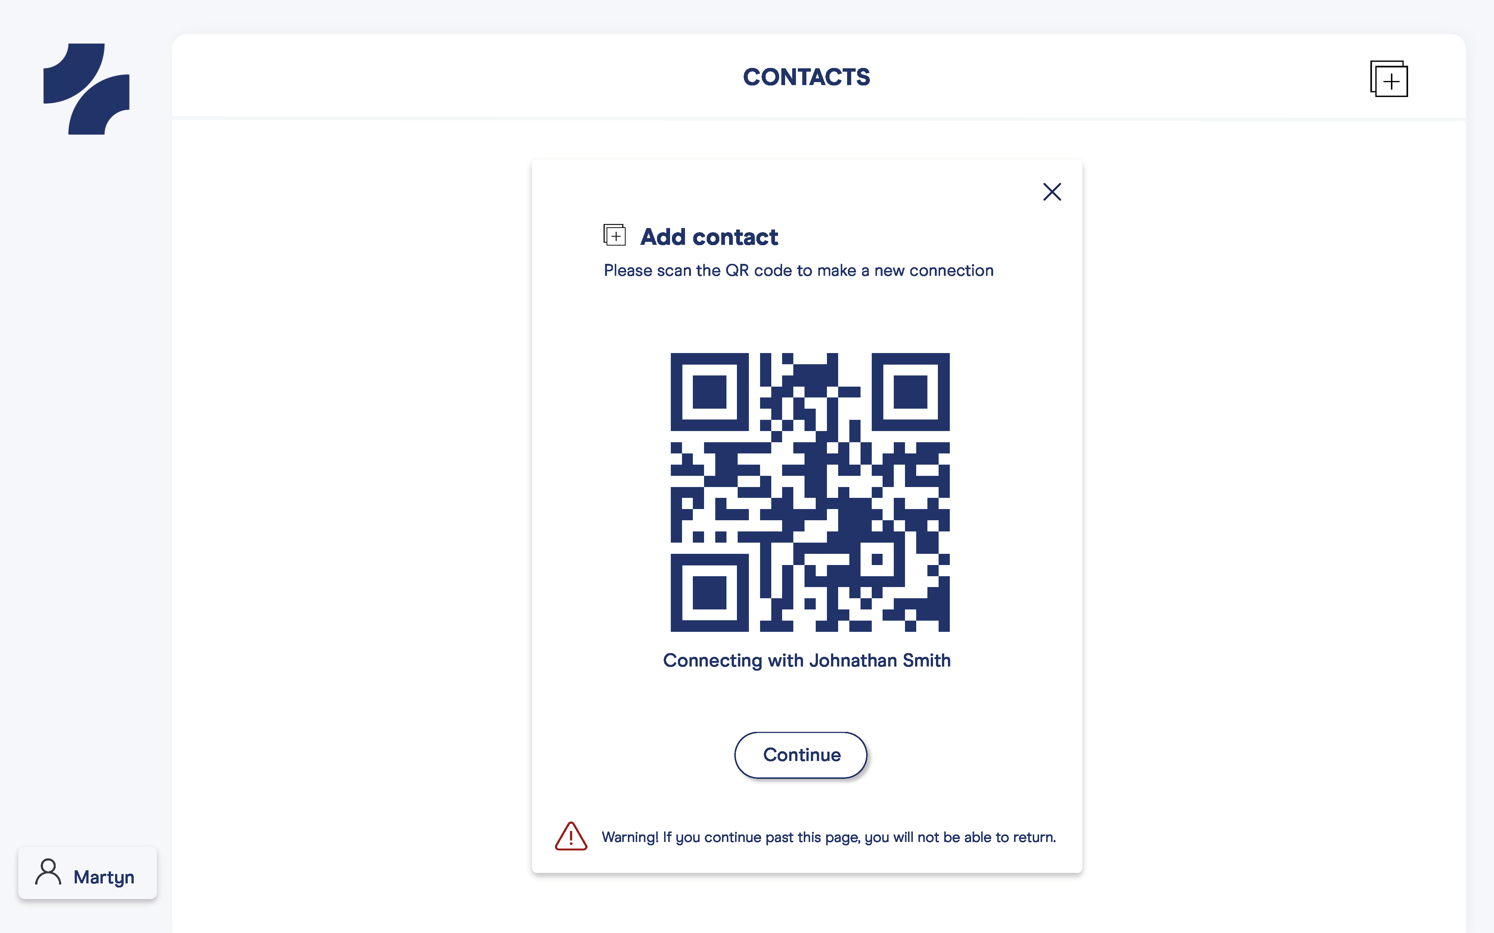
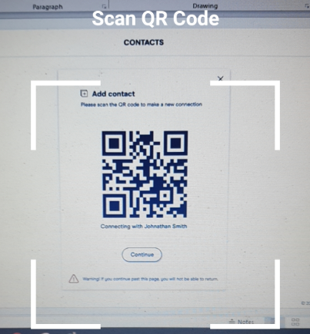
Worker uses phone to scan QR Code
© 2020, Truu Ltd

Slide 21
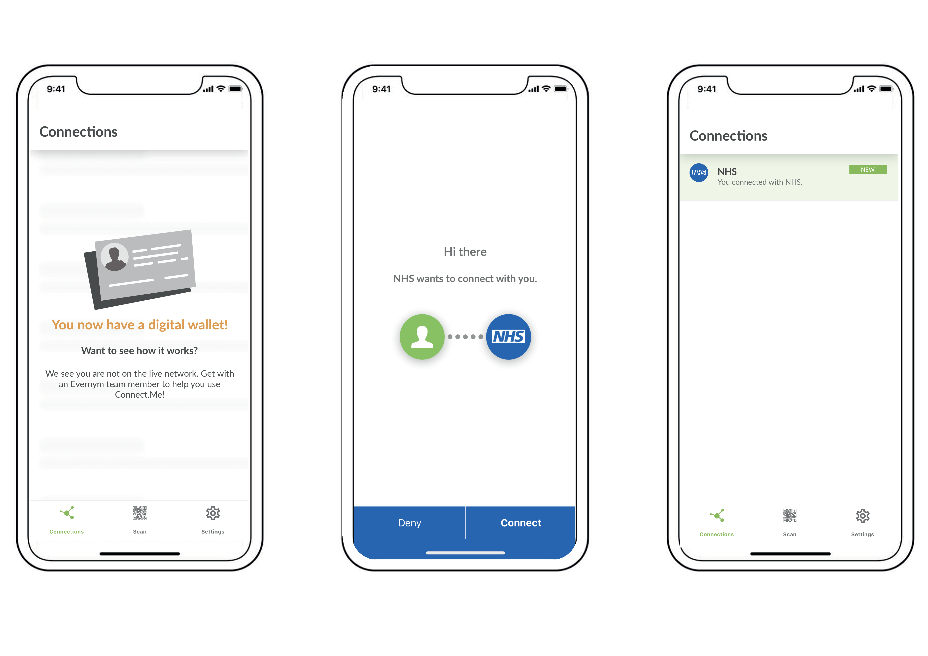
Worker receives digital connection
© 2020, Truu Ltd

Slide 22
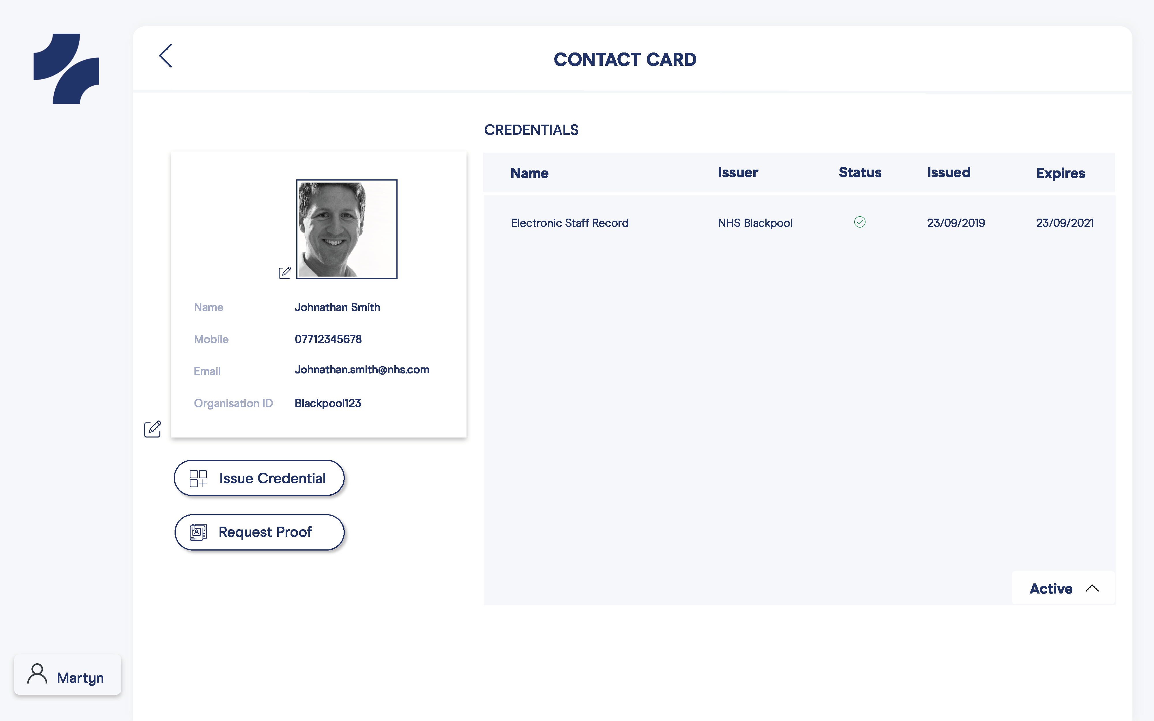
Worker’s photo is added
© 2020, Truu Ltd

Slide 23
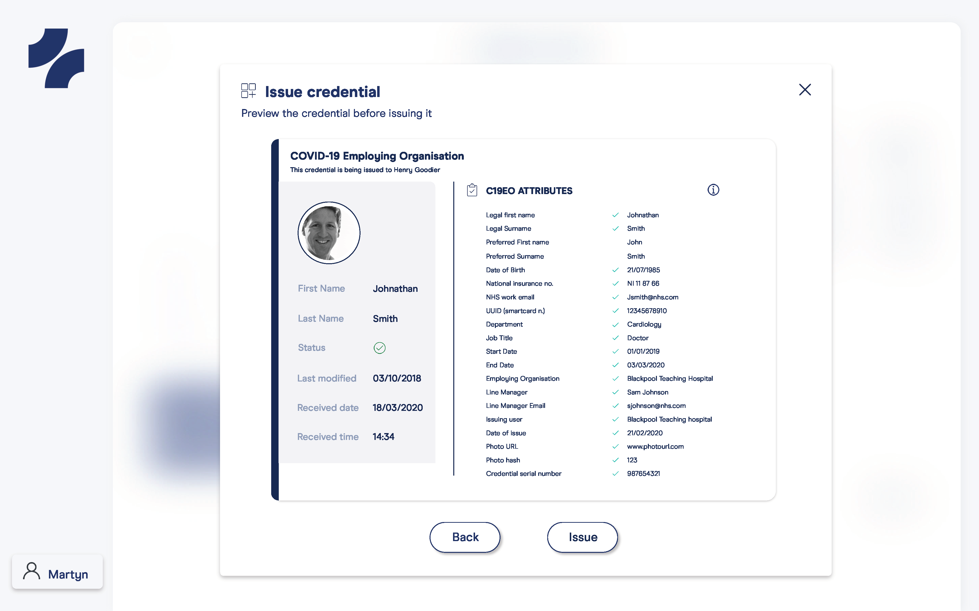
Employer Issues COVID Employment Credential
© 2020, Truu Ltd

Slide 24
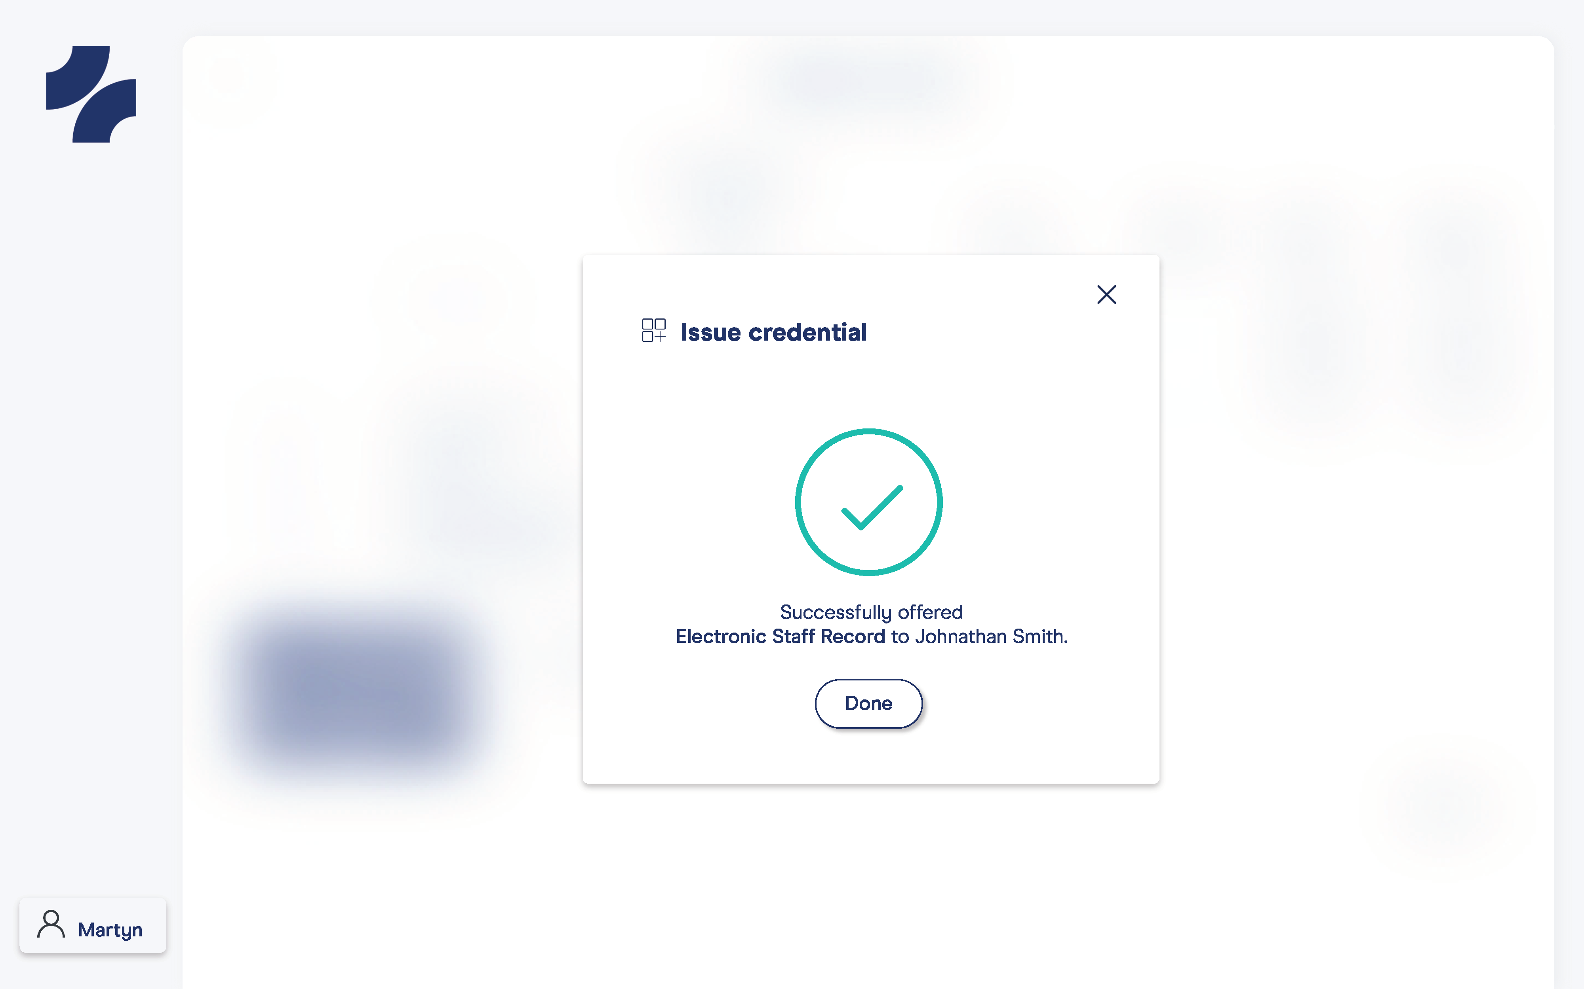
Employer Issues COVID Employment Credential
© 2020, Truu Ltd

Slide 25
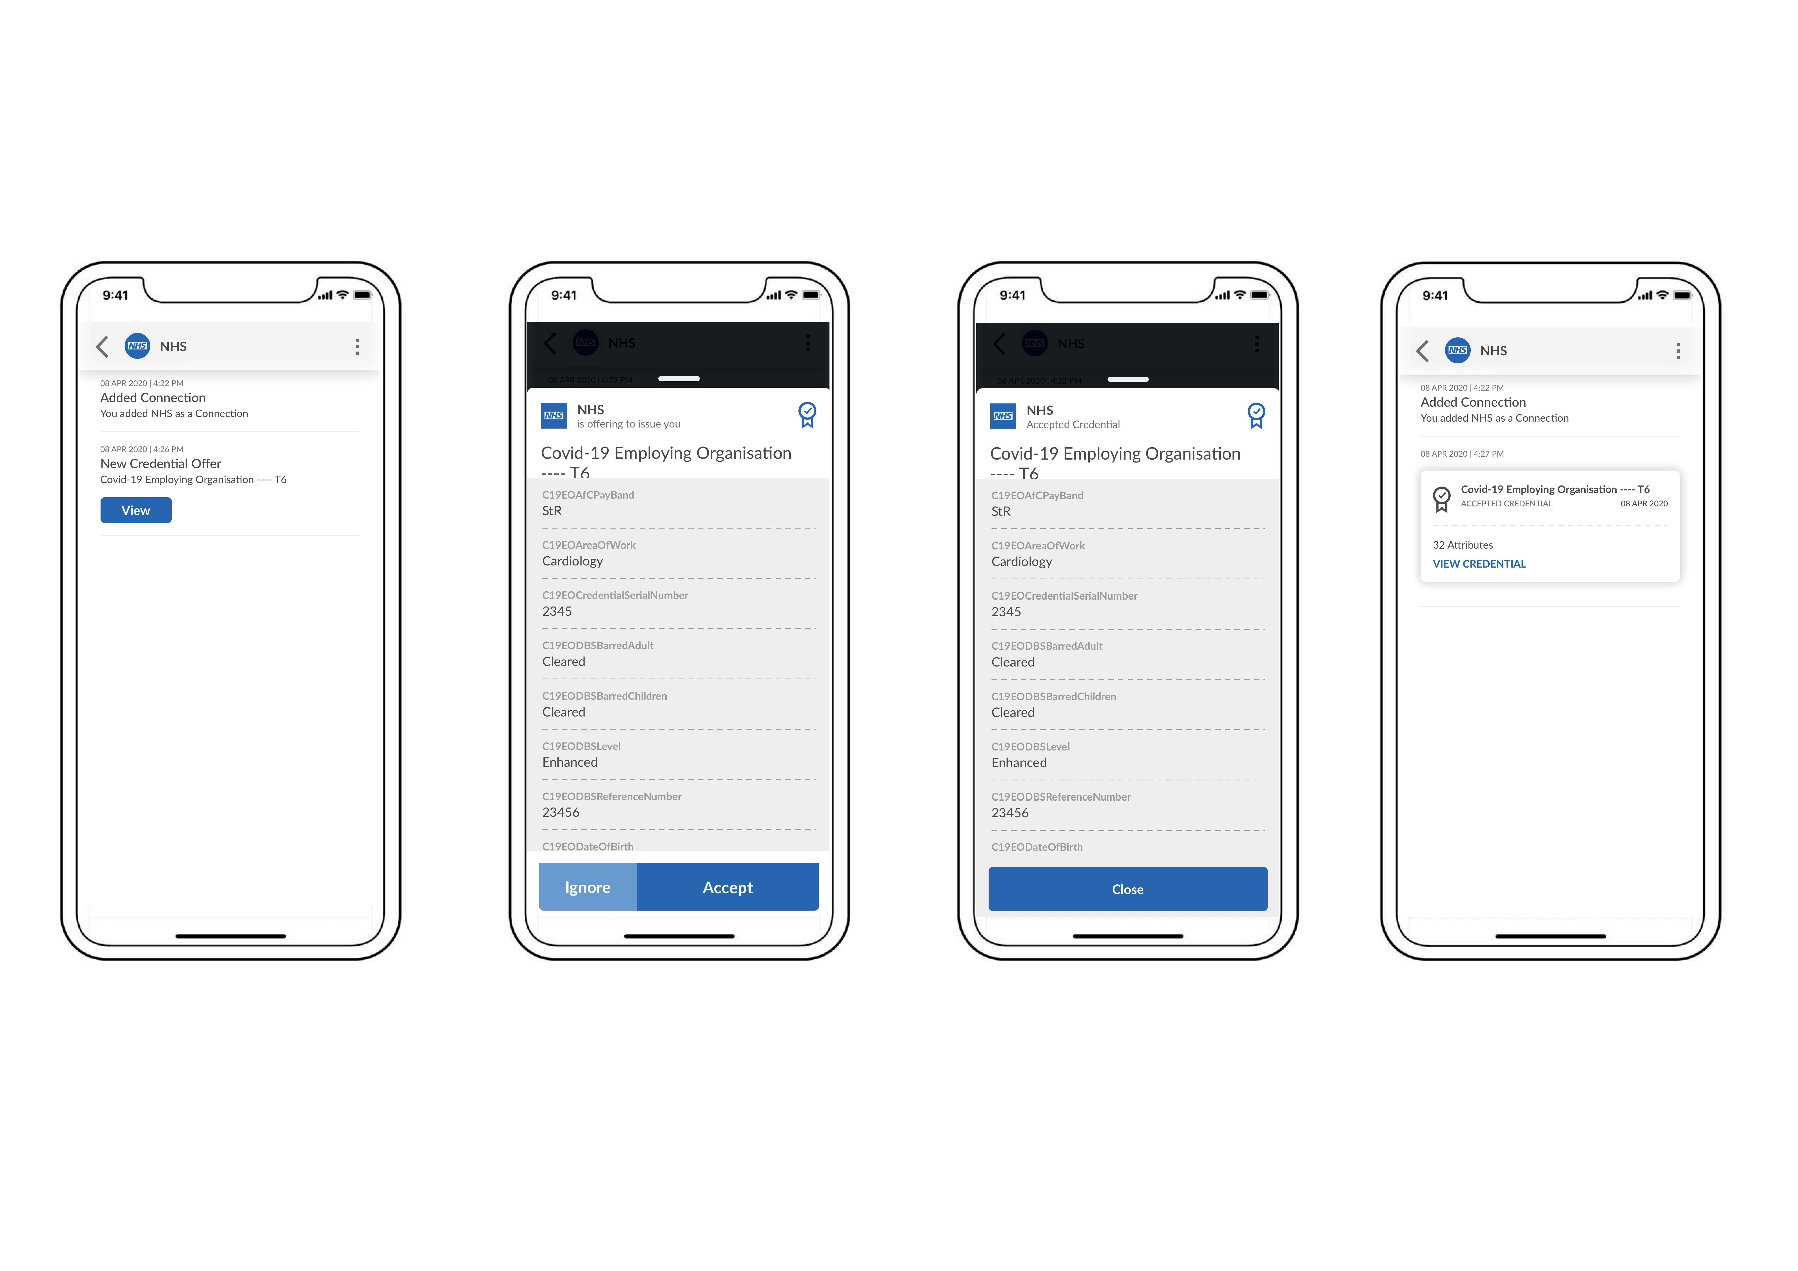
Worker’s Experience of Receiving Credential
© 2020, Truu Ltd

Slide 26
Worker contacts/arrives at Hospital B to start work

Slide 27
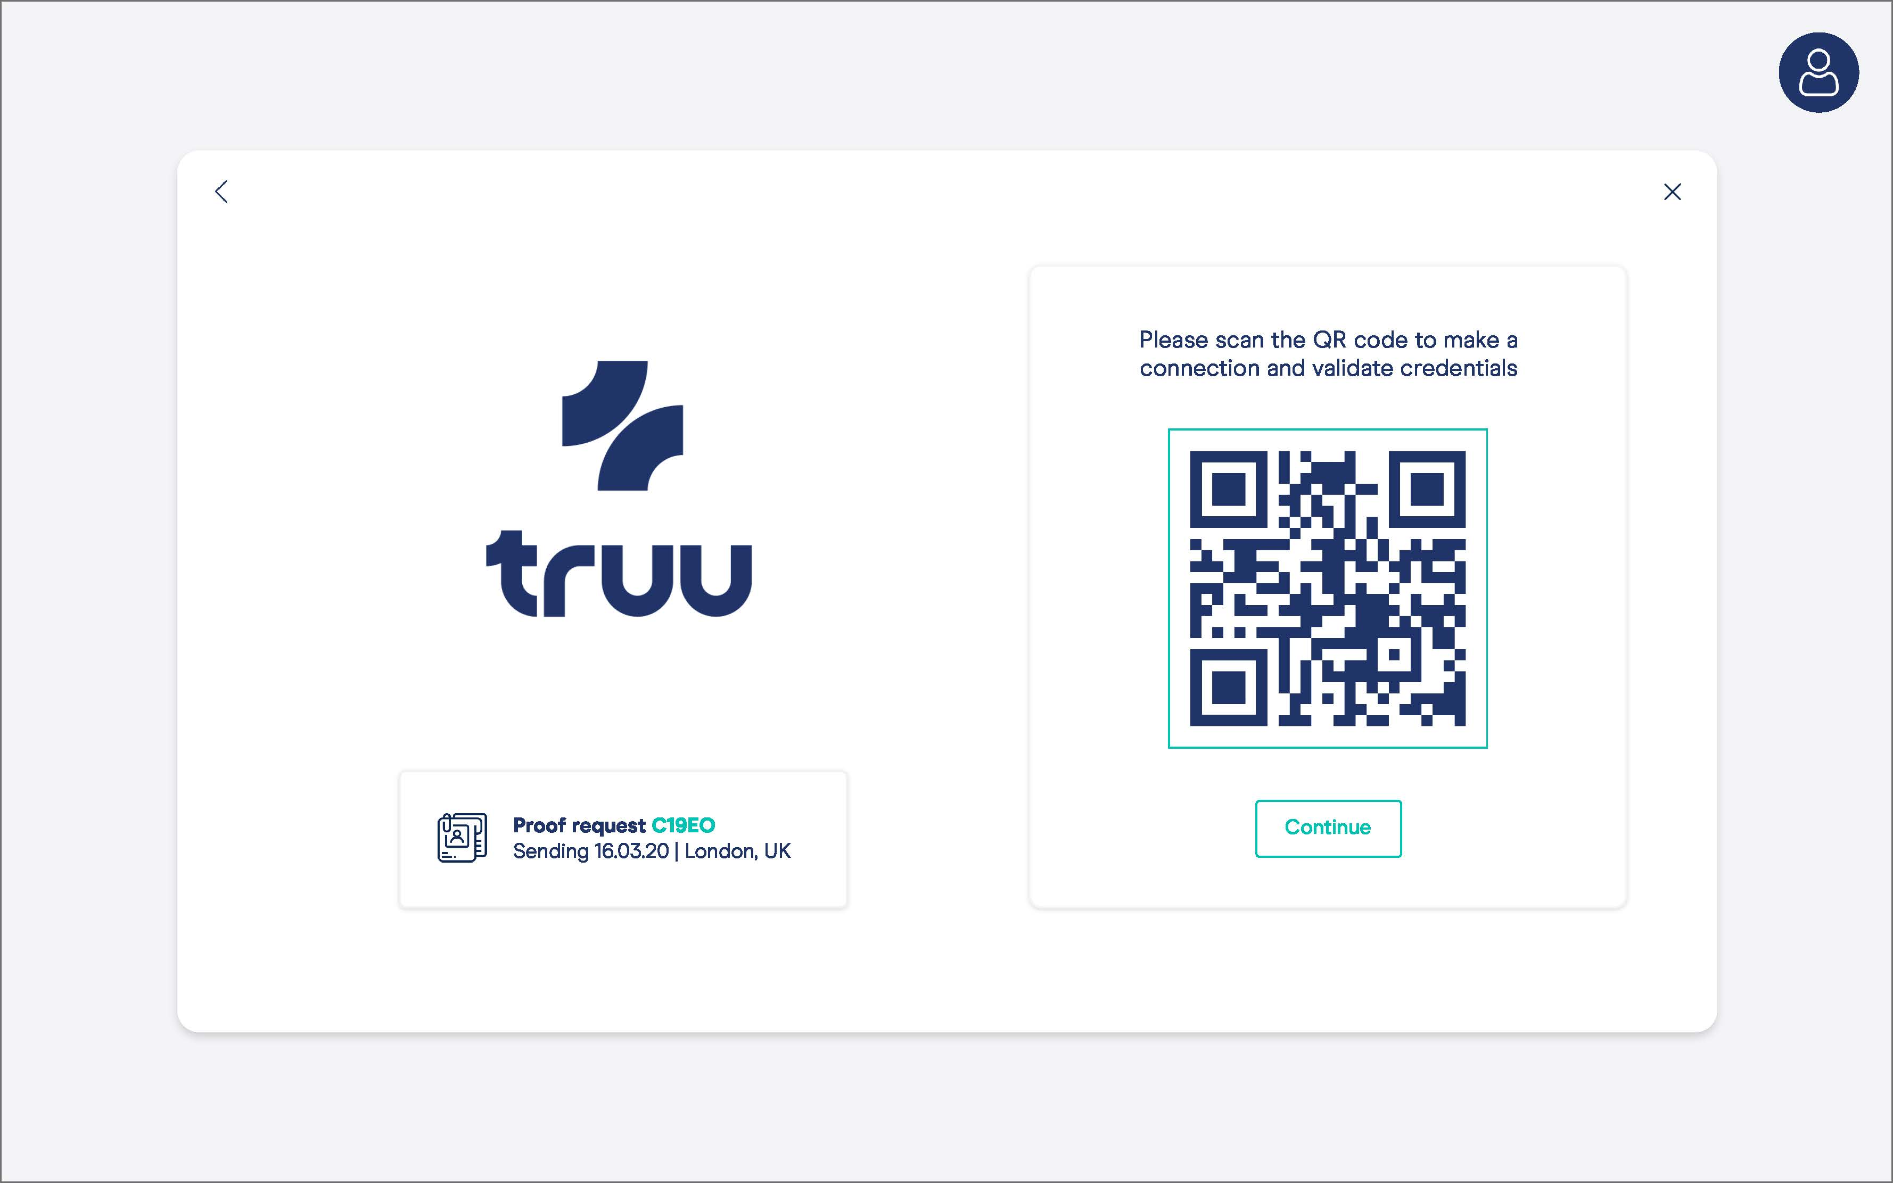
New Organisation Makes Connection
© 2020, Truu Ltd

Slide 28
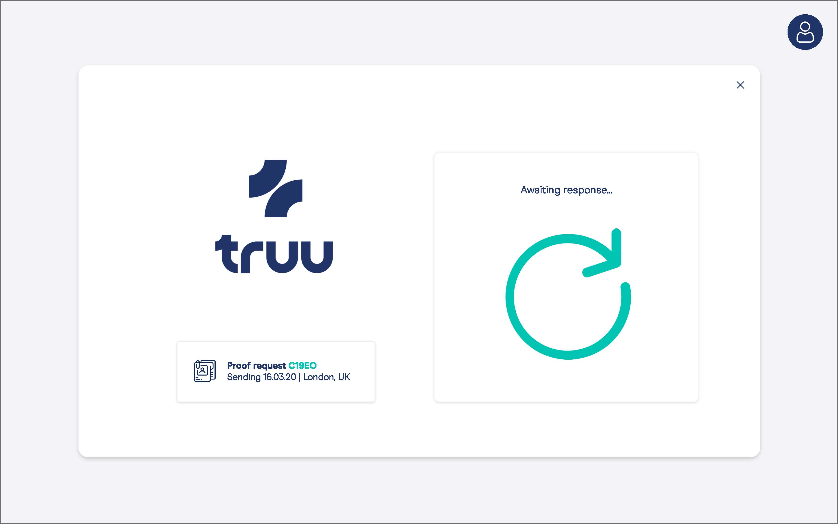
New Organisation Makes Connection and Requests COVID Employment Credential
© 2020, Truu Ltd

Slide 29
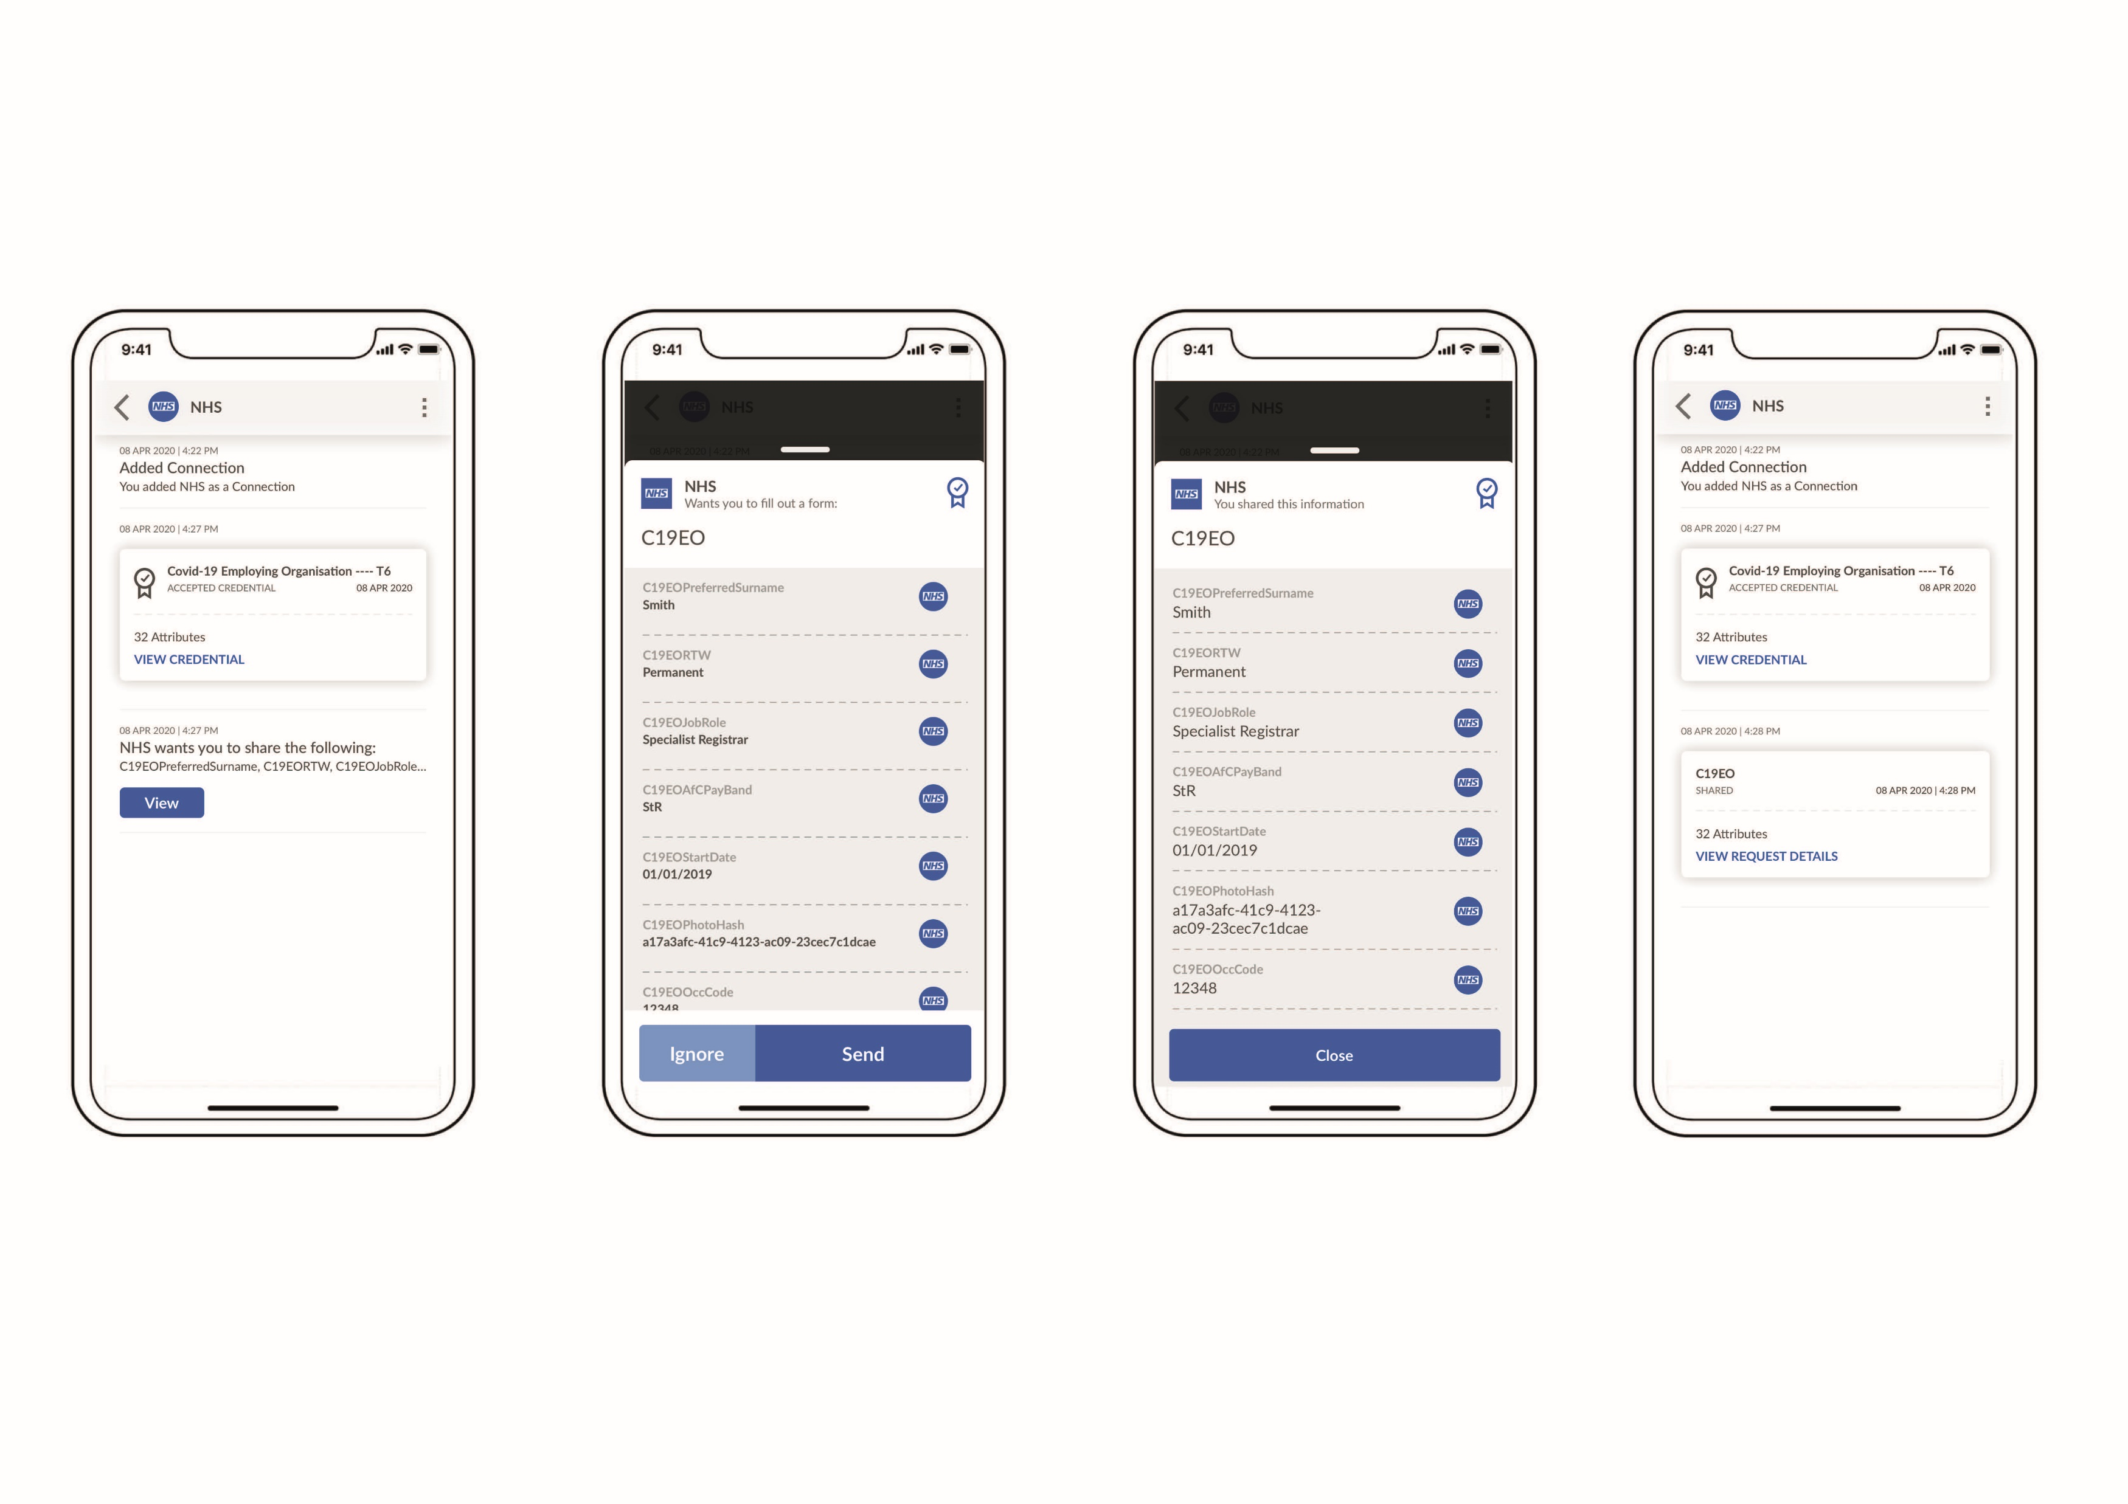
Workers Experience of Making Connection and Receiving Request to allow Credential to be viewed
© 2020, Truu Ltd

Slide 30
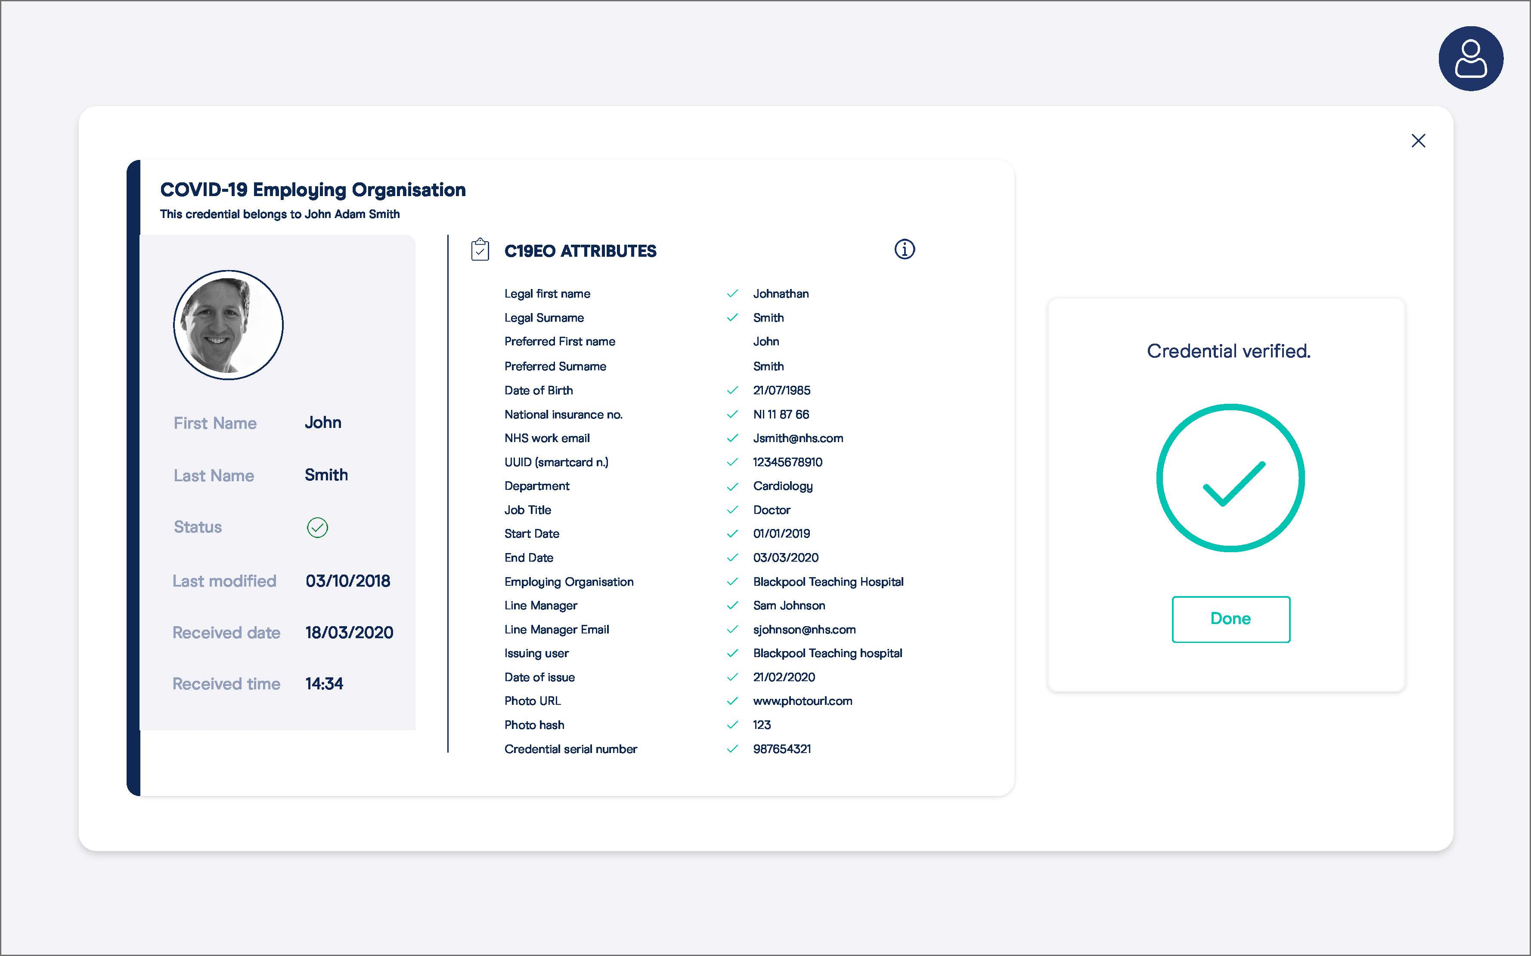
New Organisation Receives Verified Information and clears Worker to start work
© 2020, Truu Ltd

Slide 31
Contact Us
Please send requests for further information to:
nhsi.digitalstaffpassport@nhs.net
You will soon be asked to sign up your organisations through www.staffpassports.nhs.uk
(under construction)
Staff will be invited to download app via

