Slide 1
IG as an enabler at a time of crisis
Digital Health briefing and Q& A with Jackie Gray, Executive Director of Information Governance
2 June 2020

Slide 2
8 March 2020….

Slide 3
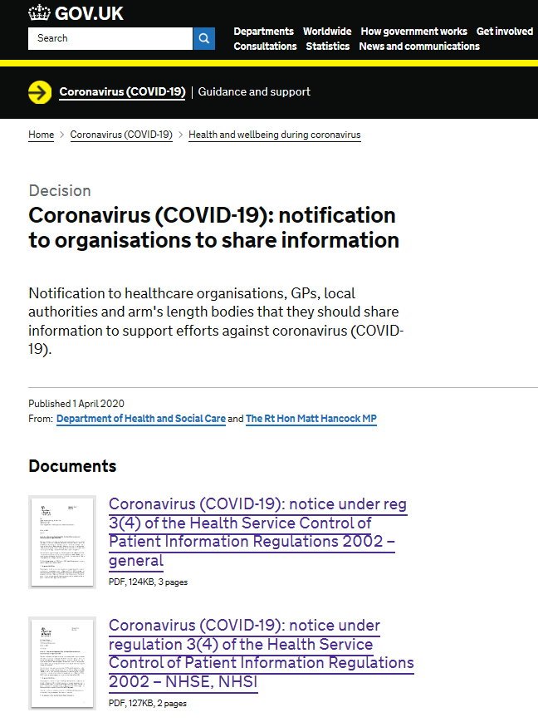
IG Framework
Section 255 Requests from National Services Scotland, Public Health Wales and the Department of Health and Public Health Agency (NI)

Slide 4
What has become apparent is how well our information governance framework is able to flex in a time of public health emergency to serve as an enabler to the rapid sharing of information while maintaining proportionate safeguards.
Dame Fiona Caldicott, 3rd April 2020
Data protection and electronic communication laws do not stop Government, the NHS or any other health professionals from sending public health messages to people, either by phone, text or email as these messages are not direct marketing. Nor does it stop them using the latest technology to facilitate safe and speedy consultations and diagnoses. Public bodies may require additional collection and sharing of personal data to protect against serious threats to public health.
The ICO is a reasonable and pragmatic regulator, one that does not operate in isolation from matters of serious public concern. Regarding compliance with data protection, we will take into account the compelling public interest in the current health emergency.
ICO Statement, 12 March 2020

Slide 5
NHS Digital COVID-19 Leadership & Command Structure
Gold Command
Supporting Functions
Sarah Wilkinson, Jonathan Benger,
Pete Rose, Jem Rashbass, Ben Davison
Programme Managers Product: Alison Cusack
Platforms : Jill Sharples
Access Logistics. Anna Hawksley
Data : Ian Boyd
Shielded Patient Service: Roarke Batten
Comms: Marc Silverside
Org. Response: Andrew Elliott
Gold Command
Workstream Leads
Other Key Execs (Tom Denwood, James Hawkins,
Julie Pinder, Dermot Ryan, Leila Shepherd, Carl Vincent)
Programme Management: James Hawkins, Nat Brewer
Silver Command
Finance: Carl Vincent, Pete Thomas
Communications: Matt Bacon, Marc Silverside (Deputy), Jo Bland (Internal), Lorna Branton (External)
Workstreams
Product Response
Platform Response
Data Response
Shielded Patients
Access Logistics Hub
Information Governance
Service + Cyber
Org. Readiness & Wellbeing
Product Lead: Ben Davison; Deputies: Ian Phoenix, Tim Magor
Platform Lead: Andrew Meyer
Deputy: Jill Sharples
Data Lead: Jem Rashbass
Deputy: Tom Denwood
Shielded Patient Lead: Mark Reynolds
Deputy: Stuart Gunson
Access Logistics Hub: Patrick Clark
Deputy: Anna Hawksley
IG Lead: Jackie Gray
Deputy: Gaynor Dalton
Cyber Security Lead: Neil Bennett
Org Readiness Lead: Nic Fox
Deputy: Julie Pinder
Testing: Ben Davison, Richard Ashcroft
Summary Care Record: Mark Burton
Data Front Door: Richard Clay / Rachel Habergham
SPL Data Management: Richard Irvine
Smart Card/ Readers: Mike Walker / Neil Gibbs
Live Services Lead: Sam Robinson
Staff Wellbeing & Org Health: Julie Pinder
111 Online: Matt Stibbs
Identity and Smartcards: Manish Loharuca, Phil Gill
Private Providers: Richard Steele
SPL Clinical Lead: Arjun Dhillon
HSCN Remote Access: James Ross
Workforce Planning and coordination:
Julie Pinder
Pathways: Mandy Williams
New Data Collections: Richard Irvine
Increased Bandwidth to NHS & Non-NHS Sites: Dan Parry/James Breeze
Technical Services and ICT: Dermot Ryan
NHS App: Chris Fleming
Open Data Publishing / Analytical Support: Chris Roebuck
HSCN Connectivity to New Sites: James Breeze
Facilities & Estates: Phil Kirtlan
EPS: Joanne Lambe
NHS.UK: Joe Risk
Data Processing Platform :Tim Gentry / Paul Giliatt
Field Hospital Liaison: Simon Dixon
NHS Mail and MS Teams: Chris Parsons
Commercial: Nic Fox
Primary Care + Vendors: Richard Alcock
ERS: Richard Ashcroft
Data Coding: Alex Elias
Field Hospital Cyber: Dan Jeffery
GP Remote Desktops/ Video Consultations: Richard Alcock
NHS Login: Melissa Ruscoe
NHS Logon
Volunteer Army
Smartcard Volunteer Army
Laptops: Dermot Ryan

Slide 6
NHS Digital COVID-19 Gold Report – 22 May, 2020 Overview of strategic focus areas supporting system-wide response to COVID-19
Provide digital channels for citizen guidance and triage | Providing digital channels for citizens to access information and guidance, self-manage and be routed to the most appropriate care, minimising contact and reducing the burden on clinical staff
Enable remote and collaborative care with systems and data | Enabling remote and collaborative care provision through digital systems and increased access to patient information, minimising transmission and managing strained capacity
Increase COVID-19 Test access and process efficiency | Increasing COVID-19 Test access and process efficiency through provision of digital infrastructure for drive-through test centres, roaming test vans and home testing services
Identify and protect vulnerable citizens | Identifying and protecting vulnerable citizens, to ensure that they can be shielded and receive additional support
Support planning across the system with data, analysis and dashboards | Providing data, analysis and dashboards to help the system understand prevalence and spread of infection
Get data and insights to research communities | Facilitating the sharing and availability of data and analyses to support research
Support clinical trials | Enabling acceleration of COVID-19 drug and vaccine clinical trials
Provide secure infrastructure and support additional capacity | Providing secure infrastructure and supporting additional care capacity through support and logistics for cross-system data access, fast-authentication of new users, Nightingale hospital facilities and private providers
Plan for recovery, restarting services and new needs | Planning for recovery, restarting services and adapting to the ongoing requirements of the health and care sector in the era of COVID-19
All COVID-19 initiatives are supported by Information Governance, Commercial, Legal and Live Services teams

Slide 7
NHS Digital COVID-19 Gold Report – 22 May, 2020 Overview of initiatives in support of the COVID-19 strategic focus areas
Major milestone reported in Executive Summary
Work ongoing
COVID-19 Strategic focus areas
Initiatives NHS Digital is delivering
Significant milestone reported in this update
Work complete
Provide digital channels for citizen guidance and triage (p.4)
Enable remote and collaborative care with systems and data (p.5)
Increase COVID-19 Test access and process efficiency (p.6)
Identify and protect vulnerable citizens (p.7)
Support planning with data, analysis and dashboards (p.8)
Get data and insights to research communities (p.9)
Support clinical trials (n/a)
Provide secure infrastructure and support additional capacity (p.10)
Plan for recovery, restarting services and new needs (n/a)
111 Online: eTriage and routing of patients to most appropriate care
NHS App: mobile access to eTriage and GP bookings, tests & prescriptions
NHS.UK: up-to-date health information and various digital services for citizens
NHS Login: secure identity verification for access to App and other NHS services
NHS Pathways: triage algorithms underpinning 111 online & call centres
Self-Isolation Notes: digital service to self-certify for COVID-19 if evidence required
Summary Care Record: augmentation for COVID-response
GP Connect: information sharing across primary and urgent care
Electronic Prescription Service (EPS): pharmacy flex and additional drugs
Video-consultations for Primary Care: assurance and rollout to >90% of practices
Video Consultations for Outpatients: rollout/implementation support to NHSE
Microsoft Teams Deployment: deployment to 1.2m NHS Mail users
NHS Mail for health and social care: rollout to social care and other new users
Digital platform for booking tests at new COVID-19 labs
Testing data capture, analysis and dissemination
Cyber Security Operations Centre: security services for Test Track & Trace
Shielded Patient List (SPL): developed & maintaining list of vulnerable patients
SPL Open Data: published V1 open data / visualisation of aggregated data
Vulnerable children: support safeguarding by sharing data with nurses, health visitors
ICU Capacity Planning Tool: new predictive models for beds & ventilators
Ethnicity Outcomes Analysis: analysis to investigate high BAME fatalities
Diabetic risk factors: linking data from national audit to support analysis
Social Care SitRep: prototyping daily collection: illness, testing & PPE
Secondary Care SitRep: data on COVID-19 patients and staff impacts
REACT1: data for community prevalence testing (antigen testing)
111 Open Data: published open data / visualisation for COVID-19 triages
Trusted Research Environment for SAGE: with NIHR/HDR UK
Central Disseminator of GP Data for research and planning
NICOR: analysis for cardiovascular status / outcomes and COVID-19
Data Access Environment for PHE: accelerating epidemiology
Plasma Trial: identification of eligible (recovered COVID-19) patients
RECOVERY Trial: providing hospital and testing data for trial evaluating treatments
PRINCIPLE Trial: primary outcome data for trial focused on older people
Connectivity: network upgrades and extensions within NHS and social care
Nightingale Hospitals: connectivity, technical / cyber
Fast and secure authentication: smartcards/readers, virtual smartcards
Returning Staff: advice and technical support for onboarding
VDI environment for Primary Care: virtual desktop to enable GPs to work remotely
Other infrastructure and cyber support: e.g. Laptops, cyber plans
Your NHS Needs You: survey for recruitment of returning clinicians
“Healthcare debt” monitoring: analysing activity, referrals & outcomes

Slide 8
Our Approach to IG
We have been rigorous around maintaining privacy and confidentiality but ensuring data flows to those who need it
Solutions focussed – we have been able to use the legal framework to solve problems and enable data to flow
Data accuracy, data minimisation, data security and transparency are key
Need to think ahead about how to control and manage data flows and solutions in the longer term, including reviews and exit arrangements when COPI Notices and COVID Directions expire
Tracking and record keeping has been essential
To manage workflow
COPI Notice requirements
GDPR record keeping requirements
COVID-19 Direction requirements
Transparency requirements
COVID-19 IG Red Team established

Slide 9
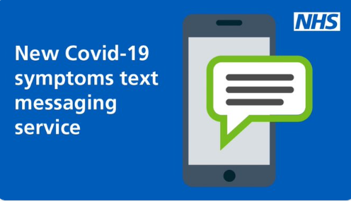
What IG has enabled

Slide 10
What IG has enabled

Slide 11
Challenges
Benefits
Urgency and competing and conflicting priorities
Pace of development
Establishing a single internal process for all new COVID-19 IG requests
Identifying the need for IG input across COVID-19 Programme
Operational and resource capacity (only 24 hours in the day!)
Accurate information: what data, from who, to who, why, what basis?
Benefits versus risks
Maintaining paperwork and records
Managing others expectations
Working across organisational boundaries
Legal framework that has enabled the flow of data
Confidence and empowerment
Working at pace and remotely
Team moral and “one team” spirit
Greater transparency of what data we are collecting, analysing and sharing
New and slicker processes
Learning by doing and setting risk tolerances
New tools, templates, knowledge and skills for the future
Stronger relationships across organisational boundaries
Closer working with ICO and NDG

Slide 12
Beyond COVID-19: “Stronger on the other side”
IG central to all that we do at NHS Digital and to digital transformation across health and social care
Transparency and Trust are key:
More transparency about what we do with data
Public and patient engagement and dialogue
Promote and explain what data sharing has achieved
Better IG guidance, tools and training:
Build on work started by Health and Social Care Information Governance Panel and NHSX
Article 40 Codes of Practice and standardised approaches eg DPIAs, Transparency Notices
Maintain pace, “one team” ethos, pride in our work and a shared mission
https://digital.nhs.uk/coronavirus/coronavirus-covid-19-response-information-governance-hub

Slide 13
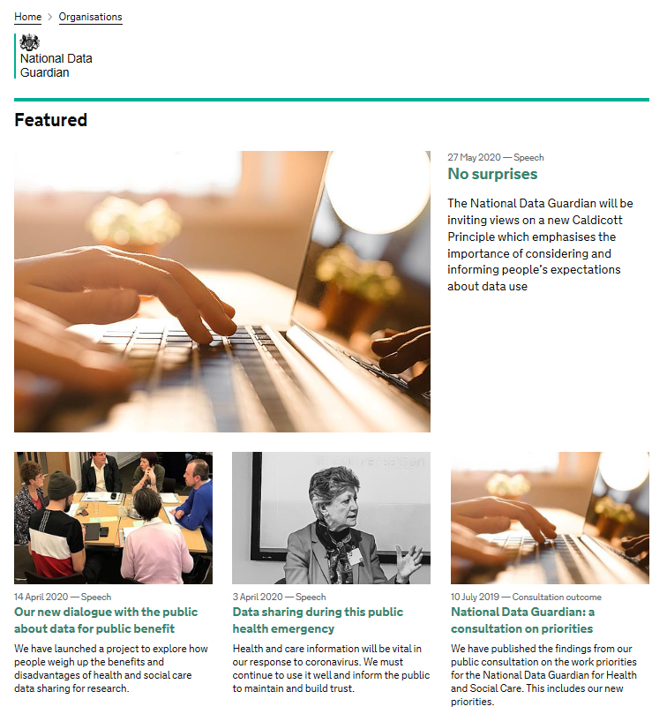
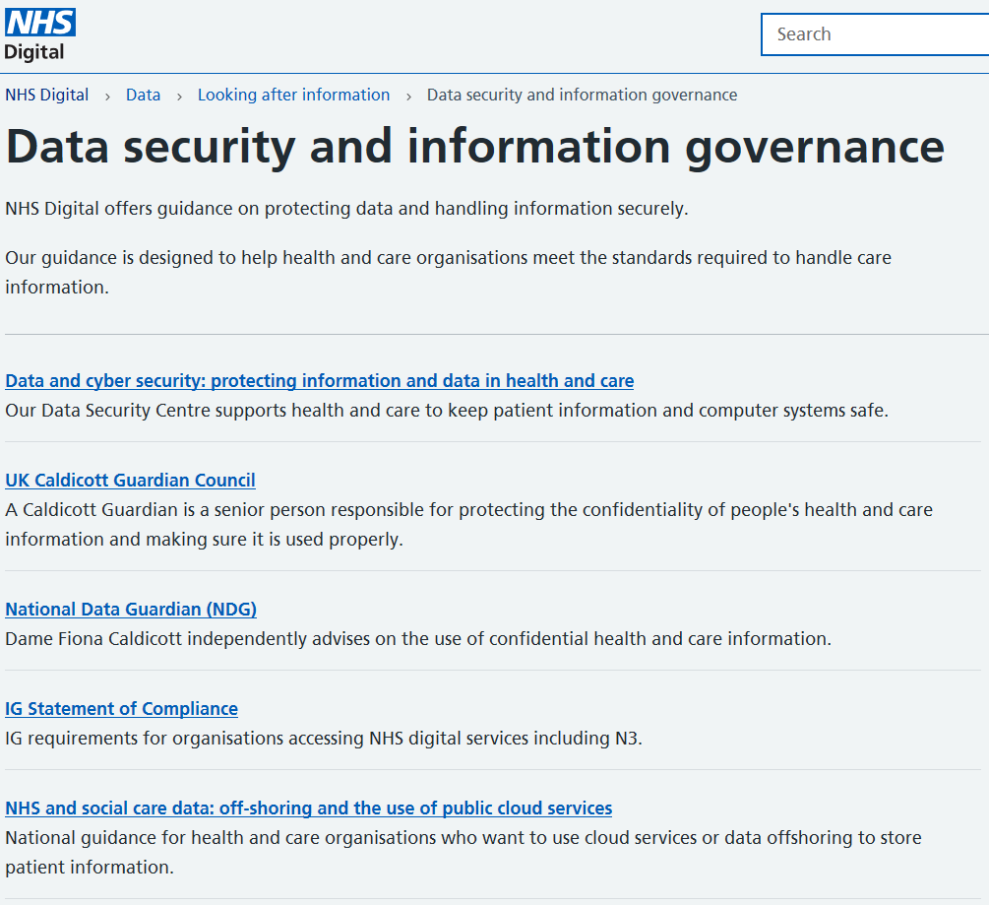
Further Information and Guidance on IG

