Slide 1
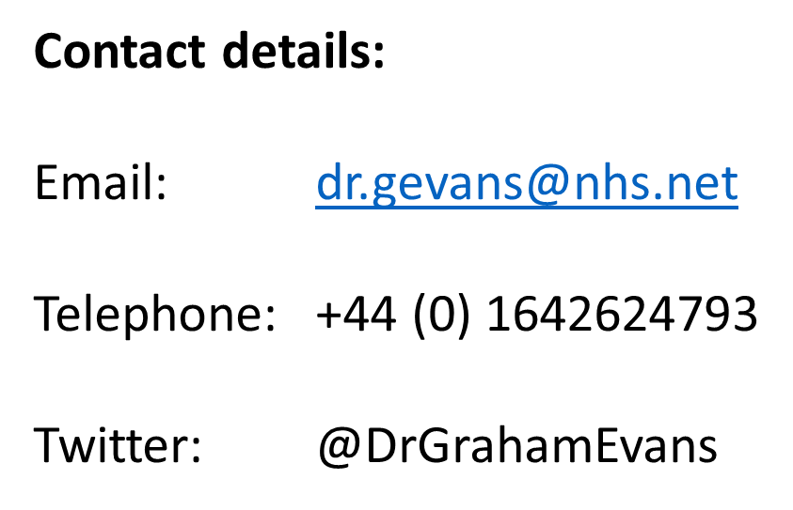
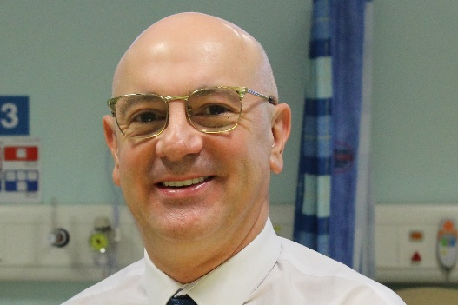
Best Practice Webinar
North East and North Cumbria
Integrated Care System
“A regional perspective”
Professor Graham Evans
Chief Digital Officer

Slide 2
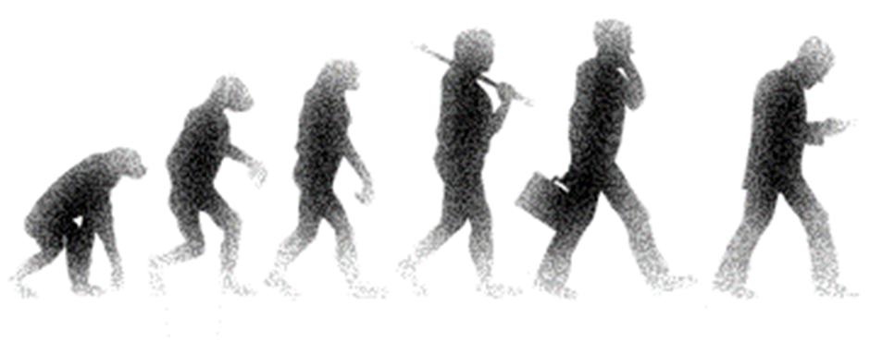
Context
Our evolution
Largest ICS in England
  Population of 3.2M
  4 X ICP’s
Legacy of collaborative working
  Remember SHA’s?
Digital is one of 6 ICS priorities
  Digital Care Programme
  Digital strategy and roadmap
  CIO Network
  Flagship Programmes

Slide 3
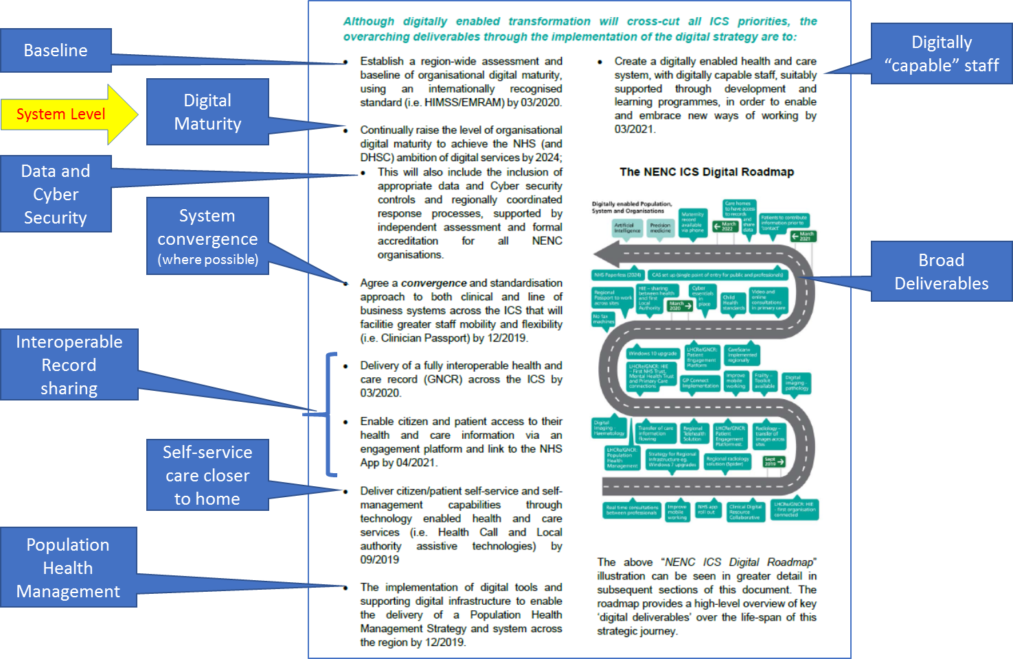
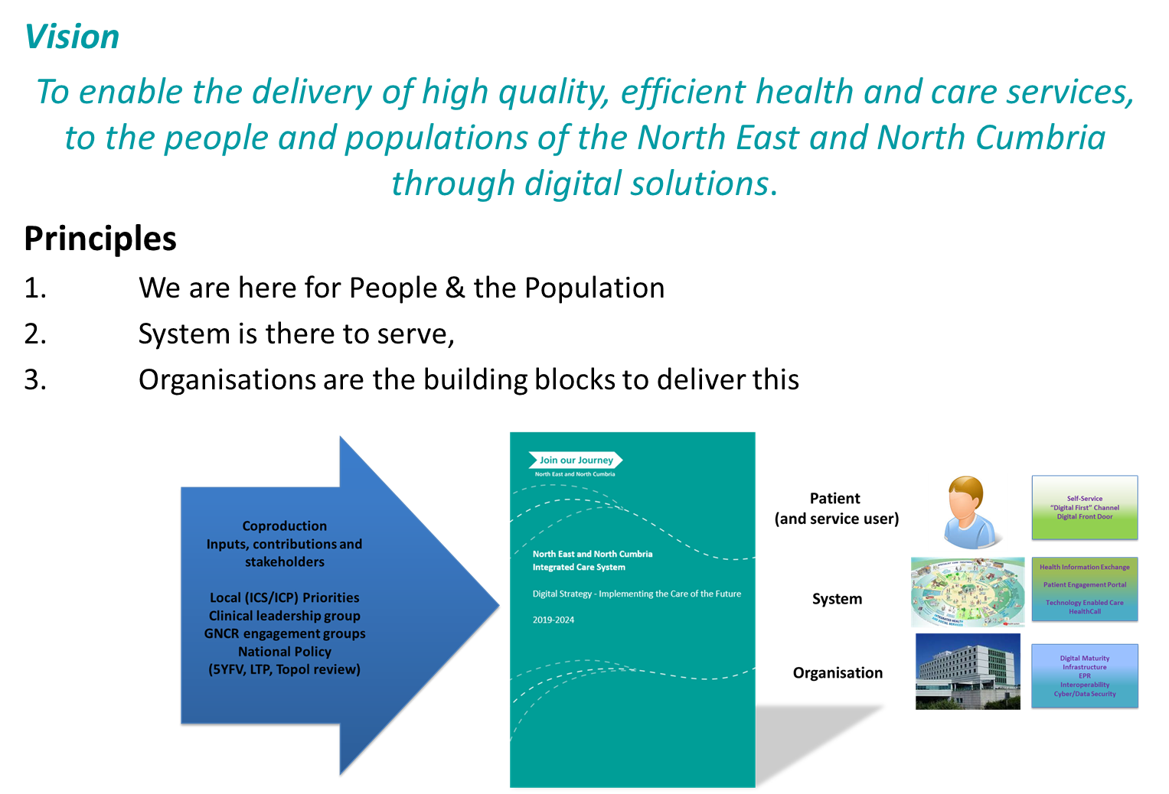
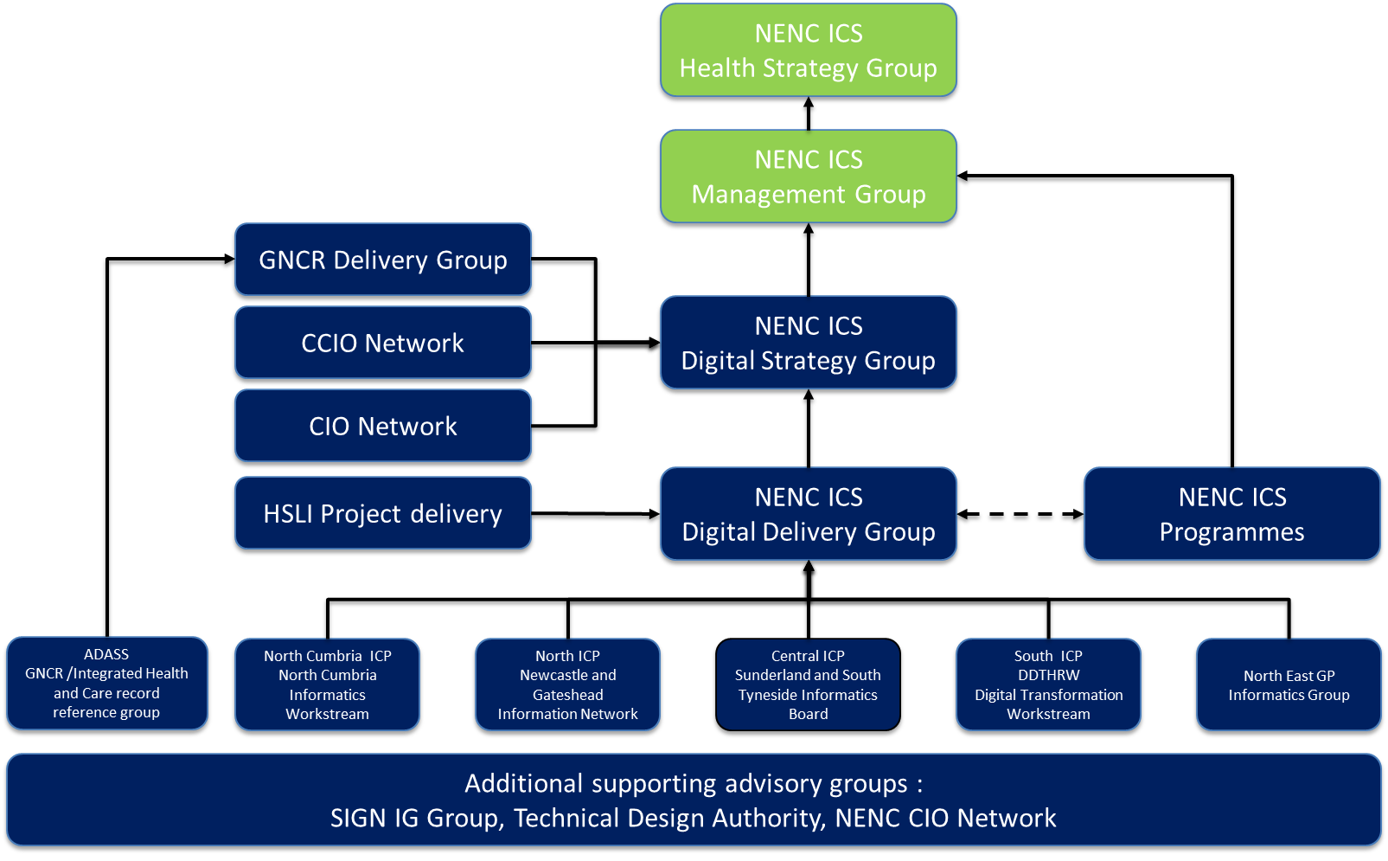
Approach
Strategic Roadmap and milestones
COVID
Digital Response Cell
NEY
Digital Community
COVID
GP Informatics Cell
NENC ICS Digital Governance

Slide 4

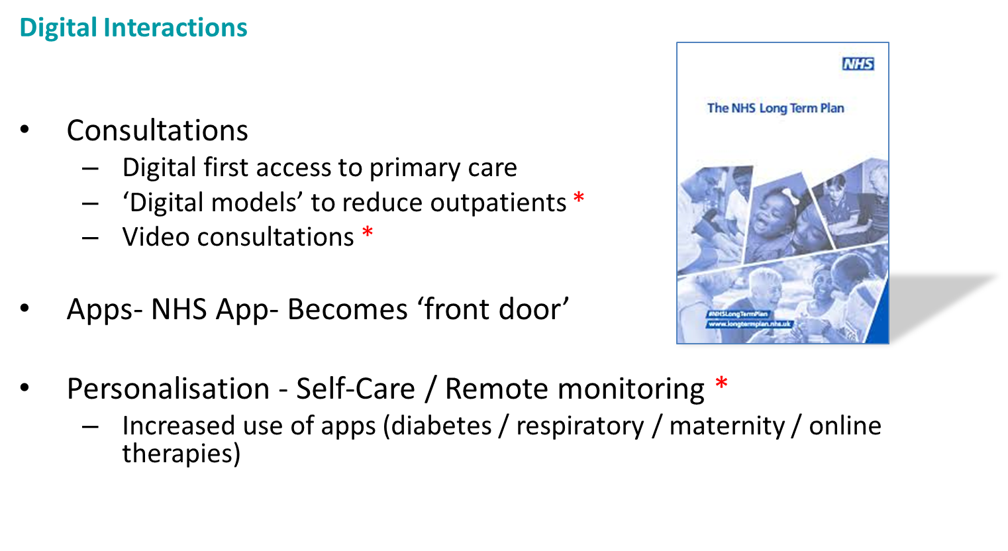
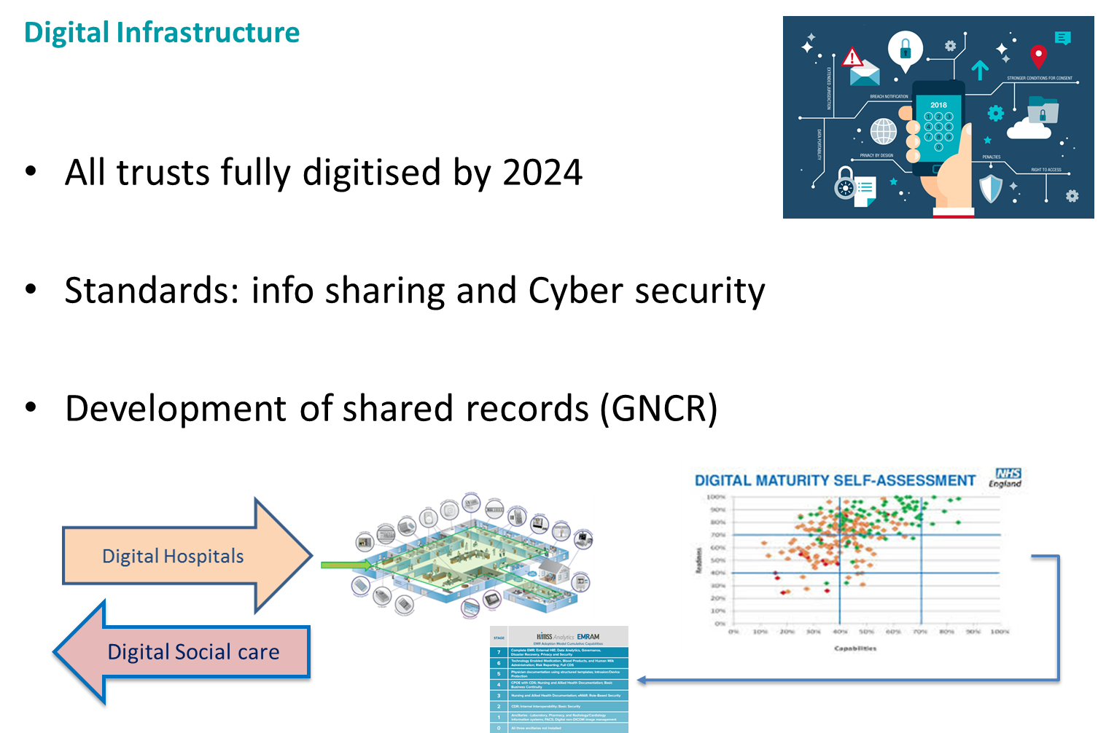

NHS Long Term Plan
* Examples of rapid adoption to COVID response

Slide 5
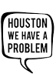









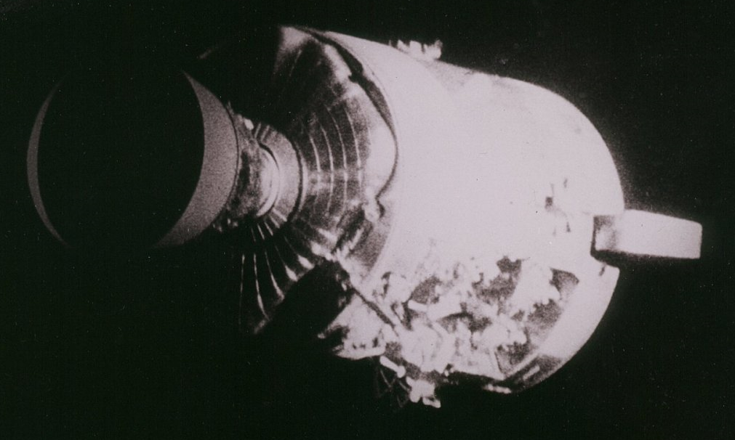




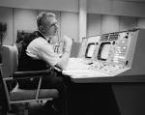
“The best laid schemes of mice and men”
Robert Burns
April 1970
April 2020
Our Astronauts
Save lives
Digital Support Services

Slide 6
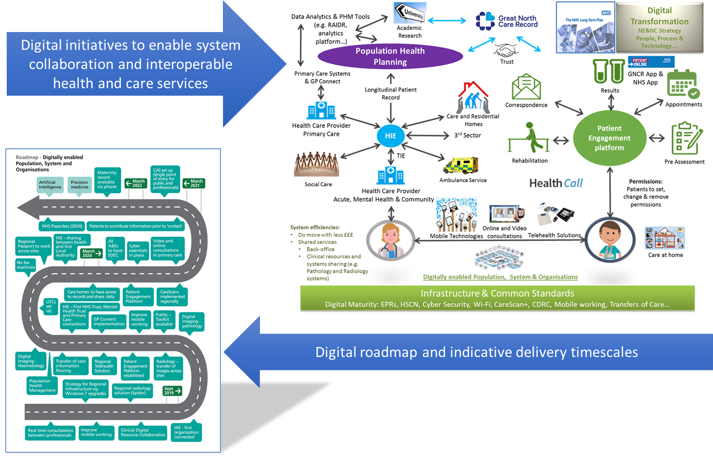
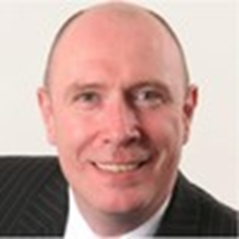
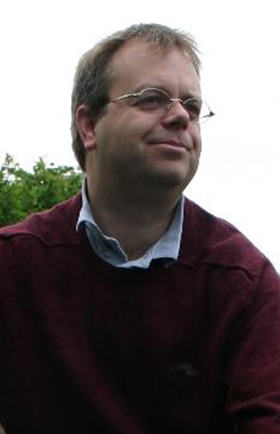
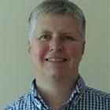
Joining it up
Examples of initiatives repurposed for COVID digital response

Slide 7
Early learning
Learning so far from phase 1 of the COVID-19 response
Those organisations that were more digitally mature have coped better with implementation of alternatives in phase.
Rapid implementation and adoption of virtual based collaboration services, including virtual consultation platforms in secondary and primary care.
Must have a planned alternative when technology fails e.g. use of phone when a video consultation solution platform failed to function.
Digital solutions are not the panacea to all situations e.g. video consultation does not meet everyone's needs.
C19 has given impetus to working in a different way and removal of organisational barriers.
C19 has enabled a pragmatic approach to progressing some longstanding initiatives e.g. GNCR; now on the verge of being able to share health information with local authorities to help decision making.
Technology depends on having appropriate capacity and capacity in the workforce.
Progress/issues in phase 2 of the COVID-19 response
The NENC Digital Strategy and Roadmap are being reviewed in context of LTP and rapid progress made during the response to C19; to identify where areas need to be maintained and built upon.
Impact on planning
There is an opportunity to use ICPs to share and spread good practice to speed innovation. Potential benefits to having a single platform across an ICP footprint.
From a digital perspective a system is only as good as its least developed part so important to bring less digitally mature systems up to a greater level of maturity.

Slide 8


Newcastle upon Tyne Hospitals - Accelerating Digital Adoption
Graham King – Chief Information Officer

Slide 9

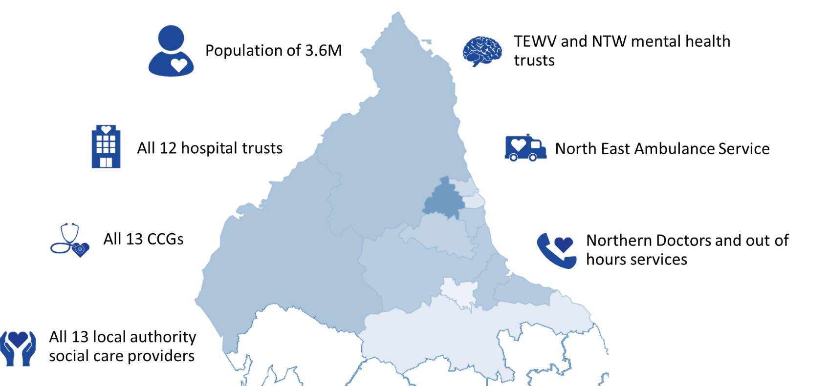
Regional Collaboration
Contract awarded to Cerner Ltd in March 19
100% of GP’s in the region connected and sharing
Newcastle Hospitals data being shared
4 Acute Community services sharing data
All Trusts and GPs in the region can view data
Two more acute Trusts connecting in July
Ambition to connect majority sites by March 21

Slide 10
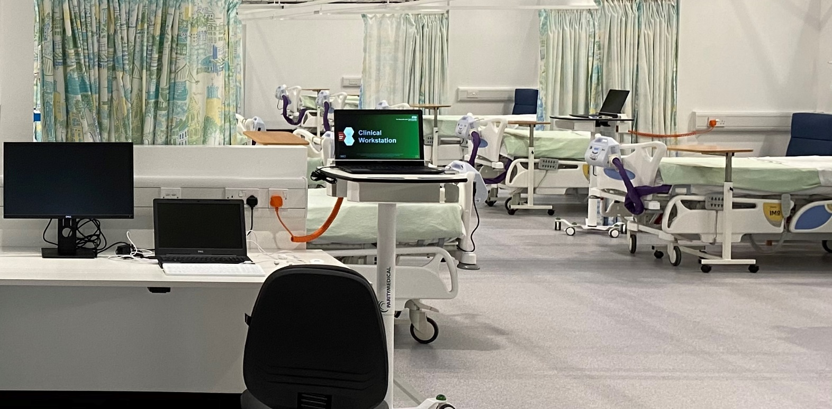
Nightingale NE – Digital first approach
Delivered as an extension of the Newcastle Hospitals’ network and systems
Paperless operation other than two pieces of paper:
  Critical care chart - unknown device type for connectivity
  Mortuary form - due to legal requirement
Decision support and remote patient status tracking to free up time to care and increase safety
Paired down EPR to reduce training
Clinical Record sharing via GNCR
Digital observations on handheld & central command room
Patient wi-fi
Full telephony solution

Slide 11
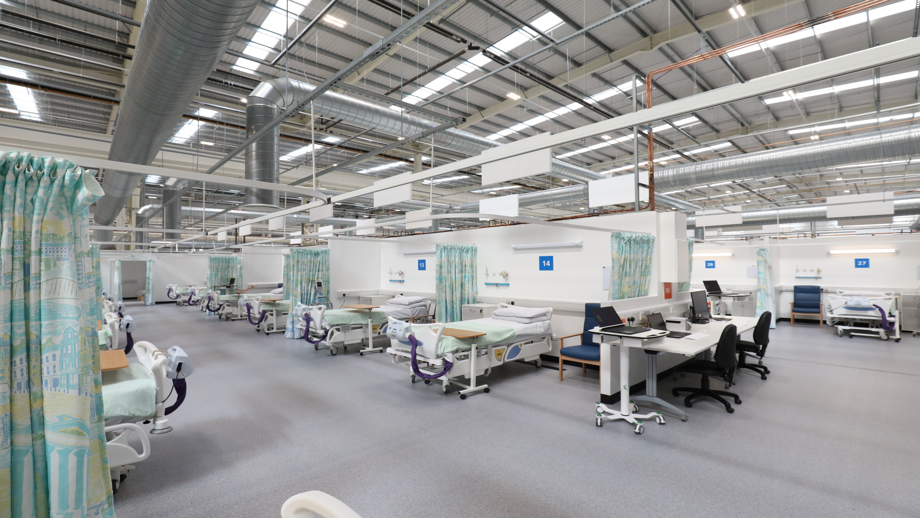
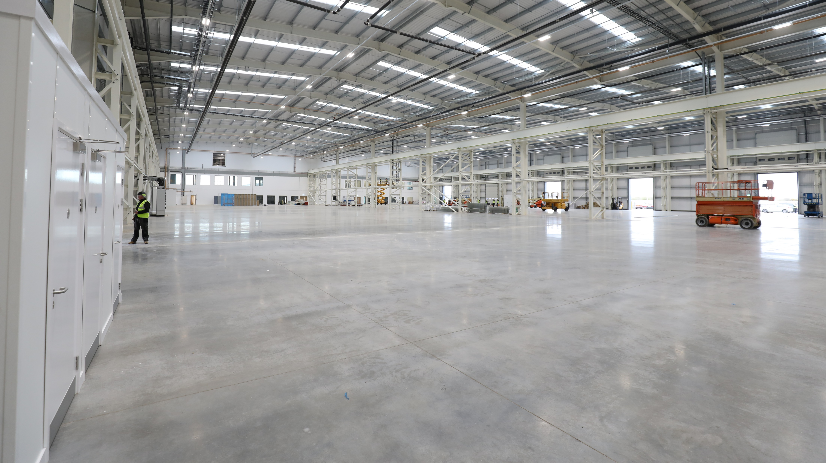

Slide 12
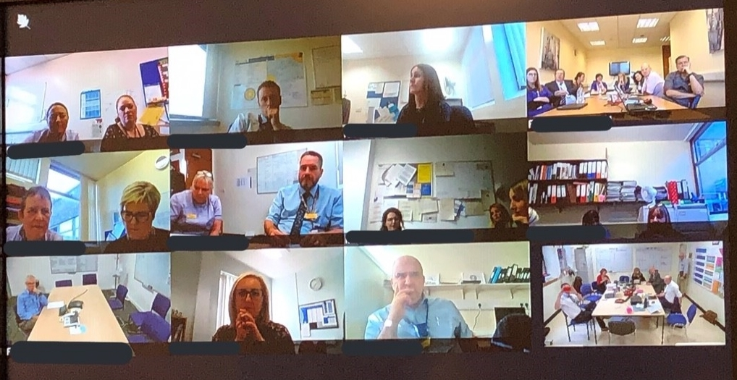
Agile Working Practices
17,300
Staff
1.72 Million
Patients contacts
2,000
Agile
Workers
200,000
Instant
messages
1.5M
Video call
minutes

Slide 13

Supporting Research
COVID-19 outcome prediction research
Research environment created
Data collection tools
COVID-19 vaccine trial
Setup digital trial in 48 hours
Online booking
Text message results
Automated reporting

Slide 14

Supporting patients
Video Consultations
Digital Visiting
Video consultations now available for 131 services, reducing the need for patients to visit the site
Enabled patients to communicate with family and friends through attend anywhere.
Keep in touch service
Patient Communications
Ability for patients relatives to send messages into wards
Enhanced patient wi-fi facilities ward based devices for patients

Slide 15
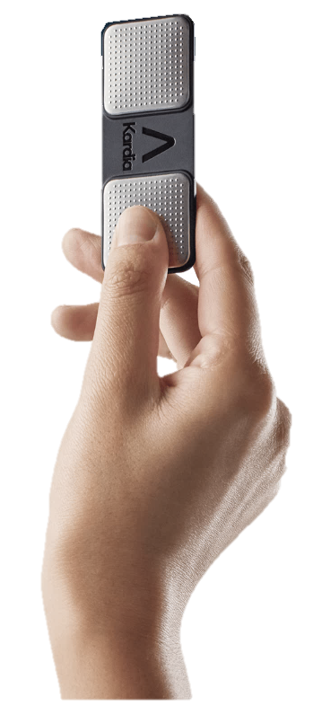
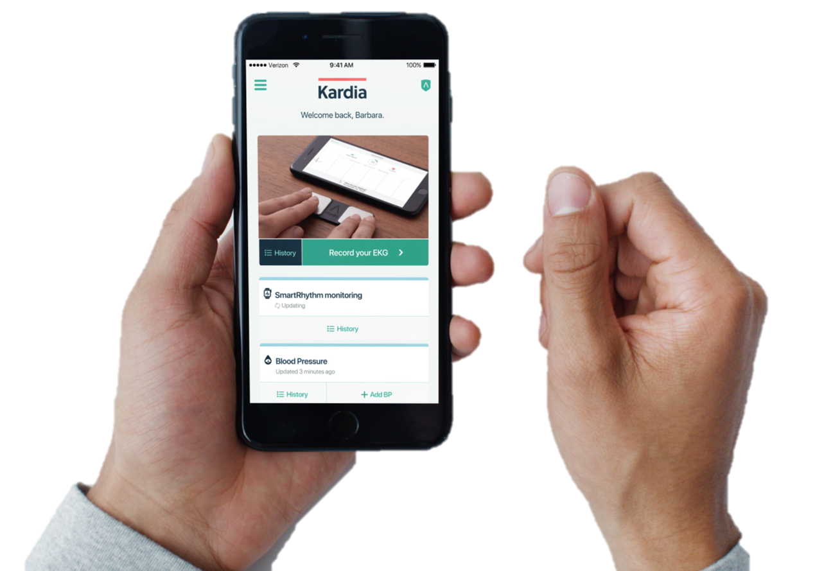
Embedding Innovation in Services
Myskin Selfie app for patients to send pictures for clinician review
AI implemented to assist with identifying acute stroke from brain CT scans
Electronic delivery of prescriptions direct to patient’s preferred Community Pharmacy
Patient self monitoring for AF, reduces visits, captures information at the point in time symptoms are experienced. Equal to 2 lead equivalent moving to 6 lead

Slide 16
Thank You
For further information please contact Ellspeth Marshall -
ellspeth.marshall@nhs.net

Slide 17

COVID and beyond:
Primary Care Response & Recovery
Dr Jonathan Harness MBBS MRCGP MFCI
CCIO, Newcastle Gateshead CCG
jharness@nhs.net

Slide 18
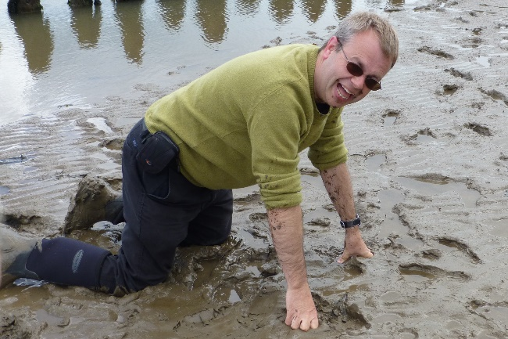
Initial Response
North East North Cumbria GP IT Response Group
Members:
Northumberland CCG
North Tyneside CCG
Newcastle Gateshead CCG
North Cumbria CCG
South Tyneside CCG
Sunderland CCG
County Durham CCG
Tees Valley CCG
NECSU
Local Medical Committee
NHSE / D
AHSN
Skill set:
CCIOs
CCG Digital Leads
Technical
Project managers
Customer liaison & support
Administrative support
Success: a blended cross-org team that mucked in together
Challenge: Governance & distraction over Command/Control

Slide 19
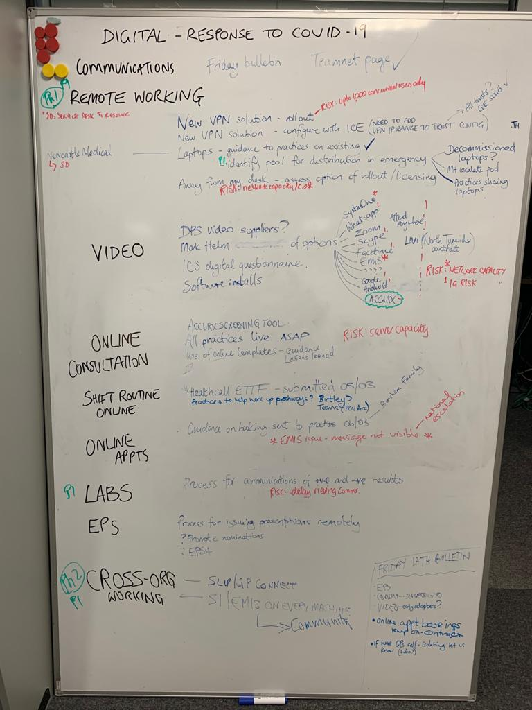
Initial Response
Agree common vision & priorities
Support mobile working
Support remote consultations
Increase resilience
Support cross system working
Success:
Strong sense of purpose within the group
Developed links with secondary care CIO group
Co-ordination with Incident Control

Slide 20
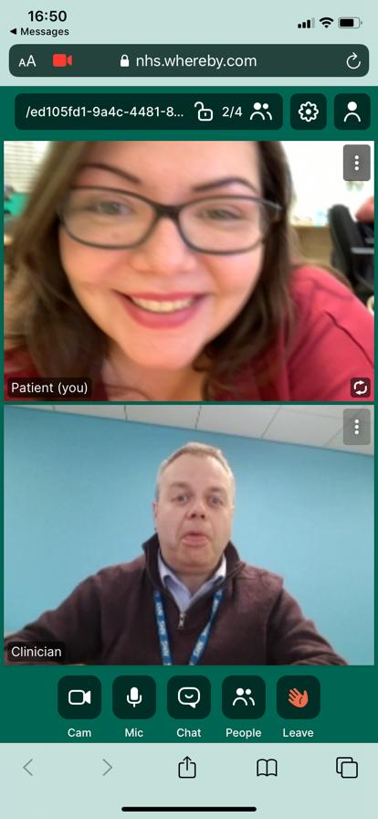
Initial Response
Rapid testing and deployment
Support mobile working
- laptops, VPN, VDI
Support remote consultations
- online consultation, video consultation, total triage
Increase resilience
- support practice business function, PCN cross org. connectivity
Support cross system working
- Great North Care Record
Success:
Compression of multiple workstreams
VDI solution stood up within 2 weeks
Challenges:
Multiple failures of VPN
Information overload

Slide 21
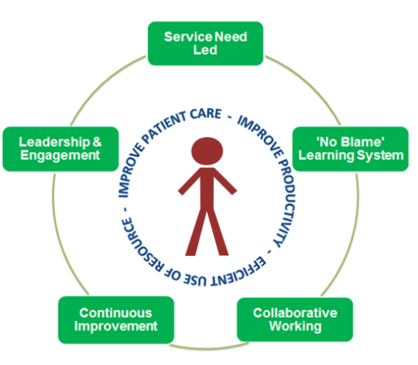
Recovery
4 workstreams
What does the new surgery look like
How will patients interact with the surgery
How do we work within the whole system
What are the finance & digital workforce implications
Success:
Desire to discover the “new normal”
Challenges:
The Day Job
Resources

Slide 22

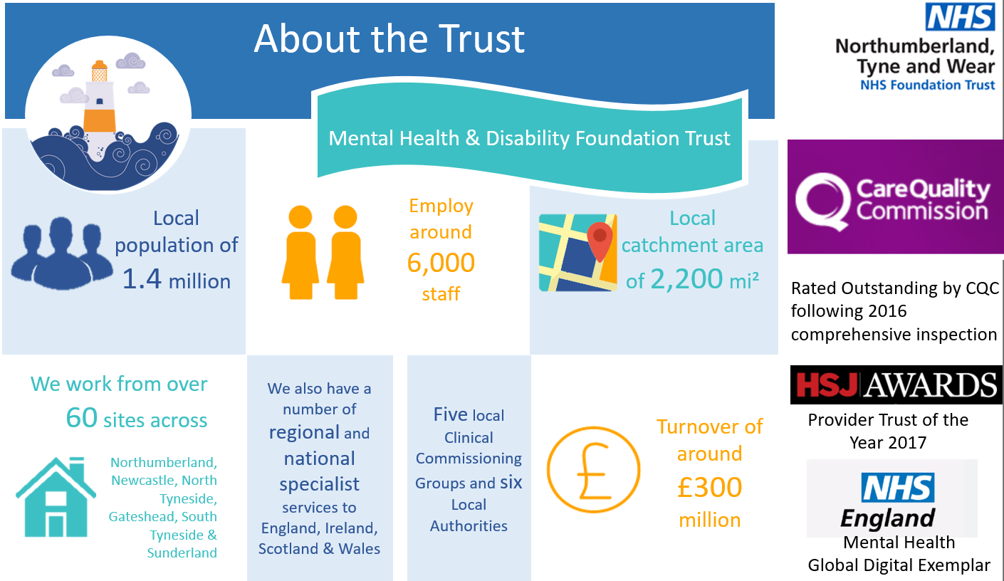

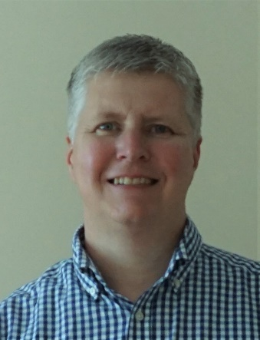
Mental Health and COVID19
Darren McKenna
Director of Informatics (CIO)
Cumbria, Northumberland, Tyne & Wear NHS Trust
Chair - North East CIO Network
Chair - NHS Provider Digital Leads Network
@DMcKennaTweets

Slide 23
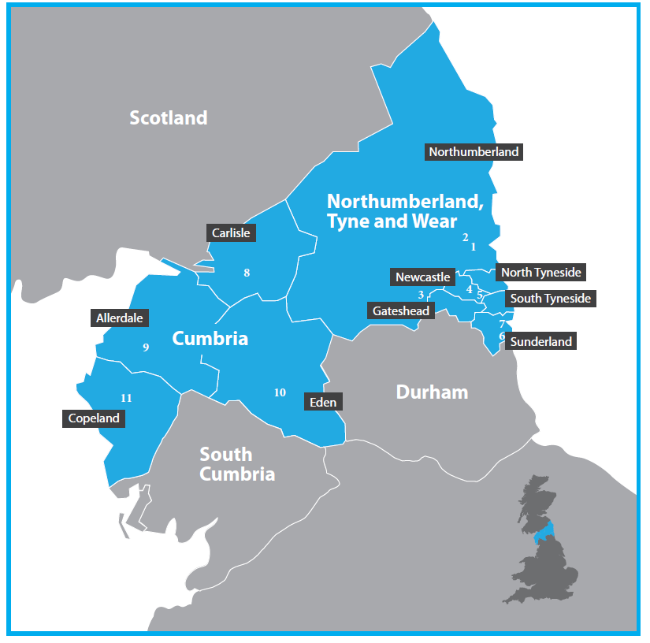

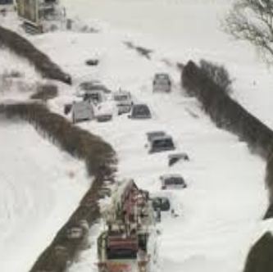
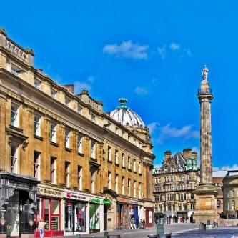
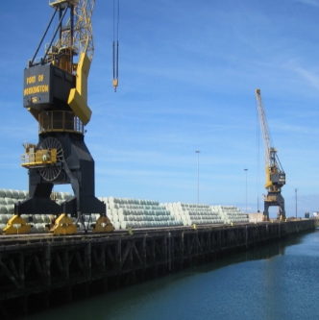
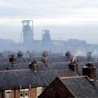
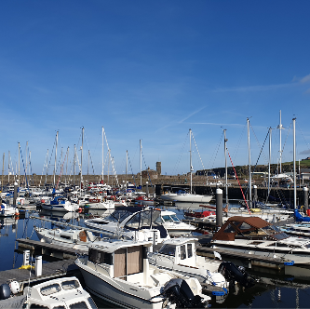
CNTW Geography

Slide 24







About the Trust
A provider of mental health and disability services
Local population of 1.7 million
Employ over 7,000 staff
Local catchment area of
3,350 mi²
2
Rated Outstanding by CQC
following 2016 and 2018
comprehensive inspection
We work from over 70 sites across
We also have a number of regional and national specialist services to England, Ireland, Scotland & Wales
Six local Clinical Commissioning Groups and seven Local Authorities
Turnover of around £380m million
Provider Trust of the Year 2017
Northumberland, Newcastle, North Tyneside, Gateshead, South Tyneside & Sunderland
Mental Health
Global Digital Exemplar

Slide 25
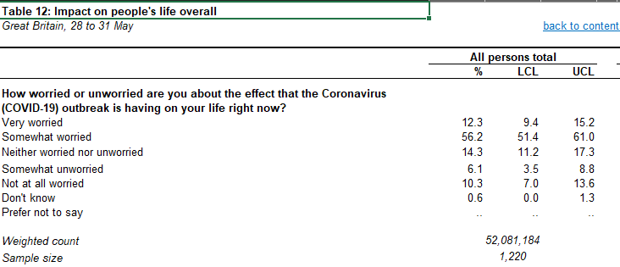
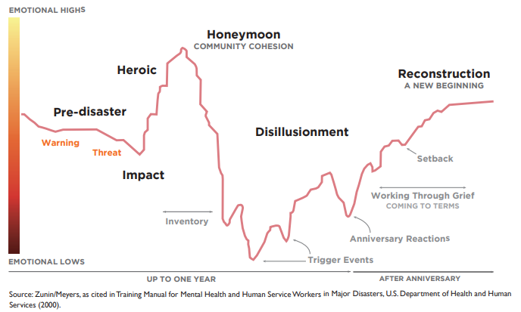
COVID19 and Mental Health
Short-term and long-term impacts of the pandemic on Mental Health on the public and our staff:
Zunin/Mayers – individual and collective
Emotional response to disaster in the community
Coronavirus and the social impacts on Great Britain
Office of National Statistics 28-31 May
68.5%
http://www.disastermh.nebraska.edu/files/recovery/2014/Stages%20of%20Disaster%20NE%20Strong%20Flyer_English.pdf
https://www.ons.gov.uk/peoplepopulationandcommunity/healthandsocialcare/healthandwellbeing/datasets/coronavirusandthesocialimpactsongreatbritaindata

Slide 26
COVID19 and Mental Health Services
Our peaks may not necessarily be the same as physical health services
Mental Health and Learning Disability services are typically mix of in-patient, crisis and community services – each with different challenges.
Mental Health and Learning Disability services look after some of the most vulnerable people in society – don’t always have access to technology.
Need to maintain significant levels of partnership working with local Acute Trusts, Ambulance/111, Local Authorities, Police, Third Sector …

Slide 27
The work from Anywhere Trust
In Mental Health we can do a lot digitally. However, the “Digital Basics” need to be in place to support remote working securely and at scale:
CNTW’s Cumbria Story. Northumberland, Tyne and Wear Trust took on running of North Cumbria Mental Health services 1st October 2020
“Big-bang migration” in November using GDE/FF blueprints to put in place the “Digital Basics”:
  Migrated 1,000 staff and thousands of clinical records to a single EPR
  Migrated staff to single Hybrid AAD network and deployed full Office 365 (including Teams)
  Rolled out 800 new laptops/desktops all with remote access using Windows 10 AOVPN
  Mobile phones and 4G laptops enablement for staff that working in the community
Had the team not delivered this work, patients and staff would have received different service levels during COVID19.

Slide 28

CNTW Digital Response
Digital was an integral part of Gold Command from the outset. Having the CIO on Gold Command is the COVID19 equivalent of the CIO being on the Board.
Able to anticipate changes and demands from other services, prioritise and react quickly.
Knowledge of pressures, demands and issues in the wider system.
Key developments were real-time systems to record and report sickness absence - agile to respond the evolving guidance.
Also developed EPR real-time COVID 19 recording and reporting
Gold Command Real-time dashboards to support Sit Rep reporting and manage the organisation
Early
March

Slide 29
CNTW Digital Response
By full lockdown on 23rd March 2020 CNTW had mobilised over 3,000 staff who were able to access all systems from home including Microsoft Teams and Remote Consultation.
Halted a lot of project work and diverted resource to remote working support and projects
Due to prior investment we were able to move fast.
Enabled over 3,000 staff to reliably work from home within days – maintained similar contact activity levels with patients.
OneConsultation delivered to 133 services – 2761 staff for remote consultations.
Microsoft Teams deployed across the organisation – supporting business and clinical meetings
Late
March

Slide 30
CNTW Digital Response
Enhanced support and training. Supporting the staff get the best from the technology.
Virtual MHA tribunals and hearings, WiFi and devices for patients on wards
Microsoft Teams has enabled cross-organisational work to continue both clinical and business. Over 1,300 meetings each day on Teams.
Microsoft Teams Live Events enabling 2 way communication and training.
Remote consultation and Teams also used to support other organisations e.g. Nightingale/Care Homes.
Maintained Information Governance processes throughout.
April/
May

Slide 31
CNTW Digital Response
Following easing of restrictions we are restoring services, the next phase could potentially be more challenging.
Next phase will bring more challenges, potential for restrictions to be eased and reintroduced and real potential for increased demand for Mental Health services.
Need to keep patients and staff safe – balancing risks.
Remote working, EPR access, remote consultation still playing significant part in service delivery.
Planning for long-term remote working and sustaining this at scale and securely.
The Digital Backlog.
Increased focus on self-help and collaborative regional projects.
June

Slide 32
CNTW Digital Response
2020
2020 will continue to be a year like no other, but one thing is certain.
Digital will become even more essential to healthcare delivery.

Slide 33
Mental Health and COVID19
Darren McKenna
Director of Informatics (CIO)
Cumbria, Northumberland, Tyne & Wear NHS Trust
Chair - North East CIO Network
Chair - NHS Provider Digital Leads Network
@DMcKennaTweets

