Slide 1

The Power of Digital Identity: Addressing healthcare IAM challenges
Wes Wright, CTO, Imprivata
Dr Sean Kelly, MD, CMO, Imprivata
Andy Kinnear, Health CIO Network (NHS) Advisory Panel
Andy Wilcox, Senior Product Marketing Manager, Imprivata

Slide 2






Today’s Speakers
Wes Wright
Chief Technology Officer
Imprivata
Dr Sean Kelly, MD
Chief Medical Officer
Imprivata
Andy Kinnear
Health CIO Network (NHS) Advisory Panel
Andy Wilcox
Senior Product Marketing Manager
Imprivata

Slide 3


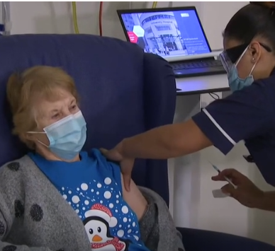


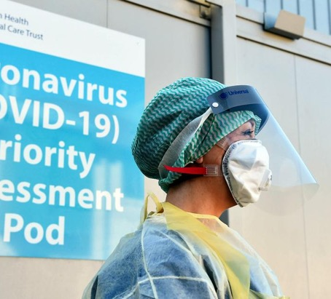

Reflecting on the last 12 months
“The NHS is mobilising like never before but the scale of this challenge has not been seen in peacetime, so we need all the support we can get.”
Ruth May
Chief Nursing Officer for England
Notes:
*Pictures build on their own
Pandemic
Flat out
Change in they way we operate
NHS Nightingale
Remote working
Innovation
Accelerated change
Vaccination
Acknowledge the effort and work that the NHS have been doing
Calls to the 111 service have increased by up to 400%
London Ambulance Service said it was receiving 8,000 calls a day - up 3,000 on an average "very busy" day
750,000 people sign up to join NHS volunteer army in less than a week
Letters sent to 65,000 retired doctors and nurses. More than 7500 nurses have been placed on an emergency register. About 11,000 former medics have also agreed to return to the health service and more than 24,000 final year student nurses and medics will join them
25% of NHS doctors are off work sick or in isolation
Nightingale London hospital at the excel arena will treat up to 4000 patients and was set up in a matter of days. Additional sites are being set up in Birmingham, Manchester, Cardiff & Glasgow.
Across England, hospital services have been reconfigured so that 33,000 hospital beds are available to treat further Coronavirus patients.
Pragmatic approach to tackling clinical need
Imprivata has 100+ customer we are helping with specific projects in relation to Covid-19.

Slide 4
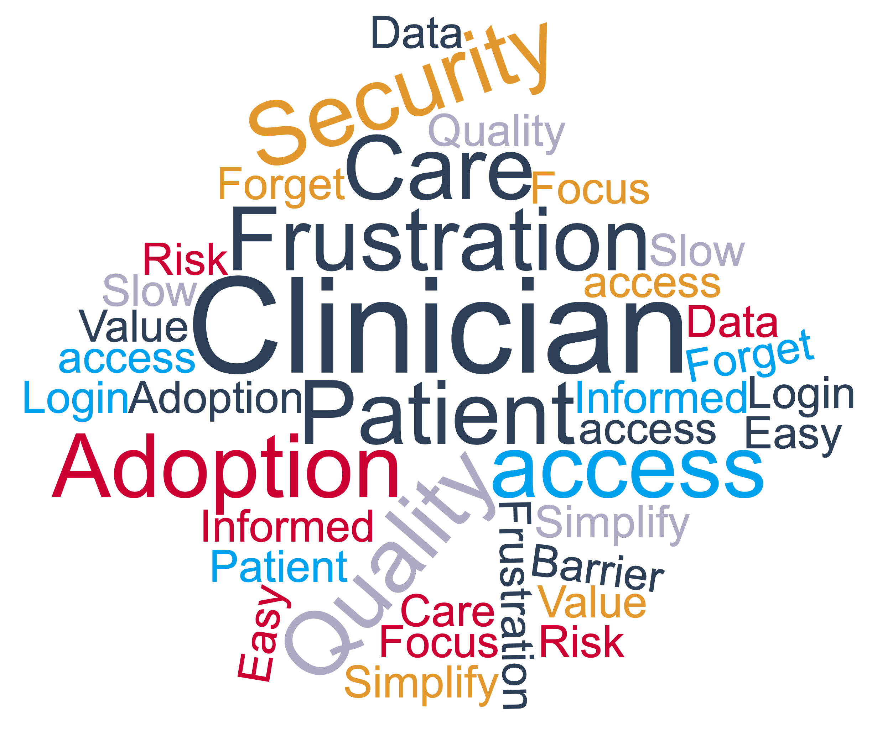
Why a digital identity is important (efficiency)
Why does it take so long to log on
I wish I could access this information
This makes my job harder
I have to leave myself logged in
I just want to focus on the patient
I can’t access this application
Notes:
Frustration
Barrier
Login
Slow
Forget
Easy access
Simplify
Quality
Patient
Care
Risk
Value
Adoption
Focus
Informed
Data

Slide 5

What is your biggest challenge with managing digital identity?

Slide 6









Key digital identity challenges
AND
Productivity
VERSUS
Compliance
Usability
Security
Privacy
Efficiency
Notes:
Our core vision, value and foundational technology solutions still resonate strongly (and extend to more endpoint (mobile etc) and more users – docs nurses and non-clinical, patients… everyone!)

Slide 7
Increasing complexity is driving the need for digital identity
Notes:
Build the four wedges with clicks from top left → top right → bottom right → bottom left

Slide 8
Identity is the new perimeter… control plane
Virtualization
Mobile
Medical devices
Healthcare Digital Identities
Beyond the 4 walls of the hospital
Notes:
Wes

Slide 9

Who is H-ISAC?
Health Information Sharing and Analysis Center (H-ISAC)
Community of critical infrastructure owners and operators within the Health Care and Public Health sector (HPH)
Shares relevant information with each other including threat intelligence, incidents and vulnerabilities, advice and best practices, mitigation strategies and more.
Notes:
H-ISAC is non-profit organization of healthcare IT leaders.
Their mission is to help its healthcare IT constituents succeed in the face of both cyberattacks and business pressures.

Slide 10
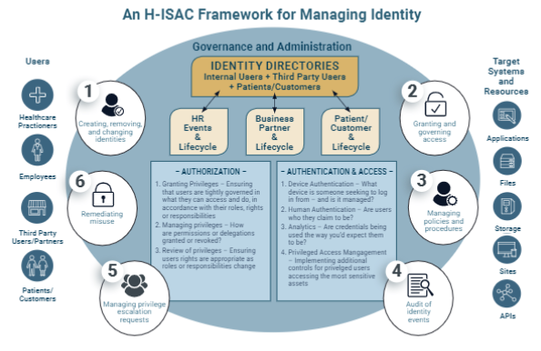
H-ISAC White Paper
“AN H-ISAC FRAMEWORK FOR CISOs TO MANAGE IDENTITY”
A framework that healthcare CISOs can use to architect, build and deploy an identity system that will protect against modern attacks and support key business drivers.
Two papers from H-ISAC:
Introductory paper -- Why identity management is important. https://h-isac.org/h-isac-white-paper-identity-for-the-ciso-not-yet-paying-attention-to-identity/
Identity framework paper -- How to manage identities. https://h-isac.org/an-h-isac-framework-for-cisos-to-manage-identity-2/ (The focus of this presentation)
Notes:
H-ISAC has written two white papers. We’ll focus on their second one, published May 2020, where they present a framework that CISOs can leverage to build a solid strategy to meet both security and business efficiency goals.
The framework, pictured here, includes a number of critical elements, from users (on the left) to systems they need to access (on the right), and with the key infrastructure needed to manage these elements throughout the lifecycle.
Imprivata is very much aligned with this framework, both in our recommended approach to strategy as well as specific product capabilities.
Note: Recommend not spending too much time on the details of the framework as the main goal is to acknowledge that it’s available as a resource and that Imprivata is aligned with it.

Slide 11




Framework Components – H-ISAC
Governance and Administration
H-ISAC Framework is rooted in Governance and Administration.
Identity Directories
The “heart” of IAM.
The “nervous system” that ties components together.
The authoritative identity store for an organization.
Provides details about each identity including the roles, accounts, attributes, and privileges that go with them.
Governance and Administration
H-ISAC Framework is rooted in Governance and Administration.
Identity Directories
The “heart” of IAM.
The “nervous system” that ties components together.
The authoritative identity store for an organization.
Provides details about each identity including the roles, accounts, attributes, and privileges that go with them.
Authorization
Authorization
The process of determining
what privileges a user should
be granted based on roles, rights, and responsibilities.
Authentication and Access
Authentication & Access
The final step: Authenticating and granting the user access to systems and resources.
Notes:
Authentication and Access:
After an identity is created from an authoritative source and permissions are authorized,

Slide 12
H-ISAC Framework – Key Points
Recommended best practices
Use a unified system for IAM.
When treated as point solutions, IAM tools fail to deliver a holistic approach that can protect against identity-centric attacks.
Identity should be owned and operated by the security organization.
IAM services should be performed separately from IT services such as the help desk or infrastructure operations, which are motivated by service and speed.
Identity is about an organization’s entire ecosystem.
Including clinicians, patients, and external vendors as well as non-human entities.
Notes:
Authentication, provisioning, authorization, and access control are all important technologies on their own but are best employed using a unified approach.
When treated as point solutions and deployed in isolation, IAM tools fail to deliver a holistic approach to identity that can protect against identity-centric attacks.
2. Identity should be owned and operated by an organizational function motivated by risk (e.g., the CISO), not one motivated by service levels and speed (e.g., the Service Desk or HR).
IAM services, including the provisioning and deprovisioning of access, should be performed within the security function, separate from shared IT services such as the help desk or infrastructure operations.
3. Identity is not just about internal workforce; it’s about an organization’s entire ecosystem including customers and external partners.
CISOs should use an identity-centric approach to cybersecurity.

Slide 13
Imprivata digital identity framework for healthcare
GOVERNANCE AND
ADMINISTRATION
IDENTITY MANAGEMENT
IDENTITY MANAGEMENT
AUTHORISATION
AUTHENTICATION AND ACCESS
REGULATIONS
IDENTITY PROVIDER
ROLES AND POLICIES
SINGLE SIGN-ON
ACCESS CONTROL
Cloud apps
Healthcare compliance
Identity stores
Coarse- and fine-grained
authorisation control
Cloud apps
Clinical/virtual desktops
Healthcare compliance
Identity stores
Coarse- and fine-grained
authorisation control
Clinical/virtual desktops
Identity stores
Government standards
Directory federation
Government standards
Directory federation
Legacy apps
Legacy apps
Shared mobile devices
Data access policies
Shared mobile devices
Data access policies
Medical devices
One identity/multiple roles
Medical devices
One identity/multiple roles
Mobile apps
Mobile apps
LIFECYCLE
Mobile apps
REPORTING, AUDITING, AND
ANALYTICS
National Systems
National Systems
Privileged access management
IDENTITY ASSURANCE
Privileged access management
Access reports and
security remediation
Access reports and
security remediation
User/group provisioning
User/group provisioning
Entitlement and attestation review
Non-human/service
account provisioning
MULTIFACTOR
AUTHENTICATION
SELF-SERVICE
Entitlement and attestation review
Non-human/service
account provisioning
Biometric patient identification
Biometric patient identification
Segregation of duties
Password management
Segregation of duties
External identity management
External identity management
Clinician identity proofing
Remote access and
virtual care
Password management
Clinician identity proofing
Remote access and
virtual care
Reauthentication reporting
Reauthentication reporting
Privileged account management
Mobile device healing
Privileged account management
Clinician re-authentication
Mobile device healing
Clinician re-authentication
Risk-based and
adaptive authentication
Cloud-based mobile
device management
Risk-based and
adaptive authentication
Cloud-based mobile
device management
Healthcare
Three or more Imprivata products
Imprivata
Identity Governance
Imprivata
OneSign
Imprivata
Mobile
Imprivata
Confirm ID
Imprivata
PatientSecure
Reset
Notes:
So as we come back and look at the framework, we can see how looking at digital identity in a holistic manner can help you to develop a unified, coherent, strategy.
The framework serves as a guide, to identify those areas where there is not a joined up approach, areas that require focus to improve the use of digital technology to support patient care, and to identify areas where inefficiency in process or workflow exist allowing you to build an action plan to address.
Imprivata, as your strategic partner in digital identity can support your digital identity strategy and provide solutions to address key elements. So, you already have OneSign, which addresses key requirements around authentication and access. Lets talk about some of those business process areas around managing your joiners, movers and leavers process. Imprivata Identity governance can provide out of the box management of provisioning and deprovisioning of all users within your organisation, it can also help you to manage your reporting and auditing requirements as well as helping to manage your license entitlement and usage needs. I love to talk to you in more detail about that.

Slide 14
NHS Data Security Protection Toolkit
GOVERNANCE AND
ADMINISTRATION
IDENTITY MANAGEMENT
IDENTITY MANAGEMENT
AUTHORISATION
AUTHENTICATION AND ACCESS
REGULATIONS
IDENTITY PROVIDER
ROLES AND POLICIES
SINGLE SIGN-ON
ACCESS CONTROL
DS1
DS4
DS4
DS4
Healthcare compliance
Identity stores
Coarse- and fine-grained
authorisation control
Cloud apps
Clinical/virtual desktops
Identity stores
Government standards
Directory federation
Data access policies
Legacy apps
Shared mobile devices
LIFECYCLE
One identity/multiple roles
Mobile apps
Medical devices
REPORTING, AUDITING, AND
ANALYTICS
DS4
DS4
National Systems
Privileged access management
Access reports and
security remediation
User/group provisioning
IDENTITY ASSURANCE
Entitlement and attestation review
Non-human/service
account provisioning
Biometric patient identification
MULTIFACTOR
AUTHENTICATION
SELF-SERVICE
DS9
Segregation of duties
External identity management
Clinician identity proofing
Remote access
Password management
DS4
ePrescribing reporting
Privileged account management
Clinician re-authentication
Mobile device healing
Cloud-based mobile
device management
Risk-based and
adaptive authentication
DS – Data Security Standard
Healthcare
Three or more Imprivata products
Imprivata
Identity Governance
Imprivata
OneSign
Imprivata
Mobile
Imprivata
Confirm ID
Imprivata
PatientSecure
Notes:
What we can see with the framework is how it maps to key compliance requirements that you as customers have such as the NHS Data Security Protection Toolkit. This framework helps you to build a strategy that unifies identity and addresses those key requirements.
IDG
Data Security Standard 1 – Personal Confidential Data
Data Security Standard 1.4.3 – Provide a list of all systems/information assets holding or sharing personal information.
Data Security Standard 4 – Managing Data Access
Data Security Standard 4.1.1 - Your organisation maintains a record of staff and their roles
Data Security Standard 4.1.2 - Does the organisation understand who has access to personal and confidential data through your systems, including any systems which do not support individual logins?
Data Security Standard 4.1.3 - Are users in your organisation only given the minimum access to sensitive information or systems necessary for their role?
Data Security Standard 4.2.1 - When was the last audit of user accounts held?
Data Security Standard 4.2.2 - Provide a summary of data security incidents in the last 12 months caused by a mismatch between user role and system accesses granted.
Data Security Standard 4.2.5 - Are unnecessary user accounts removed or disabled?
Data Security Standard 4.4.3 – The organisation does not allow users with wide ranging or extensive system privilege to use their highly privileged accounts for high-risk functions, in particular reading email and web browsing.
Data Security Standard 4.4.4 - The organisation only grants privileged access on devices owned and managed by your organisation.
Data Security Standard 4.4.2 - Privileged user access is removed when no longer required or appropriate.
Data Security Standard 4.3.4 - Provide a list of all systems to which users and administrators have an account, plus the means of monitoring access.
OneSign/CID
Data Security Standard 4 – Managing Data Access
Data Security Standard 4.3.2 – Are users, systems and where appropriate, devices, always identified and authenticated prior to being provided access to information or system?
Data Security Standard 4.3.3 - Is an acceptable IT usage banner displayed to all staff when logging in, including a personal accountability reminder?
Data Security Standard 4.5.2 – Technical controls enforce password policy and mitigate against password-guessing attacks.
Data Security Standard 4.5.3 – Multifactor authentication is used [wherever technically feasible].
Data Security Standard 4.5.6 - Do you have high strength passwords defined in policy and enforced technically for all users
Data Security Standard 9 – IT Protection
Data Security Standard 9.6.9 – All remote access is authenticated.

Slide 15
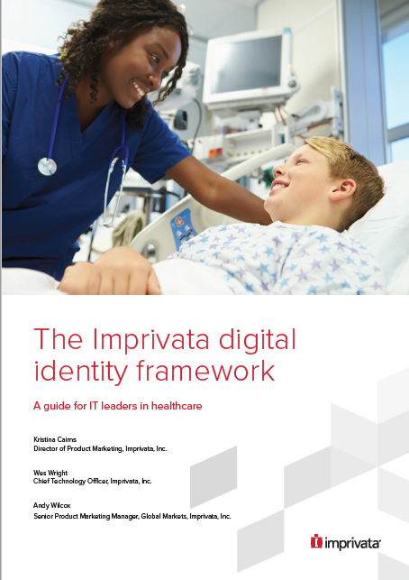
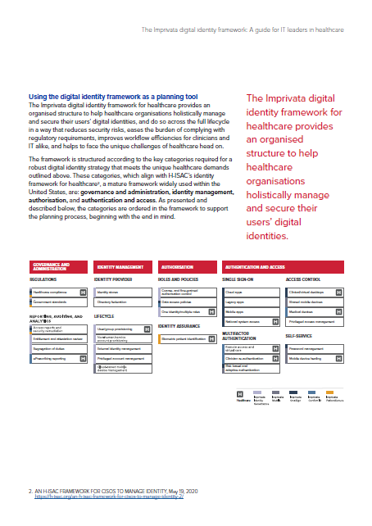

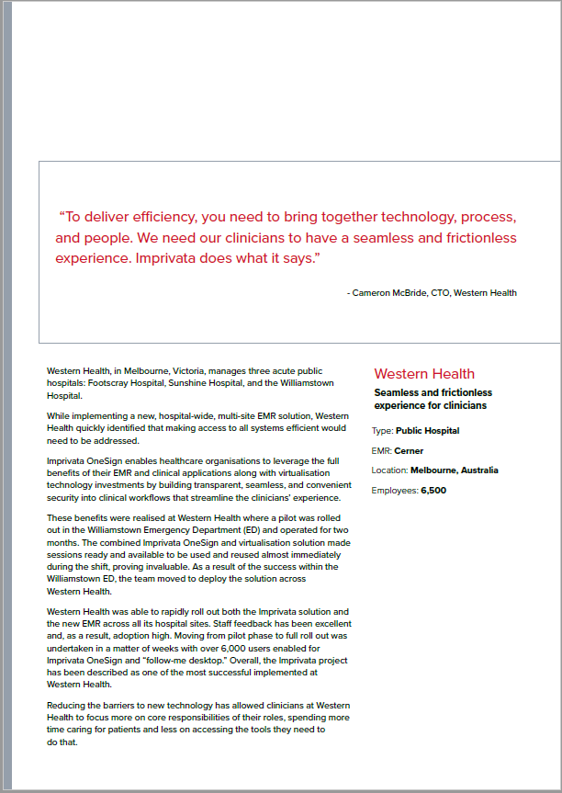
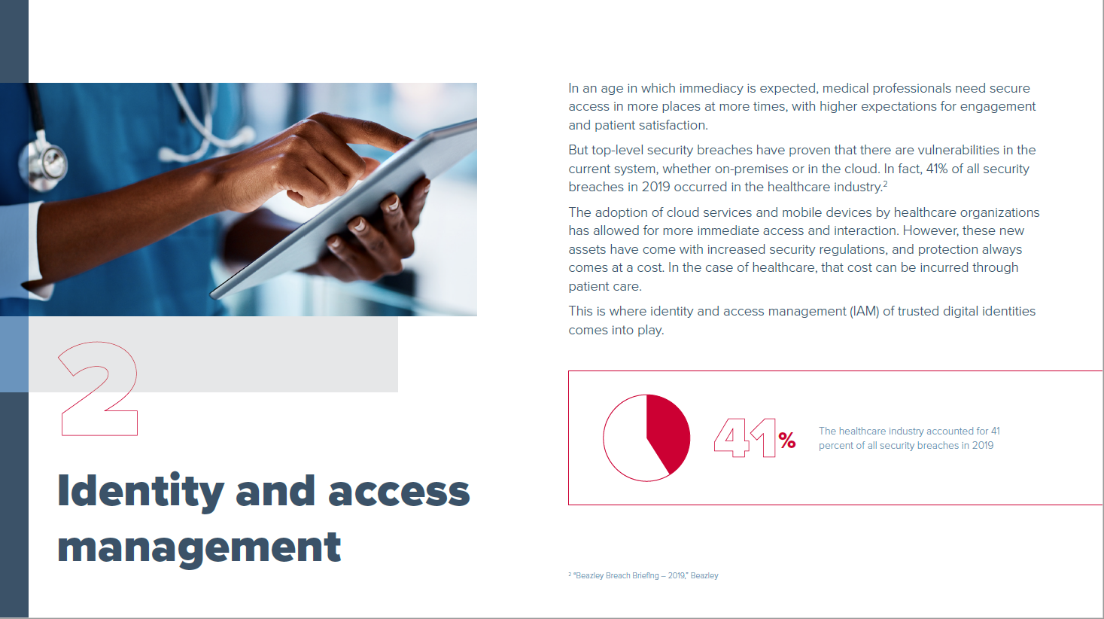
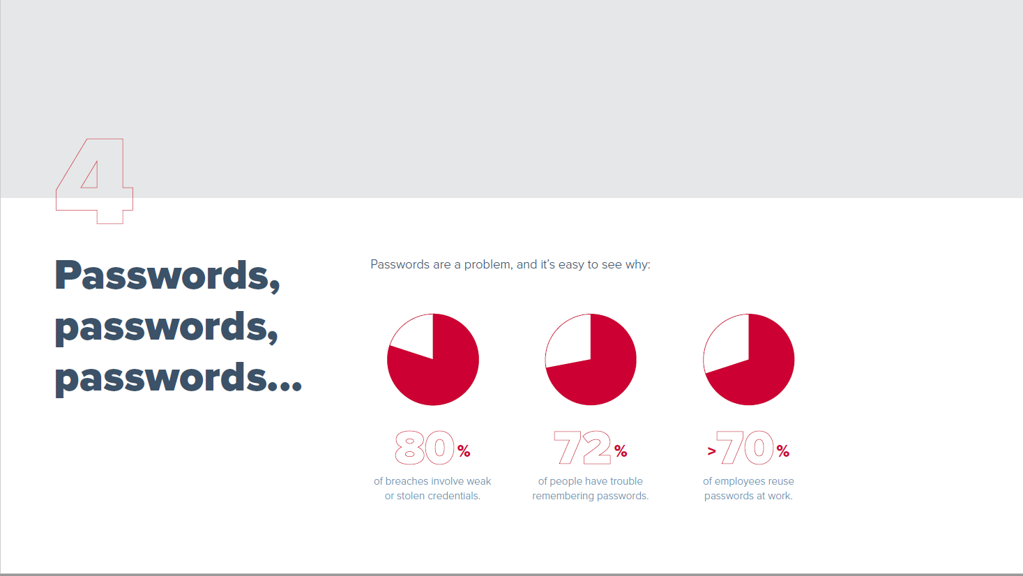
Learn more about the Digital Identity Framework
Visit our website:
https://www.imprivata.co.uk/uk/node/31681
Download now:
Digital Identity Whitepaper
Digital Identity Report
Proven ROI of SSO whitepaper

Slide 16
Contact today’s speakers
Wes Wright
Chief Technology Officer
Imprivata
wwright@imprivata.com
https://www.linkedin.com/in/4kidwes/
Dr Sean Kelly, MD
Chief Medical Officer
Imprivata
skelly@imprivata.com
https://www.linkedin.com/in/erdrsean/
Andy Kinnear
Health CIO Network (NHS) Advisory Panel
andykinnear99@gmail.com
https://www.linkedin.com/in/andy-kinnear-315856a/
Andy Wilcox
Senior Product Marketing Manager, Imprivata
awilcox@imprivata.com
https://www.linkedin.com/in/andywilcox01/

Slide 17

Questions?

Slide 18









Slide 19
Thank You

